Slide 1
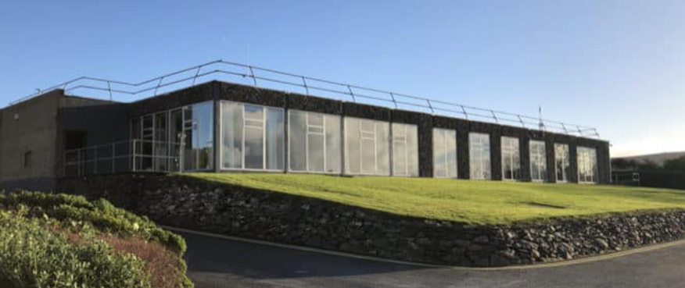
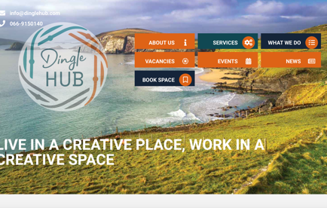
CORCA DHUIBHNE HUB
(The Dingle Hub)
Company Name
Páirc Ghnó Cúilín, Dingle, Co. Kerry
Date of Interview
22/07/2021 via video call
Contact Person
Deirdre de Bhailís, Hub Manager
Email
CLICK
TO VIEW
deirdre@dinglehub.com
The Corca Dhuibhne Creativity and Innovation Hub (Corca Dhuibhne/ Dingle Hub) is a community enterprise initiative supported by Enterprise Ireland, eir, Údarás na Gaeltachta, Kerry County Council, Net Feasa and the Dingle Business Chamber.
The vision is to build a creative, livable, sustainable and inclusive community,
fostering a vibrant and diverse ecosystem of stakeholders to facilitate the creation and maintenance of well-paid, year-round incomes on the Dingle Peninsula. The Hub aims to identify opportunities through collaborative projects, to improve core skills, to facilitate learning new skills, to help entrepreneurship and business and to improve people’s lives.
The Hub is located in a specially fitted-out office facility underpinned by 1Gb fibre broadband. There are 30 spaces available to support new business formation, comprising of co-working spaces, dedicated offices and hot desks.
Established in April 2017, The Corca Dhuibhne Hub works to create strategic antecedents for new employment within four thematic pillars;
Sustainability and Green Agenda
Digital Transformation
Creative Industries and
Community-Authored Vision and Strategy.
Dingle is a small port town on southwest Ireland’s Dingle Peninsula. The population of the Dingle Peninsula is approximately 10,000 people of which 2,050 live in Daingean Uí Chúis / Dingle Town.

Slide 2
ORGANISATION PROFILE
HOW MANY STAFF IS DIRECTLY EMPLOYED BY THE ORGANISATION?
IN ADDITION TO STAFF PRE COVID, HOW MANY PEOPLE ACCESS THE BUILDING ? (eg tenants, students, members of the public etc)
200
4 EMPLOYEES
MORE THAN PEOPLE DAILY
HOW LONG HAS THE ORGANISATION BEEN DRIVING A GREEN REVOLUTION/ INTRODUCED SDG POLICY’S OR ACTIONS?
WITHIN LAST 4 YEARS
WHAT SECTOR/S IS THE ORGANISATION ACTIVE IN?
HOW WOULD YOU DESCRIBE YOUR MAIN STAKEHOLDERS OR OCCUPANTS?
Local Enterprise/ Community Development/ Creative Sector/ and supporting Research Development and Innovation activities on the peninsula.
SMEs/ Sole Traders/ Micro-enterprises/Students (3rd level students) and Connected (Remote) workers.
GOOD PRACTICES
WHAT IS YOUR VISION AND STRATEGY RELATED TO SUSTAINABLE DEVELOPMENT/CLIMATE ACTIONS?
The Corca Dhuibhne Hub seeks to support and create a community that engages continuously in education, learning and upskilling; by being supportive of innovation, through learning about the future societal changes and using Test and Trial Networks to explore solutions; by facilitating effective engagement between the community, public bodies and private companies wishing to co-develop workable solutions for these challenges; and by encouraging the young people to believe that they can live and work in their local community at some time in the future, doing work that is both rewarding and challenging; it should be possible to support the creation of a significant number of high quality, sustainable incomes that will guarantee the economic and social development of the community on the Dingle Peninsula.
DINGLE PENINSULA 2030 - The Corca Dhuibhne Hub is part of a collaborative Dingle Peninsula 2030 strategy, an initiative for a more environmentally and economically sustainable future on the Dingle Peninsula. The goal is to transition the peninsula into a low-carbon society. This is important for the health of our planet, and to plan for future environmental changes and regulations. By reducing energy demands and using local renewable resources, the initiative could save the peninsula as much as €8 million.

Slide 3
GOOD PRACTICES
WHAT ACTIONS DID YOU TAKE?
Dingle Project -Since its launch in 2018, the ESB Dingle project has developed the electricity network and installed a range of new technologies across the Dingle peninsula. The Dingle Peninsula has been chosen as a Sustainable Innovation Pilot for the EU Ploutos project (announced October 2020). As part of this, the Corca Dhuibhne Hub will work with partners Teagasc, IFA and Net Feasa (a technology company dealing with Internet of Things and located in the Dingle Hub) to roll-out carbon emission sensor technologies to 30 farms on the Peninsula. This will encourage new collaborations between farmers, technology providers, data analysts, food/service entrepreneurs and consumers to unlock opportunities for new businesses and new revenue streams from higher value products. Data gathered will be analysed and used to develop models and effective decision-support tools for farmers and to add value to a range of products and services, e.g.
using good environmental parameters in marketing goods from the area;
localised ‘real-time’ weather data enabling providers to tailor tourist packages optimised for changing weather conditions;
building a trusted brand for the Dingle Peninsula to secure the region as a destination of choice for the sustainably conscious visitor supported by data proving low food miles and low carbon footprint.
It is hoped that facilitating collaborations across the value chain will support and enable co-created, innovative solutions to both address climate change and support the financial viability of farms (SDG11|SDG13|SDG12|SDG4|SDG17|SDG8|SDG9)
To date, activities have included home energy trials, community planning, anaerobic digestion, smart farming trial, community energy mentor training, Climate Hacks in schools, and a sustainable transport initiative. A West Kerry Dairy Farmers’ Sustainable Energy Community has recently been established, as has a new community energy group. In early February, ESB Networks launched its electric car trial with 17 EV’s being driven by trial participants across the Dingle Peninsula for a year (SDG13|SDG17|SDG11|SDG7)
.
WHICH PARTNERS AND STAKEHOLDERS WERE INVOLVED?
Established in early 2018, Corca Dhuibhne 2030 is a multi-partner initiative on the Dingle Peninsula, Co. Kerry. It involves the Corca Dhuibhne Creativity and Innovation Hub, ESB Networks, North East & West Kerry Development (NEWKD)) and the SFI MaREI Centre for Energy, Climate and Marine, at UCC. Partners actively collaborate with each other and with the local community, schools, business, transport and farming sectors to support and enable the broader societal changes required for the sustainable transition.
Across pillars:
Enterprise Ireland, KETB, KCC, MTU, ÚnaG, UCC, eir, NEWKD
Within Pillars:
Sustainability:: MaREI, SEAI, Teagasc, SFI, ESB Networks, Gas Networks Ireland, Dept of Transport, NTA, Local Link Kerry, CIE, Bus Éireann
Digital Transformation: Kerry Agribusiness, Teagasc, Net Feasa, IFA, Techspace, Coder Dojo
Creative Industries:: Ealaín na Gaeltachta, Creative Ireland, Animation Dingle, Féile na Bealtaine,
Other Voices, Ireland’s Edge, New Dingle International Film Festival, Dingle Lit

Slide 4
GOOD PRACTICES
DID YOU RECEIVE ANY KIND OF TRAINING OR SUPPORT REGARDING YOUR ACTIONS?
The mentorship from the Board has been incredibly valuable.
WHICH RESULTS DID YOU ACHIEVE ALREADY?
Successfully awarded funding through the EU Ploutos project (announced October 2020) under Horizon 2020.
Announced (Dingle Sustainable Energy Community) as Finalist with SEAI Sustainable Energy Awards.
Dingle Peninsula was the overall winner of the .IE Digital Town Awards 2021. Dingle Peninsula came out on top for their innovative project ‘Reimagining Creatively Through Digital’. The focus of the Dingle team was on promoting innovation and imagining new ways of doing things through digital.
The .IE Digital Town Awards were launched earlier this year to honour local town projects and people that have demonstrated how digital projects have contributed to enhancements or digital improvements in areas such as health, tourism, education, public services, employment opportunities, citizen empowerment, and social entrepreneurship.
SFI Discover Funding received in December 2019 - to roll out the ‘Activating the Energy Citizen’ programme.
Completed the Dingle Energy Masterplan supported by SEAI in September 20119.
The Anaerobic Digestion Feasibility study was completed in May 2020 (supported by SEAI).
The Hub has recently received funding to upgrade the windows and insulation in one of their leased premises via the Connected Hubs.
The Hub has successfully trained 12 community energy mentors (supported by Kerry Education and Training Board and the Sustainable Energy Authority of Ireland (SEAI).
WHAT ARE YOUR FUTURE PLANS AND NEXT STEPS?
Eir (large fixed, mobile and broadband telecommunications company) have been a valuable partner throughout equipping the centre with a dedicated fibre line. An upgrade is now needed, and more network access points are to be added due to increasing demand and the expanded tenant capacity of The Hub.
Exploring a project with Kerry County Council, the National Transport Authority, CIE (Córas Iompair Éireann (CIÉ) is a commercial semi-state company and the largest provider of public transport services in Ireland), the Department of Transport, LocalLink Kerry and University College Dublin to undertake a feasibility study for the enhancement of sustainable transport modes on the Peninsula.

Slide 5
RECOMMENDATIONS
WHAT KIND OF HELP AND TOOLS DO YOU NEED TO REALISE YOUR FUTURE GOALS?
WHAT ARE YOUR MOST IMPORTANT TIPS & ADVICE TO GIVE TO OTHER ORGANISATIONS TO IMPLEMENT SDG WITHIN THEIR BUSINESS?
Project management, event management, marketing and human resources training could be useful for enterprise managers starting off.
2Funding mechanisms can be disjointed and difficult to identify. Supporting centres to identify and access funding sources, and funding models would be of benefit.
Aim to be a focal point for sustainability and related capacity building initiatives in your community. This leads to business opportunities which strengthen client relationships and encourages economic activity that supports the SDGs
Connect with local education and research institutes to support the delivery of suitable courses, partner on engaged research projects and identify funding collaboration opportunities.
WHAT SUSTAINABLE GOALS WOULD YOU LIKE TO IMPLEMENT IN THE FUTURE?
01
Sustainable Infrastructure/Buildings – SDG11 Sustainable cities and Communities and SDG13 Climate action:
Ongoing. Funding has just been received for one of the leased properties, with windows to be replaced by the end of 2021.
Energy and Resource Efficiency – SDG 7 Affordable and clean energy and SDG12 Responsible consumption and production:
02
The building design concept is being progressed immediately.
Sustainable Eco-systems and Collective Action – SDG4 Quality Education, SDG12 Responsible consumption and production and SDG17 Partnership for the Goals:
03
Activities are ongoing with various partners. A learning brief from the SFI supported ‘Activating Energy Citizens will be developed in early 2022.
Digital Technology for Sustainable Enterprise Centres – SDG8 Decent work and Economic Growth and SDG13 Climate action:
04
The Hub continues to expand
05
Sustainable Futures for Enterprise Centres – SDG 9 -Industrial innovation & infrastructure and SDG17 Partnership for the Goals:
The broadband is being updated and will be completed in 2021/2022.

