Slide 1
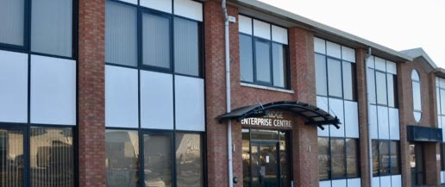

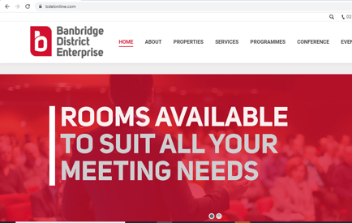
BANBRIDGE DISTRICT ENTERPRISE
Company Name
Banbridge District Enterprise
Date of Interview
26.07.21 via Zoom
Contact Person
Ciiaran Cunningham – Manager
Email
CLICK
TO VIEW
info@bdelonline.com
Banbridge District supports the development of business and enterprise in the local area through partnership approach between the public, private and voluntary sectors.
The Centre provides tailor-made office and industrial workspace for small businesses. Office suites are available ranging in size from 200 to 500 sq. ft. Industrial units range from 588 to 1400 sq. ft and are tailor made to suit a range of manufacturing capabilities.
There is 2 centres in Banbridge – Banbridge Enterprise Centre and Banbridge Business Centre. As well as the centres in Banbridge there is also have accommodation at Rathfriland Enterprise Centre and Dunbarton Court, Gilford.
Banbridge Centres are strategically located in a pivotal geographical position within easy access, all accommodation is designed to meet the needs of new and expanding businesses and a range of support services are available.

Slide 2
ORGANISATION PROFILE
HOW MANY STAFF IS DIRECTLY EMPLOYED BY THE ORGANISATION?
IN ADDITION TO STAFF PRE COVID, HOW MANY PEOPLE ACCESS THE BUILDING ? (eg tenants, students, members of the public etc)
100
5 EMPLOYEES
MORE THAN PEOPLE DAILY
HOW LONG HAS THE ORGANISATION BEEN DRIVING A GREEN REVOLUTION/ INTRODUCED SDG POLICY’S OR ACTIONS?
WITHIN LAST 9 YEARS
WHAT SECTOR/S IS THE ORGANISATION ACTIVE IN?
HOW WOULD YOU DESCRIBE YOUR MAIN STAKEHOLDERS OR OCCUPANTS?
Local Enterprise
Tenants/ Public Body/community members/SMEs
GOOD PRACTICES
WHAT IS YOUR VISION AND STRATEGY RELATED TO SUSTAINABLE DEVELOPMENT/CLIMATE ACTIONS?
Banbridge District Enterprise have Introduced Herschel Inferred Heaters that targets the person not the room, cost effective and storage heaters are not user friendly. The radiant nature of Herschel Infrared means the heat goes exactly where you want it and you don’t waste excess energy warming up unused areas of a room. There is no noise, no moving parts and no maintenance. Infrared heat helps maintain a healthy damp-free office atmosphere. This has been rolled out across all offices/tenants but it must be noted not everyone wanted it.
Other good practices: Bookkeeping system Xero to create and send professional invoices. The software lets customers pay straight away from online invoices using third-party payment services, set reminders for customers to pay, quicker and most importantly paperless.
Banbridge District Enterprise also strive to reduce waste and look to saving energy where possible.

Slide 3
GOOD PRACTICES
WHAT ACTIONS DID YOU TAKE?
Analysed the Inferred heating options. Worked with advisors to develop an action plan what the company could do, looking at the electricity providers, lighting LED and at different options to replace heating.
WHICH PARTNERS AND STAKEHOLDERS WERE INVOLVED?
Focusing on the heating sytem the company didn’t involve tenants and mainly communicated with staff when considering to implement the system. Banbridge District Enterprise installed a trial system in reception area, feedback from staff was positive.
DID YOU RECEIVE ANY KIND OF TRAINING OR SUPPORT REGARDING YOUR ACTIONS?
Training was provided on setting thermostats and set on timers for different stages of the day, if it drops below certain temperatures comes back on again. The company received Instructions as well.
WHICH RESULTS DID YOU ACHIEVE ALREADY?
The system was monitored monthly to record any changes and review the data, this is easy to do by logging into system to see usage and compare
From implementing this system it makes the company mindful of internal and external usage
From reviewing the Introduced Herschel Inferred Heaters with staff, Men & Women have mixed perception on the heating system
From conversations tenants are not interested in cost saving, as they currently have a flat rate for heat and power.
WHAT ARE YOUR FUTURE PLANS AND NEXT STEPS?
Introduce sensor lighting for common spaces & areas.
Look at co working spaces as a way to save energy and generate income for the company
Work towards a more sustainable future for Banbridge District Enterprise
Review SDG’s to see how the company can implement others into their building infrastructure and a way to improve energy & resource efficiency.

Slide 4
RECOMMENDATIONS
WHAT KIND OF HELP AND TOOLS DO YOU NEED TO REALISE YOUR FUTURE GOALS?
WHAT ARE YOUR MOST IMPORTANT TIPS & ADVICE TO GIVE TO OTHER ORGANISATIONS TO IMPLEMENT SDG WITHIN THEIR BUSINESS?
Discussions with other Enterprise Centres to see what they have implemented
More support from Invest NI, funders for example Carbon Trust Energy Efficiency Loan;
More information on sources of funding
Resources and materials to advise on energy efficiency and to be sustainable in the future.
Ongoing updates on what is available for Enterprise centres/organisations.
Research into region’s initiatives
Try to involve an expert who can advise
Ensure the funding is available
Talk to others who have implemented practices into their organisations asking what worked well, what didn’t work well to learn.
WHAT SUSTAINABLE GOALS WOULD YOU LIKE TO IMPLEMENT IN THE FUTURE?
01
Sustainable Infrastructure/Buildings – SDG11 Sustainable cities and Communities and SDG13 Climate action:
Next 6 months
Energy and Resource Efficiency – SDG 7 Affordable and clean energy and SDG12 Responsible consumption and production:
02
Ongoing
Sustainable Eco-systems and Collective Action – SDG4 Quality Education, SDG12 Responsible consumption and production and SDG17 Partnership for the Goals:
03
1 to 3 years
Digital Technology for Sustainable Enterprise Centres – SDG8 Decent work and Economic Growth and SDG13 Climate action:
04
Ongoing
05
Sustainable Futures for Enterprise Centres – SDG 9 -Industrial innovation & infrastructure and SDG17 Partnership for the Goals:
Next 6 to 12 months.

