Slide 1
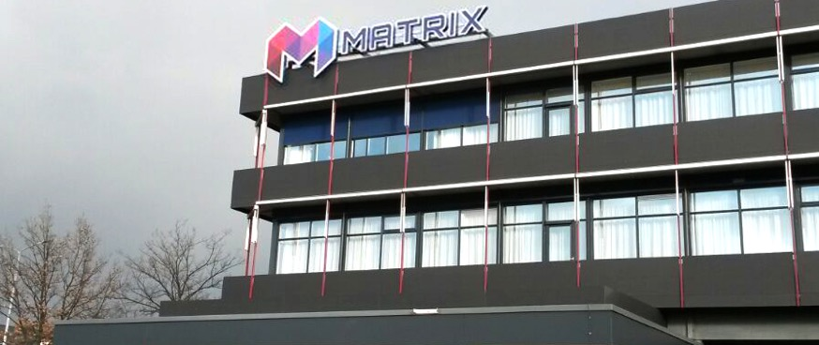

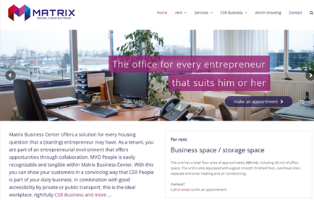
MATRIX BEDRIJVENCENTRUM
Company Name
Matrix Bedrijvencentrum
Date of Interview
15.07.21 via Telephone
Contact Person
Department for information
Email
CLICK
TO VIEW
info@matrixalmelo.nl
Matrix is an enterprise centre in the Eastern part of The Netherlands. It has a focus on “Maatschappelijk Verantwoord Ondernemen (= MVO = Corporate Social Responsibility) and integrated many measures to increase the sustainable character of the centre. Some examples are: green energy, CO2 reduction and
energy saving lighting. It has an integrated vision on Profit, Planet, People, under the name MVO Business.
The centre has also all needed facilities for people with physical limits. New tenants can use the
service of the internal company Extend BV, in order to develop their own sustainable working place. See www.extendmvo.nl.
They can help to formulate mission and vision from tenants. It also offers advisory in processes towards certification, training and coaching and strategical HRM. Matrix offers office space, starting at 20 m2, flexible work places, shared
meeting rooms, facility services and catering.
All working places are 24/7 available. Recent developments are:
installation of charging stations for electric cars and e-bikes, new solar panels on the roof of the building and a shared electric car, available for tenants.
In 2021, Matrix welcomes about 40 tenants. These tenants are very diverse; from a bakery, to a
pre school centre and from assurance to electric safety. See https://matrixalmelo.nl/huurders/
NB The website is only available in Dutch language

Slide 2
ORGANISATION PROFILE
HOW MANY STAFF IS DIRECTLY EMPLOYED BY THE ORGANISATION?
IN ADDITION TO STAFF PRE COVID, HOW MANY PEOPLE ACCESS THE BUILDING ? (eg tenants, students, members of the public etc)
800
20 EMPLOYEES
MORE THAN PEOPLE WEEKLY
HOW LONG HAS THE ORGANISATION BEEN DRIVING A GREEN REVOLUTION/ INTRODUCED SDG POLICY’S OR ACTIONS?
WITHIN LAST 7 YEARS
WHAT SECTOR/S IS THE ORGANISATION ACTIVE IN?
HOW WOULD YOU DESCRIBE YOUR MAIN STAKEHOLDERS OR OCCUPANTS?
No specific sector, sustainability is what the tenants connect
Service oriented companies, such as assurance and business administration
Electronics companies
Craft companies such as a bakery and a gardener
Probation
Pre-school day care
GOOD PRACTICES
WHAT IS YOUR VISION AND STRATEGY RELATED TO SUSTAINABLE DEVELOPMENT/CLIMATE ACTIONS?
Vision:
Under the name MVO Business, a concept has been developed towards corporate social responsibility, according the concept of planet, profit, people.
Strategy
To realise this sustainable enterprise centre, the existing building was complete renovated in 2014. That resulted in a sustainable enterprise centre. In order to advice new tenants, services were offered via an internal company. This advisory makes tenants aware of their social responsibility as well and support them to become certified.

Slide 3
GOOD PRACTICES
WHAT ACTIONS DID YOU TAKE?
A number of actions was taken:
Green electricity via 275 solar panels,
Reduction of CO2 production,
Energy saving lighting,
OHSAS certification (Safety and well-being),
Member of local sustainability network in the city of Almelo,
Partner in “1.000.000 drips” (saving water)
Car charging station
WHICH PARTNERS AND STAKEHOLDERS WERE INVOLVED?
SOWECO NV as owner of Matrix
Municipality of the city of Almelo
DID YOU RECEIVE ANY KIND OF TRAINING OR SUPPORT REGARDING YOUR ACTIONS?
We have our internal company “ExtendMVO BV” which gives advisory and training to our own staff, as well as to (new) tenants.
See: www.extendmvo.nl
WHICH RESULTS DID YOU ACHIEVE ALREADY?
We reduced the use of energy and produce own electricity.
We reduced the water consumption.
We stimulate our tenants to use our shared electric car.
We offer work places for people with physical limits
We are certified according several certifications.
WHAT ARE YOUR FUTURE PLANS AND NEXT STEPS?
We will continue our activities in producing own electricity with the ultimate goal to be independent.
We will continue to improve our monitoring systems for the use of electricity and water and for the temperature control per office.
We will reduce plastic in the restaurant.

Slide 4
RECOMMENDATIONS
WHAT KIND OF HELP AND TOOLS DO YOU NEED TO REALISE YOUR FUTURE GOALS?
WHAT ARE YOUR MOST IMPORTANT TIPS & ADVICE TO GIVE TO OTHER ORGANISATIONS TO IMPLEMENT SDG WITHIN THEIR BUSINESS?
To attract new tenants, who follow our philosophy, we will continue our marketing activities.
Budget for investments is necessary.
Technical support for long-term planning of activities to increase savings on energy and light
Further investments in facilities for (shared) electric cars and e-bikes.
Greening the outdoor areas.
We choose for an integral (holistic) approach. That means that we also look in the complete chain. We advise other centres to do the same
Calculate all costs and benefits from your SDG investments. Make calculations for the long term.
Only accept tenants who agree with the system of Corporate Social Responsibility. Make it a substantial part of your marketing strategy.
Let tenants develop their own plans.
WHAT SUSTAINABLE GOALS WOULD YOU LIKE TO IMPLEMENT IN THE FUTURE?
01
Sustainable Infrastructure/Buildings – SDG11 Sustainable cities and Communities and SDG13 Climate action:
Maintenance of the building: 1-3 years
Energy and Resource Efficiency – SDG 7 Affordable and clean energy and SDG12 Responsible consumption and production:
Improvement of savings on energy, by monitoring light and temperature:1-3 years
Installation of solar panels: 6-12 months
Monitoring water use: 6-12 months
02
Sustainable Eco-systems and Collective Action – SDG4 Quality Education, SDG12 Responsible consumption and production and SDG17 Partnership for the Goals:
03
Making green areas around the building less water- and maintenance dependant: 1-3 years
Analysis of canteens, to reduce plastic waste and to re-use coffee residues: 1-3 years
Digital Technology for Sustainable Enterprise Centres – SDG8 Decent work and Economic Growth and SDG13 Climate action:
Faster and safe internet (Glass fibre is being installed in Almelo in the coming year: 1-3 years
Ongoing activities to improve data protection: 1-3 years
04
05
More charging stations for electric cars and e-bikes (at least 10% of all places): 1-3 years
Stimulate the use of the shared electric car: within 6 months
Sustainable Futures for Enterprise Centres – SDG 9 -Industrial innovation & infrastructure and SDG17 Partnership for the Goals:

