Slide 1
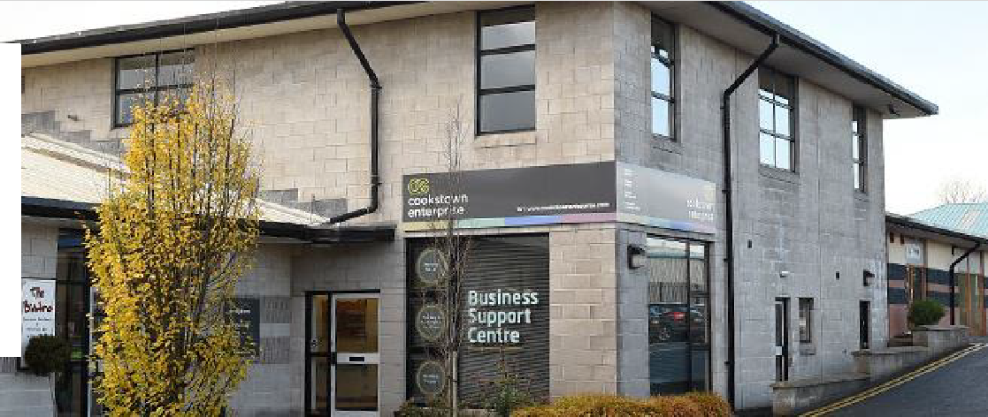


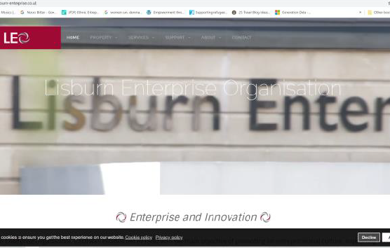


LISBURN ENTERPRISE CENTER
Company Name
Lisburn Enterprise Organisation (LEO)
Date of Interview
10/11/2021
Contact Person
Martina Crawford – Chief Executive
Email
martina@lisburn- enterprise.co.uk
Lisburn Enterprise Organisation (LEO) was established in 1990 with the main
development at both a strategic and operational level. The Organisation benefits from a dedicated Board of Directors representing public and private sector interests. This voluntary Board has overseen the effective running of LEO since its inception. Partnership is also a key priority of the Organisation and strong working
objective of promoting an
entrepreneurial culture, supporting
business start-up and providing the mechanisms needed to encourage existing businesses to grow.
LEO is an independent, not for profit
organisation offering support in the form of guidance and advice, premises, conference facilities,
relationships exist with Lisburn &
administrative support and virtual
Castlereagh City Council, South
office services. LEO’s focus is not only
on business creation but also business
Eastern Regional College, Enterprise
Northern Ireland, Princes Trust and
Invest NI to name a few.
S U S T A I N A B L E F U T U R E S F O R E N T E R P R I S E C E N T R E S
1

Slide 2



ORGANISATION PROFILE
HOW MANY STAFF IS DIRECTLY EMPLOYED BY THE ORGANISATION?
IN ADDITION TO STAFF PRE COVID, HOW MANY PEOPLE ACCESS THE BUILDING ?
(e.g. tenants, students, members of the public etc)
5 EMPLOYEES
11voluntary members on board of directors
MORE THAN 500 PEOPLE DAILY
(pre-covid)
HOW LONG HAS THE ORGANISATION BEEN DRIVING A GREEN REVOLUTION/ INTRODUCED SDG POLICY’S OR ACTIONS?
Since 2010
WHAT SECTOR/S IS THE ORGANISATION ACTIVE IN?
Local Enterprise
HOW WOULD YOU DESCRIBE YOUR MAIN STAKEHOLDERS OR OCCUPANTS?
SMEs/ micro businesses
GOOD PRACTICE
WHAT IS YOUR
VISION AND STRATEGY
RELATED TO SUSTAINABLE
DEVELOPMENT/CLIMATE ACTIONS?
Lisburn Enterprise Organisation aims to promote an entrepreneurial culture which will strengthen the local economy and boost economic development. They work tirelessly by providing sustainable, long-term supports for business start-up and business growth. In terms of sustainable development they provide low cost office space, through their phase 7 development they have implemented sustainable approaches.
WHAT
ACTIONS
DID YOU TAKE?
LEO provide low cost office spaces as part of their Phase 6 development. In 2018 they opened their new Phase 7 development, which provides more sustainable, low cost, modern office spaces for tenants.
S U S T A I N A B L E F U T U R E S F O R E N T E R P R I S E C E N T R E S
2

Slide 3


GOOD PRACTICES
LEO had in depth discussions with developers and architects around the planning and development of the Phase 7 development. Throughout these consultations LEO were advised on the best course of action to ensure a sustainable, green and climate friendly build. These included ensuring locally sourced, sustainable products were used within the building, the inclusion of solar panels to decrease use of gas heating. In addition to this the Phase 7 building has motion activated lights which are programmed on a timer schedule, this reduces electricity consumption. Finally LEO have employed a waste management company who handle the recycling of waste, easing the burden on landfills, conserving natural resources, and saving energy
WHICH
PARTNERS AND STAKEHOLDERS
WERE INVOLVED?
Local Architects
Building Consultants
Waste Management Co.
WHICH
RESULTS
DID YOU ACHIEVE ALREADY?
Reduced use of Gas heating through solar panels
Reduced electricity use overall through motion sensors
Recycling implementation
Reduction of landfill use
Energy saving
More sustainable overall Phase 7 building & learnings which will inform future development
WHAT ARE YOUR FUTURE PLANS AND NEXT STEPS?
LEO plans to learn from the Phase 7 build and apply this in relation to any new development undertakings in the future. They will continue to encourage their licensees to utilise the recycling, waste management scheme in order to minimise overall environmental impact.
S U S T A I N A B L E F U T U R E S F O R E N T E R P R I S E C E N T R E S
3

