Slide 1
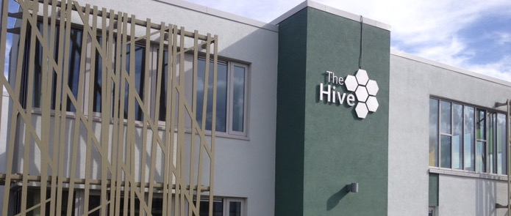

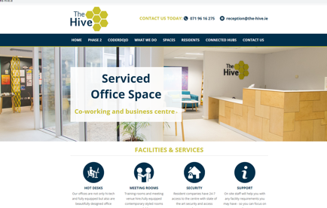
THE HIVE
Company Name
The Hive, Carrick-On Shannon
Date of Interview
26.07.2021 via Telephone
Contact Person
Colm Keane, Manager
Email
CLICK
TO VIEW
reception@the-hive.ie
The Hive is Leitrim's Technology Enterprise Centre, which operates out of its award-winning state of the art facilities. The Hive aims to facilitate the establishment and growth of sustainable enterprises by clustering knowledge-based businesses in the centre, as a key action in generating social and economic prosperity for all the people of Leitrim.
The Hive is Leitrim's Technology Enterprise Centre which was developed as part of the Innovation and Enterprise Programme (IEP) which is a joint cross border initiative between Leitrim and Omagh.
The Hive offers fully serviced office spaces, hot desk work areas and also large and small meeting rooms all with fibre broadband connection. The Hive offers a contemporary, productive work environment with our hot desk areas allowing for ample individual work space.
With access to high speed networks throughout and a contemporary design which resulted in The Hive receiving an award for sustainability at the Irish Architecture Awards in 2014 and also the Green Apple Award in 2015.

Slide 2
ORGANISATION PROFILE
HOW MANY STAFF IS DIRECTLY EMPLOYED BY THE ORGANISATION?
IN ADDITION TO STAFF PRE COVID, HOW MANY PEOPLE ACCESS THE BUILDING ? (eg tenants, students, members of the public etc)
100
5 EMPLOYEES
MORE THAN PEOPLE WEEKLY
HOW LONG HAS THE ORGANISATION BEEN DRIVING A GREEN REVOLUTION/ INTRODUCED SDG POLICY’S OR ACTIONS?
WITHIN LAST 8 YEARS
WHAT SECTOR/S IS THE ORGANISATION ACTIVE IN?
HOW WOULD YOU DESCRIBE YOUR MAIN STAKEHOLDERS OR OCCUPANTS?
Social Enterprise/ Education/ Community / Circular Economy/ Environmental
SMEs/Co-Workers
GOOD PRACTICES
WHAT IS YOUR VISION AND STRATEGY RELATED TO SUSTAINABLE DEVELOPMENT/CLIMATE ACTIONS?
The mission of Leitrim County Enterprise Fund is to facilitate the establishment and growth of sustainable enterprises in County Leitrim, as a key action in generating social and economic prosperity for all of the people of Leitrim.’
By supporting local enterprise, providing key resources for the community and ensuring the future economy of the local area they are specifically meeting SDG 8+11 good work and sustainable communities.
The building was constructed in 2013 to the highest efficiency standards of the time. The construction featured state of the art building management systems with strong energy and environmental plans. Their vision for their building management is to minimise usage through careful management of resources. All electricity comes from renewable sources, including from their own 14KW of PV panels, and the building makes use its thermal mass to regulate the internal temperature of the building.

Slide 3
GOOD PRACTICES
WHAT ACTIONS DID YOU TAKE?
Developed their own energy and environmental plan and regularly review their metrics to identify inefficiencies in their system.
Consistently seek areas to improve and are now installing their own PV panels as well as better facilities for bikes and EV charging points.
WHICH PARTNERS AND STAKEHOLDERS WERE INVOLVED?
Board of Directors, Staff, Sub Contractors and Government Bodies.
DID YOU RECEIVE ANY KIND OF TRAINING OR SUPPORT REGARDING YOUR ACTIONS?
No, research was carried out through their own network of expertise, internal and external, and contractors who were experts in the area of efficient buildings were hired.
WHICH RESULTS DID YOU ACHIEVE ALREADY?
The Hive have successfully provided a facility that improves the job prospects on a regional basis and provides an alternative workplace for commuters.
RIAI Irish Architecture awards 2015 Highly commended, Sustainability category.
National Gold Ireland award winner Green Apple Awards for built environment and Architectural heritage 2015.
Solar Panels have since been added– to reduce fuel consumption.
Switched to fully renewable electricity suppliers and LED light bulbs with sensors and timers improving efficiencies.
Successfully trained staff on how to implement their energy management system and regularly engage with their tenants on what they can do better.
WHAT ARE YOUR FUTURE PLANS AND NEXT STEPS?
Planned expansion of both their cycle to work facilities as well as EV charge points facilitating a more sustainable community.
Looking to upgrade the older parts of the building with improved insulation.
The Hive has attracted a cluster of green tech companies. Harnessing the potential of this small, but growing cluster, and engagement in EU projects will be a key focus.
.

Slide 4
RECOMMENDATIONS
WHAT KIND OF HELP AND TOOLS DO YOU NEED TO REALISE YOUR FUTURE GOALS?
WHAT ARE YOUR MOST IMPORTANT TIPS & ADVICE TO GIVE TO OTHER ORGANISATIONS TO IMPLEMENT SDG WITHIN THEIR BUSINESS?
How to better engage with tenants on environmental issues (e.g. behavioural economics, nudge theory etc)
Shared resources with similar organisations to see what they’re implementing and what can be done to help one another
3Information on how to spot funding opportunities to drive sustainability/climate action change.
Only implement what is needed (i.e. a one room hub doesn’t need a building management system)
Engage with your tenants and constantly review your metrics to find anomalies as they may be masking much bigger issues
Do what you can by utilising your network of expertise including tenants
Seek the right help and record as much information as possible to avoid issues further down the line.
WHAT SUSTAINABLE GOALS WOULD YOU LIKE TO IMPLEMENT IN THE FUTURE?
01
Sustainable Infrastructure/Buildings – SDG11 Sustainable cities and Communities and SDG13 Climate action:
1-3 years
Energy and Resource Efficiency – SDG 7 Affordable and clean energy and SDG12 Responsible consumption and production:
02
Constant improvements
Sustainable Eco-systems and Collective Action – SDG4 Quality Education, SDG12 Responsible consumption and production and SDG17 Partnership for the Goals:
03
Consistent improvement
Digital Technology for Sustainable Enterprise Centres – SDG8 Decent work and Economic Growth and SDG13 Climate action:
6 -12 months
04
05
1 – 3 years
Sustainable Futures for Enterprise Centres – SDG 9 -Industrial innovation & infrastructure and SDG17 Partnership for the Goals:

