Slide 1
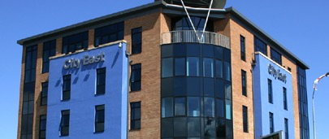

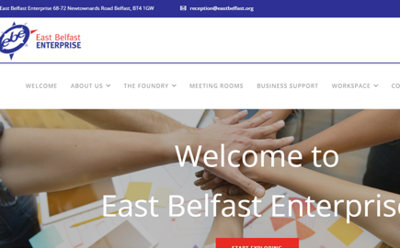
EAST BELFAST ENTERPRISE
Company Name
East Belfast Enterprise
Date of Interview
28.06.21 via Video Call
Contact Person
Jonathan McAlpin: Chief Executive
Email
CLICK
TO VIEW
reception@eastbelfast.org
East Belfast Enterprise (EBE) was established in 1995 to provide incubation workspace and training/mentoring initiatives to support new and established businesses in the local area. The company has developed from its original focus providing support in the local area and now works for the benefit of businesses in other areas of Belfast and surrounding areas, through a partnership approach with other organisations.
The company is also a member of Enterprise Northern Ireland, which is the association of enterprise agencies in Northern Ireland. Enterprise Northern Ireland aims to improve the provision of support to start-up and established micro businesses in Northern Ireland by providing a cohesive and collective approach and by working closely with other partner organisations and government agencies.

Slide 2
ORGANISATION PROFILE
HOW MANY STAFF IS DIRECTLY EMPLOYED BY THE ORGANISATION?
IN ADDITION TO STAFF PRE COVID, HOW MANY PEOPLE ACCESS THE BUILDING ? (eg tenants, students, members of the public etc)
150
6 EMPLOYEES
MORE THAN PEOPLE DAILY
HOW LONG HAS THE ORGANISATION BEEN DRIVING A GREEN REVOLUTION/ INTRODUCED SDG POLICY’S OR ACTIONS?
WITHIN LAST 12 YEARS
WHAT SECTOR/S IS THE ORGANISATION ACTIVE IN?
HOW WOULD YOU DESCRIBE YOUR MAIN STAKEHOLDERS OR OCCUPANTS?
Local Enterprise
Tenants and SMEs
GOOD PRACTICES
WHAT IS YOUR VISION AND STRATEGY RELATED TO SUSTAINABLE DEVELOPMENT/CLIMATE ACTIONS?
East Belfast have practices related to SDG11, SDG13, SDG12 including retrofitting LED and sensor controlled lighting throughout our property and retrofitted all industrial units with modern double glazing to reduce energy consumption using local suppliers to support the local economy and reduce carbon footprint by reducing travel time for suppliers.
Use Irish Waste to recycle all refuse, ensuring less than 5% goes to landfill and we have efficient gas heating.
East Belfast also have hot-desking options and conferencing to offer tenants options for remote working linking to SDG8. Electric Car points for cars is being reviewed and the building has recently changed doors & windows in units and now looking at the roofs for sustainability.

Slide 3
GOOD PRACTICES
WHAT ACTIONS DID YOU TAKE?
Motivation: Increasing awareness of environmental challenges and as a charity and social enterprise aware of triple bottom line, environmental impact is the core of the organisation.
WHICH PARTNERS AND STAKEHOLDERS WERE INVOLVED?
Mix of consultation with tenants and engagement with stakeholders through business in the community and carbon trust.
Lighting was advised by building consultants.
DID YOU RECEIVE ANY KIND OF TRAINING OR SUPPORT REGARDING YOUR ACTIONS?
No training required.
WHICH RESULTS DID YOU ACHIEVE ALREADY?
The LED lighting definitely noticed a reduction to costs and with modern double glazing to r=we have most definitely reduced energy consumption.
WHAT ARE YOUR FUTURE PLANS AND NEXT STEPS?
Short Term: Renewal within the building and be ensuring the business is using responsible business practices, researching in developing property sites and mindful of environmental .

Slide 4
RECOMMENDATIONS
WHAT KIND OF HELP AND TOOLS DO YOU NEED TO REALISE YOUR FUTURE GOALS?
WHAT ARE YOUR MOST IMPORTANT TIPS & ADVICE TO GIVE TO OTHER ORGANISATIONS TO IMPLEMENT SDG WITHIN THEIR BUSINESS?
Seeking advice from the businesses in communities
Make sure compliant with legislation
Research well in advance, energy resources & incorporating recycling processes etc
Understanding Efficiency & cost of future goals.
Depending on size of project – qualified advisors’ architects, QS to advise.
Talk to an expert partners for businesses, governments and organisations to help realise ambitious plans for a sustainable, low carbon future.
Talk to relevant government departments
Chat to other organisations who have a similar model in place.
WHAT SUSTAINABLE GOALS WOULD YOU LIKE TO IMPLEMENT IN THE FUTURE?
01
Sustainable Infrastructure/Buildings – SDG11 Sustainable cities and Communities and SDG13 Climate action:
Next 6 to 12 months
Energy and Resource Efficiency – SDG 7 Affordable and clean energy and SDG12 Responsible consumption and production:
02
Ongoing
Sustainable Eco-systems and Collective Action – SDG4 Quality Education, SDG12 Responsible consumption and production and SDG17 Partnership for the Goals:
03
1 to 3 years
Digital Technology for Sustainable Enterprise Centres – SDG8 Decent work and Economic Growth and SDG13 Climate action:
04
1 to 3 years
05
Sustainable Futures for Enterprise Centres – SDG 9 -Industrial innovation & infrastructure and SDG17 Partnership for the Goals:
1 to 3 years

