Slide 1
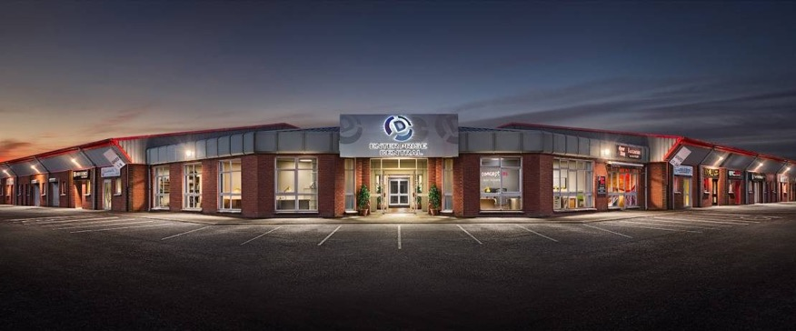
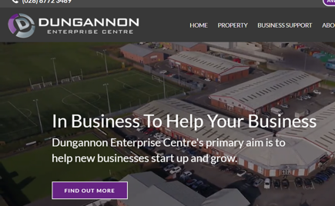
DUNGANNON ENTERPRISE
Company Name
Dungannon Enterprise
Date of Interview
08.09.21 via Telephone
Contact Person
Denise Murtagh - Business Development Manager
Email
CLICK
TO VIEW
info@dungannonenterprise.com
Located in South Tyrone in the heart of Northern Ireland, Dungannon Enterprise Centre’s primary aim is to simply help new businesses start up and to encourage existing businesses to expand.
Our mission states: “to strengthen and grow our economy by encouraging economic development and supporting entrepreneurs to create and grow competitive, profitable and wealth generating enterprises”
We provide support in many ways but is dependent upon the needs of the entrepreneur:
Industrial and office workspace units to incubate local businesses, Professional business advice and counselling, Training on business start-up and expansion planning, Low interest loans for start-up businesses, Consultancy support in sourcing government support and finance, Marketing and digital marketing content help.
The Enterprise Centre is governed by a voluntary Board of Directors made up of representatives of the local business community, voluntary sector and the local Council. The Enterprise Centre has a wealth of experience in the development of micro-businesses, in particular the provision of support for those who have already set up their own business. Since its formation, DEC has assisted more than 2,000 potential entrepreneurs to explore self-employment, many of whom started in business. The Centre rents over 100,000 sq. ft. of commercial property at several sites.

Slide 2
ORGANISATION PROFILE
HOW MANY STAFF IS DIRECTLY EMPLOYED BY THE ORGANISATION?
IN ADDITION TO STAFF PRE COVID, HOW MANY PEOPLE ACCESS THE BUILDING ? (eg tenants, students, members of the public etc)
200
10 EMPLOYEES
MORE THAN PEOPLE DAILY
HOW LONG HAS THE ORGANISATION BEEN DRIVING A GREEN REVOLUTION/ INTRODUCED SDG POLICY’S OR ACTIONS?
WITHIN LAST 5 YEARS
WHAT SECTOR/S IS THE ORGANISATION ACTIVE IN?
HOW WOULD YOU DESCRIBE YOUR MAIN STAKEHOLDERS OR OCCUPANTS?
Local Enterprise
Tenant, micro businesses
GOOD PRACTICES
WHAT IS YOUR VISION AND STRATEGY RELATED TO SUSTAINABLE DEVELOPMENT/CLIMATE ACTIONS?
The Enterprise Centre has adopted a sustainable development policy to ensure that the organisation has minimal negative impact upon the environment. To that end all procurement is focussed upon achieving zero carbon emissions and local sourcing. Energy consumption is monitored and regularly challenged to be reduced. A paperless office policy is being implemented reducing photocopying, purchasing of paper and storage space.

Slide 3
GOOD PRACTICES
WHAT ACTIONS DID YOU TAKE?
Local sourcing of products and materials to reduce carbon miles. Assessment of heating and installation of a system to monitor and control the electric consumption. Waste recycling procedures in place. Replacement of lights to LEDs . Replaced all gents urinals with waterless urinals. We have implemented a work from home policy allowing staff to choose between home of office to work, thereby reducing travel cost. A cycle to work scheme is in operation allowing staff to acquire bikes to travel to work.
WHICH PARTNERS AND STAKEHOLDERS WERE INVOLVED?
Glen Dimplex: Glen Dimplex Group is the world leader in intelligent electric heating and renewable energy solutions, as well as holding significant global market positions in domestic appliances, cooling and ventilation.
DID YOU RECEIVE ANY KIND OF TRAINING OR SUPPORT REGARDING YOUR ACTIONS?
No Training
WHICH RESULTS DID YOU ACHIEVE ALREADY?
Electric consumption reduced by 50%. Water consumption reduced.
WHAT ARE YOUR FUTURE PLANS AND NEXT STEPS?
We are exploring the installation of solar panels on the roof, the purchase of an all-electric van and the harvesting of rain water for toilets.
.

Slide 4
RECOMMENDATIONS
WHAT KIND OF HELP AND TOOLS DO YOU NEED TO REALISE YOUR FUTURE GOALS?
WHAT ARE YOUR MOST IMPORTANT TIPS & ADVICE TO GIVE TO OTHER ORGANISATIONS TO IMPLEMENT SDG WITHIN THEIR BUSINESS?
Assistance to assess and procure solar panels
More information on other ways to save energy for older buildings.
Involve all staff on the implementation of the environmental policy
Trial and Test with staff and tenants
Ask for open and honest feedback
Implementing processes should save money in the long term.
WHAT SUSTAINABLE GOALS WOULD YOU LIKE TO IMPLEMENT IN THE FUTURE?
01
Sustainable Infrastructure/Buildings – SDG11 Sustainable cities and Communities and SDG13 Climate action:
Next 12 months
Energy and Resource Efficiency – SDG 7 Affordable and clean energy and SDG12 Responsible consumption and production:
02
Next 18 months
Sustainable Eco-systems and Collective Action – SDG4 Quality Education, SDG12 Responsible consumption and production and SDG17 Partnership for the Goals:
03
Next 12 months
Digital Technology for Sustainable Enterprise Centres – SDG8 Decent work and Economic Growth and SDG13 Climate action:
04
Next 12 months
05
Sustainable Futures for Enterprise Centres – SDG 9 -Industrial innovation & infrastructure and SDG17 Partnership for the Goals:
Next 12 months

