Slide 1
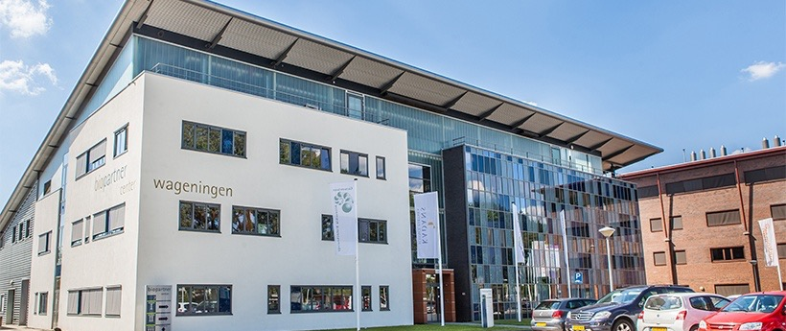

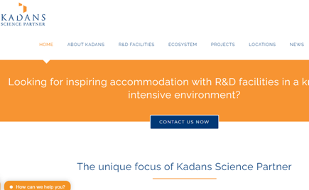
BIOPARTNER CENTER
Company Name
BioPartner Center Wageningen – Kadans Science Partner
Date of Interview
12.07.21 Face to Face Meeting
Contact Person
R. Wijngaard – Property Manager
Email
CLICK
TO VIEW
info@kadans.com
BioPartner Center Wageningen (BPCW) was originally founded in 2005. It was an initiative of Wageningen University & Research. In 2011 it was taken over by Kadans Science Partner. It serves as the catalyst and incubator of the “Food Valley”, in the heart of the Food Valley region. It has the ambition to be the most high-potential and innovative food cluster of its kind. In this region, over 10,000 people are involved in R&D, education and business in the Life Sciences.
BioPartner Center Wageningen offers tenants of its incubator and multitenant science buildings a broad spectrum of options to rent science facilities, including laboratories, cleanrooms, pilot plants, climate-controlled spaces, multifunctional research facilities. This incubator function stimulates contact and cooperation and offers facilities for experienced businesses, but also for start-ups and scale-ups. Here, innovative ideas come to life and have room to grow.
Kadans has extensive experience in finding the right specific solutions for tenants. It is capable of finding the accommodation solution that fits the needs of the 17 present tenants. BioPartner Center is located on the Business & Science Park Wageningen (BSPW), where many knowledge-intensive businesses are present and where contact and cooperation between businesses and entrepreneurs is stimulated. The Campus of Wageningen University & Research is close by.

Slide 2
ORGANISATION PROFILE
HOW MANY STAFF IS DIRECTLY EMPLOYED BY THE ORGANISATION?
IN ADDITION TO STAFF PRE COVID, HOW MANY PEOPLE ACCESS THE BUILDING ? (eg tenants, students, members of the public etc)
120
5 EMPLOYEES
MORE THAN PEOPLE DAILY
HOW LONG HAS THE ORGANISATION BEEN DRIVING A GREEN REVOLUTION/ INTRODUCED SDG POLICY’S OR ACTIONS?
WITHIN LAST 2 YEARS
WHAT SECTOR/S IS THE ORGANISATION ACTIVE IN?
HOW WOULD YOU DESCRIBE YOUR MAIN STAKEHOLDERS OR OCCUPANTS?
Mainly in the agro-food/life sciences. But also, some companies from the technical sector can be found. Example is a company, dealing with paints.
Combination of small scale start-ups and bigger organisations/companies.
GOOD PRACTICES
WHAT IS YOUR VISION AND STRATEGY RELATED TO SUSTAINABLE DEVELOPMENT/CLIMATE ACTIONS?
Kadans Science Partner, as owner of the Bio Partner Center, focuses on the development and operation of industrial and office buildings, in combination with laboratories, cleanrooms, research facilities, climate-controlled spaces and pilot plants for R&D departments of knowledge institutions, education institutes and knowledge-intensive businesses in innovative (top) sectors, such as Food, Life Sciences, Health, Living Environment, Biotechnology, Biobased and High-Tech Semicon. It has also buildings in other parts of the Netherlands, as well as in Germany (Aachen) and the UK (London).

Slide 3
GOOD PRACTICES
WHAT ACTIONS DID YOU TAKE?
Two years ago, all lights were replaced by LED Light and equipped with a monitoring system. Recently 544 solar panels are installed on the roof.
WHICH PARTNERS AND STAKEHOLDERS WERE INVOLVED?
Main stake holders:
Wageningen UR took the initiative to start the Center in 2005.
Architect: SWA
Construction company: Kuipers.
Local Government of Wageningen stimulated the development of the Science Park.
Kadans Science Partner is owner since 2011. This company owns more buildings at the Wageningen Campus as well as in other cities. Sustainability and flexibility for future users are key words for Kadans.
Tenants are: BLGG, Nippon Suisan, Kikkoman, Friesland Campina, EBI Foodsafety, Dyadic, Genetwister and Clean Light.
DID YOU RECEIVE ANY KIND OF TRAINING OR SUPPORT REGARDING YOUR ACTIONS?
Not applicable.
WHICH RESULTS DID YOU ACHIEVE ALREADY?
In 2021, BioPartner Center has a history of over 20 years, with Kadans as owner for the last 10 years.
The building is light and open. Communication possibilities are well developed. That facilitates the tenants to have an optimal communication.
Sustainable results are the installation of energy saving lighting (2019) and solar panels (2021).
WHAT ARE YOUR FUTURE PLANS AND NEXT STEPS?
Sustainability is an ongoing process. Step-by-step, energy and water saving will be realised. Also, the re-use of water is discussed.
On a smaller scale, the canteen will stop with the use of plastic cutlery, cups and plates. Waste from the coffee machines, is collected and picked up and used for mushroom growing (circular economy).

Slide 4
RECOMMENDATIONS
WHAT KIND OF HELP AND TOOLS DO YOU NEED TO REALISE YOUR FUTURE GOALS?
WHAT ARE YOUR MOST IMPORTANT TIPS & ADVICE TO GIVE TO OTHER ORGANISATIONS TO IMPLEMENT SDG WITHIN THEIR BUSINESS?
Good communication with tenants about the use of chemicals and the procedures of waste treatment.
Budget to invest in facilities for electric cars and e-bikes.
External advice to make an analysis of all processes in the enterprise centre and to create a more year plan for further improvements.
Start with a base line survey, in order to know the present situation
Make an overall plan for the coming three years and a more detailed plan for the first year.
Make a choice between urgency and needed investments.
WHAT SUSTAINABLE GOALS WOULD YOU LIKE TO IMPLEMENT IN THE FUTURE?
01
The building is over 15 years old. It is not so easy to change in the infrastructure. There are idea to replace the glass windows, in order to create a better isolation: 1-3 years
Sustainable Infrastructure/Buildings – SDG11 Sustainable cities and Communities and SDG13 Climate action:
Energy and Resource Efficiency – SDG 7 Affordable and clean energy and SDG12 Responsible consumption and production:
Further monitoring for energy saving (light and heating): 1-3 years Analysis of the solar energy, with storage facilities, combined with charging electric cars: 1-3 years
02
Sustainable Eco-systems and Collective Action – SDG4 Quality Education, SDG12 Responsible consumption and production and SDG17 Partnership for the Goals:
03
Improving the surrounding of the building: more green areas and rain water collection: 1-3 years
Digital Technology for Sustainable Enterprise Centres – SDG8 Decent work and Economic Growth and SDG13 Climate action:
Improvement of the present Wifi system in the building: 6-12 months
Introduction of glass fibre internet, as a part of local developments: 6-12 months
04
05
Kadans sees the investments in sustainability as an important marketing criterion. Modern tenants in this sector are not interested in buildings which are not sustainable: 3-5 years
Sustainable Futures for Enterprise Centres – SDG 9 -Industrial innovation & infrastructure and SDG17 Partnership for the Goals:

