Slide 1
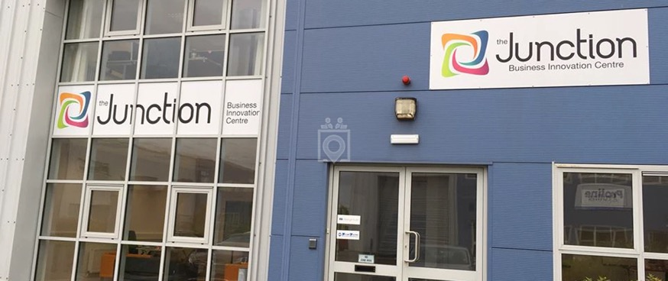

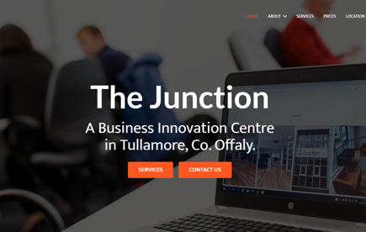
THE JUNCTION
Company Name
The Junction Tullamore (Offaly Innovation & Design Centre CLG)
Date of Interview
21/07/2021 via video call
Contact Person
Caitriona Montgomery, Business Development Manager, stream BIRR
Email
CLICK
TO VIEW
info@thejunctionoffaly.ie
The Junction Business Innovation Centre in Tullamore (population of approx.14,607 (2016) located in Ireland’s midlands) is one of several funded projects of Offaly Innovation & Design Centre CLG (supported by LEO Offaly and Offaly County Council). Offaly Innovation & Design Centre CLG was established in June 2013. It was established as a collaborative multi-agency and community initiative and its remit is to develop innovative supports for enterprise in Offaly, with regional impact. The Junction Business Innovation Centre, The Junction Office Suites, E-hive and stream BIRR are all initiatives of the CLG.
In July 2014, The Junction Business Innovation Centre was officially launched (Phase 1). The Junction Business Innovation Centre is a 390.1928 sq. metre facility, designed and fitted out as a dedicated high spec co-working space. It is a multi-functional space, providing affordable incubation space for startups, high speed internet access, training / board room hire and hot desk facilities. This is supplemented by ongoing business supports from the Local Enterprise Office (LEO) Offaly, with regular engagement with the Midland Innovation Research Centre (MIRC), Athlone, Enterprise Ireland and other stakeholders. In setting up The Junction, the Directors decided on a particular focus and so targeted the following sectors: software, design, new product development, multi-media and renewable energies. Building on the success of The Junction, the Company (with support funding from Enterprise Ireland and Offaly County Council) has expanded as follows:
The Junction Office Suites (Phase 2) – 4 additional offices with meeting room/canteen facilities have been developed in an industrial unit adjacent to The Junction Business Innovation Centre.
stream BIRR: The company successfully applied to the Enterprise Ireland Regional Development Fund and was awarded €458,240 to deliver stream BIRR.
E-Hive: Offaly Innovation and Design Centre CLG partnered with Offaly County Council to manage E-Hive, a next generation co-working hub in Edenderry.

Slide 2
ORGANISATION PROFILE
HOW MANY STAFF IS DIRECTLY EMPLOYED BY THE ORGANISATION?
IN ADDITION TO STAFF PRE COVID, HOW MANY PEOPLE ACCESS THE BUILDING ? (eg tenants, students, members of the public etc)
50
2 EMPLOYEES
MORE THAN PEOPLE DAILY
HOW LONG HAS THE ORGANISATION BEEN DRIVING A GREEN REVOLUTION/ INTRODUCED SDG POLICY’S OR ACTIONS?
WITHIN LAST 7 YEARS
WHAT SECTOR/S IS THE ORGANISATION ACTIVE IN?
HOW WOULD YOU DESCRIBE YOUR MAIN STAKEHOLDERS OR OCCUPANTS?
Local Enterprise/ Educational establishment (training facilities)/ Community (engaging and supporting the local community to thrive)/ Research and Innovation.
SMEs/ Micro Enterprises/ Sole traders/ Start-ups (The Junction is an incubation hub for businesses).
GOOD PRACTICES
WHAT IS YOUR VISION AND STRATEGY RELATED TO SUSTAINABLE DEVELOPMENT/CLIMATE ACTIONS?
The Junction aligns with the objectives of the Midlands Regional Enterprise Plan to ensure that, amongst other objectives, that the Midlands is well positioned to address the challenges posed by the transition to a low carbon economy, leverages the opportunities in big data and data analytics from iLOFAR (the Irish station in a European-wide network of state-of-the-art radio telescopes, used to observe the Universe at low frequencies) and enhances the collective offering of the Midlands as a place to live, work, and invest in.
This focus supports a decrease in commuting activity and congestion, supporting improved health and wellbeing locally, climate action through the reduction of unnecessary GHG emissions from commuting, and strives towards a sustainable and resilient community, supporting decent work and economic growth locally.

Slide 3
GOOD PRACTICES
WHAT ACTIONS DID YOU TAKE?
The Junction encourages recycling and composting, has developed a food waste management plan, and only buys in A-rated appliances (SDG12). With every action and investment in the properties, there is a focus on ensuring this meets their sustainability ambitions. The buildings are modern, designed to support collaboration, energy efficiency and innovation (SDG9|SDG8|SDG17)
In conjunction with its sister hubs stream BIRR and e-Hive, the Junction holds virtual events for their tenants, can range from data analytics, to remote working tips and resources and support tenants businesses in staying on top of recent development, innovations and so forth (SDG4) The Junction is also a training facilitating again supporting activities in the community (SDG4|SDG8)
The Junction links with the wider network of Offaly based enterprise hubs (outside of their own network) via the Midlands Network of Co-working Facilities (MNCF) to support sharing and learnings locally and the development of a resilient hub network in the region (SDG11|SDG8)
The Junction with its sister hub Stream BIRR are partnered with the Dublin Institute of Advanced Studies (DIAS) and have a PhD student on the team (SDG8|SDG17)The Junction has recently been able to upgrade to the fastest connectivity broadband (SDG9)
The Junction regularly engages its business tenants in funding developments, informing them of upcoming funding opportunities, and training opportunities (SDG8|SDG9)
The Local Enterprise Office Offaly, Offaly County Council, TUS Midwest , Enterprise Ireland (REDF funding), Science Foundation Ireland, Department of the Environment, Climate and Communications
WHICH PARTNERS AND STAKEHOLDERS WERE INVOLVED?
The Local Enterprise Office Offaly, Offaly County Council, TUS Midwest , Enterprise Ireland (REDF funding), Science Foundation Ireland, Department of the Environment, Climate and Communications
DID YOU RECEIVE ANY KIND OF TRAINING OR SUPPORT REGARDING YOUR ACTIONS?
Mentoring has been accessed via the LEO Offaly. The Directors also bring highly valuable expertise. Stakeholders also provide valuable advice and mentoring where required.
WHICH RESULTS DID YOU ACHIEVE ALREADY?
Several current and past tenants have participated in the New Frontiers programme in MIRC. One tenant (Future Ticketing) has transitioned from the LEO Offaly client portfolio to Enterprise Ireland as a High Potential Start-Up. The Junction has been cited (by the Department of Business Enterprise and Innovation (DBEI) and others) as a model of Best Practice.
Building on the success of The Junction, the parent company (Offaly Innovation and Design Centre CLG)with support funding from Enterprise Ireland and Offaly County Council, has expanded as follows:
The Junction Office Suites (Phase 2) – 4 additional offices with meeting room/canteen facilities have been developed in an industrial unit adjacent to The Junction Business Innovation Centre. This accommodates businesses that have outgrown the hot desking facilities of the Junction. The new office space opened in late July 2019 and all the four offices have already been rented.

Slide 4
GOOD PRACTICES
WHAT ARE YOUR FUTURE PLANS AND NEXT STEPS?
The Junction has applied for funding through the network of Connected Hubs, which will facilitate a range of improvements and enhancements at the centre supporting sustainability. This funding once delivered will be used with activities completed by the end of 2021. The Junction has also applied to the Just Transition Funding which will support larger energy efficiency projects and the expansion of the hub. This will be completed in late 2022. This funding will improve further the energy efficiency of their buildings.
The Junction is applying to the Local Enterprise Office Green For Micro funding to support their own ambitions onsite while also utilising all funding and sustainability supports to reinforce their own efforts to lead by doing. The ambition is to greatly increase the scope of activities onsite, and in doing so, act as a demonstrator for tenant businesses and the community.
From Autumn 2021, The Junction will be providing a programme of activities e.g. webinars, events, resources for home workers working locally, and for businesses interested in transitioning their workforce to fully remote or blended working. This will be undertaken in partnership with Grow Remote and the Local Enterprise Office in Offaly.
The Junction are planning to explore circular economy opportunities.
.

Slide 5
RECOMMENDATIONS
WHAT KIND OF HELP AND TOOLS DO YOU NEED TO REALISE YOUR FUTURE GOALS?
WHAT ARE YOUR MOST IMPORTANT TIPS & ADVICE TO GIVE TO OTHER ORGANISATIONS TO IMPLEMENT SDG WITHIN THEIR BUSINESS?
Further training on the practical integration of sustainability measures - the ‘how to’.
Funding to support sustainability and the transition of the centres and to support the tenant businesses.
The opportunity to have strategic support through collective conversations on sustainability, and to engage with other hubs to learn from and share with each other.
1Develop relationships with your Digital Officer in your Local Authority.
Connect with your Local Enterprise Office to access training, funding and keep connected.
Look at what can be done, and scale up.
Look at the practical ways to introduce sustainability measures daily and strategically.
Hubs need dedicated staff. Every hub should have a full time Centre Manager/ Business Development.
WHAT SUSTAINABLE GOALS WOULD YOU LIKE TO IMPLEMENT IN THE FUTURE?
01
Just Transition Fund (through the Department of Environment, Climate and Communications) will see works completed in early 2022
Sustainable Infrastructure/Buildings – SDG11 Sustainable cities and Communities and SDG13 Climate action:
Energy and Resource Efficiency – SDG 7 Affordable and clean energy and SDG12 Responsible consumption and production:
02
Just Transition Fund (through the Department of Environment, Climate and Communications) will see works completed in early 2022).
Sustainable Eco-systems and Collective Action – SDG4 Quality Education, SDG12 Responsible consumption and production and SDG17 Partnership for the Goals:
Just Transition Fund (through the Department of Environment, Climate and Communications) will see works completed in early 2022).
03
Digital Technology for Sustainable Enterprise Centres – SDG8 Decent work and Economic Growth and SDG13 Climate action:
Just Transition Fund (through the Department of Environment, Climate and Communications) will see works completed in early 2022).
04
05
Sustainable Futures for Enterprise Centres – SDG 9 -Industrial innovation & infrastructure and SDG17 Partnership for the Goals:
Just Transition Fund (through the Department of Environment, Climate and Communications) will see works completed in early 2022).

