Slide 1
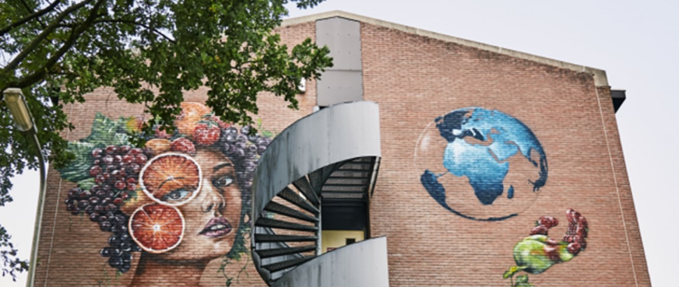

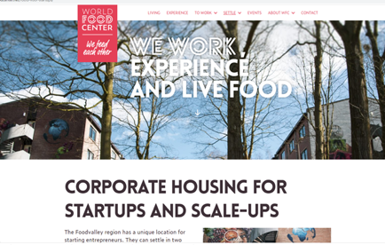
ROOTS INNOVATION HUB
Company Name
ROOTS Innovation HUB in Ede in The Netherlands
Date of Interview
02.08.2021 via Telephone
Contact Person
Louis de Boer
Email
CLICK
TO VIEW
l.boer@bpd.nl
ROOTS Innovation hub offers space to start-ups and scale-ups that are active in the Agri and food sector. ROOTS does this because young entrepreneurs play a major role in the transition and renewal of our food system into a sustainable system. The Innovation hub is located next to Ede-Wageningen railway station in the centre of the Dutch Food Valley. ROOTS is part of the World Food Center (WFC) grounds which makes it an ideal location for innovative and sustainable entrepreneurs. ROOTS is located in former military barracks. The buildings will eventually be demolished to make way for the WFC Hotel. Until then, the buildings will be used by start-ups and scale-ups. The costs to rent space are very low, there are almost no rules and therefor plenty of room to experiment. An ideal place to start and grow new innovative businesses together with other young entrepreneurs.

Slide 2
ORGANISATION PROFILE
HOW MANY STAFF IS DIRECTLY EMPLOYED BY THE ORGANISATION?
IN ADDITION TO STAFF PRE COVID, HOW MANY PEOPLE ACCESS THE BUILDING ? (eg tenants, students, members of the public etc)
160
1 EMPLOYEE
MORE THAN PEOPLE DAILY
HOW LONG HAS THE ORGANISATION BEEN DRIVING A GREEN REVOLUTION/ INTRODUCED SDG POLICY’S OR ACTIONS?
WITHIN LAST 5 YEARS
WHAT SECTOR/S IS THE ORGANISATION ACTIVE IN?
HOW WOULD YOU DESCRIBE YOUR MAIN STAKEHOLDERS OR OCCUPANTS?
Agri and food business
Tenants startups and scale-ups
GOOD PRACTICES
WHAT IS YOUR VISION AND STRATEGY RELATED TO SUSTAINABLE DEVELOPMENT/CLIMATE ACTIONS?
The world population is growing and climate is changing. Our food supply requires sustainable and healthy food and innovative business models. The World Food Center (WFC) centrally located in the Foodvalley region wants to play a key role in these developments. In a couple of years this will be the place where more and more entrepreneurs, governmental and educational institutions work together on the food supply of tomorrow.
ROOTS Innovation hub is one of the initiatives at the WFC premises. It is not a commercial activity but it facilitates tenants in their basic needs to grow their own sustainable and innovative business: a place to work and grow in an inspiring environment with a minimum of rental costs. That is the new concept behind ROOTS. It's up to the young entrepreneurs themselves to connect and to inspire and help each other.

Slide 3
GOOD PRACTICES
WHAT ACTIONS DID YOU TAKE?
Almost nothing. The buildings were already available. We made these buildings ready for the tenants with good internet connections and safety precautions so they could enter the building 24 hours a day.
We have set up a new foundation, appointed an administrator and defined the criteria for the new tenants. Their business has to be in Agri and food business (80% of the tenants) or in related business (20%). They must be a start-up or scale-up business (not older than 5 years) and prepared to participate in marketing activities of WFC (interviews, presentations or guided tour etc).
They also participate in WFC network and community with different kinds of activities (in progress). Tenants are completely free what they do with their rented space. It could be a lab, a test kitchen, an office or storage room, etc.
WHICH PARTNERS AND STAKEHOLDERS WERE INVOLVED?
A new foundation was set up to exploit the buildings and facilitate the tenants of the building. The building itself is very old and not very sustainable. Only the lifecycle of the building has been extended through this initiative and you might call that sustainable.
.
DID YOU RECEIVE ANY KIND OF TRAINING OR SUPPORT REGARDING YOUR ACTIONS?
No, the concept is new and we just started to experiment with it. There is a lot of interest and more than 25 new businesses already rented a space. Most of them are innovative and sustainable businesses concerning new kinds of products and services like microgreens, fungi, plant -based foods, biological control, indoor gardening, drone technology, etc. tenants list with links to their own business sites see https://worldfoodcenter.net/roots-voor-startups
WHICH RESULTS DID YOU ACHIEVE ALREADY?
Many new businesses with national and international backgrounds have rented space in our buildings. A lot of them arise from studies and students from the Wageningen University which is our neighbour. Wageningen University and Research is one of the main agriculture universities in the world with focus on healthy food and living environment. Further information: https://www.wur.nl/en/About-WUR.htm
WHAT ARE YOUR FUTURE PLANS AND NEXT STEPS?
The concept is successful, although the start-up and scale-ups are renting space in some old buildings at the WFC grounds. The ambition is that after the buildings have been demolished some other spaces will be available for them. Basically, it is important that WFC has room for the young entrepreneurs who can help developing and growing WFC with their fresh and innovative ideas.

Slide 4
RECOMMENDATIONS
WHAT KIND OF HELP AND TOOLS DO YOU NEED TO REALISE YOUR FUTURE GOALS?
WHAT ARE YOUR MOST IMPORTANT TIPS & ADVICE TO GIVE TO OTHER ORGANISATIONS TO IMPLEMENT SDG WITHIN THEIR BUSINESS?
Ideas to build and facilitate communities of young entrepreneurs.
Innovative business cases and arrangements to facilitate young entrepreneurs with low-cost and experimental space.
Give room to innovative young entrepreneurs.
Facilitate young entrepreneurs and use their ideas for renewal and transitions needed to build up a sustainable and climate.
WHAT SUSTAINABLE GOALS WOULD YOU LIKE TO IMPLEMENT IN THE FUTURE?
01
Sustainable Infrastructure/Buildings – SDG11 Sustainable cities and Communities and SDG13 Climate action:
Next 6 months and further
Energy and Resource Efficiency – SDG 7 Affordable and clean energy and SDG12 Responsible consumption and production:
02
Next 6 months and further
Sustainable Eco-systems and Collective Action – SDG4 Quality Education, SDG12 Responsible consumption and production and SDG17 Partnership for the Goals:
03
Next 6 months and further
Digital Technology for Sustainable Enterprise Centres – SDG8 Decent work and Economic Growth and SDG13 Climate action:
04
TBC
05
Sustainable Futures for Enterprise Centres – SDG 9 -Industrial innovation & infrastructure and SDG17 Partnership for the Goals:
Next 6 months and further.

