Slide 1
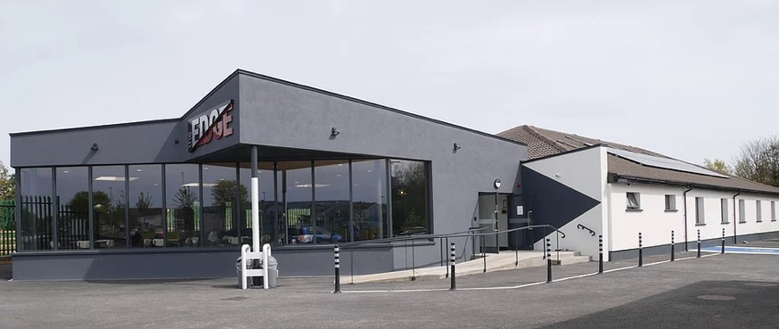

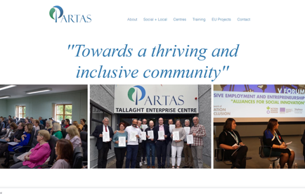
PARTAS
Company Name
Partas (Partas CLG)
Date of Interview
14/07/2021 via video call
Contact Person
Bernard Bennett
Email
CLICK
TO VIEW
receptiontec@partas.ie
Partas has four enterprise centres in the Tallaght area and is firmly at the heart of the entrepreneurial spirit within the community. Tallaght is located in South Dublin, and is the largest satellite town of Dublin City (population of 76,119 (census 2016).
The Partas training in personal and business development, computer skills, mentoring programmes, micro-financing and Social Enterprise ensure that every assistance is provided to support clients. Partas aims to build an inclusive and thriving community by being a leading source of excellence in development of local enterprise and of social economy. A key factor in creating and supporting an entrepreneurial culture in Tallaght is the provision of affordable and suitable workspace. Since 1984 Partas has worked with State agencies, NGOs, Businesses and Community Representatives in developing enterprise space and now manages four successful Community Enterprise Centres, namely:
Tallaght Enterprise Centre - 1765.1578 sq m
Bolbrook Enterprise Centre – 743.2243 sq m*
Brookfield Enterprise Centre - 2415.47904 sq m
Killinarden Enterprise Park - 2043.8669 sq. m
*The Bolbrook Enterprise Centre which recently underwent a total upgrade and refurbishment has reopened as ‘The Edge’.

Slide 2
ORGANISATION PROFILE
HOW MANY STAFF IS DIRECTLY EMPLOYED BY THE ORGANISATION?
IN ADDITION TO STAFF PRE COVID, HOW MANY PEOPLE ACCESS THE BUILDING ? (eg tenants, students, members of the public etc)
300
62 EMPLOYEES
MORE THAN PEOPLE DAILY
HOW LONG HAS THE ORGANISATION BEEN DRIVING A GREEN REVOLUTION/ INTRODUCED SDG POLICY’S OR ACTIONS?
WITHIN LAST 15 YEARS
WHAT SECTOR/S IS THE ORGANISATION ACTIVE IN?
HOW WOULD YOU DESCRIBE YOUR MAIN STAKEHOLDERS OR OCCUPANTS?
Local Enterprise/ Education/ Food and Hospitality/Social Enterprise.
Learners/ Local Community/ SME’s/ Micro Enterprise/ Sole traders/ Start-ups/Social Enterprises.
GOOD PRACTICES
WHAT IS YOUR VISION AND STRATEGY RELATED TO SUSTAINABLE DEVELOPMENT/CLIMATE ACTIONS?
In pursuance of a sustainability agenda, Partas has incorporated the following goals in the formulation and implementation of its plans, strategies & programmes in all areas of activity.
Minimise the consumption of natural non-renewable resources.
Encourage energy efficiency, reduction in emissions and where possible adopt alternative/ renewable energy sources and best practice in its operations.
Accommodate new development needs in an environmentally sensitive manner.
Promote water conservation measures, waste prevention, reduction, re-use, recycling, energy recovery & safe disposal.
Equality Policy: Partas is committed to equality of opportunity in terms of its employment practices, its policies and procedures, and access to its services. This commitment to equality of opportunity is evidenced in the mission statement of the organisation: “Our aim is to build an inclusive and thriving community by being a leading source of excellence in development of local enterprise and of social economy.”
Environmental Policy: Partas provides business support, advice and training to individuals, community businesses, SMEs and Social Enterprises throughout Tallaght. Partas recognises that environmental concerns are an integral part of its business both within its own operation & in its relationship with clients.

Slide 3
GOOD PRACTICES
both within its own operation and in its relationship with clients. To this end See below for some of the activities Partas engages in below:
Internal
Ensure that wherever practicable all consumables within Partas are recycled
Identify and offer environmental training to all staff, where appropriate.
External
Advise all new and existing clients, where appropriate, of their environmental responsibilities.
Internal/External
Make every effort to minimise use of private transport in the internal and external work of the Centre
Review this policy from time to time against best practice in the business support sector.
WHAT ACTIONS DID YOU TAKE?
The Bolbrook Enterprise Centre underwent a refurbishment between 2019, reopening in 2020 as ‘The Edge’. In developing ‘The Edge’ every effort was taken to marry sustainability efforts from an environmental perspective with cost savings potential while exploring opportunities to generate income (the Coffee Shop) in the building also. The building is state of the art. It incorporates a Heat Recovery System (similar to Passive House systems) and also installed a Heat Pump with underfloor heating. These actions have greatly reduced energy usage and bills (SDG7|SDG11).
Partas accessed grant funding through the SEAI EXEED programme (match funding secured from South Dublin County Council). Solar panels were installed at construction, which during the summer months covers the full load of electricity used on site. Funding via the REDF (Regional Enterprise Development Fund) was also central in supporting the upgrade (SDG7|SDG11).
Partas have led the development of the Social and Local Sustainable Energy Community (through SEAI) in Tallaght. This was initiated 18 months ago and involves South Dublin County Council, the South Dublin Chamber of Commerce, the Local Enterprise Office and the Technological University of Dublin, Tallaght. The aim is to develop a forum of participants to drive the discussion on developing a local energy generation and use scheme, with a possible role for Partas here to supply excess energy from solar locally (local distribution) (SDG7|SDG11).
When businesses arrive, they are helped and supported to adopt environmentally conscious and sustainable business practices. This is initiated from the very start, with the aim that as businesses grow, they will grow with strong environmental practices (SDG13|SDG11|SDG7|SDG12).
WHICH PARTNERS AND STAKEHOLDERS WERE INVOLVED?
SEAI/ South Dublin County Council/ the Local Enterprise Office/ Enterprise Ireland/ tenant businesses and Partas staff.
DID YOU RECEIVE ANY KIND OF TRAINING OR SUPPORT REGARDING YOUR ACTIONS?
SEAI (Sustainable Energy Authority of Ireland) covered 75% of the cost of a consultant (through the EXEED programme) and also provided mentorship.

Slide 4
GOOD PRACTICES
WHICH RESULTS DID YOU ACHIEVE ALREADY?
Social enterprises like Partas constantly face funding challenges, and so it was of significant import that Tallaght Partnership, following its inception in 1991, sub-contracted a significant portion of its enterprise programme to Partas. This enabled the organisation to expand its services to its client base, and firmly established Partas as a key player in the development of the local economy. In addition to enterprise supports for individuals, Partas established a Social Economy Unit in 1997 to provide management & enterprise supports to community businesses in Tallaght. In addition to its core work in Tallaght, Partas has participated in many EU programmes over the past 25+ years and has significantly benefited from its experience with European partners.
Of significance also is The Rise programme, which is radically different from the majority of programmes available for Social Enterprise development. Based on a three-year pan-European research programme (on why social enterprises have failed to achieve sustainability) this programme incorporates two cutting- edge entrepreneurial processes – disruptive design thinking and action coaching. Free to a limited number of applicants, training and mentoring with an estimated commercial value of €15,000 is now available to selected social entrepreneurs and social enterprises with ambitious plans for growth and impact.
Partas also secured funding from the Department of Justice and Equality for WEBNET through the Gender Equality European Social Fund (ESF) PEIL programme, to run a 3 year programme offering mentoring and support to budding female entrepreneurs. Participants will avail of networking support from their peers, also receiving accredited skills through the delivery of three QQI modules, including Sales and Marketing Skills, Business Planning and Career Planning.
The Bolbrook Enterprise Centre which was redeveloped to ‘The Edge’ centre and is now a state of the art location, where once people had to wear coats inside due to the cold, it has now been completely transformed. The Edge solar panels cover the energy usage (during the summer) of the entire building.
The cafe’s (The Edge and Main Road Tallaght Enterprise Centre) and the brewery (Priory Brewery - social enterprise) were developed with sustainability and environmental practices as a central tenet in each project. Each work to keep down their environmental footprint, simultaneously keeping down costs and generating revenues for the centres.
WHAT ARE YOUR FUTURE PLANS AND NEXT STEPS?
Tackle increasing unemployment in their communities through the promotion of self employment and social entrepreneurship
Continue to expand and widen services
Tackle new and emerging target groups in the community (supporting startups and microbusinesses)
Continue to develop our ‘Social + Local’ strategy to encourage a thriving local/social economy
Concentrate on further developing EU partnerships and capitalise on funding opportunities.
Planning to install electric car charge points for tenants or the public at ‘The Edge’ centre to utilise the excess energy generated from the solar panels while in tandem developing a new income stream for the centre. Potential partnership with Glas Energy.
With all new developments and all opportunities to invest in upgrading of facilities, every effort is taken to ensure that sustainability/ energy efficiency criteria are met along the way.

Slide 5
RECOMMENDATIONS
WHAT KIND OF HELP AND TOOLS DO YOU NEED TO REALISE YOUR FUTURE GOALS?
WHAT ARE YOUR MOST IMPORTANT TIPS & ADVICE TO GIVE TO OTHER ORGANISATIONS TO IMPLEMENT SDG WITHIN THEIR BUSINESS?
Funding is a big challenge for Enterprise Centres..
A more secure process for Enterprise Centres with less uncertainty when applying for grants such as the SEAI EXEED Grant..
Many Enterprise Centres struggle to survive - the connection between sustainability from a financial perspective and sustainability from an environmental perspective needs to be acknowledged and supported.
Support and funding needs to be easier to navigate.
Take action. Do it today. Do something. Don’t let perfection stop you getting started. Better to get started.
Agree the strategy at Board level. Set out the rationale, the business case and get support.
Seek out synergies and partnerships where these could be mutually helpful.
Communicate plans clearly to centre managers..
Enterprise Centres must look to link opportunities to be self-sustainable economically with those opportunities to ensure environmental and social sustainability.
WHAT SUSTAINABLE GOALS WOULD YOU LIKE TO IMPLEMENT IN THE FUTURE?
01
Sustainable Infrastructure/Buildings – SDG11 Sustainable cities and Communities and SDG13 Climate action:
Electric car charging infrastructure - by the end of 2021
Energy and Resource Efficiency – SDG 7 Affordable and clean energy and SDG12 Responsible consumption and production:
02
Main Road Tallaght Centre insulation retrofit, food hub and solar panels - mid to late 2022
Sustainable Eco-systems and Collective Action – SDG4 Quality Education, SDG12 Responsible consumption and production and SDG17 Partnership for the Goals:
03
Training Academy - 2022-2023
Digital Technology for Sustainable Enterprise Centres – SDG8 Decent work and Economic Growth and SDG13 Climate action:
04
Local and Social SEC - discussion around local generation and distribution - in 2022
05
Sustainable Futures for Enterprise Centres – SDG 9 -Industrial innovation & infrastructure and SDG17 Partnership for the Goals:
Solar panels and refurbishments (Main Road) - in 2022

