Slide 1
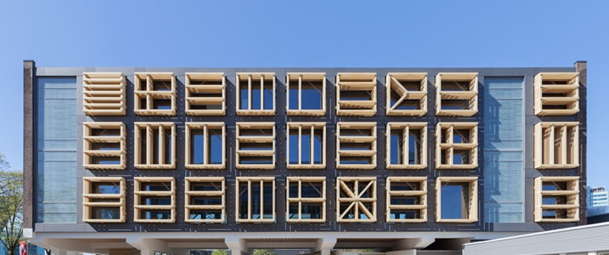
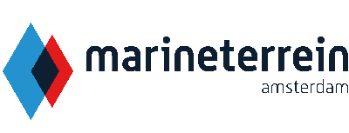
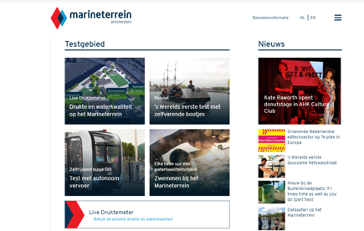
HET MARINETERREIN
Company Name
Het Marineterrein
Date of Interview
14.07.21 via Telephone
Contact Person
Mr De Vries and Mr Thijs Meijer – Communication Managers
Email
CLICK
TO VIEW
nfo@marineterrein.nl
In the middle of the city, Marineterrein Amsterdam is the place where small and large businesses, organizations, colleges and universities can experiment in the field of learning, working and living.
In these partnerships, there is a lot of experimentation with technology and how it can improve the living environment. Marineterrein Amsterdam used to be the place where the Royal Dutch was situated. Its history goes back to the 17th century.
Under the responsibility of the National Government and the Amsterdam Municipality, it is being transferred into a test area and an urban district for learning, working and living, situated in the city center of Amsterdam.
Its special and flexible approach is gradually developing the test area into anurban district with space for open innovation, special forms of housing, sports, recreation and greenery.
Most of the buildings are from the 20th century, built in a period that sustainability was not yet a hot issue. It is foreseen that some these buildings will be broken down, making place for new ones. Nevertheless, finding new destination for old buildings is also sustainable.
Cities like Amsterdam, need a new approach to resolving social problems and ask what role technology play in this.
This approach is gradually developing the test area into an urban district with space for open
innovation, special forms of housing, sports, recreation and greenery.

Slide 2
ORGANISATION PROFILE
HOW MANY STAFF IS DIRECTLY EMPLOYED BY THE ORGANISATION?
IN ADDITION TO STAFF PRE COVID, HOW MANY PEOPLE ACCESS THE BUILDING ? (eg tenants, students, members of the public etc)
1000
20 EMPLOYEES
MORE THAN PEOPLE DAILY
HOW LONG HAS THE ORGANISATION BEEN DRIVING A GREEN REVOLUTION/ INTRODUCED SDG POLICY’S OR ACTIONS?
WITHIN LAST 10 YEARS
WHAT SECTOR/S IS THE ORGANISATION ACTIVE IN?
HOW WOULD YOU DESCRIBE YOUR MAIN STAKEHOLDERS OR OCCUPANTS?
On the Marineterrein, 51 organisations, companies are active in 3 sectors:
Learning
Living
Working
All sectors are represented.
GOOD PRACTICES
WHAT IS YOUR VISION AND STRATEGY RELATED TO SUSTAINABLE DEVELOPMENT/CLIMATE ACTIONS?
The emphasis on innovation stems from the growing importance of knowledge and creativity for the national economy and national employment. In addition, research has shown that inner city environments create excellent incubators for innovation. The Marineterrein will therefore become an economic ecosystem that will strengthen the city, the region, and the Netherlands as a whole.

Slide 3
GOOD PRACTICES
WHAT ACTIONS DID YOU TAKE?
Some examples are:
Sector Learning:
Tech jobs for everybody
Amsterdam University of Arts has started a Learning Lab
Sector Living:
Re-using human urine
Roboat eases congestion in a crowded city
Open source crowd monitor government and civil society.
WHICH PARTNERS AND STAKEHOLDERS WERE INVOLVED?
National government and the Municipality of Amsterdam created an Estate Agency, to coordinate the use of buildings by the tenants.
Also, the Ministry of Defence is a partner, since a part of the area will be used by the Royal Dutch Navy. In 2026, new barracks will be ready.
DID YOU RECEIVE ANY KIND OF TRAINING OR SUPPORT REGARDING YOUR ACTIONS?
Not Applicable.
WHICH RESULTS DID YOU ACHIEVE ALREADY?
Learning
Continuing to learn is becoming increasingly important in a society that is changing rapidly. At the same time, the number of early school leavers is increasing.
At Marineterrein Amsterdam, we are testing all kinds of solutions to modernize our education, reduce the number of school leavers and find ways in which employees can continue to develop their skills. We are testing new methods of learning, new skills and new surroundings with the aid of technology.
Working
The pressure to perform in our society is increasing. The partnerships at Marineterrein Amsterdam community-based solutions for a sustainable career for everyone, with and without technology.
Living
Experiments by all kinds of businesses, organisations, knowledge institutes and active citizens are taking place in the outdoor space at Amsterdam Marine Park, where our site functions as an inner-city testing ground for how technology can improve our living environment.
WHAT ARE YOUR FUTURE PLANS AND NEXT STEPS?
Some buildings will be broken and replaced by new buildings. Till that time, the buildings are used by the tenants. Royal Dutch Navy plans new barracks for 2026..

Slide 4
RECOMMENDATIONS
WHAT KIND OF HELP AND TOOLS DO YOU NEED TO REALISE YOUR FUTURE GOALS?
WHAT ARE YOUR MOST IMPORTANT TIPS & ADVICE TO GIVE TO OTHER ORGANISATIONS TO IMPLEMENT SDG WITHIN THEIR BUSINESS?
Good cooperation between the national government, the Navy and the Municipality of Amsterdam.
Good marketing tools (focus on sustainability) to attract new tenants.
Financial resources, to realise the future plans.
1We realise that the Marineterrein is not just an enterprise centre. It is a big open area, surrounded by water, with a lot of buildings on it. Many of these buildings are in use by a big number of companies. That makes us unique in The Netherlands.
2We advise comparable places in Europe to communicate with us, to see how we started our developments. On our website you can find the background information of the steps we have made in the last 10 years.
WHAT SUSTAINABLE GOALS WOULD YOU LIKE TO IMPLEMENT IN THE FUTURE?
01
Present buildings are not sustainable in structure. Little improvements have been made. Main developments are planned for 2026 and later: 3-5 years.
Sustainable Infrastructure/Buildings – SDG11 Sustainable cities and Communities and SDG13 Climate action:
Energy and Resource Efficiency – SDG 7 Affordable and clean energy and SDG12 Responsible consumption and production:
Heating is still with gas. Electricity: first solar panels are installed. Also here, main developments are planned for 2026 and later: 3-5 years.
02
Sustainable Eco-systems and Collective Action – SDG4 Quality Education, SDG12 Responsible consumption and production and SDG17 Partnership for the Goals:
On tenant level are several examples of sustainable eco-systems, like an organic brewery, a greenhouse with solar energy and a restaurant with organic products. More to come: 1-3 years.
03
Digital Technology for Sustainable Enterprise Centres – SDG8 Decent work and Economic Growth and SDG13 Climate action:
Internet is available on the entire area, Wifi is still on tenant level. Plans for central Wifi are in progress: 1-3 years.
04
05
Sustainable Futures for Enterprise Centres – SDG 9 -Industrial innovation & infrastructure and SDG17 Partnership for the Goals:
Marineterrein is already an interesting example of sustainable developments. This will accelerate from 2026 on: 3-5 years.

