Slide 1
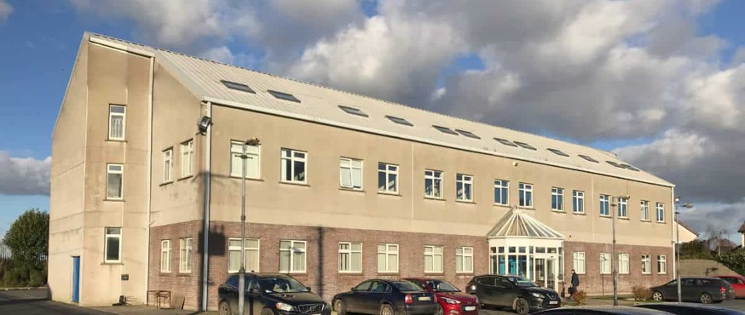

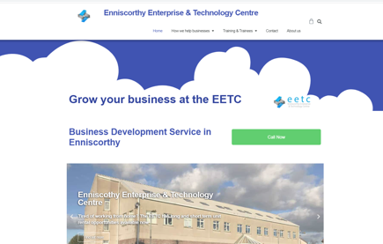
ENNISCORTHY ENTERPRISE & TECHNOLOGY CENTRE
Company Name
Enniscorthy Enterprise & Technology Centre, Co. Wexford
Date of Interview
27/07/2021 via Video call
Contact Person
John O’Connor, CEO
Email
CLICK
TO VIEW
info@eetc.ie
The Enniscorthy Enterprise & Technology Centre (EETC) is a purpose-built premises located just outside of Enniscorthy town (Enniscorthy is the second-largest town in County Wexford, South East of Ireland and has a population of 19,381 residents (Census, 2016) with a population of 35,000 within a 20km radius).
Equipped with office units of various sizes, excellent facilities and supportive staff with industry experience, EETC helps businesses succeed, whether start-ups or established businesses. The Enniscorthy Enterprise & Technology Centre offers a unique opportunity to its tenants – that is, the cooperative culture that exists between the various businesses who operate onsite.
Each business at the EETC has the common goal of reaching their business’ potential. Networking is an important part of the success of any business, at the EETC businesses can find that there is the opportunity to make many important contacts through the other businesses operating within the centre.

Slide 2
ORGANISATION PROFILE
HOW MANY STAFF IS DIRECTLY EMPLOYED BY THE ORGANISATION?
IN ADDITION TO STAFF PRE COVID, HOW MANY PEOPLE ACCESS THE BUILDING ? (eg tenants, students, members of the public etc)
90
4 FULL TIME EMPLOYEES
MORE THAN PEOPLE DAILY
HOW LONG HAS THE ORGANISATION BEEN DRIVING A GREEN REVOLUTION/ INTRODUCED SDG POLICY’S OR ACTIONS?
WITHIN LAST 19 YEARS
WHAT SECTOR/S IS THE ORGANISATION ACTIVE IN?
HOW WOULD YOU DESCRIBE YOUR MAIN STAKEHOLDERS OR OCCUPANTS?
Local Enterprise/ SMEs/ Start-ups/ Community development/ Training and Development (reskilling for employment)
SMEs/ Startups/Trainees
GOOD PRACTICES
WHAT IS YOUR VISION AND STRATEGY RELATED TO SUSTAINABLE DEVELOPMENT/CLIMATE ACTIONS?
The Enniscorthy Enterprise & Technology Centre is a non-profit organisation committed to helping the Enniscorthy District Community. The core objective of the EETC is to support local start-ups, established businesses and individuals. The EETC achieves these objectives by providing a sheltered environment and incubation space for vulnerable start-ups to develop their businesses. Offering affordable office space in order to give new and established businesses the best opportunity to reach their potential, the EETC also provides training, support and work placements for individuals to become employment ready.
The EETC is also committed to taking steps towards becoming more sustainable in its business practices. In this way, the EETC sets an example for other businesses to adopt more sustainable practices. The EETC have developed our their 3 pillars of sustainable development which they strive to achieve:
Positive local economic outcomes
Positive social outcomes
Positive environmental outcomes.

Slide 3
GOOD PRACTICES
WHAT ACTIONS DID YOU TAKE?
Positive local economic outcomes
By providing incubation space for startups, affordable workspaces for businesses and training programmes for individuals, the EETC encourages positive local economic outcomes. In this way, the local economy will have a strong economic asset base which will assist businesses and individuals to reach their potential. The incubation space encourages diverse and responsible businesses in the local community leading to positive consequences for the local economy with higher employment opportunities located in Enniscorthy (SDG8|SDG4|SDG11)
Positive social outcomes
The EETC supports society by providing a supportive and enabling environment for start-ups and individuals to develop their skills, test their ideas and reach their potential. Through this, the EETC fosters local activism, participation and capability through the people of Enniscorthy (SDG11|SDG8)
Positive environmental outcomes
The EETC is committed to improving its organisational sustainability and has, for example built a community garden and upgraded the facility’s lighting to more efficient systems. The EETC are making changes to support sustainability, and are working towards becoming an example for their tenants and local business to show how they too can become more sustainable and adopt long-term improvements for the environment (SDG13|SDG11).
To support their ambition from a climate action, environmental management perspective, the EETC initiated a certification with the EcoMerit environmental award certification in 2014. The certification process acts as a framework and guide to work within and has been very useful in propelling and achieving progress:
Moved energy supplier to fully renewable electricity supplier
transitioning lighting to LED via Sustainable Energy Authority Ireland grant.
Air conditioning unit is being replaced (saving energy)
Sensor lighting has been fitted in the building (saving on energy)
An infra-red panel has been fitted in one of the meeting rooms (acts as a heating and lighting unit)
EETC signed up to the All Ireland Pollinator Plan in 2016, and maintains sections of their garden for wildflowers and biodiversity enhancement.
Started their centre garden in 2019, and continue to encourage wider community involvement. The garden is growing beetroot, radishes, and swiss chard along with herbs.
Through adopting the EcoMerit certification, the Centre aims to work as a demonstrate on site for its tenant businesses and the community (SDG11|SDG13|SDG7).
In 2009/2010, the EETC invited Cultivate to speak to their tenant businesses on the topic of peak oil and transition communities (SDG11|SDG13).
Each of the 23 businesses in the centre have adopted a charity that they support on an ongoing basis. This is actively encouraged and facilitated (SDG11).
The EETC also works closely with Waterford Institute of Technology to help tenants develop their business with their national programme supporting early stage entrepreneurship, New Frontiers. New Frontiers Entrepreneur Development Programme – Phase 1 Commenced in September 2020 (SDG8).
Through affordable office rental prices, high speed broadband connection, reception services and invaluable mentoring, the EETC supports their local community to thrive. New businesses require careful planning, access to professional support, low overhead costs and high speed communications in order to succeed in today’s business environment – this is what EETC strives to provide (SDG8|SDG11).

Slide 4
GOOD PRACTICES
WHICH PARTNERS AND STAKEHOLDERS WERE INVOLVED?
Wexford Local Enterprise Office, Enterprise Ireland, Waterford Wexford Education and Training Board, Wexford Local Development LEADER Company, Waterford Institute of Technology, Wexford County Council, Sustainable Energy Authority of Ireland.
.
DID YOU RECEIVE ANY KIND OF TRAINING OR SUPPORT REGARDING YOUR ACTIONS?
The EcoMerit certification process, and through the support this has afforded the centre, has helped in guiding the energy management actions onsite.
WHICH RESULTS DID YOU ACHIEVE ALREADY?
Two thirds of the building has been transitioned to LED lighting.
The community garden has expanded and is a success with centre tenants.
The building energy efficiency has increased through simple actions like tightening windows (in 2021).
A fabrication lab was set up in the centre.
The Centre is home to a diverse range of businesses and tenants.
The Centre strives to be a model of entrepreneurship and economic activity in the region.
The EETC has a 400mb download speed for tenants.
WHAT ARE YOUR FUTURE PLANS AND NEXT STEPS?
In a report developed by the Centre, Natural Step Actions Report 2009, the opportunity for the Centre to become a national centre for sustainable enterprises and a catalyst for sustainability within the community was recognised. Since this report, the Centre has been striving to implement changes and actions to support sustainability. This is done on an ongoing basis with sustainability incorporated into decision making and planning.
Future plans include:
Solar panel installation is to be explored in the future
An electric car charge point will be installed in winter 2022
There will be indigenous trees planted in the community garden (apple and pear trees) in 2021/2022.

Slide 5
RECOMMENDATIONS
WHAT KIND OF HELP AND TOOLS DO YOU NEED TO REALISE YOUR FUTURE GOALS?
WHAT ARE YOUR MOST IMPORTANT TIPS & ADVICE TO GIVE TO OTHER ORGANISATIONS TO IMPLEMENT SDG WITHIN THEIR BUSINESS?
Support to progress sustainability actions is so important. A sustainability toolkit would be very useful giving a ‘How To’ checklist, and expanding on the relevance and applicability of the UN Sustainable Development Goals
When progressing an idea/ action, you need to be determined, explore the options and get the support from your community.
WHAT SUSTAINABLE GOALS WOULD YOU LIKE TO IMPLEMENT IN THE FUTURE?
01
Sustainable Infrastructure/Buildings – SDG11 Sustainable cities and Communities and SDG13 Climate action:
Electric car charging point in Winter 2022.
Energy and Resource Efficiency – SDG 7 Affordable and clean energy and SDG12 Responsible consumption and production:
02
The integration of solar panels is being explored. No set date for installing.
Sustainable Eco-systems and Collective Action – SDG4 Quality Education, SDG12 Responsible consumption and production and SDG17 Partnership for the Goals:
03
TBC
Digital Technology for Sustainable Enterprise Centres – SDG8 Decent work and Economic Growth and SDG13 Climate action:
04
The community garden is being planted with indigenous trees in 2021/2022.
05
Sustainable Futures for Enterprise Centres – SDG 9 -Industrial innovation & infrastructure and SDG17 Partnership for the Goals:
TBC.

