Slide 1
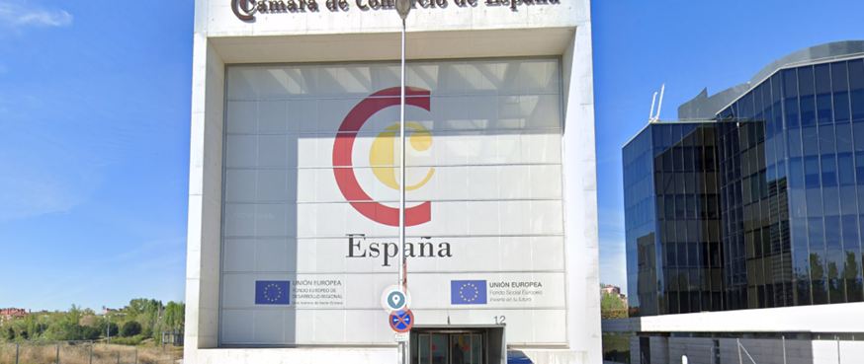

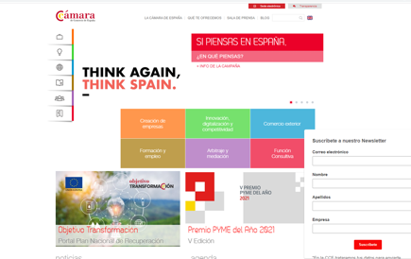
CÁMARA OFICIAL DE COMERCIO
(Santiago Chamber of Commerce)
Company Name
Santiago Chamber of Commerce
Date of Interview
02.07.2021 via Video Call
Contact Person
Ms. Belén Mendoza / EU projects Senior Manager
Email
CLICK
TO VIEW
proyectos@camaracompostela.org
Santiago Chamber is a corporate of Public Law, founded in 1889, including 32 municipalities in the south of the province of A Coruña, in Galicia region, Northwest Spain.
The Chamber collaborates actively with the more than 30,000 Santiago de Compostela area-based companies, covering various needs, such as advice for the creation and development of businesses, promoting, training human capital, and developing initiatives to extend the culture of quality and innovation. We are also a consultative and collaborative body liaising with the Administrations, which represents, promotes, and defends the general interests of companies in the region.
The support to SMEs and entrepreneurs is one of the main tasks of the Chamber in Santiago city and its district. We have set a Creation and Business Development office that brings together all the information related to the start-up of a business project, giving orientation and advice to the entrepreneurs, especially on the following issues: definition of the project, draft of the Business Plan, general information on the legal status and constitution steps, new business areas, business networks and entrepreneurs cooperation, contacts of interest, opportunities for self-employment, contracting, intellectual and industrial property, internal commerce, subsidies and aids, credits and all the employer obligations and requirements.

Slide 2
ORGANISATION PROFILE
HOW MANY STAFF IS DIRECTLY EMPLOYED BY THE ORGANISATION?
IN ADDITION TO STAFF PRE COVID, HOW MANY PEOPLE ACCESS THE BUILDING ? (eg tenants, students, members of the public etc)
30
9 EMPLOYEES
MORE THAN PEOPLE DAILY
HOW LONG HAS THE ORGANISATION BEEN DRIVING A GREEN REVOLUTION/ INTRODUCED SDG POLICY’S OR ACTIONS?
WITHIN LAST 5 YEARS
WHAT SECTOR/S IS THE ORGANISATION ACTIVE IN?
HOW WOULD YOU DESCRIBE YOUR MAIN STAKEHOLDERS OR OCCUPANTS?
Local Enterprise
Chamber of Commerce and Industry
GOOD PRACTICES
WHAT IS YOUR VISION AND STRATEGY RELATED TO SUSTAINABLE DEVELOPMENT/CLIMATE ACTIONS?
We have drafted a strategy that makes us to be a close and friendly support to the SMEs and entrepreneurs in our area to work towards the goal of making the sustainability a lever to improve their organizations and increase their business opportunities.
At the same time, we have committed to do our best to apply the SDGs also in our organization, starting from small actions that increase our visibility while improving and getting more and more committed towards sustainable development and climate change and global warming fight

Slide 3
GOOD PRACTICES
WHAT ACTIONS DID YOU TAKE?
We have followed a strategy of “small actions to reach a bigger one to make a more sustainable world”. Amongst those actions we can highlight the following ones:
Incorporate SDG logo to our Chamber logo to increase visibility and show our commitment with the SDG.
Recycling paper and plastic as well as effort to reduce its use, not only recycling.
Digitalisation of documents and tools to keep the files, all Chamber system has been adapted to remote working due to pandemic outbreak
Promotion between staff of the use of collective transport
Since March 2021 we offer in our facilities a brand new “digital co-working” with the main aim of reduce waste, increase digitalisation of companies.
WHICH PARTNERS AND STAKEHOLDERS WERE INVOLVED?
We have involved both profiles: public administrations and private companies since we believe that this is the way to cooperate in a local challenge that need global solutions. In the trainings and informative sessions addressed to SMEs to inform on SDGs we always try to involve our local companies in the events, to give them the opportunity to show their best practices.
DID YOU RECEIVE ANY KIND OF TRAINING OR SUPPORT REGARDING YOUR ACTIONS?
All staff have followed several trainings in SDGs organised by Spanish Chamber and UN Global Compact Spanish Network staff. Besides that, the EU Projects Department staff is taking part in workshops with other European Chambers or business support organizations.
WHICH RESULTS DID YOU ACHIEVE ALREADY?
We have increased awareness in our territory on SDGs as well as we have cooperated in the increasing of company’s signatories or participants in the UN Global Compact Spanish Network.
At Chamber level we have increased the number of challenges every year, what makes the staff more conscious to incorporate the SDGs in the most of their activities and tasks.
We have learned about project STEEEP managed by Eurochambres, a project developed in to train staff Chambers in “energy efficiency” measures to explain to SMEs owners and entrepreneurs and a project from Malta Business Bureau to increase awareness in companies to develop low carbon technology.
WHAT ARE YOUR FUTURE PLANS AND NEXT STEPS?
We would like to work closer to companies to develop and spread the “Sustainable Business Charter” to give support to them to incorporate the SDGs in their business model;
We would like to have more staff working directly with this issue to open a unique portal to show the work we are trying to implement to increase awareness and impact of our actions.

Slide 4
RECOMMENDATIONS
WHAT KIND OF HELP AND TOOLS DO YOU NEED TO REALISE YOUR FUTURE GOALS?
WHAT ARE YOUR MOST IMPORTANT TIPS & ADVICE TO GIVE TO OTHER ORGANISATIONS TO IMPLEMENT SDG WITHIN THEIR BUSINESS?
Co-financing to increase our energy efficiency measures with concrete measures and assessment or current performance.
More collaboration to offer to companies’ financial support to reach their sustainability challenges related to SDGs.
Training in the calls that could be offered to SMEs to get co-financing to increase business opportunities in this field,
More information on impact of the actions being developed to inform our members.
Some useful simple guides to promote amongst our members the implementation of the SDGs inside their organizations, including selected “success stories”.
1See the SDGs as an opportunity for your business.
You are not alone, look for support in business associations.
Start with small actions to reach bigger goals.
Specify your specific challenges and put in a calendar to reach them.
Learn from other similar actors, incorporate best practices to your business.
WHAT SUSTAINABLE GOALS WOULD YOU LIKE TO IMPLEMENT IN THE FUTURE?
01
We will keep our own assessment on the energy efficiency of our buildings trying to incorporate as much as possible low energy consumption materials and tools. (Within next 6 months).
Sustainable Infrastructure/Buildings – SDG11 Sustainable cities and Communities and SDG13 Climate action:
Energy and Resource Efficiency – SDG 7 Affordable and clean energy and SDG12 Responsible consumption and production:
02
We will explore options for the use of renewable energy in our premises. (Within 3-5 years).
Sustainable Eco-systems and Collective Action – SDG4 Quality Education, SDG12 Responsible consumption and production and SDG17 Partnership for the Goals:
We will continue our partnership to reach the goals and increase awareness in our area. (Within next 12 months).
03
Digital Technology for Sustainable Enterprise Centres – SDG8 Decent work and Economic Growth and SDG13 Climate action:
We will increase awareness in our companies towards decent work and hiring policies. (Within 1-3 years).
04
05
Sustainable Futures for Enterprise Centres – SDG 9 -Industrial innovation & infrastructure and SDG17 Partnership for the Goals:
We will increase awareness in R&D innovation investment to improve industrial productions cleaner and more sustainable. (Within 1-3 years).

