Slide 1
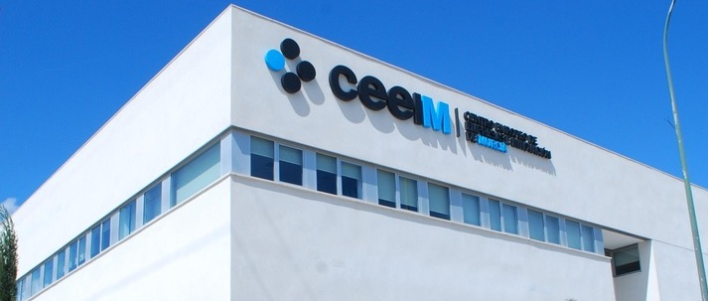

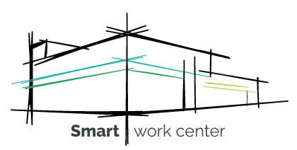
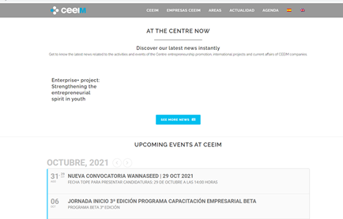
CENTRO EUROPEO DEEMPRESAS E INNOVACIÓN DE LA REGIÓN DE MURCIA (Business Innovation Centre of Murcia)
Company Name
Business Innovation Centre of Murcia
Date of Interview
08/04/2021 via Face to Face Meeting
Contact Person
Esther Peñalver Ibarra - Manager
Email
CLICK
TO VIEW
info@CEEIM.es
The Business Innovation Centre of Murcia, is working every day in the support, encouragement and promotion of entrepreneurship, especially on high technology fields, innovation and creativity. CEEIM is accustomed to create and implement new and innovative methodologies in the field of business creation, support and consolidation, specifically meeting start-up needs.
CEEIM position makes possible the interaction with stakeholders, what means positive and active influence in action plans and policies developments and is part of different national networks: Regional from the Economy Ministry, ANCES, Punto PIDI… CEEIM is promoting entrepreneurship and innovation on society by means of different kind of events, training, workshops, courses and projects.

Slide 2
ORGANISATION PROFILE
HOW MANY STAFF IS DIRECTLY EMPLOYED BY THE ORGANISATION?
IN ADDITION TO STAFF PRE COVID, HOW MANY PEOPLE ACCESS THE BUILDING ? (eg tenants, students, members of the public etc)
120
10-20 EMPLOYEES
MORE THAN PEOPLE DAILY
HOW LONG HAS THE ORGANISATION BEEN DRIVING A GREEN REVOLUTION/ INTRODUCED SDG POLICY’S OR ACTIONS?
WITHIN LAST 1 YEAR
WHAT SECTOR/S IS THE ORGANISATION ACTIVE IN?
HOW WOULD YOU DESCRIBE YOUR MAIN STAKEHOLDERS OR OCCUPANTS?
Private & non-profit foundation
Tenants /SMEs
GOOD PRACTICES
WHAT IS YOUR VISION AND STRATEGY RELATED TO SUSTAINABLE DEVELOPMENT/CLIMATE ACTIONS?
Smart Work Center (SWC) is a concept that combines work and life while leveraging ICT to increase productivity through collaboration and sustainable practices. In the SWC, its users have at their disposal not only a physical space, but also a virtual space, thanks to a wide variety of ICT services available. ICT + COLLABORATIVE WORK + SUSTAINABLE PRACTICES = SWCThe design of a SWC is generally organized in the form of open spaces and shared furniture, where users can work individually or in teams. It also includes areas for concentration and creativity, meeting rooms and relaxation areas.
SWC seeks to promote smart labour and business practices that are compatible with the 3 aspects of sustainability: economic, social and environmental. In a climate emergency context, our proposal involves including good practices that promote the 3 aspects of sustainability (Economy, Ecology and Society). Emphasizing the development of the following areas:
• Eco-efficiency: Water savings, energy efficiency, responsible supplies, use of natural resources, noise pollution.
• Circular Economy: selective collection and recycling systems.
• Responsible consumption: Saving resources, sustainable mobility, sustainable events.
• Awareness: Training, communication, promotion of sustainability and inclusion.

Slide 3
GOOD PRACTICES
WHAT ACTIONS DID YOU TAKE?
Phases of the activity:
Diagnosis on the implementation of the SWC model: Preparation of questionnaires and conclusions.
Preparation of the Implementation Plan of the SWC model
Identification of technologies and actions (to be determined)
Advice on the implementation and application of methodologies and technologies. (to be determined) During 2020 we have been able to develop phase 1 | Diagnosis and phase 2 | Preparation of implementation plans.
WHICH PARTNERS AND STAKEHOLDERS WERE INVOLVED?
None
DID YOU RECEIVE ANY KIND OF TRAINING OR SUPPORT REGARDING YOUR ACTIONS?
We have received support from Ricardo Estévez, CEO of ECOINTELIGENCIA
WHICH RESULTS DID YOU ACHIEVE ALREADY?
The diagnostic questionnaires have made it possible to outline the objectives of CEEIM with respect to the SWC model.
The conclusions of this diagnosis have served to identify the strengths and the points for improvement, being the basis for the proposed implementation plans.
This diagnosis has been presented and shared with managers and the CEEIM team.
Preparation of implementation plans.
WHAT ARE YOUR FUTURE PLANS AND NEXT STEPS?
First objective: awareness and dissemination. Actions: Develop a specific SWC section on the CEEIM website, where the project will be explained) and schedule talks on sustainability and evaluate acceptance..
Second objective: Eco efficiency. Actions: Water savings and energy efficiency through the ticketing system to obtain information on improvements and upgrades in the centre.
Third objective: Circular Economy. Actions: Selective waste collection, responsible consumption and sustainable events
Fourth objective: Increase productivity. Actions: Development of a Digitalization Plan, a Teleworking Plan and an updated catalogue, with web services to facilitate transparency.

Slide 4
RECOMMENDATIONS
WHAT KIND OF HELP AND TOOLS DO YOU NEED TO REALISE YOUR FUTURE GOALS?
WHAT ARE YOUR MOST IMPORTANT TIPS & ADVICE TO GIVE TO OTHER ORGANISATIONS TO IMPLEMENT SDG WITHIN THEIR BUSINESS?
Economic Financing.
2. Include the project in the programs to be executed through The Next Generation recovery funds
3. Training/Advice on the application of the new instruments.
You must get the involvement of the entire team, for this it is very important to start with the communication and dissemination actions of the project.
2. Have the collaboration of an expert in the field external to the organization.
3. Communication / Training in the benefits that the actions entail and what their implementation reports for the improvement of the company's brand.
4. Increase in synergies between the companies housed in the centre.
WHAT SUSTAINABLE GOALS WOULD YOU LIKE TO IMPLEMENT IN THE FUTURE?
01
Next 1 to 3 years.
Sustainable Infrastructure/Buildings – SDG11 Sustainable cities and Communities and SDG13 Climate action:
Energy and Resource Efficiency – SDG 7 Affordable and clean energy and SDG12 Responsible consumption and production:
Next 1 to 3 years.
02
Sustainable Eco-systems and Collective Action – SDG4 Quality Education, SDG12 Responsible consumption and production and SDG17 Partnership for the Goals:
Next 1 to 3 years.
03
Digital Technology for Sustainable Enterprise Centres – SDG8 Decent work and Economic Growth and SDG13 Climate action:
Next 1 to 3 years.
04
05
Next 1 to 3 years.
Sustainable Futures for Enterprise Centres – SDG 9 -Industrial innovation & infrastructure and SDG17 Partnership for the Goals:

