Slide 1
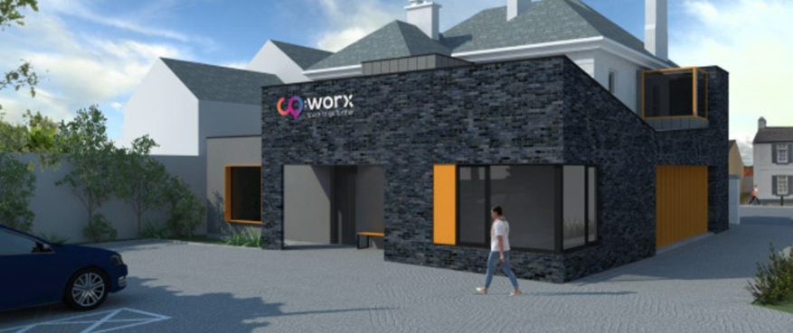

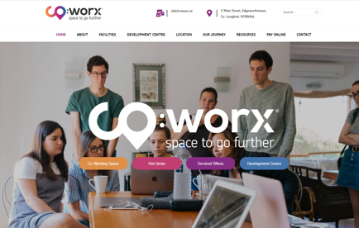
CO:WORX
Company Name
Co:worx
Date of Interview
29/07/2021 via video call
Contact Person
Clare McEnroe, EEH clg Director // Ronan Fitzpatrick, Architect, Craftstudio Architecture
Email
CLICK
TO VIEW
hello@coworx.ie
CO:WORX is a landmark building in Edgeworthstown, Co. Longford. Edgeworthstown has a population of 2,072 (census, 2016), with a regional commuting population of approximately 24,000.
CO:WORX will open in Q4, 2021. The building is a protected heritage structure and ceased operating as a bank in 2017. It was then acquired by a local voluntary group, Edgeworthstown Enterprise Hub CLG with a view to creating a Digital Hub in Edgeworthstown. The new facility will provide vibrant collaborative and co-working spaces, acting as a launch pad for innovative start-up businesses, new entrepreneurs and remote workers in the local community.
CO:WORX is being developed for the local and remote community and will be a financially self-sustaining enterprise for the benefit of all, allowing people the opportunity to work, live and to participate in the local community. The project is supported by Longford County Council, Enterprise Ireland and LEADER.

Slide 2
ORGANISATION PROFILE
HOW MANY STAFF IS DIRECTLY EMPLOYED BY THE ORGANISATION?
IN ADDITION TO STAFF PRE COVID, HOW MANY PEOPLE ACCESS THE BUILDING ? (eg tenants, students, members of the public etc)
50
3 EMPLOYEES
MORE THAN PEOPLE DAILY
HOW LONG HAS THE ORGANISATION BEEN DRIVING A GREEN REVOLUTION/ INTRODUCED SDG POLICY’S OR ACTIONS?
WITHIN LAST 1 YEAR
WHAT SECTOR/S IS THE ORGANISATION ACTIVE IN?
HOW WOULD YOU DESCRIBE YOUR MAIN STAKEHOLDERS OR OCCUPANTS?
Local Enterprise/ Training/ Community Development/ Educational establishment (Athlone Institute of Technology
Learning Gate)
SMEs/ Start-ups/ Community
Stakeholders on the project range across: Longford County Council/LEADER Longford/ Enterprise Ireland/ Regional Skills Forum
GOOD PRACTICES
WHAT IS YOUR VISION AND STRATEGY RELATED TO SUSTAINABLE DEVELOPMENT/CLIMATE ACTIONS?
CO:WORX ambition statement is “By 2024, our co-working hub will be positioned as a transformative, sustainable initiative enabling the growth of the region’s economy in Edgeworthstown and beyond”. Co:Worx, a community organisation and digital working hub has been created to be a transformative, sustainable initiative enabling the growth of Longford’s regional economy. The aim of CO:WORX is to stimulate economic growth in the locality, providing the latest technological advances allowing people to return to work in their community, increase spend in the local economy and strike a better work/life balance. Digitisation is a powerful force for change for a rural community. Co:worx will lead this change through:
Promoting the uptake of digital services for local businesses.
Providing tailored digital literacy and digital skills.
Promotion and awareness of remote working opportunities to our diverse community.
The facility will provide multi-functional space providing high speed broadband, hot-desk facilities, dedicated desks, office suites, business training, mentoring and facilities for people to develop ideas and business.

Slide 3
GOOD PRACTICES
WHAT ACTIONS DID YOU TAKE?
The co:worx CPD (Development) centre will function primarily as a training, education and development centre. The provision of an Athlone Institute of Technology (AIT) Learning Gate in CO:WORX together with tailored courses provided by Longford Westmeath Education and Training Board (LWETB), Skillsnet and other training providers will provide reskilling and upskilling opportunities and allow co:worx to become a gateway to education & employment and wellbeing (SDG4|SDG8|SDG11)
The CPD Centre will accommodate 25 people for training purposes. This will be a 120m2 centre with high speed internet and catering facilities (SDG4)
Refurbishment works are ongoing to the existing building and have already included the upgrade to the thermal fabric of the building through the use of breathable wood fibre based board, adding insulation. The floors have also been re-laid to improve the insulation value while the roof has also been insulated and repaired. An air to water heat pump has been installed. A building energy management system has been installed to support ongoing monitoring of energy usage. There is an electric car charge point situated at the front of the centre. The use of this otherwise derelict building supports the regeneration of the town (which has a commercial vacancy rate of 26.9% - the third highest in Ireland) supporting the heritage of the town and survival of its unique character while also re-energising the built environment. CO:WORX will, in tandem with its co-working and educational functions, be a demonstration site to tenants and the community on the use of sustainable materials and alternative energy and heating technology (SDG11|SDG7)
Covid 19 has accelerated the digitalisation in the workplace by 5-8 years, however in local communities, it has advanced the digital divide further. When operational, CO:WORX will provide commuters and start-ups/entrepreneurs/ remote workers with the opportunity to relocate to a workspace close to where they live and allow them to live, work and participate locally. CO:WORX and its extensive network will provide an opportunity for networking and the creation of new opportunities for businesses to develop in their local community, playing an important role in the economic recovery from Covid-19 and supporting the community to become more sustainable (SDG11|SDG8|SDG17)
Regionally, CO:WORX is an active member of Midlands Network of Co-Working Facilities, which comprises over 20 facilities in the Midlands region, with the aim of providing 600 desk spaces giving an opportunity to the 24,000 workers currently commuting out of the region to work locally and create an opportunity for second landing spaces to be developed for large companies in the region. Nationally, co:worx is also an active member of National Association of Community Enterprise Centres and Connected hubs and Grow Remote. CO:WORX director has also set up the Grow Remote Longford Chapter, bringing remote working to regional communities and schools (SDG17)
WHICH PARTNERS AND STAKEHOLDERS WERE INVOLVED?
Longford County Council Regeneration Team / LEADER Longford / Longford County Council/ Enterprise Ireland/ Longford Local Enterprise Centre/Midlands Network of Co-Working Facilities/ Grow Remote Longford Chapter/ Athlone Institute of Technology/ Regional Skills Forum/ Skillsnet/ Guinness Enterprise Centre/ Upper Shannon Erne Future Economy Project (USEFE) / National Association of Community Enterprise Centres (NACEC) / Irish Manufacturing Research (IMR)

Slide 4
GOOD PRACTICES
DID YOU RECEIVE ANY KIND OF TRAINING OR SUPPORT REGARDING YOUR ACTIONS?
No formal training. Support, advice and guidance has been gained along the way from other hubs in the network, which has been very valuable.
WHICH RESULTS DID YOU ACHIEVE ALREADY?
CO:WORX digital hub wins €9,000 in Medium Town (2,500 – 5,000 population) category at the .IE Digital Town Awards 2021. CO:WORX is a member of the Digital First Communities pilot – Digital Ireland Network. The second part of this pilot will be the link to the Heritage Council and the inclusion of Edgeworthstown in the Collaborative Town Centre Health Check Programme to support the revitalisation of commercial activity in the town.
WHAT ARE YOUR FUTURE PLANS AND NEXT STEPS?
CO:WORX will open in Q4 2021.
The Centre will have 1gb connectivity.
The facility has been constructed and designed to be a flexible space and can be reformed to suit future needs.
The Centre will act as a vector for development, economic and community activity in the region.

Slide 5
RECOMMENDATIONS
WHAT KIND OF HELP AND TOOLS DO YOU NEED TO REALISE YOUR FUTURE GOALS?
WHAT ARE YOUR MOST IMPORTANT TIPS & ADVICE TO GIVE TO OTHER ORGANISATIONS TO IMPLEMENT SDG WITHIN THEIR BUSINESS?
Distillation of the vast quantity of information available to be tailored for the needs and scope of the enterprise centres. Translation of the SDG’s to everyday life
Ongoing support (peer groups) for hub managers would be useful, for example, support and guidance on where to access relevant information and updates
Training on sustainability, on the ‘How To’ for sustainability and energy efficiency would be very useful.
Ongoing support for collaboration is key, supporting the opportunities to learn from each other (hubs)
Create a win - win. Create a location that attracts people in, that is comfortable as well as a highly functional space.
The ability to apply the training and knowledge to embed sustainable practices in our everyday decision-making processes which will support the enterprise centres, their clients and local communities and create a ripple effect.
Seek out the opportunities to re-energise existing infrastructure in your town centre
The ability to communicate and translate the SDG’s as they apply to their organisations work practices, to create a an achievable and practical plan
WHAT SUSTAINABLE GOALS WOULD YOU LIKE TO IMPLEMENT IN THE FUTURE?
01
CO:WORX will open in Q4 2021
Sustainable Infrastructure/Buildings – SDG11 Sustainable cities and Communities and SDG13 Climate action:
Energy and Resource Efficiency – SDG 7 Affordable and clean energy and SDG12 Responsible consumption and production:
The Centre will open in Q4 2021 with an Energy Management System installed.
02
Sustainable Eco-systems and Collective Action – SDG4 Quality Education, SDG12 Responsible consumption and production and SDG17 Partnership for the Goals:
This is ongoing and the centre will open with a Training Centre.
03
Digital Technology for Sustainable Enterprise Centres – SDG8 Decent work and Economic Growth and SDG13 Climate action:
The Centre will open with 1Gb connectivity
04
05
The Centre will open as a state of the art facility with flexible and adaptable design to support changing functionality and spacing orientations demands.
Sustainable Futures for Enterprise Centres – SDG 9 -Industrial innovation & infrastructure and SDG17 Partnership for the Goals:

