Slide 1
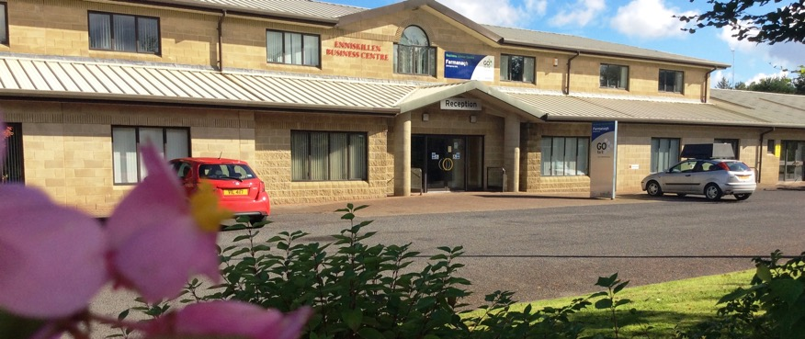
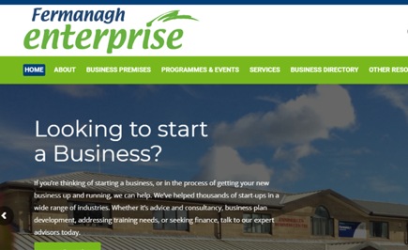
FERMANAGH ENTERPRISE
Company Name
Fermanagh Enterprise
Date of Interview
July 2021 via Telephone
Contact Person
Rodney Malone
Email
CLICK
TO VIEW
info@fermanaghenterprise.com
Fermanagh Enterprise Limited was set up in 1985 as one of the first Local Enterprise Agencies in Northern Ireland. The Organisation represents the vision of a dedicated group of local professional and business people who sought realistic solutions to the problems of unemployment, through promoting the establishment and development of small businesses. The Organisation is based in the Enniskillen Business Centre, 21 Lackaghboy Road, Enniskillen and also works in close co-operation with a network of other Enterprise Centres and a range of Partnership Bodies at a Local, Regional and Cross Border level. The Agency is a member of Enterprise Northern Ireland, an association of Enterprise Agencies which exists to make Northern Ireland more enterprising and innovative

Slide 2
ORGANISATION PROFILE
HOW MANY STAFF IS DIRECTLY EMPLOYED BY THE ORGANISATION?
IN ADDITION TO STAFF PRE COVID, HOW MANY PEOPLE ACCESS THE BUILDING ? (eg tenants, students, members of the public etc)
200
10 EMPLOYEES
MORE THAN PEOPLE WEEKLY
HOW LONG HAS THE ORGANISATION BEEN DRIVING A GREEN REVOLUTION/ INTRODUCED SDG POLICY’S OR ACTIONS?
WITHIN LAST 10 YEARS
WHAT SECTOR/S IS THE ORGANISATION ACTIVE IN?
HOW WOULD YOU DESCRIBE YOUR MAIN STAKEHOLDERS OR OCCUPANTS?
Local Enterprise
Tenants & SME’s
GOOD PRACTICES
WHAT IS YOUR VISION AND STRATEGY RELATED TO SUSTAINABLE DEVELOPMENT/CLIMATE ACTIONS?
Fermanagh Enterprise aims to strengthen the economy of Fermanagh through encouraging, assisting and advising individuals wishing to move to self-employment and set up and grow their own business, to relieve poverty through stimulating economic prosperity.
For Sustainable development/Climate actions, the business has started looking at their 4 business premises on how they can be improved in line with SDGs, adding solar panels and recycling bins in all premises. Recently all staff have had the option to work from home.

Slide 3
GOOD PRACTICES
WHAT ACTIONS DID YOU TAKE?
Kept the staff involved in all discussions with improvements to building. To support working from home have software in place to host virtual meetings and purchased laptops so staff can remotely work.
We are constantly planning ahead and managing our buildings and looking to make improvements for the future.
WHICH PARTNERS AND STAKEHOLDERS WERE INVOLVED?
Staff & Tenants.
DID YOU RECEIVE ANY KIND OF TRAINING OR SUPPORT REGARDING YOUR ACTIONS?
N/A
WHICH RESULTS DID YOU ACHIEVE ALREADY?
No Commute Means Fewer Emissions
Less Paper Usage
Less Plastic Usage
More productive staff
Achieve better work-life balance
WHAT ARE YOUR FUTURE PLANS AND NEXT STEPS?
Become more aware of Digital Technology for Sustainable Enterprise Centres
Minimising waste and maximising reuse
Look at other Enterprise Centres to see what systems they have in place
Minimising energy use in all buildings

Slide 4
RECOMMENDATIONS
WHAT KIND OF HELP AND TOOLS DO YOU NEED TO REALISE YOUR FUTURE GOALS?
WHAT ARE YOUR MOST IMPORTANT TIPS & ADVICE TO GIVE TO OTHER ORGANISATIONS TO IMPLEMENT SDG WITHIN THEIR BUSINESS?
A place where we can see current trends in Northern Ireland and other regions
Guidance on older building how to make them greener without investing a large amount of money
Training and resources.
Take time to make decisions and research
Connect communities and people
Consider all stages of a building's life-cycle
Look for funding options
WHAT SUSTAINABLE GOALS WOULD YOU LIKE TO IMPLEMENT IN THE FUTURE?
01
Sustainable Infrastructure/Buildings – SDG11 Sustainable cities and Communities and SDG13 Climate action:
1 to 3 years
Energy and Resource Efficiency – SDG 7 Affordable and clean energy and SDG12 Responsible consumption and production:
02
1 to 3 years
Sustainable Eco-systems and Collective Action – SDG4 Quality Education, SDG12 Responsible consumption and production and SDG17 Partnership for the Goals:
03
1 to 3 years
Digital Technology for Sustainable Enterprise Centres – SDG8 Decent work and Economic Growth and SDG13 Climate action:
6 -12 months
04
05
Ongoing
Sustainable Futures for Enterprise Centres – SDG 9 -Industrial innovation & infrastructure and SDG17 Partnership for the Goals:

