Slide 1
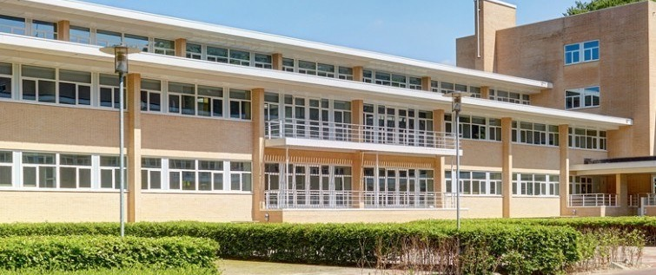
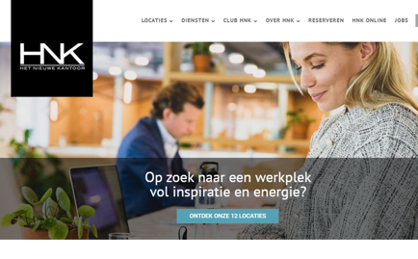
HNK
Company Name
HNK, Ede, The Netherlands
Date of Interview
23.07.21 via Telephone
Contact Person
Annemarie de Leeuw – Head of Asset Management
Email
info@hnk.nl
The name of the building “HNK”, stands for “Het Nieuwe Kantoor” (=The New Office). In The Netherlands, there are 12 NHK office centres. Main objective is to offer an inspiring and professional working place. Owner of the HNK-office centres is NSI (= Nieuwe Steen Investments)
Sustainability is an integral part of NSI’s value creation strategy. Their business model is geared towards offering and developing future-proof buildings, minimizing their carbon footprint, and creating inspiring, flexible working environments articulated around the health and well-being of their occupants.
NSI recognizes that our industry significantly contributes to the global carbon footprint, and they are committed to reducing their impact on the environment. By making their spaces more efficient, developing in a sustainable way, and always looking for new and better ways of doing things they deliver on their ESG targets while offering the very best experiences for their customers.
NSI participates in the worldwide sustainability benchmark for office owners GRESB and has reached 5 stars. It aims to create healthy, inspiring and flexible working environments for its tenants and promotes a healthy way of working for its employees. Moreover, NSI aims to have a positive impact on the community. It considers an active lifestyle important to the health and well-being of its employees, and it therefore promotes physical activity, healthy nutrition and a healthy work-life balance.

Slide 2
ORGANISATION PROFILE
HOW MANY STAFF IS DIRECTLY EMPLOYED BY THE ORGANISATION?
IN ADDITION TO STAFF PRE COVID, HOW MANY PEOPLE ACCESS THE BUILDING ? (eg tenants, students, members of the public etc)
100
5 EMPLOYEES
MORE THAN PEOPLE DAILY
HOW LONG HAS THE ORGANISATION BEEN DRIVING A GREEN REVOLUTION/ INTRODUCED SDG POLICY’S OR ACTIONS?
WITHIN LAST 15 YEARS
WHAT SECTOR/S IS THE ORGANISATION ACTIVE IN?
HOW WOULD YOU DESCRIBE YOUR MAIN STAKEHOLDERS OR OCCUPANTS?
Agrofood sector.
Small and medium sized enterprises, active in the Dutch Food Valley Region
GOOD PRACTICES
WHAT IS YOUR VISION AND STRATEGY RELATED TO SUSTAINABLE DEVELOPMENT/CLIMATE ACTIONS?
Vision
Future-proof buildings should be designed for future-proof exploitation and therefore should be flexible in usage or suitable for potential transformation. The focus should be on circularity (choice of materials), both in the construction and exploitation phase. Furthermore, Future-proof buildings have a positive impact on their community and have a minimal impact on the environment.
Strategy
Our ESG strategy is built around three focus areas addressing the most relevant environmental and social trends to create value for our stakeholders: Future-proof buildings, Energy & Carbon and Health & Wellbeing. Improving our ESG performance has been an integral part of our long-term value creation strategy.

Slide 3
GOOD PRACTICES
WHAT ACTIONS DID YOU TAKE?
Energy & Carbon is one of the three main themes in the NSI ESG programme. Our ambition is to achieve carbon neutrality of our real estate portfolio by 2035. Key measures that will be taken to reach this goal is improving energy efficiency and transitioning to renewable energy sources throughout the entire lifecycle of our assets. One of the key steps that NSI has taken in2020 towards realising this goal by 2035 is finalizing its Paris Proof roadmap. This roadmap provides a step by-step guideline over time that allows for pragmatic climate action in energy efficiency and carbon neutrality, including measurable targets towards energy reduction and climate neutrality. For example, NSI aims to stop using natural gas in its existing portfolio by 2032. In 2021, NSI will identify which investments are required on asset level according to the Paris Proof Roadmap, including investigating which assets are suitable for thermal storage units. The roadmap is key for this strategic theme on which the relevant targets are based and will be used as a framework to collaborate with our tenants and supply chain to achieve energy reductions.
The importance of Health & Well-being came in particular more in focus in 2020, due to the effects of the Covid-19 pandemic. In its responsibility as employer and as a landlord, NSI took multiple actions to safeguard the health, safety and well-being of its staff and tenants as much as possible.
WHICH PARTNERS AND STAKEHOLDERS WERE INVOLVED?
Main owner is NSI. This company was founded in 1992. The HNK in Ede was originally built with support from the Dutch Ministry of Agriculture, Food and Fishery.
DID YOU RECEIVE ANY KIND OF TRAINING OR SUPPORT REGARDING YOUR ACTIONS?
Not Applicable.
WHICH RESULTS DID YOU ACHIEVE ALREADY?
In September 2019 NSI was awarded the EPRA sBPR silver award and sBPR most improved award You can view our EPRA sustainability performance measures here EPRA Sustainability Performance Measures
NSI N.V. has achieved a five-star rating in the annual GRESB Real Estate Assessment. This is the highest GRESB rating possible and recognition for being an industry leader.
The result of 88 points (out of 100) is NSI’s best score so far and a significant improvement on last year’s score of 71 points and an initial score of 49 points in 2018.

Slide 4
GOOD PRACTICES
WHAT ARE YOUR FUTURE PLANS AND NEXT STEPS?
We proceed our work and are preparing a new location at an old military complex nearby.
WHAT ARE YOUR FUTURE PLANS AND NEXT STEPS?
The following link brings the reader to our sustainability report:
https://nsi.nl/wp-content/uploads/2021/07/NSI-Sustainability-Report-2020.pdf
Our ambition runs much higher and we have plans in place to make a further push. We are committed to deliver on our duty to contribute to a more sustainable world.
Our ambition level Our ESG strategy is built around three focus areas addressing the most relevant environmental and social trends to create value for our stakeholders: Future-proof buildings, Energy & Carbon and Health & Wellbeing. Improving our ESG performance has been an integral part of our long-term value creation strategy. Over the past years, the implementation of the NSI ESG program had a pragmatic approach to each sustainability theme. NSI appreciates the importance of continuous improvement of the ambition level against market developments and trends. In 2020, the progress towards reaching our strategic ESG targets in the long-term was re-assessed, which resulted in a recalibration of our targets and implementation plans for each ESG theme. In theme sessions, we improved the process, ambition level and targets to better reflect the actions that are needed to achieve our long-term sustainability and future-proof ambition.

Slide 5
RECOMMENDATIONS
WHAT KIND OF HELP AND TOOLS DO YOU NEED TO REALISE YOUR FUTURE GOALS?
WHAT ARE YOUR MOST IMPORTANT TIPS & ADVICE TO GIVE TO OTHER ORGANISATIONS TO IMPLEMENT SDG WITHIN THEIR BUSINESS?
Car sharing
Ventilation improvements
People counters
Solar panels on our roofs
These are four goals we work on, now and in the future!
Many sustainability aspects have to be realised during the construction. So pay attention to this during the design phase.
Look for general or more specific certifications. Being certified, increases the attractiveness of the centre and it helps to make a checklist for all kind of aspects. For example, see www.BREEAM.nl.
Calculate costs and benefits from your SDG investments. Make calculations for the long term..
We present ourselves as a company with attention to SDGs. This is part of our marketing. Pay attention to effective marketing of your centre/
WHAT SUSTAINABLE GOALS WOULD YOU LIKE TO IMPLEMENT IN THE FUTURE?
01
Construction of a new building in Amsterdam, made with wood: 1-3 years
Our ambition is to achieve carbon neutrality of our real estate portfolio by 2035
Sustainable Infrastructure/Buildings – SDG11 Sustainable cities and Communities and SDG13 Climate action:
Energy and Resource Efficiency – SDG 7 Affordable and clean energy and SDG12 Responsible consumption and production:
Ongoing improvement of savings on energy, by monitoring light and temperature:1-3 years
Installation of over 3000 solar panels: 6-12 months
02
Sustainable Eco-systems and Collective Action – SDG4 Quality Education, SDG12 Responsible consumption and production and SDG17 Partnership for the Goals:
Insight in people management (Crowd management): 1-3 years NSI therefore promotes physical activity, healthy nutrition and a healthy work-life balance: 1-3 years
03
Digital Technology for Sustainable Enterprise Centres – SDG8 Decent work and Economic Growth and SDG13 Climate action:
Update of existing facilities toward better internet (Glass fibre will be installed in Wageningen in the coming year: 1-3 years
04
05
Stimulate sharing electric cars and e-bikes and increasing car charging stations: 1-3 years
Some reconstruction of the building to make it more flexible and attractive for smaller tenants: 1-3 years
Sustainable Futures for Enterprise Centres – SDG 9 -Industrial innovation & infrastructure and SDG17 Partnership for the Goals:

