Slide 1
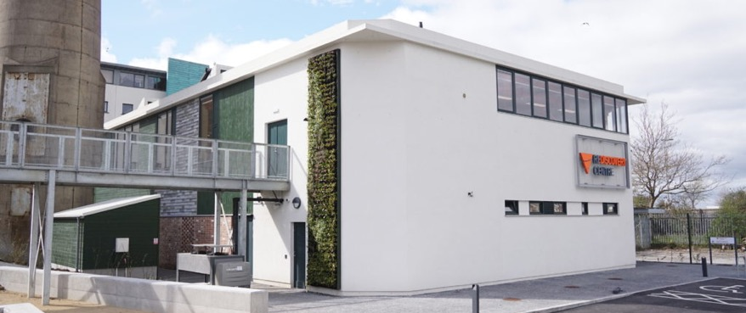

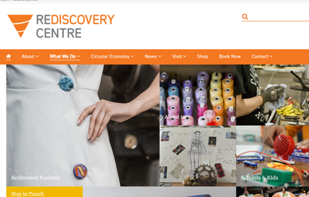
THE REDISCOVERY CENTRE
Company Name
THE REDISCOVERY CENTRE, Co. Dublin
Date of Interview
21/07/2021 via video call
Contact Person
Sarah Clear, Head of Education
Email
CLICK
TO VIEW
education@rediscoverycentre.ie
The Rediscovery Centre is the National Centre for the Circular Economy in Ireland. A creative movement connecting people, ideas and resources to support greener low-carbon living, and is located in Ballymun, an outer suburb of Dublin, at the northern edge of the Northside (population of 21,626, census 2016).
As the National Centre for the Circular Economy, it brings together the skills and expertise of artists, scientists, designers and crafts people united in a common purpose of sustainability.
Located in a bespoke demonstration eco-facility, The Rediscovery Centre supports four reuse social enterprises; Rediscover Furniture, Rediscover Fashion, Rediscover Paint and Rediscover Cycling. These businesses use unwanted materials for new product development and design demonstrating effective resource efficiency, reuse and low carbon living. The Rediscovery Centre is located in the repurposed Boiler House in Ballymun.
The building has undergone a major green revamp and it is now a state of the art facility with a focus on sustainability and reuse. It is perfect for meetings that require a unique setting and that have a focus on sustainability and the protection of the environment. The facilities at the centre are suitable for conferences, workshops, meetings, team building events and exhibitions.

Slide 2
ORGANISATION PROFILE
HOW MANY STAFF IS DIRECTLY EMPLOYED BY THE ORGANISATION?
IN ADDITION TO STAFF PRE COVID, HOW MANY PEOPLE ACCESS THE BUILDING ? (eg tenants, students, members of the public etc)
150
22 EMPLOYEES
MORE THAN PEOPLE DAILY
HOW LONG HAS THE ORGANISATION BEEN DRIVING A GREEN REVOLUTION/ INTRODUCED SDG POLICY’S OR ACTIONS?
WITHIN LAST 15 YEARS
WHAT SECTOR/S IS THE ORGANISATION ACTIVE IN?
HOW WOULD YOU DESCRIBE YOUR MAIN STAKEHOLDERS OR OCCUPANTS?
Social Enterprise/ Education/ Community / Circular Economy/ Environmental
Students/ Local and wider community groups/ Social Enterprises and Micro-Enterprises/ Large Corporates/ SMEs/ Funders
GOOD PRACTICES
WHAT IS YOUR VISION AND STRATEGY RELATED TO SUSTAINABLE DEVELOPMENT/CLIMATE ACTIONS?
The Rediscovery Centre is the National Centre for the Circular Economy in Ireland. A creative movement connecting people, ideas and resources to support greener low-carbon living. The Centre is based in the repurposed Boiler House in Ballymun which was developed as a prototype ‘3D textbook’ a new concept in experiential learning and the first of its kind in Europe. The centre demonstrates best practice building design, construction and operation and defines the building and environs as an educational tool to effect positive behavioural change with respect to resource management and efficiency.
The Centre has been driving the green revolution since ideation in 2006. Since the concept's inception, and becoming a registered company in 2009, The Rediscovery Centre has been a leading voice and example of environmental practices, education and training in Ireland. The Rediscovery has been driving innovative thinking and circular design since the project initiation in 2006.

Slide 3
GOOD PRACTICES
WHAT ACTIONS DID YOU TAKE?
Completed in 1966, the boiler house in Ballymun was the largest civic heating scheme in Ireland and the United Kingdom, which supplied heat and water to 3,000 flats in the town. When the regeneration of Ballymun necessitated the demolition of the flat complex, the Boiler House was also scheduled for demolition. This changed however in 2014 when the Rediscovery Centre, Dublin City Council and the European Commission (under its Life+ funding programme) joined forces to save and repurpose the iconic building. The aim was to repurpose the building as a prototype ‘3D textbook’ a novel concept in experiential learning which capitalizes upon the educational value within the built, natural and cultural environment. The building completed in early December 2016. The re-imagined building resulted in an exemplar eco-centre which won the National ‘Green Construction Award’ in 2017 and SEAI’s Green Building award in 2018. It is now the Rediscovery Centre’s headquarters and an international eco-destination. (SDG11|SDG4|SDG17|SDG13|SDG12|SDG9|SDG7)
The reuse of the old Ballymun Boiler House showcases the environmental and economic benefits that come from seeing waste as an opportunity. The building is a novel interactive experience and learning environment designed to stimulate curiosity in the natural, physical and cultural environment. (SDG11|SDG4). Throughout the project, opportunities for reuse were given preference. The original concrete and steel flooring was maintained, and a staircase and upstairs floor built using Irish fir and plywood respectively. The outside of the building was finished using recycled brick, and cladded with old louvres from the original boiler house.. (SDG12|SDG11)
Thermal and PV solar panels were fitted to the roof with the aim of ensuring 80% energy self-sufficiency. The building fabric for the east and south facing walls were constructed using hempcrete (a mixture of hemp and lime) which creates a breathable membrane that also efficiently retains heat. The west elevation was developed using timber frame and insulated with salvaged sheep’s wool (SDG13|SDG7|SDG9).
Whenever possible materials were specifically selected based upon their ability to demonstrate best practice reuse, recycling or recovery (SDG12). The building has a number of sustainable features that include but are not limited to:
Optimising orientation for solar gain
Heating and electricity from alternative, renewable and sustainable sources
Rain water harvesting and grey water recycling
Composting toilets & Onsite reed bed system
The incorporation of green roofs and a green living wall
Materials selection having regard to their reuse, recycled, natural sustainable properties
Urinal waste water collection and use for plant nutrition within the internal comfrey wall(SDG13|SDG11|SDG14|SDG15|SDG12|SDG9|SDG7)
The Rediscovery Centre engages with schools and communities on an ongoing basis and as part of their core activity. As an example of this work, the Centre recently initiated a STEM and Sustainability project. The project includes the delivery of free education workshops and programmes for DEIS (Delivering Equality of Opportunity in Schools) schools. (SDG4). The Centre also offers specialised workshops for national STEM and environmental awareness weeks and events (SDG4). The Rediscovery Centre is also home to a unique Eco Store that sells sustainably made products from over 20 independent Irish suppliers and from our own reuse social enterprises (SDG8)
(Social Enterprise) Rediscover Fashion - The Rediscovery Centre has created a space where the circular fashion model can be brought to life through training, lectures and by developing innovative products that highlight circular design principles. These products are then sold in our Eco Store. Rediscover Furniture creates training opportunities for the long term unemployed and all revenue generated from its activities are reinvested back into the enterprise. As the National Centre for the Circular Economy, the Rediscovery Centre runs a ‘Circular Economy Conversations’ series.. (SDG4| SDG11)

Slide 4
GOOD PRACTICES
WHICH PARTNERS AND STAKEHOLDERS WERE INVOLVED?
The concept was successfully brought to fruition through The Rediscovery Centre, Dublin City Council and the European Commission (under its Life+ funding programme), Waste Regions (Midlands, Southern and Eastern). The Circular Economy Academy is delivered in partnership with the Environmental Protection Agency’s National Waste Prevention Programme. The National Waste Prevention Programme is a Government of Ireland initiative, funded by the Department of Communications, Climate Action and the Environment. The STEM and Sustainability project is funded by Science Foundation Ireland under the SFI Discover Programme. The Rediscovery Centre has recently initiated a partnership with Dulux paints allowing the Centre to expand the recycling and reuse of paint social enterprise.
DID YOU RECEIVE ANY KIND OF TRAINING OR SUPPORT REGARDING YOUR ACTIONS?
Ongoing training, for staff (circular economy, social inclusion, compost (tackling food waste), expert sessions and training/ info provision. Upskilling and learning is ongoing.
WHICH RESULTS DID YOU ACHIEVE ALREADY?
The renovation of the old Ballymun boiler house showcases the environmental and economic benefits that come from seeing waste as an opportunity. The WISER LIFE project has transformed the Boiler House into a 3D textbook: an experiential learning environment designed to stimulate curiosity in the natural, physical and cultural environment and promote sustainable living within a circular economy. The building provides a new centre for the community, and is an exemplar in sustainable development and a source of social enterprise and employment.
Since March 2017, more than 7,000 people have visited the site as part of eco skills training courses or building tours. In the same time period, the Rediscovery Centre’s education programme has delivered courses to more than 8,000 students (from all levels) both on and off-site. The Centre and project has been nominated for LIFE 2020 awards, and featured on the EU Commission website.
Building is A2 rating which is incredibly rare and hard to achieve for a retrofit of an old industrial building. The Centre hosted Ireland's first Circular fashion conference in April
WHAT ARE YOUR FUTURE PLANS AND NEXT STEPS?
The Centre will continue to expand its national Circular Economy Academy programme. Supported by Dulux, the reuse and recycling of paint social enterprise will expand nationally.
The Centre also wants to expand the programme of community engagement with the principles of the circular economy. This activity is set to grow through events, competitions, seminars etc.
The activities are evolving all the time, and have grown over the years with partnerships a key enabler of this growth.
The Centre is always looking for opportunities to enhance the public realm and community space in the locality. The Centre is exploring opportunities to expand activities and scope of the Centre.

Slide 5
RECOMMENDATIONS
WHAT KIND OF HELP AND TOOLS DO YOU NEED TO REALISE YOUR FUTURE GOALS?
WHAT ARE YOUR MOST IMPORTANT TIPS & ADVICE TO GIVE TO OTHER ORGANISATIONS TO IMPLEMENT SDG WITHIN THEIR BUSINESS?
Mentorship support is key - a mentorship programme to upskill staff could be very influential and a big help in supporting businesses to transition.
Funding can be very disjointed - this should be improved.
A networking database of organisations which shares information on ‘who’s working on what’ instead of duplication, which can happen. This would be really helpful.
A yearly sustainability conference which supports networking, sharing and learning
A ‘How To Guide’ for Enterprise Centres could be incredibly helpful. A Lot of times the ‘How’ is the stumbling block.
Start small and with manageable activities and action. Small actions can make a big difference too.
Partner with other organisations and avail of mentorship opportunities.
Get expert advice to support you in your efforts.
Start with what you're passionate about, it’ll make the next action easier.
Lead by example, where possible be a demonstrator of what can be achieved.
WHAT SUSTAINABLE GOALS WOULD YOU LIKE TO IMPLEMENT IN THE FUTURE?
01
Sustainable Infrastructure/Buildings – SDG11 Sustainable cities and Communities and SDG13 Climate action:
This is ongoing. There is a funding application awaiting a response to support additional activities.
Energy and Resource Efficiency – SDG 7 Affordable and clean energy and SDG12 Responsible consumption and production:
02
This is ongoing. There is a funding application awaiting a response to support additional activities.
Sustainable Eco-systems and Collective Action – SDG4 Quality Education, SDG12 Responsible consumption and production and SDG17 Partnership for the Goals:
03
This is ongoing.. The school programme will expand from September 2021. The business CE Academy programme expansion is ongoing as is the expansion of the paint recycling project.
Digital Technology for Sustainable Enterprise Centres – SDG8 Decent work and Economic Growth and SDG13 Climate action:
Ongoing
04
05
Ongoing
Sustainable Futures for Enterprise Centres – SDG 9 -Industrial innovation & infrastructure and SDG17 Partnership for the Goals:

