Slide 1
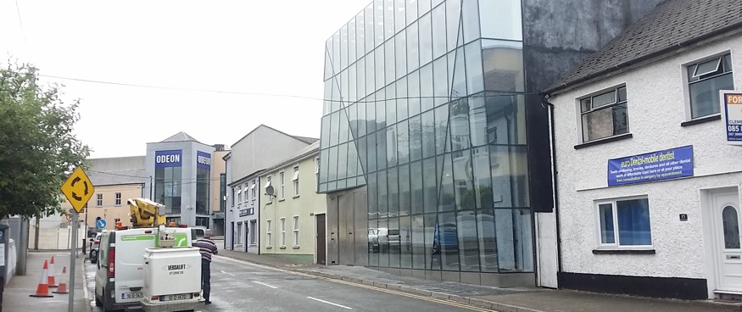

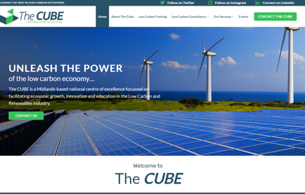
THE CUBE CENTRE
Company Name
The Cube Centre, Co Laois
Date of Interview
16/07/2021 via Video call
Contact Person
Niall Kelly, Director
Email
CLICK
TO VIEW
https://cubecentre.ie/
The CUBE is a Midlands-based national centre of excellence focussed on facilitating economic growth, innovation and education in the Low Carbon and Renewables industry.
The Cube is situated in Portlaoise, a county town of County Laois, and is in the south midlands in the province of Leinster (population of 22,050 (census, 2016).
The Cube is a multipoint national centre of excellence that will merge the national low carbon agenda with the economic potential present in the low carbon economy. The Cube offers support and services in the following: to Design and Scale, Finance and Funding, Education and Training, and High Potential start-up and Research Incubation.
The Cube is Strategically positioned in the Midlands as this region is uniquely positioned to deliver a cluster of Low Carbon-based activity that will stimulate growth, innovation and investment into the region and Ireland into the future. The CUBE is funded by Enterprise Ireland under the Regional Enterprise Development Fund (REDF).

Slide 2
ORGANISATION PROFILE
HOW MANY STAFF IS DIRECTLY EMPLOYED BY THE ORGANISATION?
IN ADDITION TO STAFF PRE COVID, HOW MANY PEOPLE ACCESS THE BUILDING ? (eg tenants, students, members of the public etc)
1 EMPLOYEE
OPENING DECEMBER 2021
HOW LONG HAS THE ORGANISATION BEEN DRIVING A GREEN REVOLUTION/ INTRODUCED SDG POLICY’S OR ACTIONS?
WITHIN LAST 1 YEAR
WHAT SECTOR/S IS THE ORGANISATION ACTIVE IN?
HOW WOULD YOU DESCRIBE YOUR MAIN STAKEHOLDERS OR OCCUPANTS?
Public Body/ Local Enterprise
High potential start-ups/ SMEs/ Community/ Training providers/ Consultants
GOOD PRACTICES
WHAT IS YOUR VISION AND STRATEGY RELATED TO SUSTAINABLE DEVELOPMENT/CLIMATE ACTIONS?
The Cube’s vision is to create a globally attractive location for the establishment of sustainable focussed business, through a world class cluster of skilled personnel, sustainable innovation development, design and infrastructural capabilities that will provide regional competitive advantage in the Low Carbon economy of the future.
The Cube links existing and emerging industries and top-class education to ensure Ireland has the technical knowledge and the skills necessary to excel in the transition of the industry to carbon neutrality. The Cube has a network of partners in place that deliver internationally accredited, best in class training and services to an industry that will help to future proof Irish industry and create a competitive advantage as we transition to a net-zero economy.
Through partnerships, The Cube will offer a suite of educational programmes that will both inspire revenue-generating activity and carbon efficiencies, while also offering the opportunity to develop bespoke programmes tailored to deal with the intricacies of a particular business.

Slide 3
GOOD PRACTICES
WHAT ACTIONS DID YOU TAKE?
The Cube building is due to open in December 2021. Currently there are a number of activities taking place with courses being delivered online (SDG4)
The building has been designed and constructed to be a showcase of best practice in retrofitting and energy efficiency. The building had been idle for 15 years, and has now been completely rejuvenated embracing new technologies and materials to ensure energy efficiency but also to showcase this to visitors and tenants as a tangible representation of what is being promoted by the centre. This is also key from a sustainable cities and communities perspective as the building is located in the heart of Portlaoise town and had been lying derelict. The refurbishments of an old building in the heart of the town has re-energised the town centre. This aligns with the wider Laois County Council Project 2040 strategy. The centre strives to be an exemplar of what can be achieved (SDG11|SDG7|SDG4)
The Centre has multiple partnerships in place to support the delivery of the full suite of services and ambitions of the centre (SDG17)
The Cube has links to university research centres around the country of particular value to startups (SDG4)
The Cube building will open with rooftop solar pv for onsite energy generation, and a heat pump system to ensure efficiencies (SDG11|SDG7)
A waste management plan will be in place across the site, with environmental practices core to all activities i.e. in the cafe, office spaces etc. The Cube will link with an anaerobic digestion facility locally to ensure the reuse of waste to energy (SDG12)
The Cube will be state of the art to the highest specifications when completed (SDG9). The technologies onsite will have adaptability for customers/ tenant businesses requirements. There will be remote access and bluetooth access supported via the Louth County Council partnership with SIRO.
The member benefits of those businesses engaged with the centre are numerous across (SDG4|SDG7|SDG9|SDG13|SDG8):
Exclusive One to One Mentorship
Participation in Innovative Accelerator Programmes
Off The Shelf and Bespoke Low Carbon Training Programmes
Introduction to Low Carbon & Renewables Experts
Introduction to Science Foundation Ireland & Enterprise Ireland Research Partners
Introduction to Long & Short Term Funding Entities
International Business Development Online Platform
Consultancy for Climate Change, Carbon Foot printing and Carbon Emissions.
WHICH PARTNERS AND STAKEHOLDERS WERE INVOLVED?
The Cube has high level partners in place to deliver world class Pre-Accelerator and Accelerator programmes, delivering both tailored and established programmes from inception and beyond. The Cube has an extensive network of potential collaborators established and waiting to work with businesses or social projects. These include Industry experts, Funding Entities, Consultants, Research, Entrepreneurs and Government agencies e.g Enterprise Ireland, SEAI, Laois County Council.

Slide 4
GOOD PRACTICES
DID YOU RECEIVE ANY KIND OF TRAINING OR SUPPORT REGARDING YOUR ACTIONS?
No training was required. All of the understanding and knowledge was in place beforehand.
WHICH RESULTS DID YOU ACHIEVE ALREADY?
The Cube is yet to open however there are activities ongoing currently. Training courses and accelerator programmes are being delivered.
The Cube is supporting SMEs in addressing their own requirements onsite to transition to a low carbon economy through advice and consultancy support. SMEs are being supported in the identification and development of onsite renewable energy projects/ energy efficiency projects. Though not open yet, The Cube has exceeded their KPI target in this area.
WHAT ARE YOUR FUTURE PLANS AND NEXT STEPS?
The centre aims to open by December 2021.
The Cube will always have a focus on growing partnerships and activities, also on maintaining and increasing the efficiencies of the centre through the application of emerging technologies.

Slide 5
RECOMMENDATIONS
WHAT KIND OF HELP AND TOOLS DO YOU NEED TO REALISE YOUR FUTURE GOALS?
WHAT ARE YOUR MOST IMPORTANT TIPS & ADVICE TO GIVE TO OTHER ORGANISATIONS TO IMPLEMENT SDG WITHIN THEIR BUSINESS?
A pool of expertise for Enterprise Centres, centrally managed, would be hugely beneficial from an access to specialist skills and cost perspective. If contracts were centrally held, it could create an economy of scale and support the affordability of expertise. Supporting centres around the country to access skills and knowledge.
Funding and resourcing is a constant challenge. The ability to deliver training/ support through internal capacity would be hugely beneficial to centres.
A joined up approach instead of any type of competitive landscape between enterprise centres is important. Centres should work together.
1Look at your own building/ operation first to see what you can do.
Share your expertise learned through efforts to transition the Centre with businesses and the wider community.
3Get buy-in from the community.
WHAT SUSTAINABLE GOALS WOULD YOU LIKE TO IMPLEMENT IN THE FUTURE?
01
This is ongoing and will continue to evolve over time with new technologies being explored, as relevant.
Sustainable Infrastructure/Buildings – SDG11 Sustainable cities and Communities and SDG13 Climate action:
Energy and Resource Efficiency – SDG 7 Affordable and clean energy and SDG12 Responsible consumption and production:
The Centre will open in December 2021 with solar panels and heat pump technology.
02
Sustainable Eco-systems and Collective Action – SDG4 Quality Education, SDG12 Responsible consumption and production and SDG17 Partnership for the Goals:
Training, skills and partnerships will continue to evolve and grow.
03
Digital Technology for Sustainable Enterprise Centres – SDG8 Decent work and Economic Growth and SDG13 Climate action:
The Cube will open with the highest specification of technology to support businesses. This will continue to evolve over time.
04
05
The technologies onsite will evolve over time.
Sustainable Futures for Enterprise Centres – SDG 9 -Industrial innovation & infrastructure and SDG17 Partnership for the Goals:

