Slide 1
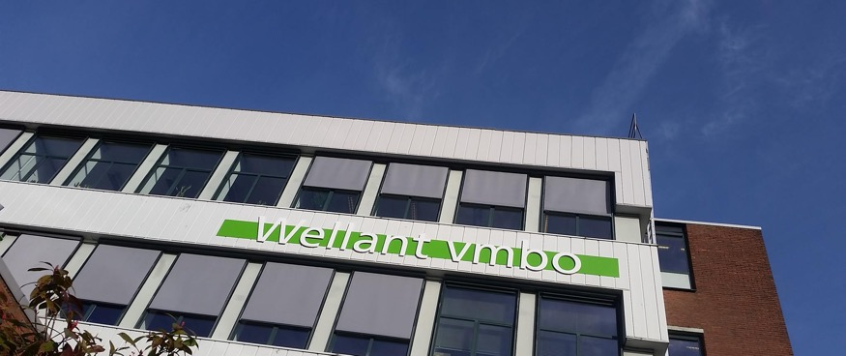

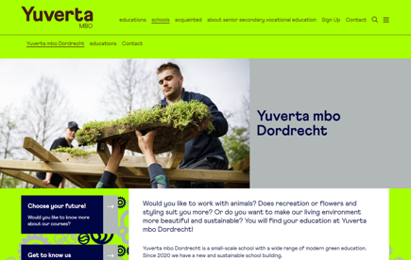
WELLANT COLLEGE
Company Name
Wellant College Dordrecht, The Netherlands
Date of Interview
07.08.21 via Telephone
Contact Person
Machteld Vroom - Project Manager Housing
Email
CLICK
TO VIEW
mbo.dordrecht@yuverta.nl
Wellant MBO Dordrecht is a small-scale VET school with a wide range of modern green educational programs. It provides education on vocational level in the areas of Animal care & Management, Green & Styling, Gardening, Food, Liveable City and Climate, Nature, Water & Recreation and Equine, Sports & Management. The Care program is unique, because the care for animals is combined with the care for people.
The school is part of a larger educational institute with almost 30 locations (12.000 students) with programs on vocational and pre-vocational level and lifelong learning programs. Wellant will merge this year with two other Dutch Educational Institutes. The new name of the merged institute is Yuverta.
Wellant MBO Dordrecht is situated in a new very modern and sustainable school building with the highest Dutch Energy label A++++. This means that the energy efficiency of the building and the installations is optimal according the current Dutch standards. The energy label is awarded on the basis of the energy performance coefficient (EPC) of the building. Apart of the building, the landscape surrounding the building is also designed in a sustainable way and to strengthen the biodiversity.

Slide 2
ORGANISATION PROFILE
HOW MANY STAFF IS DIRECTLY EMPLOYED BY THE ORGANISATION?
IN ADDITION TO STAFF PRE COVID, HOW MANY PEOPLE ACCESS THE BUILDING ? (eg tenants, students, members of the public etc)
500
50 EMPLOYEES
MORE THAN PEOPLE DAILY
HOW LONG HAS THE ORGANISATION BEEN DRIVING A GREEN REVOLUTION/ INTRODUCED SDG POLICY’S OR ACTIONS?
WITHIN LAST 12 YEARS
WHAT SECTOR/S IS THE ORGANISATION ACTIVE IN?
HOW WOULD YOU DESCRIBE YOUR MAIN STAKEHOLDERS OR OCCUPANTS?
Educational establishment /VET school
Students, teachers and staff
GOOD PRACTICES
WHAT IS YOUR VISION AND STRATEGY RELATED TO SUSTAINABLE DEVELOPMENT/CLIMATE ACTIONS?
Sustainability and the SDGs are guiding the choices of Wellant in their Educational programs, Business operations and relationships with SME’s and society. They believe that sustainable thinking and acting is important for all employees (teachers and supporting staff ) and students. That is why they became the most sustainable VET-school of the Netherlands in 2020. https://wellant.nl/duurzaamste-mbo-school.

Slide 3
GOOD PRACTICES
WHAT ACTIONS DID YOU TAKE?
Sustainability was the leading principle guiding the design of the new school building in Dordrecht. Goal was that the building and his surroundings would be an inspirational learning environment for students and teachers.
See: https://www.youtube.com/watch?v=JyTIoYvN4gw
The building is completely energy neutral with the highest Dutch energy label A++++: it has an energy efficient construction, is gas free with solar panels on the roof. Most of the furnishing of the building is also sustainable with for example furniture that is made of waste materials. The school has good facilities to separate waste.
Also during designing the outdoor space, explicit attention was paid to stimulate biodiversity and climate adaptation. Examples: good drainage to the groundwater, use plants which attract insects, filter the air or absorb heat.
WHICH PARTNERS AND STAKEHOLDERS WERE INVOLVED?
Architect Erik Schotte van LIAG was responsible for the design of the building ( https://www.liag.nl/team/erik-schotte Arcadis (Timo Cents) is responsible for the landscape design surrounding the building.
DID YOU RECEIVE ANY KIND OF TRAINING OR SUPPORT REGARDING YOUR ACTIONS?
No specific training. Only support of external experts.
WHICH RESULTS DID YOU ACHIEVE ALREADY?
The VET school building was opened in august 2020 as one of the first sustainable buildings of the Green Campus in Dordrecht. The Green Campus is now being developed further with other sustainable school buildings and a park that will act as a practical field lab for SME’s, where students work together on innovative solutions in the field of greening, water, animals, recreation and circular economy.
WHAT ARE YOUR FUTURE PLANS AND NEXT STEPS?
Regarding business development and operations, Wellant has the ambition to work on CO2 reduction, both within their school buildings and in the surroundings of the school, in cooperation with other schools and businesses. In 2030, Wellant will save 55% energy compared to 2012 and has the ambition to stimulate its stakeholders to act sustainable as well. This means that they want to focus on:
SDG 7 Affordable and clean energy,
SDG 11. Sustainable cities and communities and SDG 13 Climate action.

Slide 4
RECOMMENDATIONS
WHAT KIND OF HELP AND TOOLS DO YOU NEED TO REALISE YOUR FUTURE GOALS?
WHAT ARE YOUR MOST IMPORTANT TIPS & ADVICE TO GIVE TO OTHER ORGANISATIONS TO IMPLEMENT SDG WITHIN THEIR BUSINESS?
The Whole School, Approach to Sustainable Development ( https://wholeschoolapproach.lerenvoormorgen.org/en/)
The natural step approach https://thenaturalstep.org/
Don’t act alone, cooperation with local en regional stakeholders and experts is needed to develop solutions.
Use the energy and ideas of the youth..
Work from an integral an interdisciplinary point of view in which the whole school or business is involved.
Start with awareness and build up a movement that is ‘natural’ part of the DNA of your organisation.
Develop a clear vision and strategy for the next five years with smart/measurable goals.
WHAT SUSTAINABLE GOALS WOULD YOU LIKE TO IMPLEMENT IN THE FUTURE?
01
Sustainable Infrastructure/Buildings – SDG11 Sustainable cities and Communities and SDG13 Climate action:
Next 1 to 3 years
Energy and Resource Efficiency – SDG 7 Affordable and clean energy and SDG12 Responsible consumption and production:
Next 1 to 3 years
02
Sustainable Eco-systems and Collective Action – SDG4 Quality Education, SDG12 Responsible consumption and production and SDG17 Partnership for the Goals:
Next 1 to 3 years
03
Digital Technology for Sustainable Enterprise Centres – SDG8 Decent work and Economic Growth and SDG13 Climate action:
Next 1 to 3 years
04
05
Next 1 to 3 years.
Sustainable Futures for Enterprise Centres – SDG 9 -Industrial innovation & infrastructure and SDG17 Partnership for the Goals:

