Slide 1
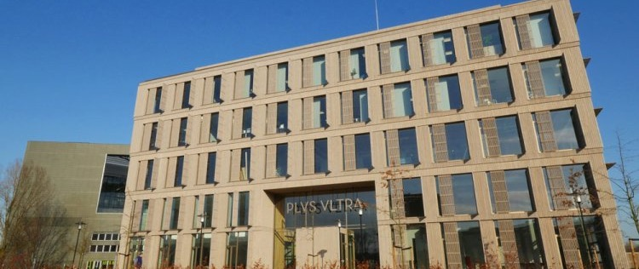
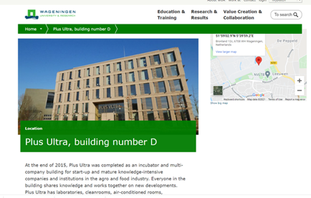
PLUS ULTRA
Company Name
Plus Ultra, Wageningen - Kadans Science Partner
Date of Interview
12.07.21 via Face to Face Meeting
Contact Person
R. Wijngaard – Property Manager
Email
CLICK
TO VIEW
r.wijngaard@kadans.com
Plus Ultra is one of the buildings on the Campus of Wageningen University. It hosts 24 starting and knowledge intensive companies and organisations, with the focus on health, food and education. Construction was ready in 2015. It has a unique architecture and an inspiring environment. Plus Ultra has 7.500 m2 for laboratories, clean rooms, pilot plants, conditioned rooms, multifunctional research rooms, techno halls, meeting rooms, presentation rooms and offices.
The open and transparent character of the building stimulates contacts between the different companies. “Plus Ultra” means “Always further” and want to facilitate ongoing innovation. Plus Ultra is designed and built according the BREEAM guidelines. BREEAM stands for “Building Research Establishment Environmental Assessment Method” and is used in over 80 countries worldwide. With this certification, Plus Ultra has high sustainability characteristics. On the roof of the building are 200 solar panels and during the construction, mostly natural materials were used, such as glass, wood and concrete.
After the success of Plus Ultra, a second identical building was completed in 2020. Its name is Plus Ultra II and it can be found on the Campus as well.

Slide 2
ORGANISATION PROFILE
HOW MANY STAFF IS DIRECTLY EMPLOYED BY THE ORGANISATION?
IN ADDITION TO STAFF PRE COVID, HOW MANY PEOPLE ACCESS THE BUILDING ? (eg tenants, students, members of the public etc)
150
5 EMPLOYEES
MORE THAN PEOPLE DAILY
HOW LONG HAS THE ORGANISATION BEEN DRIVING A GREEN REVOLUTION/ INTRODUCED SDG POLICY’S OR ACTIONS?
WITHIN LAST 6 YEARS
WHAT SECTOR/S IS THE ORGANISATION ACTIVE IN?
HOW WOULD YOU DESCRIBE YOUR MAIN STAKEHOLDERS OR OCCUPANTS?
Agro Food
Combination of start ups (“techno starters”) and bigger companies such as DSM.
GOOD PRACTICES
WHAT IS YOUR VISION AND STRATEGY RELATED TO SUSTAINABLE DEVELOPMENT/CLIMATE ACTIONS?
From the beginning on (2014) sustainability was a leading topic. The vision from the owner is:
To facilitate tenants to work on knowledge intensive developments in the green sector in a sustainable, stimulating and healthy environment,
To have an open and transparent working place, to stimulate communication among the tenants, leading to “cross-breeding”.
To make exploitation not only sustainable, but also cost reducing, compared with more traditional buildings.

Slide 3
GOOD PRACTICES
WHAT ACTIONS DID YOU TAKE?
Design: Open design, with a big central staircase.
Construction: Use of natural materials, such as glass, concrete and wood. Related to SDG 9 and 11.
Energy: Solar panels on the roof. LED lights, monitored by sensors. Temperature per room monitored. Related to SDG 7.
Human factor: Shared meeting rooms and little canteens for coffee and tea. Outside: gardens with little demand for water and maintenance. Parking with facilities for electric cars and bicycles.
Related to SDG 17.
In general: The building got a BREEAM certification See www.BREEAM.nl. This certification asks for sustainability in all phases: design, construction and exploitation.
WHICH PARTNERS AND STAKEHOLDERS WERE INVOLVED?
Main stake holders:
Kadans; estate agent and owner. This company owns more buildings at the Wageningen Campus as well as in other cities. Sustainability and flexibility for future users are key words for Kadans.
Wageningen UR is owner of the Campus, is also tenant.
Architect: “Proof of the sum”.
Construction company: Hendriks Bouw, Oss.
DID YOU RECEIVE ANY KIND OF TRAINING OR SUPPORT REGARDING YOUR ACTIONS?
Not Applicable
WHICH RESULTS DID YOU ACHIEVE ALREADY?
Plus Ultra has been opened in 2015. Since then, about 25 companies and organisations have found their place. Companies come and go. Some grow fast and leave for a bigger place. Others are not successful and stop. And a group stays for a longer.
WHAT ARE YOUR FUTURE PLANS AND NEXT STEPS?
Plus Ultra is very popular among tenants. That is why Kadans decided to build a second, comparable building. This plan has been realized: Plus Ultra II opened on the 4th of May 2020. The second building is 1.5 times bigger.
Main tenants are Wageningen University & Research and One Planet Research Center. But, also some smaller companies found their way.
Latest developments: Plus Ultra III is planned. The model can already be admired in the central hall of building.
.

Slide 4
RECOMMENDATIONS
WHAT KIND OF HELP AND TOOLS DO YOU NEED TO REALISE YOUR FUTURE GOALS?
WHAT ARE YOUR MOST IMPORTANT TIPS & ADVICE TO GIVE TO OTHER ORGANISATIONS TO IMPLEMENT SDG WITHIN THEIR BUSINESS?
Financial resources
Good communication with local government
Marketing tools
Advice about sustainable gardens around the building.
Install monitored LED light.
Install monitored heating systems
Discourage the use of elevators
Have a good contact with the tenants. They also come with valuable suggestions.
Anticipate on the future growing use of electric cars.
WHAT SUSTAINABLE GOALS WOULD YOU LIKE TO IMPLEMENT IN THE FUTURE?
01
For the development of building III, the same procedure will be followed: sustainable construction materials, inside and outside the building: 1-3 years
Sustainable Infrastructure/Buildings – SDG11 Sustainable cities and Communities and SDG13 Climate action:
Energy and Resource Efficiency – SDG 7 Affordable and clean energy and SDG12 Responsible consumption and production:
Light and temperature monitoring are essential. Also, the water consumption is monitored 24/7 per working room. Looking at more options in next 1-3 years
02
Sustainable Eco-systems and Collective Action – SDG4 Quality Education, SDG12 Responsible consumption and production and SDG17 Partnership for the Goals:
03
All results of monitoring and are discussed with the tenants on a regular basis. Once per year, the analyses are used to make improvements: 6-12 months
Digital Technology for Sustainable Enterprise Centres – SDG8 Decent work and Economic Growth and SDG13 Climate action:
Digital technology is used for monitoring. Digital safety has priority. Patch closets can only be opened with a digital code. Digital data protection is an ongoing process: 1-3 years
04
05
In the future.
Sustainable Futures for Enterprise Centres – SDG 9 -Industrial innovation & infrastructure and SDG17 Partnership for the Goals:

