Slide 1
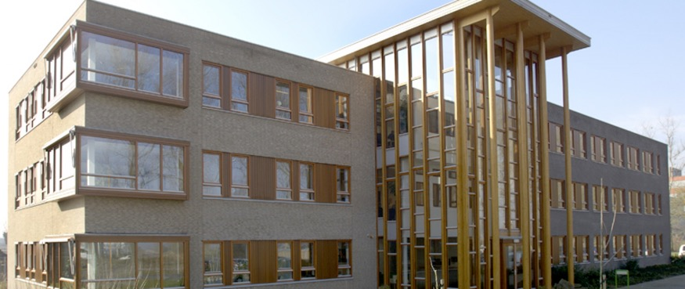

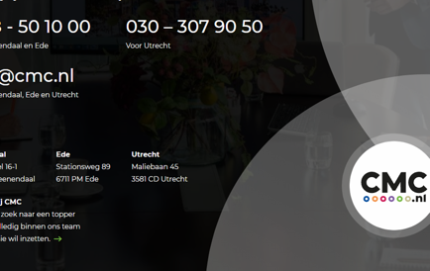
HET CAMBIUM
Company Name
HET Cambium
Date of Interview
12.07.21 via Telephone
Contact Person
Denise - Communication Manager
Email
CLICK
TO VIEW
denise@cmc.nl
The name of the building “Het Cambium” refers to wood. It is the place in a tree, where new cells are made. It is well chosen. The building has a lot of wood and the idea that this place can lead to new activities, is also in line with this name. The building is from 2006. Characteristic is the use of wood. The original owner was “Triodos Vastgoed” (= real estate). Triodos follows antroposophical principles in building.
In 2006, Het Cambium was one of the first offices, which received the “groenverklaring utiliteitsbouw” (= green certificate for utility construction). The building was mainly used by organisations SKH and SHR which are specialists in research in the use of wood. The total office space is 2500 m2.
Special sustainability measurements were taken. It was possible to safe energy by improving isolation and recovery of heath. As a result of that the energy performance coefficient was 30% lower as necessary for normal buildings.
Now, in 2021, the building is 15 years old and it is interesting to see that the condition of this building is still good. Although small repair and maintenance were necessary, it has a long life ahead. Present contact is CMC brokerage, on behalf of the owner.

Slide 2
ORGANISATION PROFILE
HOW MANY STAFF IS DIRECTLY EMPLOYED BY THE ORGANISATION?
IN ADDITION TO STAFF PRE COVID, HOW MANY PEOPLE ACCESS THE BUILDING ? (eg tenants, students, members of the public etc)
80
5 EMPLOYEES
MORE THAN PEOPLE DAILY
HOW LONG HAS THE ORGANISATION BEEN DRIVING A GREEN REVOLUTION/ INTRODUCED SDG POLICY’S OR ACTIONS?
WITHIN LAST 15 YEARS
WHAT SECTOR/S IS THE ORGANISATION ACTIVE IN?
HOW WOULD YOU DESCRIBE YOUR MAIN STAKEHOLDERS OR OCCUPANTS?
Mainly used by organisations SKH and SHR which are specialists in research
Tenants
GOOD PRACTICES
WHAT IS YOUR VISION AND STRATEGY RELATED TO SUSTAINABLE DEVELOPMENT/CLIMATE ACTIONS?
Vision: The vision of the original owner was clear: use as much as possible, natural building materials, with the focus on different types of wood, such as larch and pine. It was also the wish to safe energy. This has been realised with efficient isolation and reclaim of heath.
Strategy: The building as such was also a kind of experiment: how long the wood will stay in a good condition.

Slide 3
GOOD PRACTICES
WHAT ACTIONS DID YOU TAKE?
Isolation gave an interesting problem. On one hand, it was necessary to isolate. On the other hand, for the condition of the wood, it was necessary to have a good ventilation. It asked for special technical measures. Wood needs more maintenance, but also after 16 years, the building is still in a good condition. Also the orientation of the building to the south and the regulation of humidity were necessary aspects during the construction.
WHICH PARTNERS AND STAKEHOLDERS WERE INVOLVED?
Main owner was “Triodos Vastgoed”. Triodos follows the antroposophic ideas for building.
Also the organisation Senter Novem, related to the Ministry of economic affairs, was directly involved.
Further partners were:
Development: Bouwfonds Asset Management,
Construction: Zegersbouw
One of the tenants: Stichting Hout Research
DID YOU RECEIVE ANY KIND OF TRAINING OR SUPPORT REGARDING YOUR ACTIONS?
Not Applicable.
WHICH RESULTS DID YOU ACHIEVE ALREADY?
Apart of general measures, such as monitoring light and energy, also recovery of heat was realised, leading to an overall reduction of energy consumption of 30%. Monitoring of water consumption will follow.
WHAT ARE YOUR FUTURE PLANS AND NEXT STEPS?
In general, the ongoing maintenance in a sustainable way is important for a building like this.
Also, an effective marketing to attract new tenants, is essential. The architecture and the sustainable aspects are important in this marketing.

Slide 4
RECOMMENDATIONS
WHAT KIND OF HELP AND TOOLS DO YOU NEED TO REALISE YOUR FUTURE GOALS?
WHAT ARE YOUR MOST IMPORTANT TIPS & ADVICE TO GIVE TO OTHER ORGANISATIONS TO IMPLEMENT SDG WITHIN THEIR BUSINESS?
We need some new tenants! We will intensify our marketing (CMC)
Ongoing advisory about the condition of wood on the longer term.
Long-term planning of activities to increase savings on energy and light
Investments in facilities for electric cars and e-bikes.
Upgrade of the green area around the building towards more sustainability.
Many sustainability aspects have to be realised during the construction. So pay attention to this during the design phase.
Look for general or more specific certifications. Being certified, increases the attractivity of the centre and it helps to make a checklist for all kind of aspects.
Calculate costs and benefits from your SDG investments. Make calculations for the long term.
Pay attention to effective marketing of your centre. This is an ongoing process.
WHAT SUSTAINABLE GOALS WOULD YOU LIKE TO IMPLEMENT IN THE FUTURE?
01
Sustainable Infrastructure/Buildings – SDG11 Sustainable cities and Communities and SDG13 Climate action:
Maintenance of the building: 1-3 years
Energy and Resource Efficiency – SDG 7 Affordable and clean energy and SDG12 Responsible consumption and production:
02
Monitoring light and temperature:1-3 years
Control of humidity in the building: 6-12 months
Installation of solar panels: 1-3 years
Sustainable Eco-systems and Collective Action – SDG4 Quality Education, SDG12 Responsible consumption and production and SDG17 Partnership for the Goals:
03
Redesign green areas around the building towards sustainable gardens: 1-3 years
Analysis of canteens, to reduce plastic waste and to re-use coffee residues: 1-3 years
Digital Technology for Sustainable Enterprise Centres – SDG8 Decent work and Economic Growth and SDG13 Climate action:
Update of existing facilities toward better internet : 1-3 years
Ongoing activities to improve data protection: 1-3 years
04
05
More facilities for electric cars and e-bikes (at least 10% of all places): 1-3 years
Some reconstruction of the building to make it more flexible and attractive for smaller tenants: 1-3 years
Sustainable Futures for Enterprise Centres – SDG 9 -Industrial innovation & infrastructure and SDG17 Partnership for the Goals:

