Slide 1
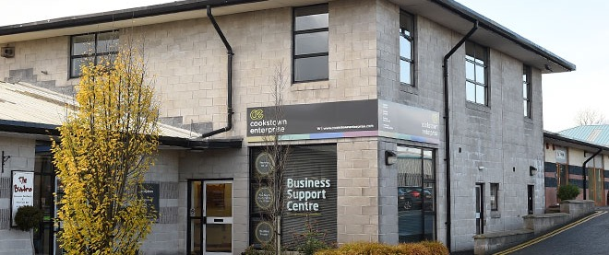
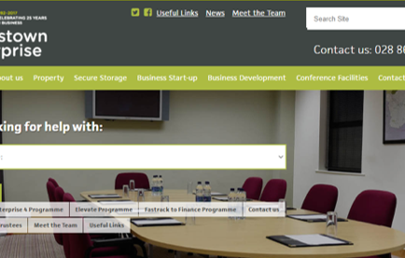
COOKSTOWN ENTERPRISE
Company Name
Cookstown Enterprise
Date of Interview
02/07/2021 via phone call
Contact Person
Jim Eastwood – General Manager
Email
CLICK
TO VIEW
info@cookstownenterprise.com
Cookstown enterprise Centre (CEC) was established in 1991 and is centrally located in the Mid Ulster Council District and in the heart of Northern Ireland. CEC is a social enterprise with charitable status and is a non-profit taking ISO 9001 quality accredited organization. While successfully operation the business for the last 30 years, the company is primarily concerned with business start-up and growth in Cookstown and its immediate hinterland.
A small team of core staff deliver high level professional business support services to local entrepreneurs with the provision of business property and bespoke training and mentoring among the core services provided.
Within Northern Ireland, Mid Ulster is well known for its ‘entrepreneurial flair’ and the region boasts business start-up statistics only surpassed by Belfast. The regions has historically not benefited from much inward investment and therefore indigenous small businesses are responsible for employment and wealth creation locally.
The voluntary board of trustees, management and staff of CEC are fully committed to assist with the creation and growth of successful and sustainable businesses which have their roots in the local economy.

Slide 2
ORGANISATION PROFILE
HOW MANY STAFF IS DIRECTLY EMPLOYED BY THE ORGANISATION?
IN ADDITION TO STAFF PRE COVID, HOW MANY PEOPLE ACCESS THE BUILDING ? (eg tenants, students, members of the public etc)
150
7 EMPLOYEES
MORE THAN PEOPLE DAILY
HOW LONG HAS THE ORGANISATION BEEN DRIVING A GREEN REVOLUTION/ INTRODUCED SDG POLICY’S OR ACTIONS?
WITHIN 3 TO 5 YEARS
WHAT SECTOR/S IS THE ORGANISATION ACTIVE IN?
HOW WOULD YOU DESCRIBE YOUR MAIN STAKEHOLDERS OR OCCUPANTS?
Local Enterprise
SMEs
GOOD PRACTICES
WHAT IS YOUR VISION AND STRATEGY RELATED TO SUSTAINABLE DEVELOPMENT/CLIMATE ACTIONS?
CEC is conscious of the need to take sustainable actions and the Board is committed to ensuring this core objective is achieved. All current and future capital building projects will incorporate design and construction features to address the reduction of the carbon footprint. Currently as light fitting become worn out all units are being replaced with low voltage LED equipment. CEC has always considered its employees to be its most valuable asset.
WHAT ACTIONS DID YOU TAKE?
The company has always ensured that its staff are properly rewarded for their work and that the issue of poverty is addressed by ensuring that salaries are well above the recommended national living wage levels.

Slide 3
GOOD PRACTICES
WHICH PARTNERS AND STAKEHOLDERS WERE INVOLVED?
As well as the Trustees and staff of the company, CEC has a range of stakeholders who are consistently consulted in all decisions and actions surrounding sustainability. Tenants, programme clients, conference room users and suppliers as well as economic development partners are also at the forefront of this consultation process. Mid Ulster District Council, Invest NI, Enterprise NI and Enterprising West are engaged in this consultation regularly.
DID YOU RECEIVE ANY KIND OF TRAINING OR SUPPORT REGARDING YOUR ACTIONS?
While no formal training was received, the management of CEC has ensured that the organisation is kept abreast of the necessary actions required to ensure future sustainability. Through effective collaboration CEC shares important information and learn from others in respect of good practice in these matters.
WHICH RESULTS DID YOU ACHIEVE ALREADY?
The decision to replace all current light fittings with LED Units and the upgrade of building insulation on a phased replacement programme have already been implemented. Currently the directors are researching the installation of solar panel on selected roof areas. This could make a significant contribution to more efficient energy production for the company and its tenant businesses.
The development of a new’ pilot’ facility to allow employees of larger public and private organisations to work ‘nearer to home’ is currently underway. This will allow employees to reduce their commute time and hence will contribute significantly to reducing their carbon footprint and environmental pollution. The company has funded the necessary hardware and software to provide CEC staff with the option of spending some more time working from home.
WHAT ARE YOUR FUTURE PLANS AND NEXT STEPS?
To ensure that all CEC stakeholders are fully conversant with the need to incorporate sustainable action into their everyday business-related operations.

Slide 4
RECOMMENDATIONS
WHAT KIND OF HELP AND TOOLS DO YOU NEED TO REALISE YOUR FUTURE GOALS?
WHAT ARE YOUR MOST IMPORTANT TIPS & ADVICE TO GIVE TO OTHER ORGANISATIONS TO IMPLEMENT SDG WITHIN THEIR BUSINESS?
Information, training, and support to better understand sustainability.
Access to sources of funding which will assist us to meet our objectives.
Modern technology and communication methods to share good practice.
Learn from other enterprise centres which are recognised leaders in this field.
Collaborate with likeminded organisations.
Have confidence to share information and regularly consult stakeholders to gain valuable feedback.
Agree and strategy and set realistic and achievable sustainability objectives.
Regularly measure progress and take corrective action where appropriate.
Demonstrate leadership to ensure an appropriate culture is developed within the organisation
WHAT SUSTAINABLE GOALS WOULD YOU LIKE TO IMPLEMENT IN THE FUTURE?
01
Sustainable Infrastructure/Buildings – SDG11 Sustainable cities and Communities and SDG13 Climate action:
1 – 2 years
Energy and Resource Efficiency – SDG 7 Affordable and clean energy and SDG12 Responsible consumption and production:
02
2 – 3 years
Sustainable Eco-systems and Collective Action – SDG4 Quality Education, SDG12 Responsible consumption and production and SDG17 Partnership for the Goals:
03
2 – 3 years
Digital Technology for Sustainable Enterprise Centres – SDG8 Decent work and Economic Growth and SDG13 Climate action:
04
12 – 18 months
05
Sustainable Futures for Enterprise Centres – SDG 9 -Industrial innovation & infrastructure and SDG17 Partnership for the Goals:
1 – 2 years

