Slide 1
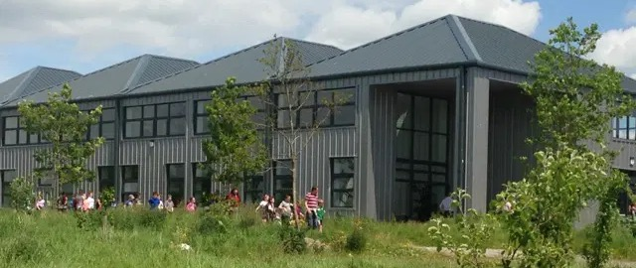

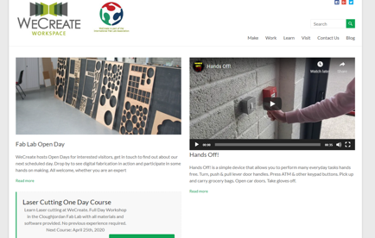
CLOUGHJORDAN ECOVILLAGE
Company Name
Cloughjordan Ecovillage: WeCreate Enterprise Centre
Date of Interview
17.08.21 via video call
Contact Person
Davie Philip – Community Resilience Manager
Email
CLICK
TO VIEW
info@wecreate.ie
WeCreate is based in Cloughjordan Ecovillage in North Tipperary, an award-winning community pioneering in green building, renewable energy and local food.
WeCreate supports digital fabrication projects in these areas and aims to share open-source hardware and software solutions that enhance community resilience by providing employment opportunities as the region transitions away from extractive economic activities.
WeCreate allows individuals to work in a unique creative and technological workspace located in the Cloughjordan Ecovillage and offers access to a Fab Lab, work space units and co-working spaces.

Slide 2
ORGANISATION PROFILE
HOW MANY STAFF IS DIRECTLY EMPLOYED BY THE ORGANISATION?
IN ADDITION TO STAFF PRE COVID, HOW MANY PEOPLE ACCESS THE BUILDING ? (eg tenants, students, members of the public etc)
200
5-10 EMPLOYEES
MORE THAN PEOPLE DAILY
HOW LONG HAS THE ORGANISATION BEEN DRIVING A GREEN REVOLUTION/ INTRODUCED SDG POLICY’S OR ACTIONS?
WITHIN LAST 9 YEARS
WHAT SECTOR/S IS THE ORGANISATION ACTIVE IN?
HOW WOULD YOU DESCRIBE YOUR MAIN STAKEHOLDERS OR OCCUPANTS?
Local Enterprise/Education
Co-Workers, Learners and SMEs
GOOD PRACTICES
WHAT IS YOUR VISION AND STRATEGY RELATED TO SUSTAINABLE DEVELOPMENT/CLIMATE ACTIONS?
The Ecovillage is a pioneer in sustainable living in Ireland, with 'Building Sustainable Community' being the founding mission statement over 20 years ago. The WeCreate Enterprise Centre, which operates as a separate entity within the community, contributes towards this ecosystem by promoting employment opportunities and facilitating remote working creating a more resilient rural community. The work and impact of WeCreate stretch further than the EcoVillage by providing opportunities and education for people from the wider region. WeCreate uses the Ecovillage biomass district heating system, while the buildings are built as efficiently as possible. WeCreate also commits to education and training and providing replicable, sustainable practices for communities across Ireland.

Slide 3
GOOD PRACTICES
WHAT ACTIONS DID YOU TAKE?
Setting up WeCreate within the Ecovillage provided an opportunity to develop job opportunities for the wider community
It also provided an opportunity to invite people into the community and share the learnings of the Ecovillage with people hoping to implement sustainable initiatives in their communities
WHICH PARTNERS AND STAKEHOLDERS WERE INVOLVED?
WeCreate is a part of a larger ecosystem of sustainable communities and organisations. Founded initially as the North Tipperary Green Enterprise Centre with support from Enterprise Ireland and LEADER, WeCreate is managed by Cultivate http://www.cultivate.ie/about-cultivate-new.
DID YOU RECEIVE ANY KIND OF TRAINING OR SUPPORT REGARDING YOUR ACTIONS?
The Cloughjordan Ecovillage is a pioneer in the space of sustainable communities in Ireland and so have forged their own way with their wealth of expertise from their network of contributors. The Enterprise Centre was funded with help from Enterprise Ireland and LEADER. From the outset, support was forthcoming from Local Enterprise Office.
WHICH RESULTS DID YOU ACHIEVE ALREADY?
WeCreate is a successfully functioning enterprise centre in a sustainable community in rural Ireland. They're energy efficient and provide a shared resource work place for co-workers and SMEs.
They also provide conference facilities for many national agencies and run a number of training courses out of their facilities where they share their learnings on sustainable living with people from around Ireland. Ireland's first Fab Lab is located on their premises, providing an important resource for the local economy. The Fab Lab provides a range of digital fabrication equipment based on the MIT Fab Lab model which are designed to let people make almost anything. This equipment combined with workshop space is available to rent to Makers, developers, artists and many others. sustainable initiatives.
WHAT ARE YOUR FUTURE PLANS AND NEXT STEPS?
WeCreate is working on adapting the building for a post-covid mixed approach to work and learning by upgrading the conference rooms with cameras and microphones.
In all of their plans they are considering the future growth of the community and how they can best provide for them.
WeCreate and the EcoVillage is working on a Food Hub for the area which would consist of training facilities as well as a digital farmers market.
WeCreate strives to share their knowledge with communities and cities that must now try to implement their own sustainable initiatives.

Slide 4
RECOMMENDATIONS
WHAT KIND OF HELP AND TOOLS DO YOU NEED TO REALISE YOUR FUTURE GOALS?
WHAT ARE YOUR MOST IMPORTANT TIPS & ADVICE TO GIVE TO OTHER ORGANISATIONS TO IMPLEMENT SDG WITHIN THEIR BUSINESS?
Information on what funding streams are available, both nationally and in Europe.
What support is available for implementing new initiatives.
Think about regenerating and restoring your local community and environment more so than sustaining it.
Focus first on what you can do to add value to, and strengthen your local economy and provide meaningful work.
Look at how you can help to shorten supply chains.
WHAT SUSTAINABLE GOALS WOULD YOU LIKE TO IMPLEMENT IN THE FUTURE?
01
Sustainable Infrastructure/Buildings – SDG11 Sustainable cities and Communities and SDG13 Climate action:
Within next 6 months
Energy and Resource Efficiency – SDG 7 Affordable and clean energy and SDG12 Responsible consumption and production:
02
6 -12 months
Sustainable Eco-systems and Collective Action – SDG4 Quality Education, SDG12 Responsible consumption and production and SDG17 Partnership for the Goals:
03
1 – 3 years
Digital Technology for Sustainable Enterprise Centres – SDG8 Decent work and Economic Growth and SDG13 Climate action:
6 -12 months
04
05
1 - 3 years
Sustainable Futures for Enterprise Centres – SDG 9 -Industrial innovation & infrastructure and SDG17 Partnership for the Goals:

