Slide 1
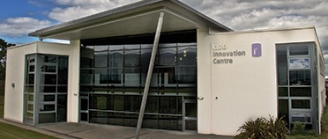

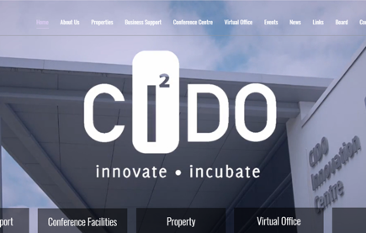
CIDO
Company Name
Craigavon Industrial Development Organisation (CIDO)
Date of Interview
13.08.21 via Telephone
Contact Person
Cara Dallat
Email
CLICK
TO VIEW
info@cido.co.uk
CIDO operates as a not-for-profit Local Enterprise Agency in Craigavon, established in 1983 to promote local business start and enterprise among SMEs. As a registered charity the organisation manages a considerable portfolio of commercial property, aimed at small businesses across a range of sectors, as well as providing a range of business support services, ranging from formal revenue generating training programmes to ad hoc business consultancy/advice/services funded by CIDO.
CIDO’s aim is to encourage innovation, to incubate and accelerate business for the good and growth of the economy, Craigavon and beyond by providing exceptional support for our clients in the form of premises, training, guidance and advocacy

Slide 2
ORGANISATION PROFILE
HOW MANY STAFF IS DIRECTLY EMPLOYED BY THE ORGANISATION?
IN ADDITION TO STAFF PRE COVID, HOW MANY PEOPLE ACCESS THE BUILDING ? (eg tenants, students, members of the public etc)
100
7 EMPLOYEES
MORE THAN PEOPLE DAILY
HOW LONG HAS THE ORGANISATION BEEN DRIVING A GREEN REVOLUTION/ INTRODUCED SDG POLICY’S OR ACTIONS?
WITHIN LAST 7 YEARS
WHAT SECTOR/S IS THE ORGANISATION ACTIVE IN?
HOW WOULD YOU DESCRIBE YOUR MAIN STAKEHOLDERS OR OCCUPANTS?
Local Enterprise
Tenants & Local SME’s
GOOD PRACTICES
WHAT IS YOUR VISION AND STRATEGY RELATED TO SUSTAINABLE DEVELOPMENT/CLIMATE ACTIONS?
We plan to include SDG actions in our next capital build development which will include the creation of new basic industrial units for rent to start-up businesses as well as modern office pods which can be relocated if necessary.
Any future buildings will adopt a low carbon emissions policy as we previously carried out on our Innovation Centre which was built over 10 years ago. These measures include solar panels on the roof, sufficient building insulation and heating sourced from air derived energy. Regular maintenance of the buildings is vital to ensure maximum energy conservation.

Slide 3
GOOD PRACTICES
WHAT ACTIONS DID YOU TAKE?
We have engaged a local architect to design the new industrial units with energy efficiency and sustainability in mind, whilst using locally sourced materials where possible and to engage local builders to carryout the work which will also keep carbon emissions lower.
WHICH PARTNERS AND STAKEHOLDERS WERE INVOLVED?
Board of Directors, Staff, Sub Contractors, local architects, local building firm.
DID YOU RECEIVE ANY KIND OF TRAINING OR SUPPORT REGARDING YOUR ACTIONS?
Only advice from local architect and local Council regarding planning and building control.
WHICH RESULTS DID YOU ACHIEVE ALREADY?
Building:
Solar Panels to reduce fuel consumption
Thermostats in each office of Innovation Centre to reduce heat waste
Building insulated to reduce heat waste
Air derived underfloor heating
Recycling of waste materials
Staff/Tenants
Allow Home working for staff to reduce carbon footprint
Provide Hot desk facilities for tenants to reduce carbon footprint
WHAT ARE YOUR FUTURE PLANS AND NEXT STEPS?
Work with architect to ensure SDGs are incorporated into plan for new Buildings
Develop a building that is innovative in design and flexible to the future needs of companies

Slide 4
RECOMMENDATIONS
WHAT KIND OF HELP AND TOOLS DO YOU NEED TO REALISE YOUR FUTURE GOALS?
WHAT ARE YOUR MOST IMPORTANT TIPS & ADVICE TO GIVE TO OTHER ORGANISATIONS TO IMPLEMENT SDG WITHIN THEIR BUSINESS?
Information on access to grants with regards to sustainable energy sources
Resources that we can share with tenants to help them keep their costs down and reduce their own carbon footprint
Shared information with other enterprise agencies to see what good practice they have already adopted
Talking to other businesses & organisations to see what works well for them
Consider SDGs early in planning stage of any new build
Engage consultants to assess existing buildings and how they could be improved to enhance sustainability and efficiency
Keep abreast of any grants or funding available for new sustainability projects.
WHAT SUSTAINABLE GOALS WOULD YOU LIKE TO IMPLEMENT IN THE FUTURE?
01
Sustainable Infrastructure/Buildings – SDG11 Sustainable cities and Communities and SDG13 Climate action:
Next 6 months
Energy and Resource Efficiency – SDG 7 Affordable and clean energy and SDG12 Responsible consumption and production:
02
1 to 5 years
Sustainable Eco-systems and Collective Action – SDG4 Quality Education, SDG12 Responsible consumption and production and SDG17 Partnership for the Goals:
03
Ongoing
Digital Technology for Sustainable Enterprise Centres – SDG8 Decent work and Economic Growth and SDG13 Climate action:
04
3 to 5 years
05
Sustainable Futures for Enterprise Centres – SDG 9 -Industrial innovation & infrastructure and SDG17 Partnership for the Goals:
Ongoing

