Slide 1
Module 1:
Introduction to Sustainable Business

Slide 2
M1: Introduction to Sustainable Business
01
The Importance of Sustainability and SME’s for Europe’s Future
For many SMEs, sustainability is viewed as a nice to have. In this module, we lay out the importance of action, the impact SMEs can have on Europe’s sustainability and most importantly, the business case for SME’s adopting more sustainable Business Practices.
Module 1 lays down the foundation for the rest of the course bringing learning from a theoretical background to best practice sustainability in SMEs.
02
Sustainability In Depth: Environmental
03
Sustainability In Depth: Economic, including Circular Economy
04
Sustainability In Depth: Social including CSR – corporate social responsibility
05
The Business Case for Sustainability

Slide 3
SECTION 1
The Importance of Sustainability and SME’s for Europe’s Future

Slide 4
Sustainability in its simplest form means meeting our own needs without compromising the ability of future generations to meet their own needs.
A widely accepted definition of sustainability:
‘Sustainable development is development that meets the needs of the present without compromising the ability of future generations.’ (WCED, 1987).
You may have noticed that the term sustainability has become ambiguous over time due to its overuse. While the climate crisis is undoubtedly the most dauting challenge we currently face, sustainability takes into account more than just the environment.
What is Sustainability?

Slide 5
When you think of sustainability, what comes to mind?
Financial Sustainability?
Carbon Reduction?
Protecting Biodiversity?
Human Rights issues?
Inclusivity?
Sustainability covers a wide array of issues and topics

Slide 6
WHY SMES?
Small and medium-sized enterprises (SMEs) are the backbone of Europe's economy, they;
Represent 99% of all businesses in the EU
Employ around 100 million people
Account for more than half of Europe’s GDP and
Play a key role in adding value in every sector of the economy.
As an SME, you are essential to Europe’s competitiveness and prosperity, industrial ecosystems, economic and technological sovereignty, and resilience to external shocks. They bring innovative solutions to challenges like climate change, resource efficiency and social cohesion and help spread innovation throughout Europe’s regions. SMEs are therefore central to the EU’s transition to a sustainable and digital economy.
See Unleashing the full potential of European SMEs’ factsheet

Slide 7

SMEs are the drivers of Europe’s Competitiveness, prosperity and sustainability.
There are over 25 million SMEs in Europe
2 out of 3 jobs in the EU are with SME’s
SME’s make up 50% of Europe’s total GDP
And the motivation behind this course, just 25% of EU SMEs are already working on some form of green integration
While a business's individual actions may seem insignificant, European SME’s combined effort can have a lasting impact on Europe’s sustainability efforts.
Source March 2020

Slide 8






Current Fundamental Sustainability Issues Facing SMEs
Environment
Understand the impact your products, services and supply chain have on the environment
Energy
Introduce actions to systematically reduce energy consumption
Greenhouse Gas Emissions (GHG)
Manage your Greenhouse Gas (GHG) Emissions as a result of activities, product or service
Resource Optimization Evaluate, measure, report on consumption of natural resources
Social and Ethical Demonstrate social responsibility through activities that have a positive impact on society
Biodiversity
Measure the health, maintenance and improvement of a defined ecosystem

Slide 9
While sustainability as a concept has become a widely accepted term in public discourse in recent years, it owes its routes to the birth of the modern environmentalism movement and other social justice movements.
Key events have cemented it as a priority in recent decades and formed frameworks from which we now base our political, business, and even personal decisions.
One of the widely known sustainability myths is that SMEs cannot afford to put sustainability on their agenda. The opposite is true, SMEs cannot afford not to make sustainability their priority.
Background to Sustainability

Slide 10

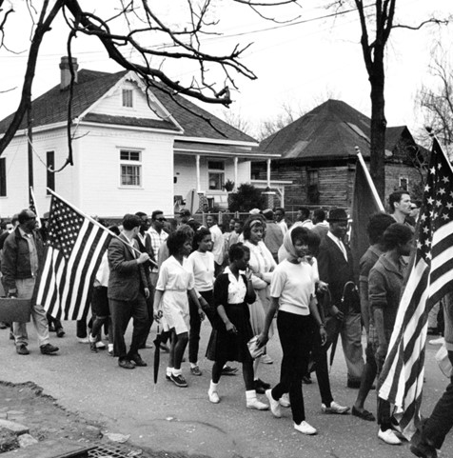

Development of Sustainability as we know it
Rachel Carson’s Published her book Silent Spring which drew mainstream media attention to the impact humans were having on nature through pesticides
From the mid 20th Century on there was a rising concern for the over production and pollution that capitalistic systems were producing.
20th Century
As environmental concerns were being raised, the Social Justice Movement was raising concerns of inequalities for minorities
1962
Notes:
Photo Credit:
https://www.americanyawp.com/text/27-the-sixties/
https://geneticliteracyproject.org/2018/05/01/how-does-the-science-of-rachel-carsons-silent-spring-stand-up-more-the-50-years-later/

Slide 11
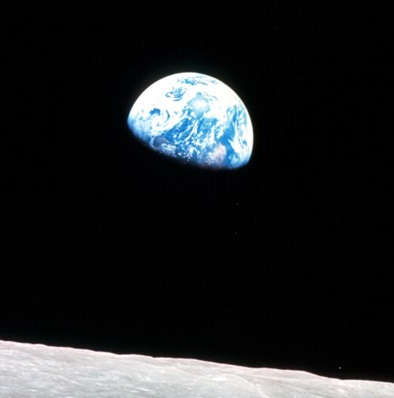
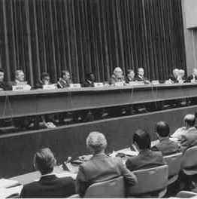
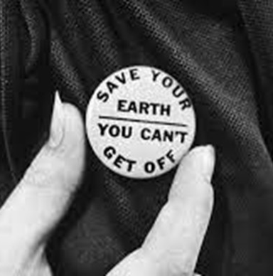
Earth Day
Born from this newfound sense of unity the first Earth Day was held on the 22nd of April 1970 through a series of events held across the US. 20 million people participated placing concerns for our planet at the forefront.
1968
1979
Earthrise
In 1968 “the most influential environmental photograph ever taken” was released when the Apollo 8 mission pictured the Earth, as viewed from the Moon. For the first time people were viewing our planet as a small and beautiful connected dot in space, and from that a sense of unity and a need to protect all people and environments on Earth was born.
1970
First World Climate Conference is held
They conclude that that “greenhouse effect” from increased build-up of carbon dioxide in the atmosphere demands urgent attention
Notes:
Photo credits:
https://www.nasa.gov/multimedia/imagegallery/image_feature_1249.html
https://www.history.com/this-day-in-history/the-first-earth-day
https://climatechronology.org/1979/climate-conference/

Slide 12

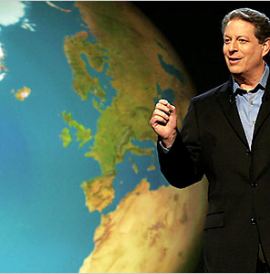

Kyoto Protocol
The first cohesive and global steps made towards a more sustainable future were taken at the Kyoto Protocol in Japan in 1997 when an international agreement was made between industrialised countries to reduce CO2 emissions and the presence of Greenhouse Gases in the atmosphere
1968
2006
Publishing of ‘Our Common Future’ The World Commission on Environment and Development (WCED) consolidates decades of sustainability work and comes up with the now widely accepted definition of sustainable development that takes into account environmental, social, and economic issues and published this new concept in their ‘Brundtland report’, titled ‘Our Common Future’.
An inconvenient Truth Despite the positive outcome from the Kyoto Protocol, action was not matching the scale of the issue. In 2006, former Vice President of the United States Al Gore illuminated this in his documentary ‘An Inconvenient Truth’. The documentary has been credited for raising international public awareness of global warming and reenergizing the environmental movement.
1997
Notes:
Photo Credit:
https://www.nytimes.com/2006/05/24/movies/24trut.html

Slide 13
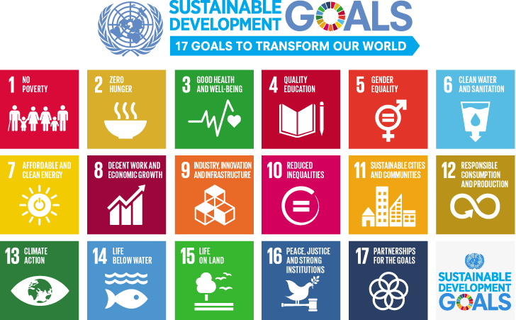
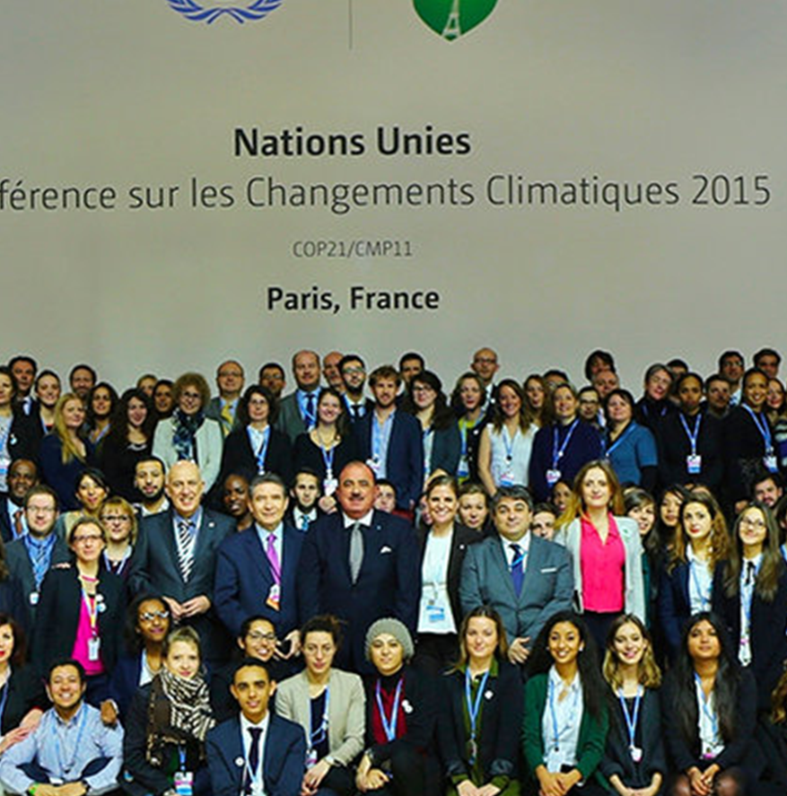
Paris Agreement
In 2015, 196 countries at COP 21 in Paris, signed a legally binding international treaty on climate change. The Goal of the treaty was to limit global warming to well below 2, preferably to 1.5 degrees Celsius, compared to pre-industrial levels. The Global Agreement called for a peaking of global temperatures and emissions asap with rapid reductions after that.
COPs
For nearly three decades the UN has been bringing together almost every country on earth for global climate summit – called COPs – which stands for ‘Conference of the Parties’. In that time climate change has gone from being a fringe issue to a global priority.
2015
The UN Sustainable Development Goals are introduced.
The United Nations General Assembly set up the SDGs to be achieved by 2030. Based off the Brundtland report’s definition of sustainable Development the mission statement for the goals is “A shared blueprint for peace and prosperity for people and the planet, now and into the future"
2015
KEEP UP TO DATE
Sharm el-Sheikh Climate Change Conference - November 2022 | UNFCCC

Slide 14
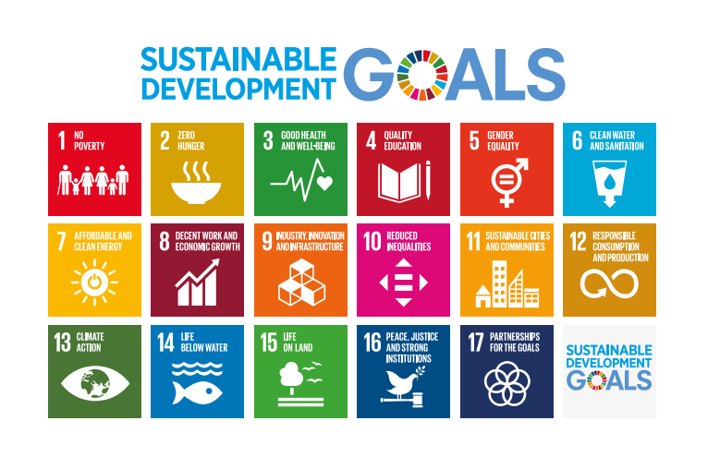
Importance of SDGs to SMEs
SDGs are meant to protect the planet from the environmental, social, and economic problems which are plaguing our world and exerting a global impact on businesses. One might wonder how the UN SDGs could be relevant to small and medium enterprises (SMEs) which have profitability and revenue generation as their main objectives.

Slide 15
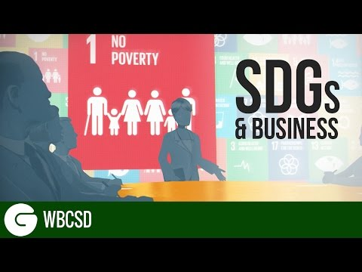
WATCH - Importance of SDGs to SMEs
The World Business Council for Sustainable Development (WBCSD) launched the CEO Guide to the SDGs - a new resource aimed at galvanising engagement from global business leaders in relation to the Sustainable Development Goals (SDGs). The CEO Guide to the SDGs sets out clear actions that CEOs can take to begin to align their organisations with the SDGs and plot a course towards unlocking the value they represent.
Click play to watch this short and powerful video exploring SDGs and business
Find out more: CEO Guide to the SDGs (wbcsd.org)

Slide 16
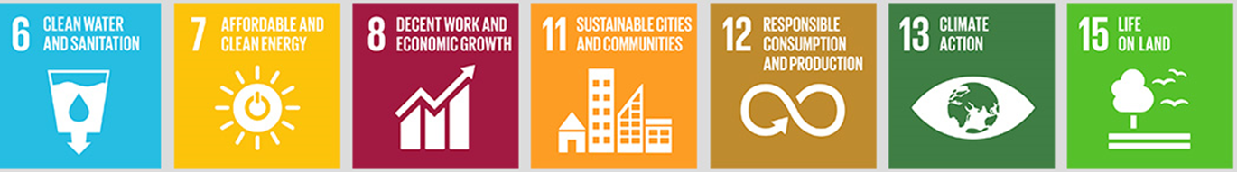
Practical ways of delivering SDGs in SMEs
How SMEs can Consciously Consume | SDG Number
Ensure that your building has efficient water consumption practices | (6, 12)
Encourage staff to take nationally recommended online Water Conservation Training | (6, 12)
Switch to green energy suppliers | (7, 12, 13, 15)
Switch to electric vehicles (EVs) if you offer company cars | (7, 12, 13)
Fund on-site car charging points to encourage staff to switch to EVs | (7, 12, 13)
Undergo an energy audit | (7, 12, 13)
Switch to more efficient lighting options in your building | (7, 12, 13)
Insulate your office building | (7, 12, 13)
Undertake energy management training with the national sustainable energy authority | (7, 12, 13)

Slide 17

Practical ways of delivering SDGs in SMEs
How SMEs can Protect the Planet | SDG Number
Encourage recycling and the reduction of waste across the business | (12, 13, 14, 15)
Get involved with the circular economy movement and find innovative ways to reuse waste materials from your business | (12, 13, 14, 15)
Source suppliers who use – or request that they use – reusable or biodegradable packaging | (12, 13, 14, 15)
Remove single-use plastic from the workplace | (12, 13, 14, 15)
Insulate your office building | (7, 12, 13)
If using chemicals or harmful substances in your workplace, work with the EPA to find solutions to minimise the negative impact on the environment | (12, 13, 14, 15)
Arrange car-pool groups to reduce your staff’s carbon emissions | (12, 13)

Slide 18
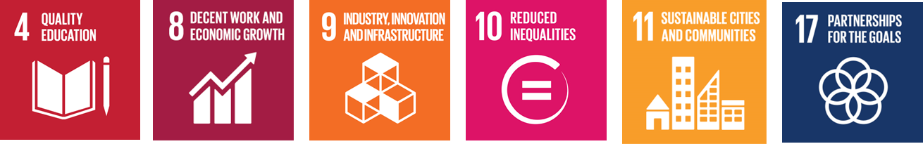
Practical ways of delivering SDGs in SMEs
How SMEs can Support Local Communities | SDG Number
Consider moving your business/secondary offices out of cities to support local economies and improve regional development | (9, 11)
Encourage employees to get involved with their communities by supporting volunteer work | (8, 11, 17)
Introduce apprenticeship and traineeship programmes to introduce marginalised groups into your business sector | (4, 8, 10)
Mentor in schools/DEIS schools around pathways to employment | (4, 8, 10)
Offer paid internships to ensure that this opportunity is accessible to all | (4, 8, 10)

Slide 19
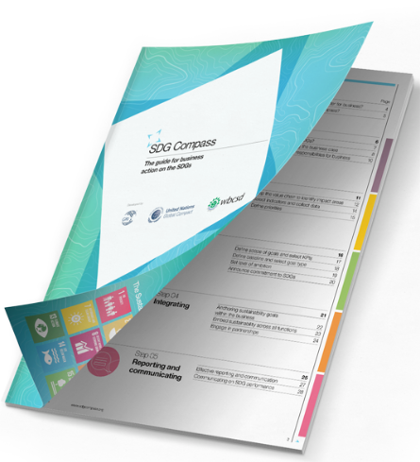
ENGAGE WITH THIS RESOURCE: SDG COMPASS GUIDE
The SDG Compass Guide provides guidance for companies on how they can align their strategies as well as measure and manage their contribution to the realization of the SDGs. The guide is organised into sections that address each of the five steps-
1 Understand the SDGs
As a first step, companies need to familiarise themselves with the 17 SDGs. Be aware of how your company addresses each of the SDGs and its potential.
2 Define Priorities
SMEs must define their priorities based on their current positive and negative current and potential impact on the SDGs across their business value chains. This will open up opportunities and reduce risks.
DOWNLOAD AND START USING SDG Compass – A Guide for Business Action to Advance the Sustainable Development Goals

Slide 20
RESOURCE: SDG COMPASS GUIDE
3 Set Goals
Setting goals will help you put down your priorities in black and white, identify the required actions and make them a reality. Aligning SME company goals with the SDGs will form a leadership that is demonstrated with a commitment to global sustainable development priorities.
4 Integrating
Integrating the SDGs into the core business and governance will embed corporate social responsibility (see later in the Module) and sustainability development targets and functions. Objectives to address challenges must engage partnerships across the value chain, across the sector, with the government and civil society communities.
5 Reporting & Communicating
SDGs enable SMEs to report information on sustainable development performance using the common indicators and a shared set of priorities. The SDG Compass encourages to build these SDGs into their communication, reporting and applications with stakeholders and partners.

Slide 21
The Three Pillars of Sustainability
Based off the three-pillar approach to sustainability, the SDGs recognise that no action exists in isolation, and they all affect each other.
Sustainability issues can be divided between three pillars which were first defined in the Brundtland reports’ definition of Sustainability.
In order to achieve an equitable and sustainable world, we all need to work towards economic growth and social progress while promoting environmental sustainability. The sequence of this Module follows this flow.
2. Social Sustainability
1. Environmental Sustainability
3. Economic Sustainability

Slide 22
The environmental pillar often gets the most attention. Many companies are focused on reducing their carbon footprints, packaging waste, water usage, or other damage to the environment. Besides helping the planet, these practices can also have a positive financial impact. For example, reducing the use of packaging materials means lower spending, and improved fuel efficiency also helps with the SME budget.
In a recent example, Walmart keyed in on packaging through their zero-waste initiative, pushing for less packaging throughout their supply chain and for more of that packaging to be sourced from recycled or reused materials.
1. Environmental Sustainability

Slide 23
Due to the climate crisis we are now facing, it is important that all businesses, big and small are aware of their environmental impacts and work to reduce them. Environmental sustainability and climate change are typically the first things we think of when we consider sustainability.
One of the challenges with the environmental pillar is that a business's impact is often not fully costed, meaning that there are externalities that are not reflected in consumer prices. The all-in costs of wastewater, carbon dioxide, land reclamation, and waste in general are not easy to calculate. This is where benchmarking comes in to try and quantify those external costs, so that progress in reducing them can be tracked in a meaningful way.
At the environmental level, sustainability prevents nature from being used as an inexhaustible source of resources and ensures its protection and rational use. While it is only one of three pillars of sustainability, it is vital that businesses focus their resources towards minimizing their impact and so a large component of these resources will be targeted towards environmental considerations.

Slide 24

Throughout this course, we will be learning how businesses can reduce their impact on the planet by focusing on a range of subjects from carbon reduction through sustainability plans, supply chain engagement, greening products and services among others.
Read more: https://www.acciona.com/sustainable-development/?_adin=02021864894

Slide 25
Social sustainability is about identifying and managing business impacts, both positive and negative, on people. The quality of a company’s relationships and engagement with its stakeholders is critical. Directly or indirectly, SMEs affect what happens to employees, workers in the value chain, customers and local communities, and it is important to manage impacts proactively. For businesses, social sustainability ties in closely with the concept of a social license to operate which refers to the perception of a companies or organisations operations by their employees, stakeholders and wider community it operates in.
2. Social Sustainability

Slide 26
For SMEs, economic sustainability is an area where most feel they already work towards as all businesses need to remain profitable to operate.
Economic sustainability addresses more than profit and loss, but also takes into consideration good business practices such as compliance, maintaining honest and transparent accounting practices as well as ensuring business practices reflect the interests of shareholders and the wider stakeholders, which ties in the other two pillars as well.
Later this module, we dive deeper into some of the issues surrounding economic sustainability for SME’s
3. Economic Sustainability

Slide 27
The economic pillar of sustainability is where most businesses feel they are on firm ground. To be sustainable, a business must be profitable. That said, profit cannot trump the other two pillars. In fact, profit at any cost is not at all what the economic pillar is about. Activities that fit under the economic pillar include compliance, good governance, alignment with shareholders' interests as well as that of the company's community, value chains, and end-user customers. and risk management.
It is the inclusion of the economic pillar and profit that makes it possible for SMEs to develop their sustainability strategies.
READ MORE:
https://www.investopedia.com/articles/investing/100515/three-pillars-corporate-sustainability.asp

Slide 28
SECTION 2
Sustainability In Depth:
Environmental
Notes:
Sustainability In Depth: Environmental

Slide 29
The climate crisis has quickly become the challenge of our generation, and we all must take responsibility to operate more responsibly.
The first step towards taking action is understanding the challenge. In this section, we will be diving deeper into environmental sustainability covering the following key topics of relevance to SMEs:
The Science Behind Climate Change
The Drivers of Climate Change
The Impacts of those Changes
How climate change and biodiversity loss are linked
Environmental Sustainability

Slide 30
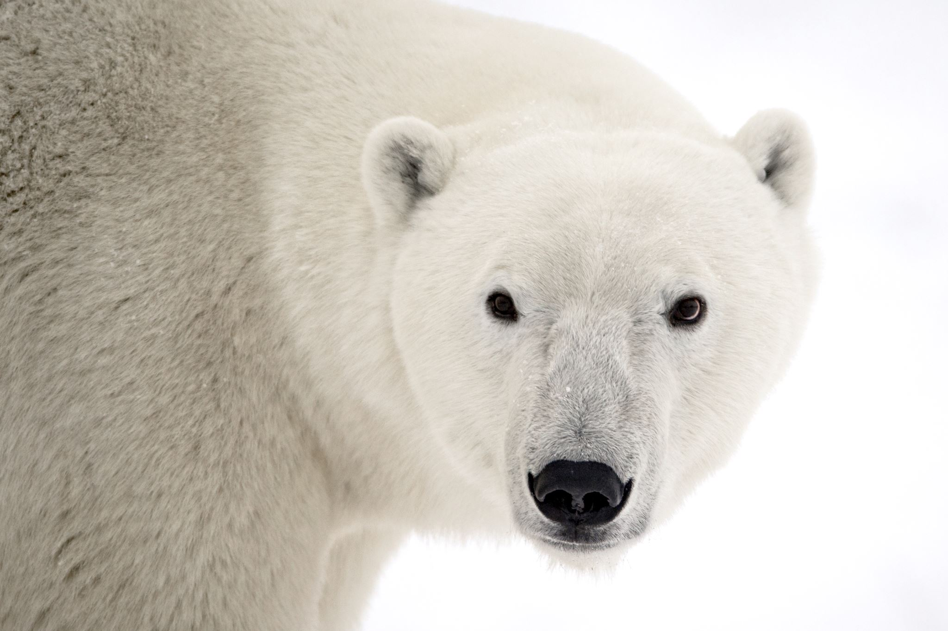
The Science behind Climate Change
The science behind climate change can be daunting, with 75% of young people stating they are frightened about what the future holds. While climate science can lead to a ‘head-in-the-sand” approach, it is important that we remember that many small steps can have a large impact.
As SMEs, the first recommended step towards becoming more climate conscious is to become Climate Literate.
Climate Literacy is short for Climate Science Literacy, which is an understanding of human impacts on climate and the impacts of climate on human systems.
In this section, we will go through everything you need to know to become climate literate and start on your sustainability journey.

Slide 31
Global warming refers to the long-term warming of the planet, or the rise in global temperatures. While this is occurring, the way we experience this day to day is not always hotter weather, but rather comes in the form of more extreme weather events.
Climate Change is a broad, more general term for the changes we are witnessing. It’s largely the consequence of global warming, and describes a wide range of changes in our long-term climate including hurricanes, drought, flooding and heat waves
‘Climate Change’ and ‘Global Warming’ are often used interchangeably but despite being profoundly linked, they are not the exact same thing
Both are caused by the greenhouse effect.
Global Warming or Climate Change

Slide 32



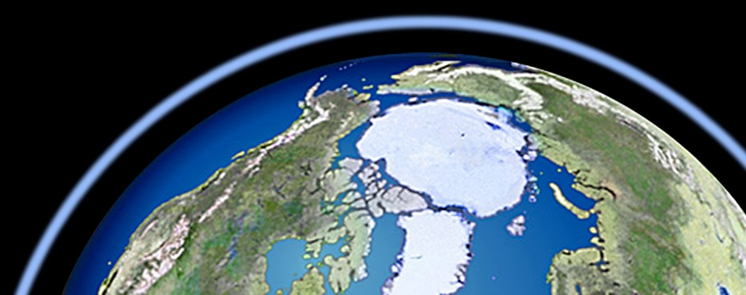

The Science: The Greenhouse Effect
1) Solar radiation
in the form of light waves
pass through the
atmosphere
3) Some energy is radiated back into space by the earth in the form of infrared waves
4) Some of this outgoing infrared radiation is trapped by the earth’s atmosphere and warms it
2) Most of this radiation
is absorbed by the
Earth and warms it

Slide 33
The Science: The Greenhouse Effect
6) As the greenhouse gas layer thickens, more radiation is retained by the atmosphere, and less is radiated back into space
5) Burning fossil fuels like coal, gas, petrol, and diesel releases CO2 and other greenhouse gases creating a layer around the earth.

Slide 34
Carbon Dioxide
(CO2)
Greenhouse Gases
Methane
(CH4)
While the greenhouse effect outlined above is a natural and essential phenomenon that helps maintain the Earth’s temperature, the balance of greenhouse gas ‘sources’ and ‘sinks’ are affected by humans leading to increased concentrations in our atmosphere, which in turn causes global temperatures to rise. (See Carbon Cycle on the next slide)
The most abundant greenhouse gases in the Earth’s atmosphere are carbon dioxide, methane, nitrous oxide, ozone, and chlorofluorocarbons.
Why the focus on Carbon? CO2 makes up 82% of the harmful gases being released into our atmosphere. When discussing GHGs we relate everything back to Carbon, treating it like a currency for environmental footprint.
Nitrous Oxide
(N20)
Ozone
(O3)
Chloro-fluorocarbons (CFC)
Carbon Monoxide
(CO)
Sulphur Dioxide
(SO2)

Slide 35
The Carbon Cycle
Carbon Dioxide
(CO2)
Carbon is essential to all life on Earth – it’s in our DNA, in the food we eat and the air we breathe. The amount of carbon on Earth has never changed but where carbon is located is constantly changing – it flows between the atmosphere and organisms on Earth as it’s released or absorbed. This is known as the carbon cycle – a process that has been perfectly balanced for thousands of years.
This essential system is being thrown off kilter as the Earths natural carbon sources and sinks are being thrown off kilter from human activity.
We’re releasing more carbon into the atmosphere than the Earth’s natural carbon sinks can absorb. Our continued reliance on fossil fuels for energy means billions of tonnes of carbon are released into the atmosphere every year. The importance of carbon sinks has never been greater.

Slide 36

Did you know?
When we talk about our Carbon footprint and how we can reduce it we’re not just referring to Carbon Dioxide.
This is because carbon acts as a currency for greenhouse gas emissions. The other gases are converted into carbon, each getting a different exchange rate depending on how harmful it is. This allows us to effectively compare emission impacts across industries and come up with cross-sectoral solutions.
So, just like we use Euro to place value on and manage our assets, we use Carbon to measure our impact on the climate.
Carbon as a Currency

Slide 37

Put simply, we’re using up more resources than the Earth’s systems can handle.
While it’s important to understand the basic Science of Climate change and the severity of the problems we’re facing, as SMEs, it is more important we know what’s driving it.
The Drivers of Climate Change

Slide 38
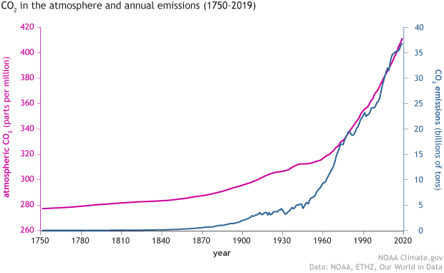
What’s Causing Climate Change?
97% of climate scientists agree that man made pollution is causing climate change and the science is clear to see when we look at the Emissions and atmospheric CO2

Slide 39
“
‘It is “unequivocal” that human influence has warmed the atmosphere, oceans and land, with human activities responsible for approximately 1.1°C of warming since the late 19th century. The contribution of natural factors to this warming is estimated to be close to zero.
“
IPCC Working Group I

Slide 40
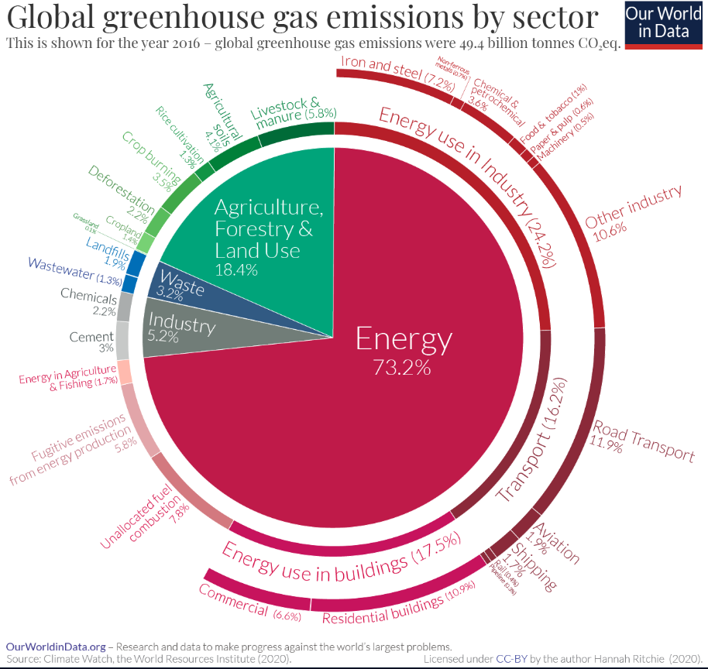
Energy
Fossil fuels – coal, oil and gas – are by far the largest contributor to global climate change, accounting for over 75 per cent of global greenhouse gas emissions and nearly 90 per cent of all carbon dioxide emissions.
Just blaming fossil fuels and the natural resource companies extracting them would be too simplistic. It is important we look at what activities are causing these fossil fuels to be burnt.

Slide 41
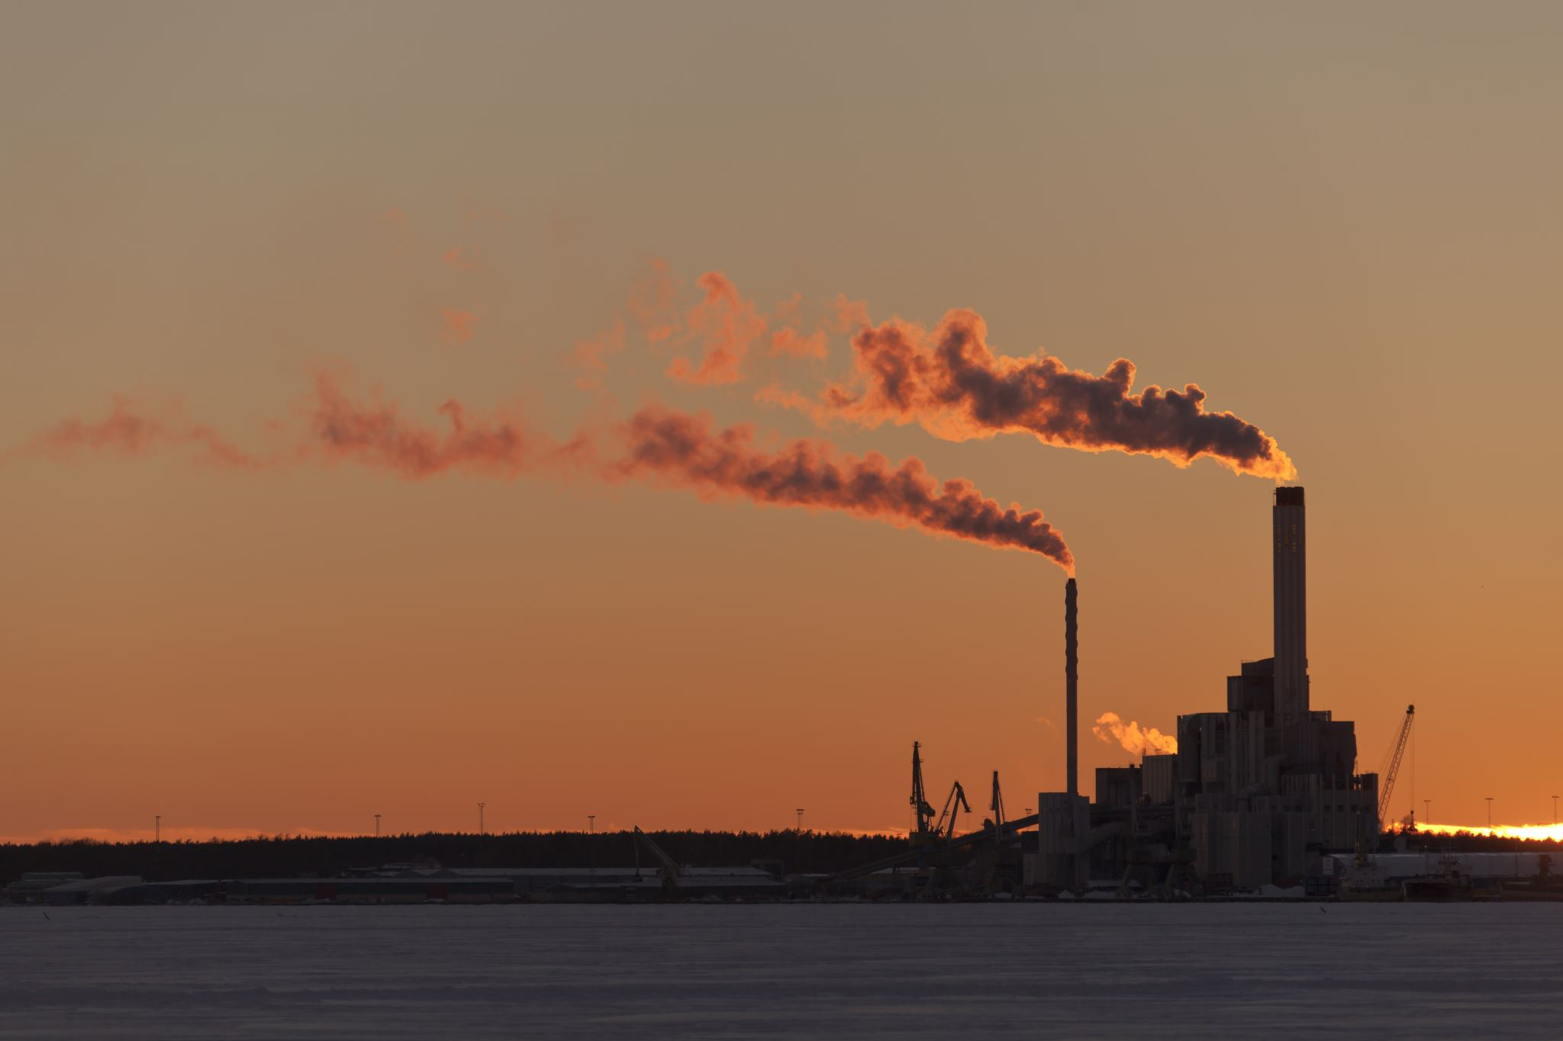
Activities that are causing these fossil fuels to be burnt
1. Generating Power
Generating electricity and heat by burning fossil fuels causes a large chunk of global emissions. Most electricity is still generated by burning coal, oil, or gas, which produces carbon dioxide and nitrous oxide – powerful greenhouse gases that blanket the Earth and trap the sun’s heat.
Globally, one third of all electricity is generated from renewable sources, but the share continues to grow.
UN Climate Action: Causes and Effects of Climate Change

Slide 42
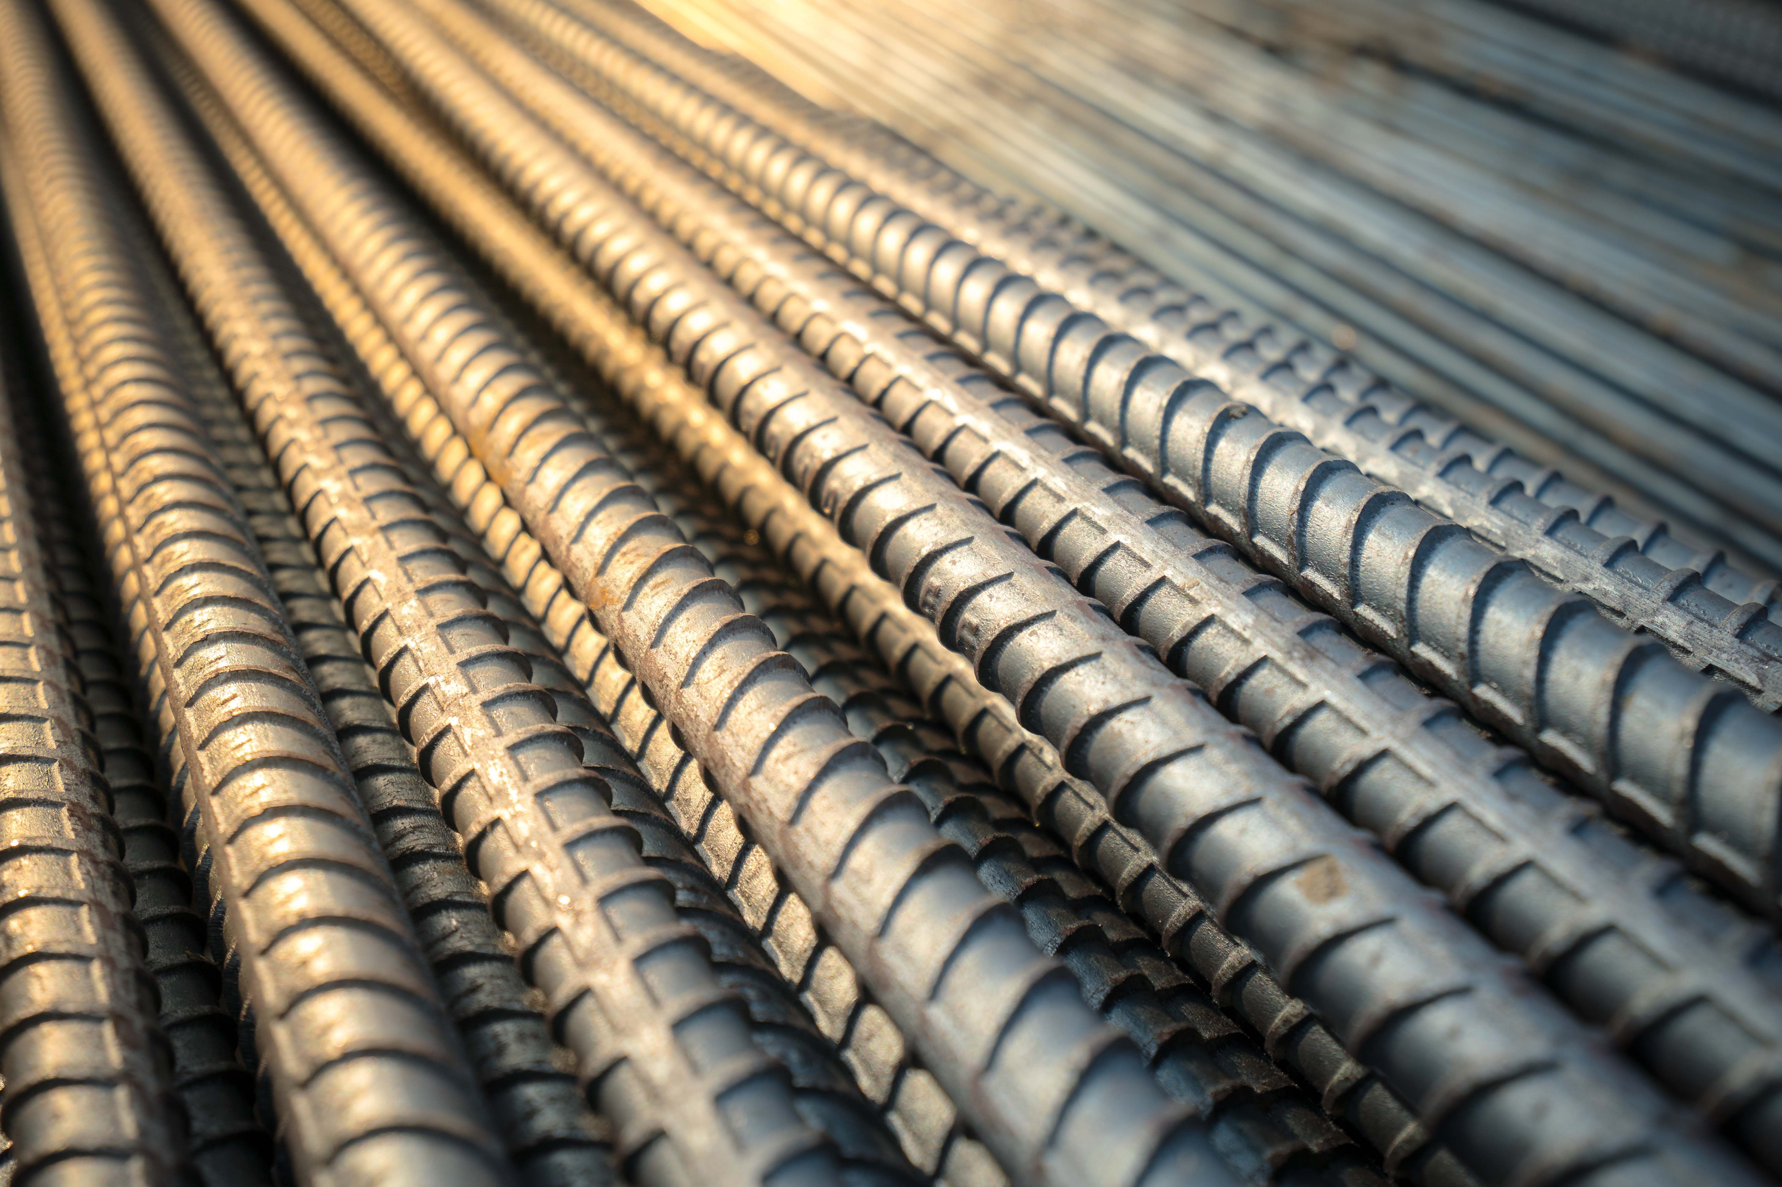
Activities that are causing these fossil fuels to be burnt
2. Manufacturing Goods
Manufacturing and industry produce emissions, mostly from burning fossil fuels to produce energy for making things like cement, iron, steel, electronics, plastics, clothes, and other goods. Mining and other industrial processes also release gases, while machines used in the manufacturing process often run on fossil fuels.
As businesses it is important, we look into our supply chains, so we are fully aware of our impact across the board.
UN Climate Action: Causes and Effects of Climate Change

Slide 43
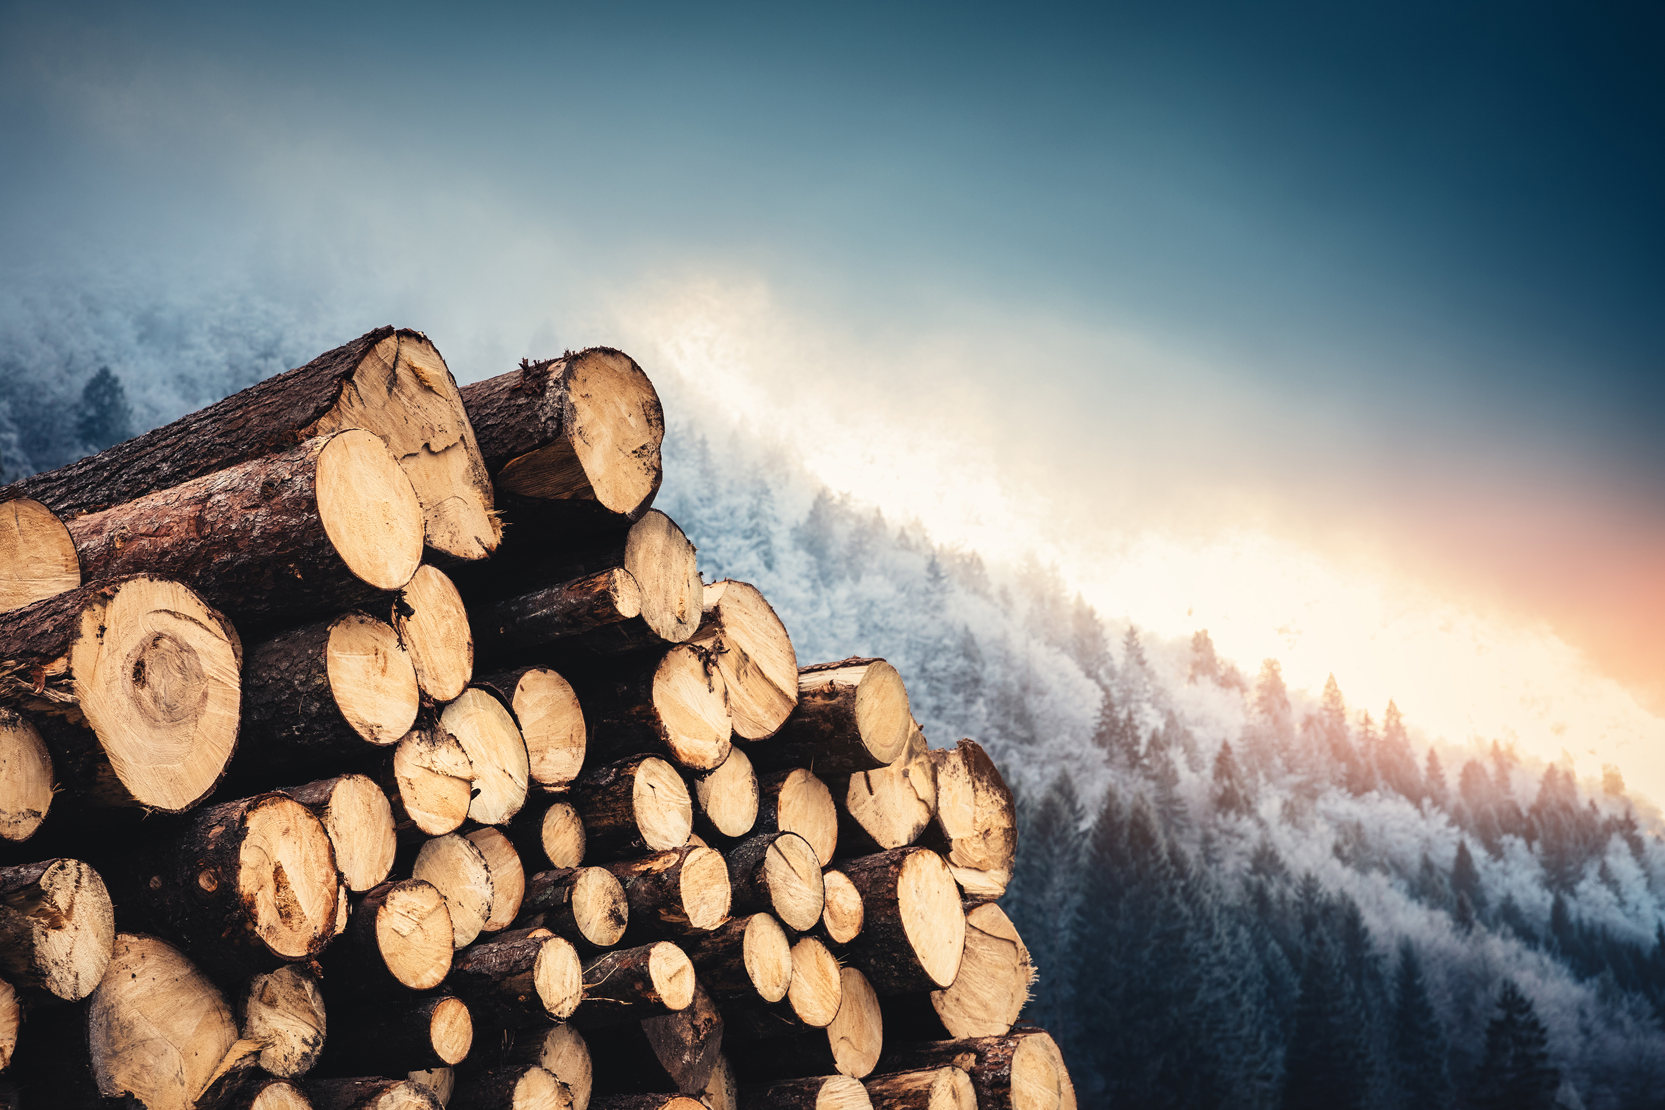
Activities that are causing these fossil fuels to be burnt
03
3. Deforestation
Around the globe forests are being cleared for timber, fuel and to make way for pastures and other intensive farming.
Each year approximately 12 million hectares of forest are destroyed. Since forests absorb carbon dioxide, destroying them also limits nature’s ability to keep emissions out of the atmosphere. Deforestation, together with agriculture and other land use changes, is responsible for roughly a quarter of global greenhouse gas emissions.
UN Climate Action: Causes and Effects of Climate Change

Slide 44
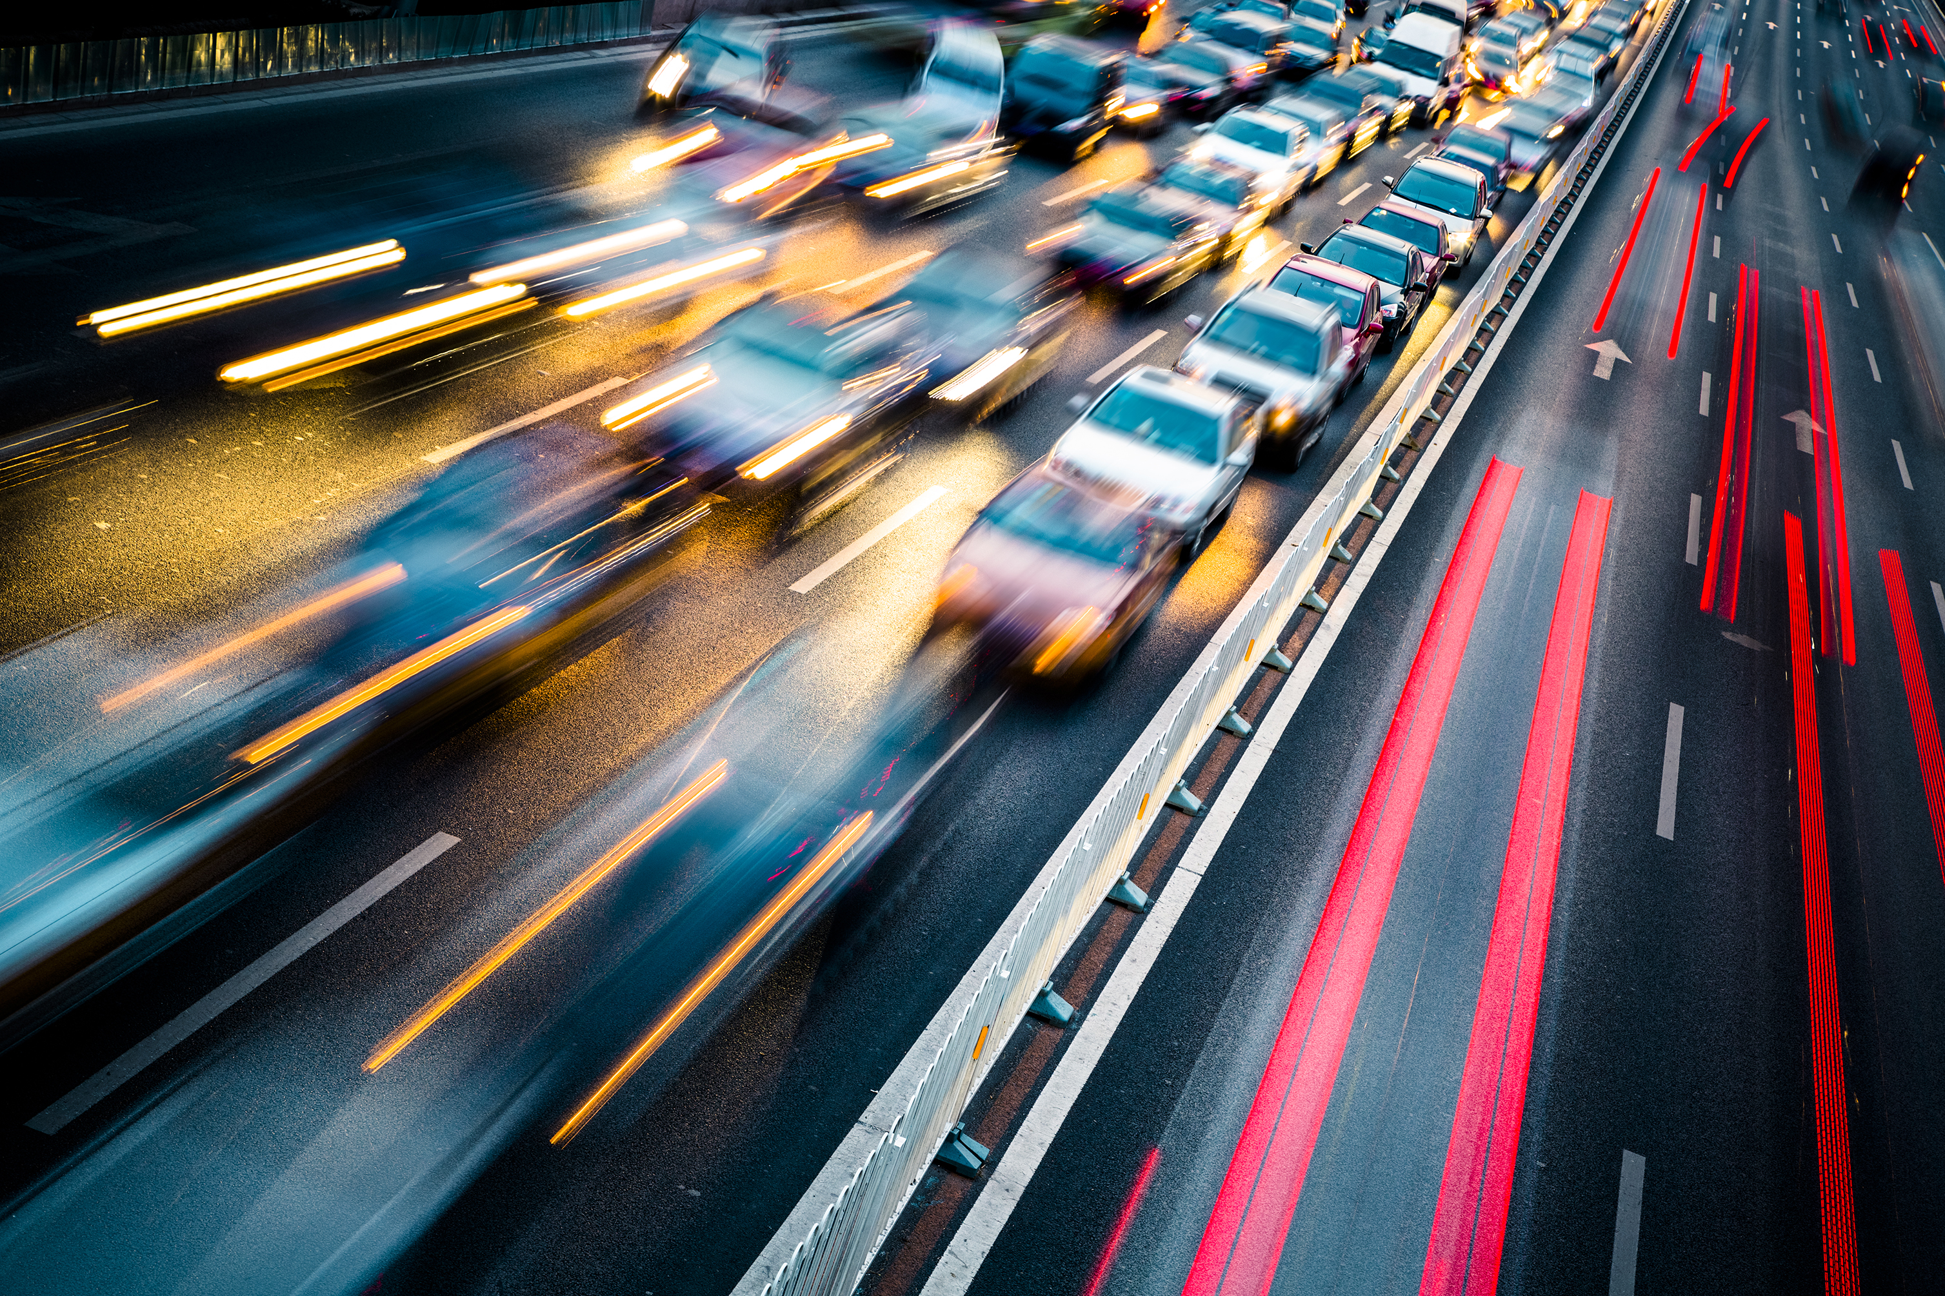
Activities that are causing these fossil fuels to be burnt
4. Using Transportation
04
Most cars, trucks, ships, and planes still run on fossil fuels. That makes transportation a major contributor of greenhouse gases, especially carbon-dioxide emissions. Road vehicles account for the largest part, due to the combustion of petroleum-based products, like gasoline, in internal combustion engines. But emissions from ships and planes continue to grow. Transport accounts for nearly one quarter of global energy-related carbon-dioxide emissions. And trends point to a significant increase in energy use for transport over the coming years.
UN Climate Action: Causes and Effects of Climate Change

Slide 45
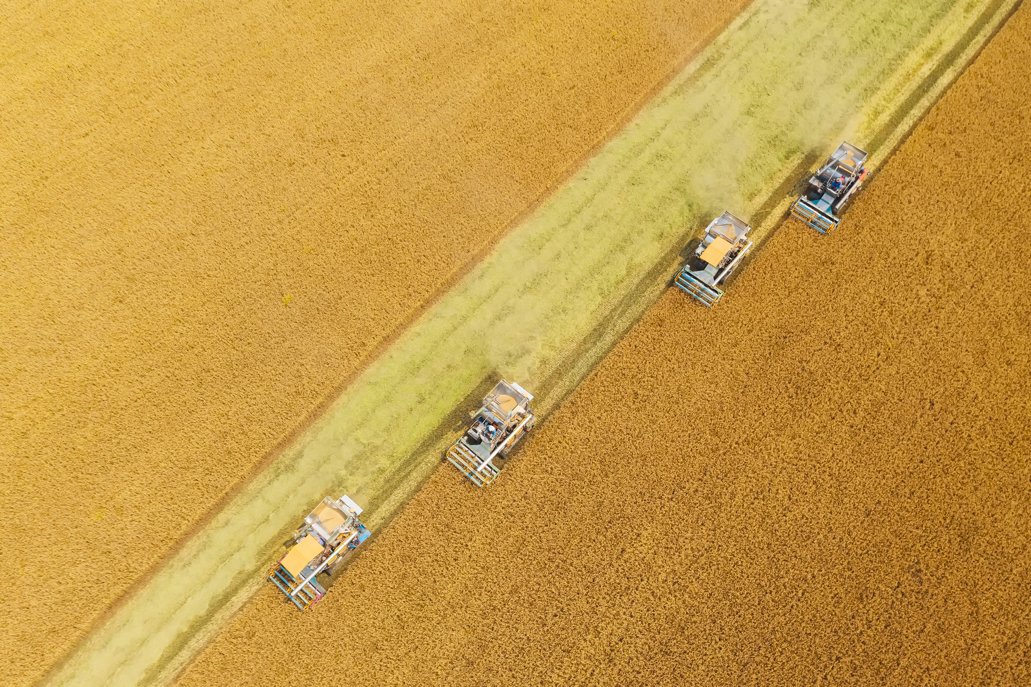
Activities that are causing these fossil fuels to be burnt
05
5. Producing Food
Producing food causes emissions of carbon dioxide, methane, and other greenhouse gases in various ways, including through deforestation and clearing of land for agriculture and grazing, digestion by cows and sheep, the production and use of fertilizers and manure for growing crops, and the use of energy to run farm equipment or fishing boats, usually with fossil fuels. All this makes food production a major contributor to climate change. And greenhouse gas emissions also come from packaging and distributing food.
UN Climate Action: Causes and Effects of Climate Change

Slide 46

Activities that are causing these fossil fuels to be burnt
06
6. Powering Buildings
Globally, residential and commercial buildings consume over half of all electricity. As they continue to draw on coal, oil, and natural gas for heating and cooling, they emit significant quantities of greenhouse gas emissions. Growing energy demand for heating and cooling, with rising air-conditioner ownership, as well as increased electricity consumption for lighting, appliances, and connected devices, has contributed to a rise in energy-related carbon-dioxide emissions from buildings in recent years.
UN Climate Action: Causes and Effects of Climate Change

Slide 47
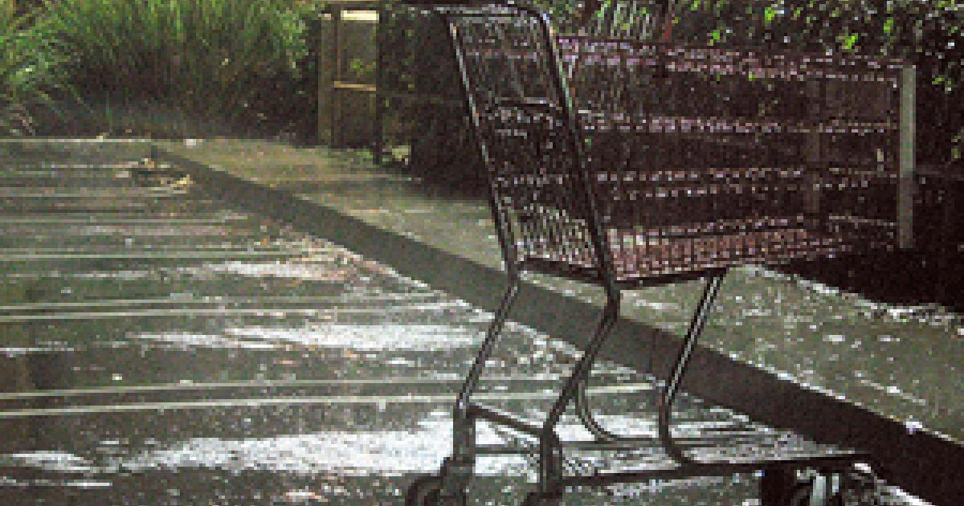
Activities that are causing these fossil fuels to be burnt
08
7. Consuming Too Much
Overconsumption in general is causing an increase in the emission of greenhouse gases. The take make waste model of consuming goods such as clothing, electronics, and plastics is unsustainable and as well as producing emissions it contributes towards pollution.
As businesses, we can look to incorporating circular models to reduce this consumption as well as producing products that are built to last.
UN Climate Action: Causes and Effects of Climate Change

Slide 48



When you think of Sustainability, what comes to mind?
Financial Sustainability?
Carbon Reduction?
Protecting Biodiversity?
Human Rights issues?
Inclusivity?
Sustainability covers a wide array of issues and topics

Slide 49
SECTION 3
Sustainability In Depth:
Economic, including Circular Economy
Notes:
Sustainability In Depth: Environmental

Slide 50
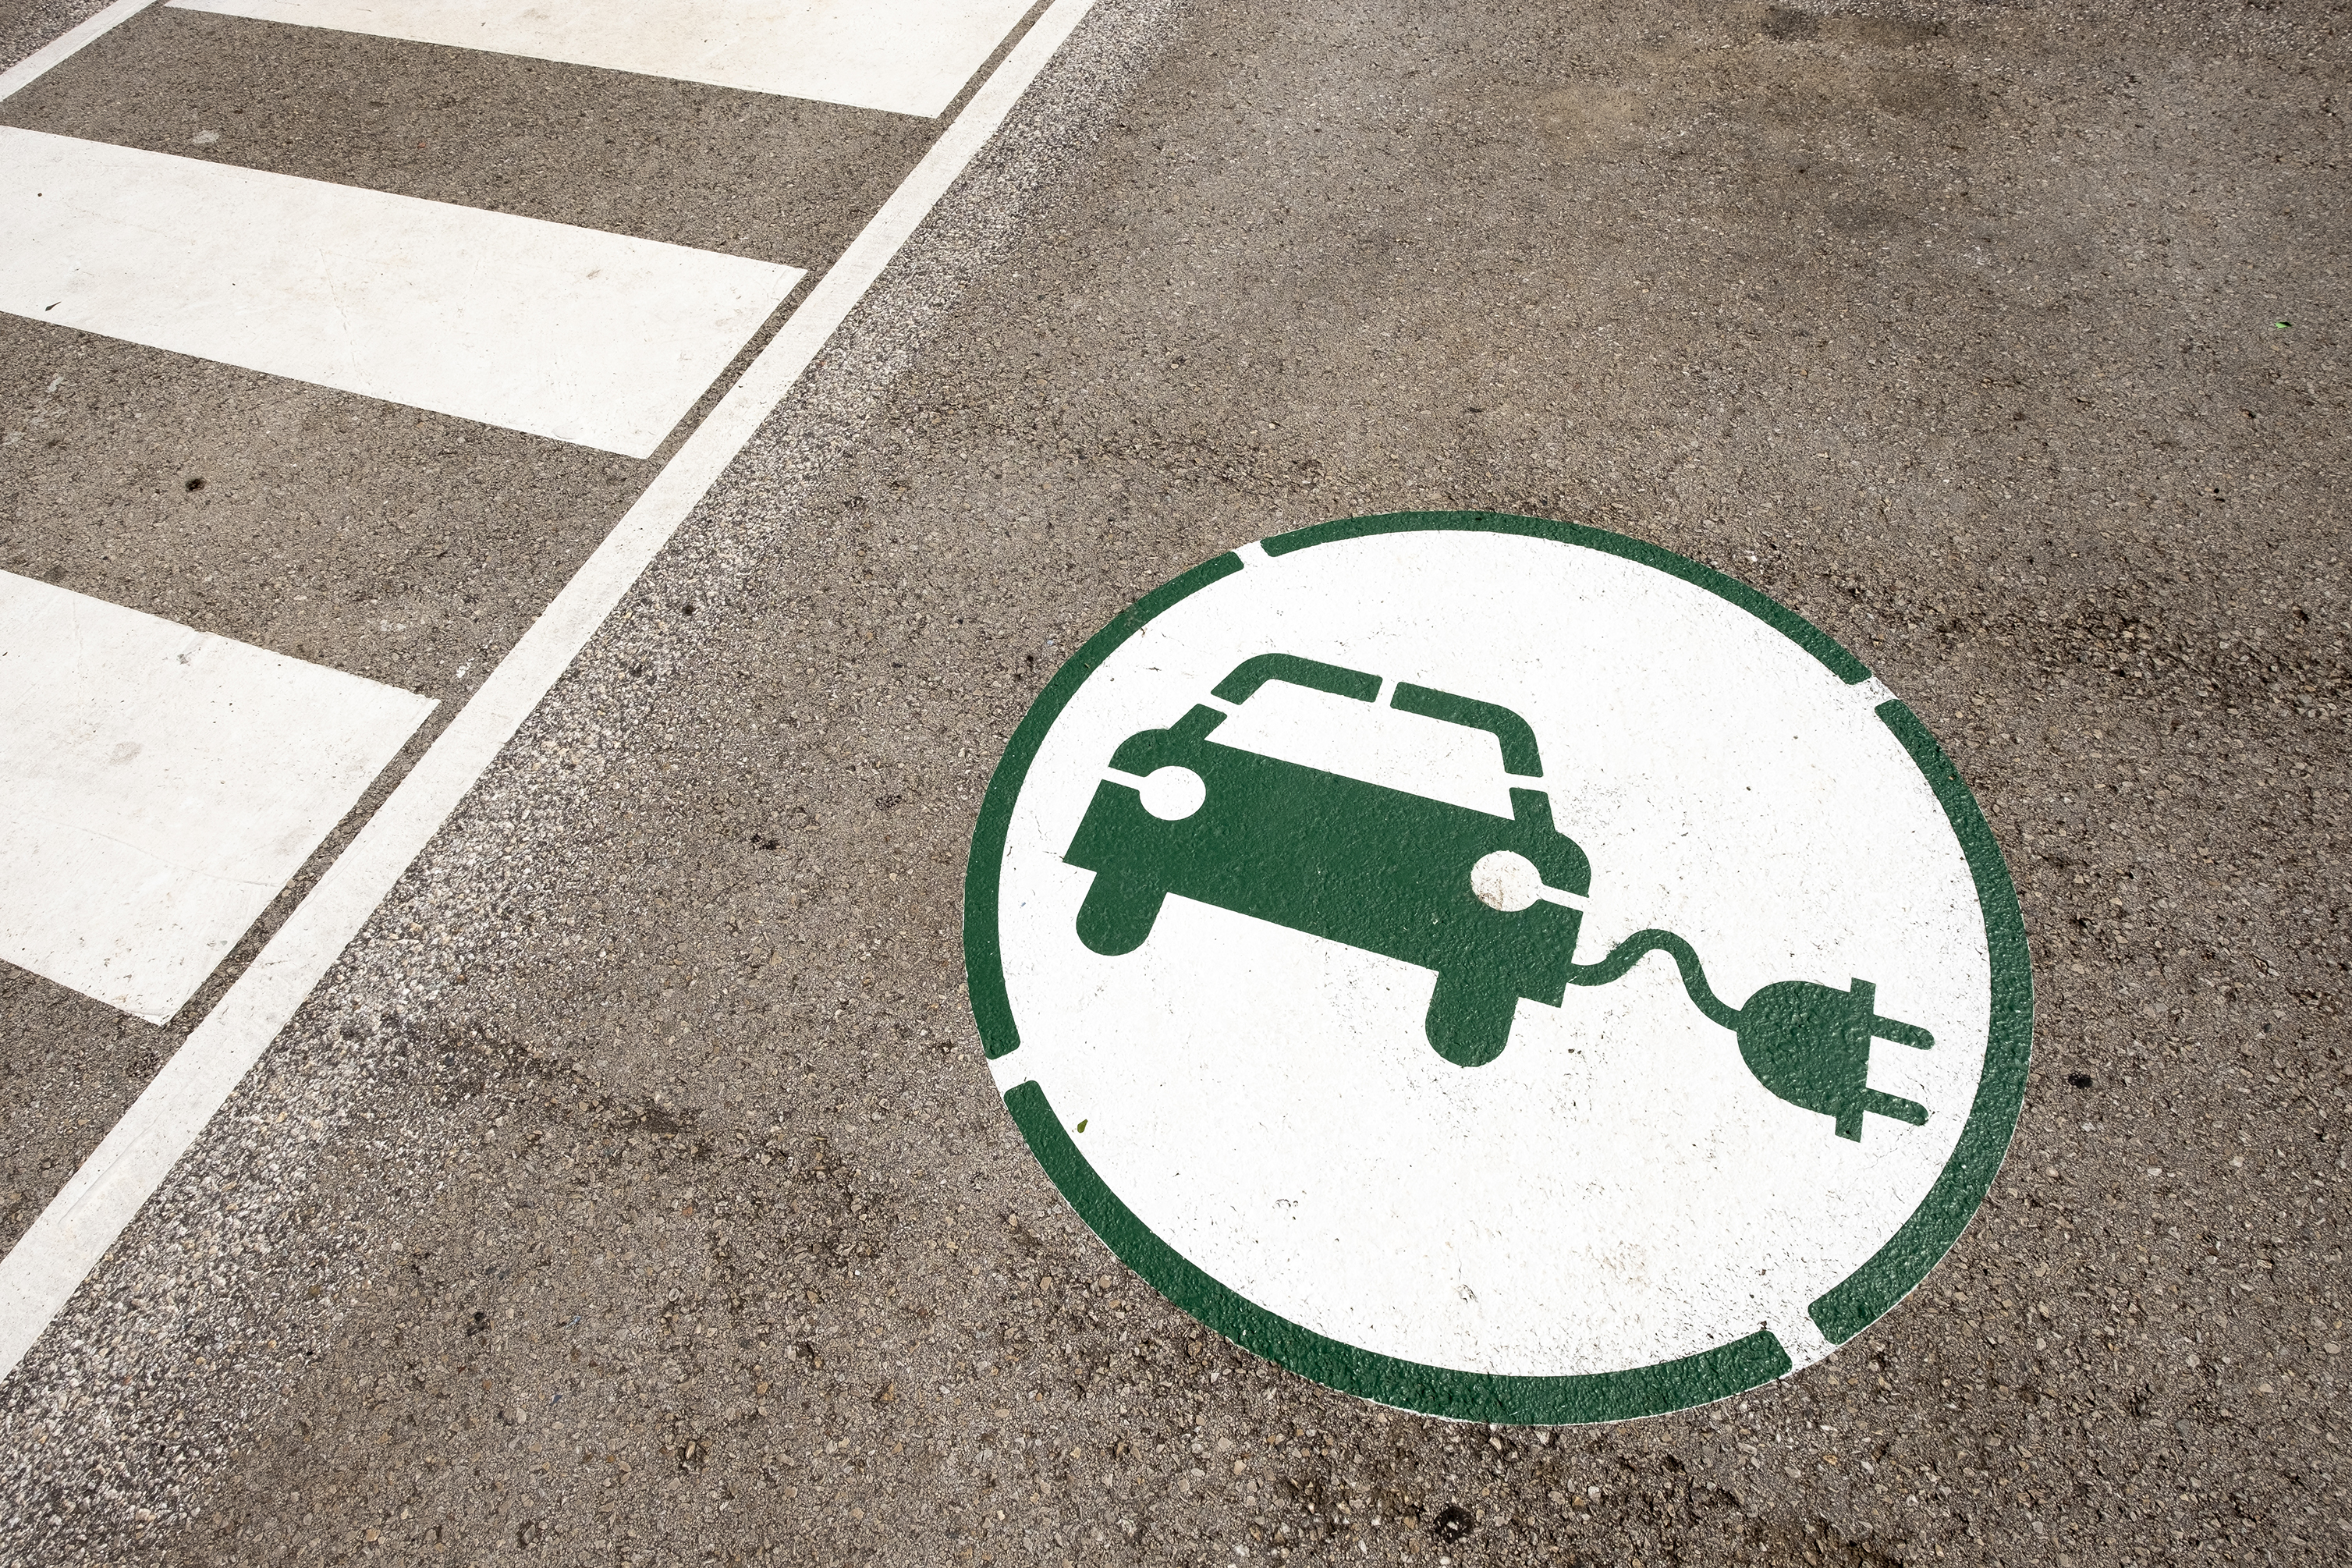
SMEs are in the Driving Seat of Environmental Impact
SMEs are at the forefront of change. They have more flexibility than larger organisations to implement and adapt sustainability strategies and programs to reduce business risk, improve reputation and provide opportunities for cost savings. Even the simplest energy efficiency measures can generate savings and make a difference to your business.
Examples include:
Renewable energy, such as solar, wind, hydroelectric, and biomass.
Recycling of paper, plastics, card, metals (e.g., iron and steel, and minerals)
Reduce paper waste, energy consumption,
Work remotely if possible, to reduce carbon emissions
Choose environmentally friendly consumables

Slide 51
Economic Drivers
There are many drivers pushing SMEs to make changes to their business models so that they are kinder to the environment. Let’s look at some current drivers…
Supply chain disruptions
Most businesses now have global supply chains with 76% of suppliers identifying potential climate risks in their supply chain. These risks can be caused by extreme weather or health events caused by climate and environmental damage. Considering these risks and how to mitigate them is an important driving factor for Business Sustainability.
Consumer Demand for Sustainability
While consumers have been expressing an interest in sustainable products and offerings for years, when ultimately faced with sustainable choices, consumers have historically reverted to old habitual behaviour. However, last year the IBM Institute for Business Value found that 93% of global respondents said the pandemic had influenced their views on sustainability with 51% of global consumers expressing that environmental sustainability was more important to them today that it was 12 months ago. (IBM: Institute for Business Value)

Slide 52
Economic Drivers
Employee Demand
SMEs are becoming increasingly aware of the impacts everyday decisions have on the climate and so this is affecting their decisions when choosing where to work. Climate change and environmental protection is the issue that millennials care about the most and by 2025, millennials and beyond will make up to 75% of the global workforce who want to work for companies that are affecting positive change. SMEs depend on attracting the best talent, and so working on the becoming a more sustainable SME is a key step in creating your value proposition for a modern workforce.
Response to Pressure Movements
The modern environmental movement was born on the first Earth Day in April 1970, and since then traction has built year on year. From Greta Thunberg’s ‘Friday’s for Future’ strikes, to sectoral lobbying and pressure groups, combined with the transparency afforded by reporting SMEs can no longer hideaway. This now applies to SMEs of all sizes, as a certain social and environmental performance is required in order to build trust with your users and receive the social license to operate.

Slide 53
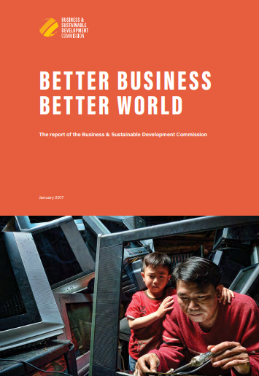
Economic Drivers
Efficiency Gains and Innovation
By aligning your SME with the sustainability goals, you are automatically taking a future focused lens to your operations which can provide you with a number of competitive advantages. This drives innovation as we are forced to explore new options and business models that are outside of the ‘norm’ as well as identifying the market opportunities of tomorrow.
Check out this report which outlines the 60 biggest market opportunities related to delivering the Sustainable Development Goals. Circular business models are also a key area of exploration as not only do they provide us with a greater social license and help us build trust and reputation, but they also help us to design out inefficiencies and save costs.

Slide 54

In our current economy, we take materials from the Earth, make products from them, and eventually throw them away as waste – the process is linear. In a circular economy, by contrast, we stop waste being produced in the first place.
The circular economy is based on three principles, driven by design:
Eliminate waste and pollution
Circulate products and materials (at their highest value)
Regenerate nature
It is underpinned by a transition to renewable energy and materials. A circular economy decouples economic activity from the consumption of finite resources. It is a resilient system that is good for business, people and the environment.
Circular Economy
As course authors, we highly recommend the work of ​
​
What is a circular economy? | Ellen MacArthur Foundation

Slide 55
In the circular economy, goods are produced, consumed, recycled, produced and re-consumed, entering a circular life cycle. It is a recent and increasingly widespread concept based on economic principles and other aspects such as the environment. In this way, the life cycle of products is extended. In that sense, the concept of circular economy covers all stages of the product life cycle, from product design and production process, through transformation and consumption to waste management, recycling & reuse.
The circular economy also demands greater efficiency in production processes and here the focus is on seeking to reduce the environmental and social impact of production, such as through promoting innovative industrial processes or more sustainable supply.
Circular Economy
Recycle
Refurbish
Reuse
Repair
Source
Produce
Sell
Use
Incinerate/
Landfil
We go into the potential of this topic for your SME in a lot more detail in Module 4: Greening your Product

Slide 56
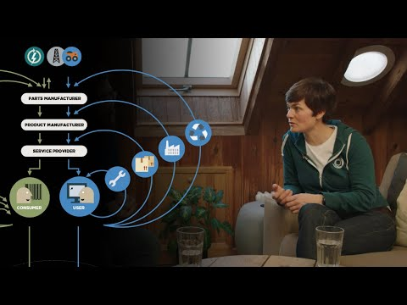
Click play to watch this short and powerful video (9 minutes) from Ellen MacArthur on the basics of the circular economy
* Includes Spanish subtitles

Slide 57

THE BIG PICTURE
European Green Deal
The EU created a plan for The Future of Europe (Green Deal) which is now Climate Law since July 2021 making it legally binding across all 27 member states.
Summarized opportunities that the European Green Deal) are as follows:
Target the 1st climate-neutral continent by 2050
New business models
Affordable, clean technology solutions
Carbon footprint reduction
Secure supply of clean and affordable energy and raw materials
Just Transition Mechanism €100 billion is being set aside to support those less fortunate

Slide 58
SECTION 4
Sustainability In Depth:
Social
Notes:
https://www.linkedin.com/posts/b-corp-uk_b-corp-certification-topics-activity-6996772964167786496-l3hn?utm_source=share&utm_medium=member_desktop
- Good link to B Lab issues

Slide 59
Are you a Good Corporate Citizen?
Many consumers want to support companies that have a reputation for being good corporate citizens. In 2019, a national survey found that
70% of consumers wanted to know what the brands they support are doing to address social and environmental issues, and
46% paid close attention to a brand’s social responsibility efforts when they buy a product.
On the flip side, another 2019 survey found that
25% of consumers had a “zero tolerance” policy toward companies that embrace questionable practices on the ethical front. A business that engages in socially or environmentally harmful behaviour risks losing a significant number of potential customers.

Slide 60
In simplistic terms, social sustainability is all about building trust both globally and locally. On a global social scale, a business needs to be aware of how its supply chain is being filled. Is child labour going into the end product? Are people being paid fairly? Is the work environment safe? Many of the large retailers have struggled with this as public outrage over tragedies like the Bangladesh factory collapse.
In the local context, companies have come up with many ways to give back, including fundraising, sponsorship, scholarships and investment in local public projects.
In terms of employees, businesses focus on retention and engagement strategies, including more responsive benefits such as better family benefits, flexible scheduling (e.g. remote working), and learning and development opportunities. Later in this module, we dive deeper into some of the key social sustainability issues facing Small Businesses.
READ MORE:
https://www.investopedia.com/articles/investing/100515/three-pillars-corporate-sustainability.asp
https://www.unglobalcompact.org/what-is-gc/our-work/social

Slide 61
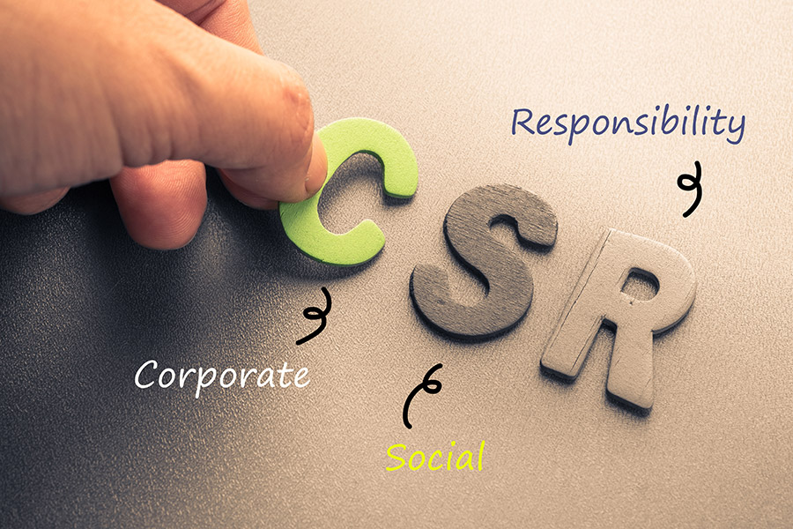
CSR, a foundation for sustainability
Corporate Social Responsibility (CSR) is a strategic d sustainable response from companies to address fair and prosperous societies with a modern resource-efficient and competitive economy and a climate-neutral Europe. It applies to products and services SMEs offer, but also working conditions, human rights, health, the environment, innovation, education, and training
CSR is about a company's responsibility for society in the sense of sustainable business practices. CSR refers to a company's responsibility for its impact on society, the environment and the economy. Source

Slide 62
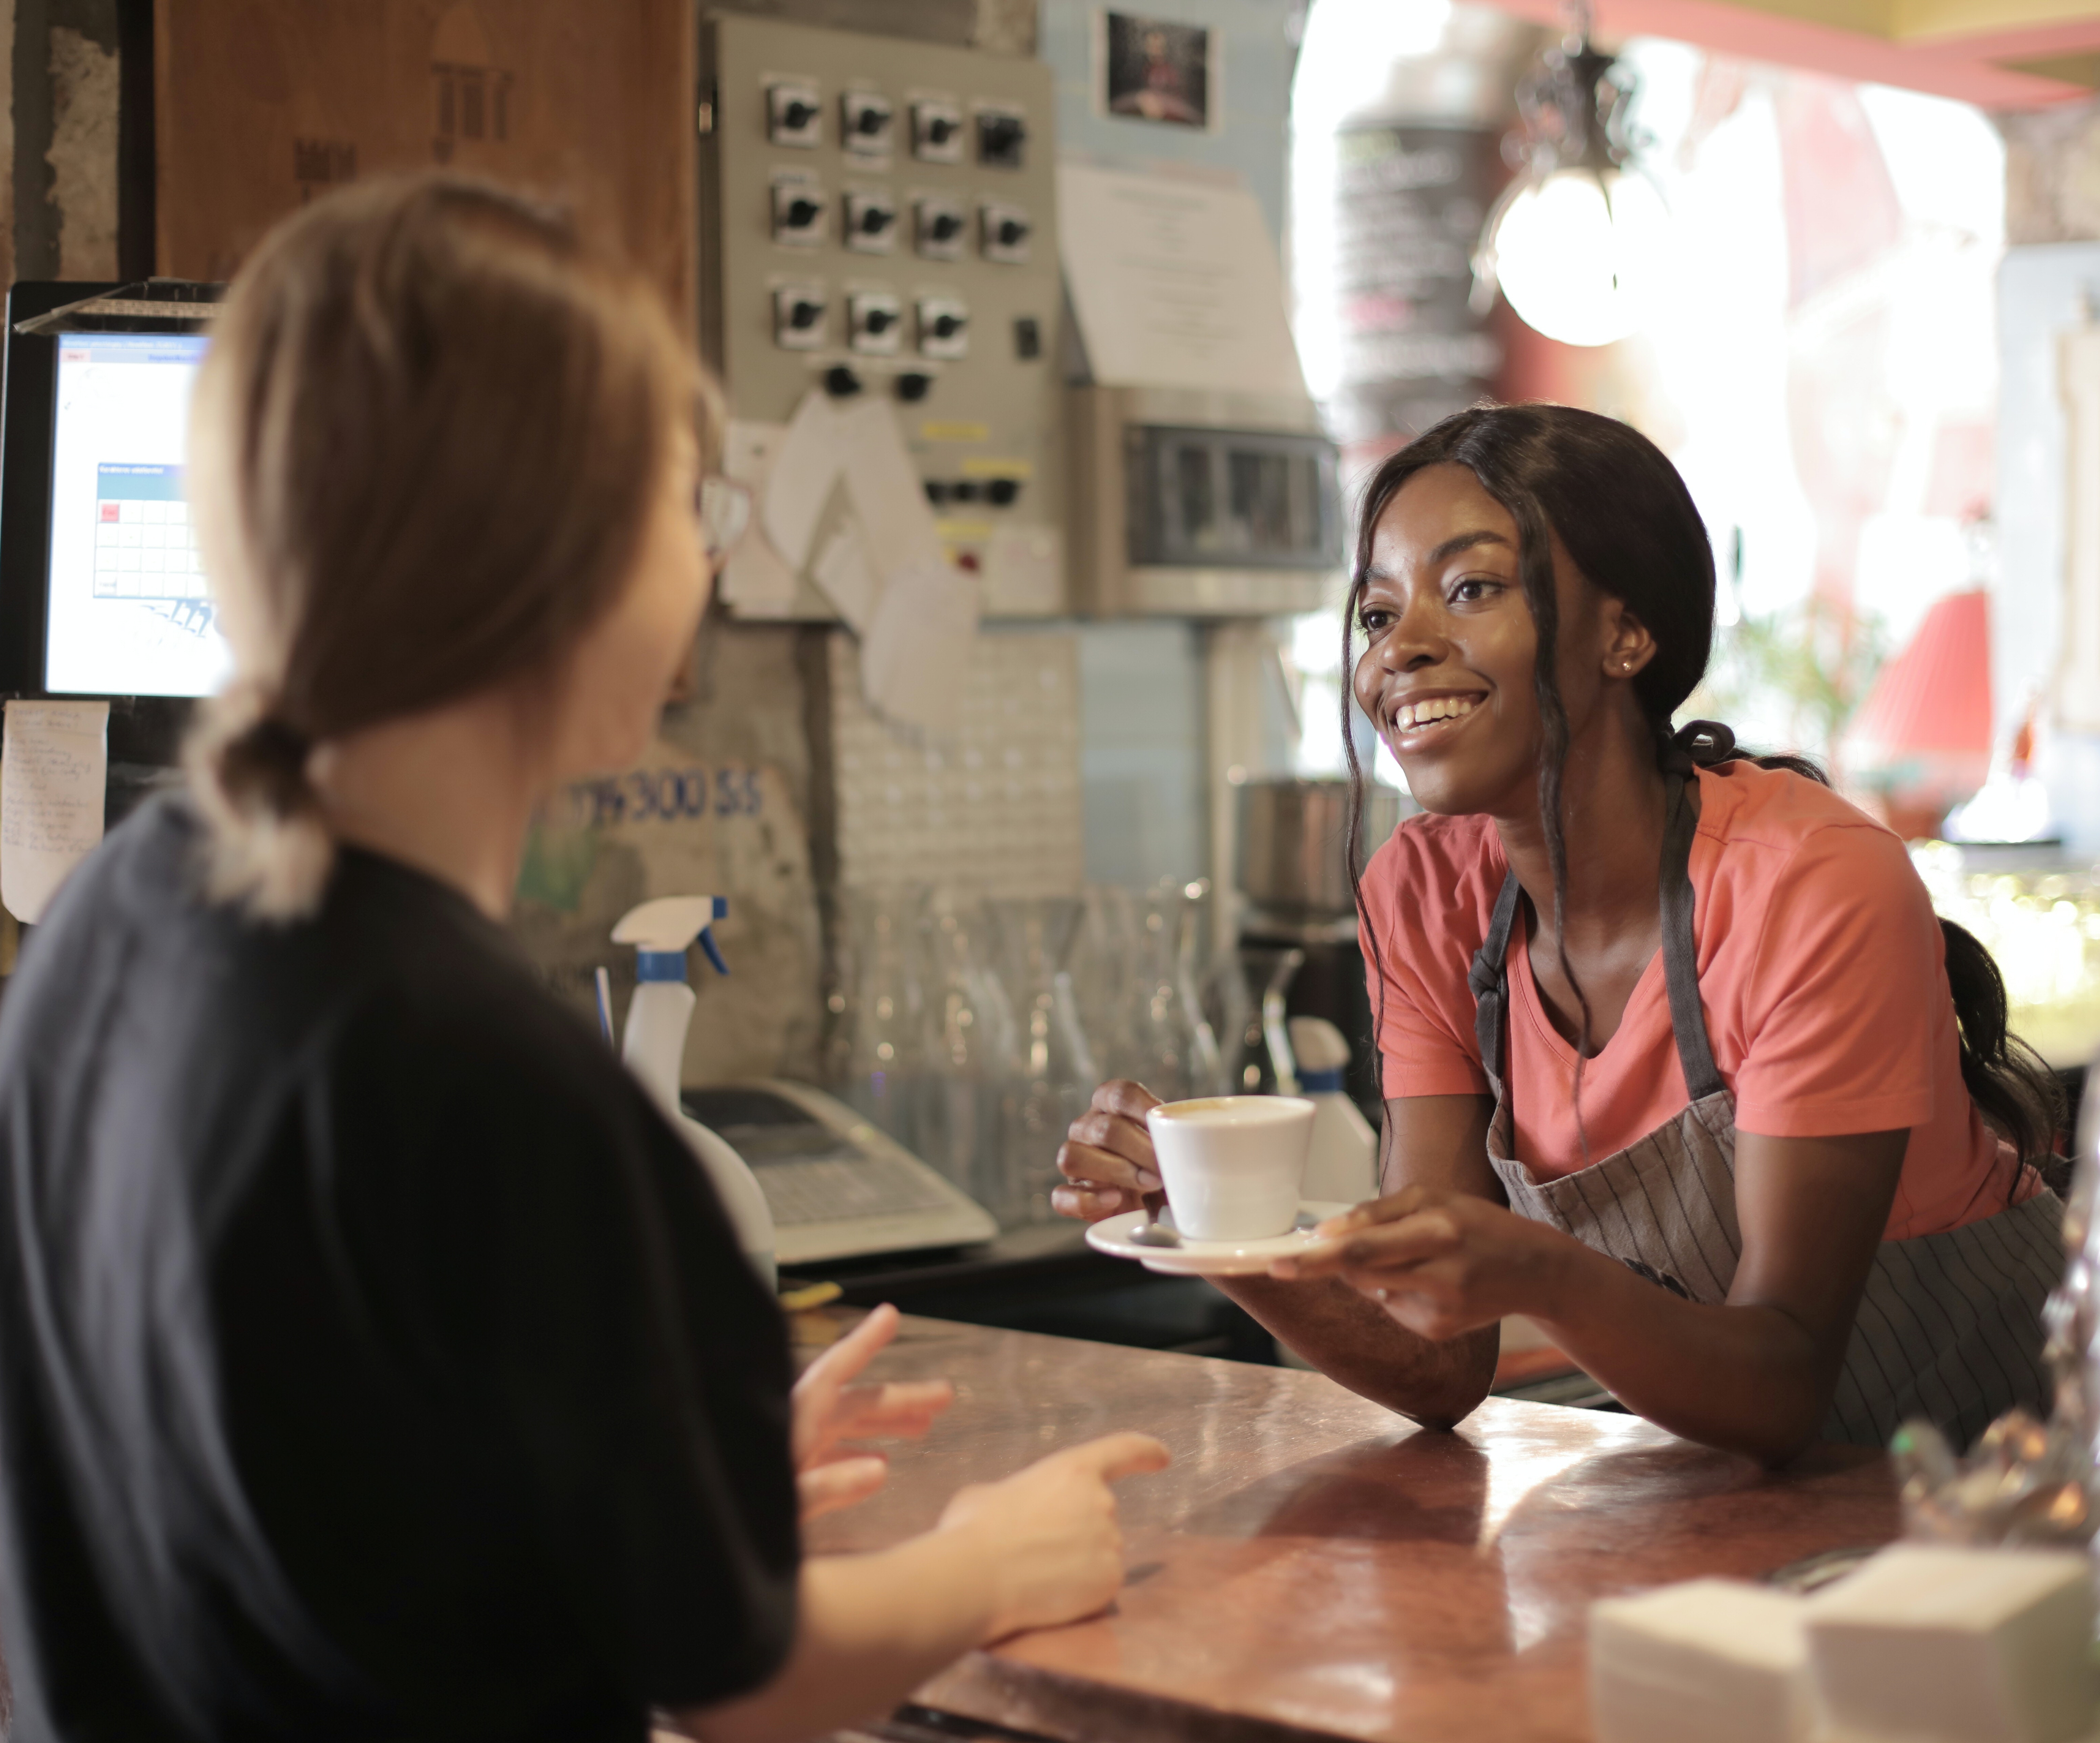

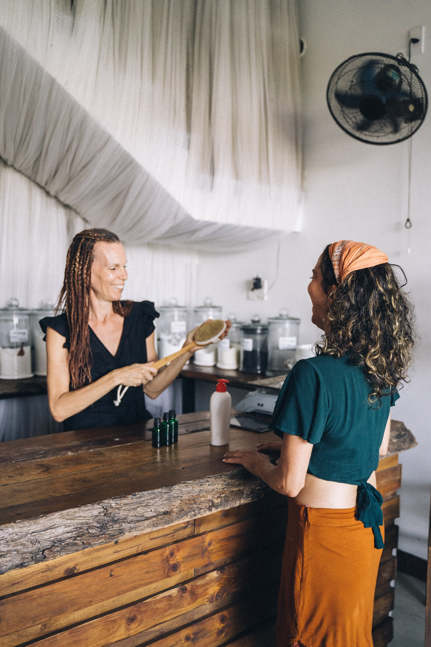
Strong SME CSR Benefits Everyone
Enterprises
Competitiveness
Builds Reputation and Trust
Become and Employer and Provider of Choice
Consumer and Stakeholder Engagement
Efficient and profitable operations and partnerships
Society
Supports prosperity, sustainability and wellbeing
Protects the environment, economy and culture
Social progress in diversity and inclusion
Combats unemployment and poverty
Economy
Innovation & Competitiveness
Responsible Businesses Sustainable businesses and sectors
Effective economies, protected environments and prosperous communities

Slide 63
SECTION 5
The Business Case for Sustainability

Slide 64
A recent survey by Boston Consulting Group (BCG) reported that 60% of businesses* believe that sustainable business is key to remaining competitive and 70% plan to increase their commitment over the next year.
Building sustainability into your SME can help you overcome key business issues across the board e.g., impact your sales, employee motivation, and carbon footprint.
Practicing sustainability has been proven to increase the bottom line of SMEs. While many small businesses are not able to match the lower prices of chains and larger businesses, they can often gain invaluable customer loyalty by establishing themselves as a positive influence in the community which will increase their sales.
These long-term results show the benefits of why you should master and develop the right, sustainability strategy for your SME. This is the focus of Module 2.

Slide 65
Case of competitive advantage
Sustainability can boos SME competitiveness through enhanced customer loyalty and satisfaction, repeat business, increase community support and loyalty, higher motivation of workers and reduced employee turnover (consistent productivity and quality outputs), improved public fund access, improved image and reputation and good suppliers who want to work and partner with you.
You will have the upper hand over a competitor (who might not have a focus on sustainability) attracting consumers who are conscious about who they buy from. As a result, customers are more likely to choose and recommend your brand as a brand of choice, and you’ll enjoy their repeated business.

Slide 66
Customers admire businesses that take positive steps toward improving the world.
By increasing your sustainability focus, you can provide three forms of value to consumers; emotional, social and functional.
Your sustainability credentialsCSR can help customers become aware of what you do and see what you do as a positive force in society. You become recognised as a ‘leader of positive change’ by ‘doing good for your environment, society or economy’. You win new customers and keep existing customers. You develop a platform to market and earn your audiences attention. Remember, having a good grasp of social responsibility is important to stakeholders and shareholders so keep it authentic and real. Hence, they are more likely to stick with you. Stakeholders, partners and customers are more likely to be interested in business offering who provide the services they need with a compelling CSR pledge.

Slide 67
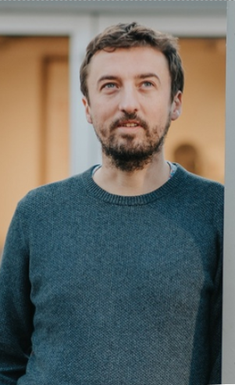
Case Study - 3fe Coffee https://3fe.com/​
Dublin's 3fe Coffee is one of the world's most innovative and progressive speciality coffee shops. 3fe have a company-wide project engaging in the circular economy, through inventive solutions to food waste at their cafes and finding new uses for industrial waste at their roastery.​
Reduced their food waste from 8kg per day to 2-3kg per day at their flagship location. Almost 2 tonnes of waste from their roastery is diverted to other businesses that can use it. ​
Saved money on bin charges due and made additional profit margins from re-used food waste. ​
It has contributed to changing the broader culture within the company towards sustainability. ​
Short and long-term marketing benefits, through increased awareness of the 3fe brand as a sustainability-driven company. ​

Slide 68
Case Study - 3fe Coffee https://3fe.com/​
3fe linked their sustainability activities to the 'Towards Responsible Business' - Irelands National Plan on CSR 2017-2020. They identified selected Sustainable Development Goals inked to their initiatives and then established a 'sustainability team' made up of people from different business sections to exchange ideas and make changes happen across the board. ​
Track their fascinating sustainability journey
Sustainability at 3fe Week 1​
Sustainability at 3fe Week 2​
Sustainability at 3fe Week 14
​

Slide 69
Next Module 2
Sustainable Strategy

