Slide 1
Module 2
Sustainable Strategy

Slide 2
M2: Sustainable Strategy
01
Why Create a Sustainable Strategy?
New risks and opportunities are facing SMEs at an unprecedented rate. And you know that sustainability is key to success. But mindful that ‘what is not measured, cannot be improved’, in the second module, we dive deeper into Sustainable Business Strategies, what matters to you, and the tools you need develop a roadmap for effective and measurable sustainability in your business.
02
Roadmap to an Effective Sustainability Strategy
03
What Matters to You? Defining your SME purpose and Identifying Key Issues
04
Setting Targets and Implementing Changes
05
Reviewing and Reporting on Progress

Slide 3
Section 01
Why Create a Sustainable Strategy?

Slide 4

Why Create a Sustainability Strategy?
Developing a Strategy (not another Strategy we hear you ask!) can take time and effort, so for many SME’s with tight resources, sustainability can often be viewed as a nice to have rather than an essential business activity.
An effective strategy is important for businesses to align all stakeholders (staff, customers, supporters) with a forward-focused vision.
However, SME’s that successfully introduce sustainability issues into their everyday activities and business development stand to gain in a number of key ways.
Notes:
Strategies are important for all businesses to align their stakeholders with a forward-focused vision.
Key areas of focus:
Strategic Approaches and Organisational Alignment
Goals and Objectives
Setting Targets
Sustainability Factors in Business Decisions
Aligning to the SDG’s
Your Enterprise Hub’s Effect on the Environment

Slide 5


Why Create a Sustainability Strategy?
New Challenges, Risks and Opportunities
By creating a sustainability strategy you are preparing your business for new risks and opportunities that are coming your way. Climate change is creating new risks in the supply chain, while new regulatory requirements bring new challenges, risks and opportunities.
Creating a Roadmap to success
An effective Sustainability Strategy will help your business prioritise and plan for the change coming your way. You will be prioritising what is important to you and your business, and in doing so providing a focus for your resources and stakeholders

Slide 6


Why Create a Sustainability Strategy?
Drive Innovation and Cost Savings
By choosing to create a sustainability strategy, you are switching from a business-as-usual approach to a forward focused mindset. Engaging with themes such as the circular economy, you are forcing your company to develop new approaches and offer new services. Sustainability has the potential to reduce business costs from reducing energy consumption to improving employee productivity, a sustainable business model can save your company money. Read more: How Can Sustainability Reduce Business Costs? - performanceinspired.tv
Building a brand and growing your reputation
By building a sustainability strategy, you are illustrating your commitment towards transitioning to a green economy and in turn, building trust among your stakeholders. As a business, building trust is key. It enables you to deliver better experiences, increase loyalty, and retain more customers. Lots more on this in Modules 3 and 5.

Slide 7


Why Create a Sustainability Strategy?
Attract and Retain Employees
In a survey carried out by IBM, 68% of respondents stated that they would be more likely to accept a job with a business that they consider to be environmentally sustainable. By structuring and communicating your efforts you will be able to attract the best talent.
Engage Stakeholders
Collaborating and partnering is vital in developing your sustainability efforts particularly for smaller businesses with less access to resources at their disposal. By effectively planning and laying out your priorities you are inviting stakeholders, both internally and externally to get involved.

Slide 8

Why Create a Sustainability Strategy?
Cut Costs and Improve your bottom line
One of the easiest first steps you can take towards a more sustainable business is to look at your resource use. By cutting costs you can often cut emissions and reduce your carbon footprint overall while also improving your bottom line.

Slide 9
Section 02
Roadmap to an Effective Sustainability Strategy

Slide 10

Strategies come in a range of different forms and will differ depending on the nature of your business.
The Sustainability Strategy or report created by a large multinational may be very ambitious and data driven, but as an SME, you should start small (not no less ambitiously) and expand it with your business.
A strategy in its simplest form is all about choices. By creating a strategy, we are creating a framework that we can refer to for guidance when faced with difficult decisions and trade-offs as we move forward.
When starting a business, you wouldn’t jump in without first making a business plan. The same applies to your business sustainability journey. While a strategy may seem like an unnecessary undertaking, an effective Sustainability Strategy should help you prioritise and conserve resources so you can maximise your impact while focusing on your business practices.
Let's start with what is a Sustainability Strategy?

Slide 11
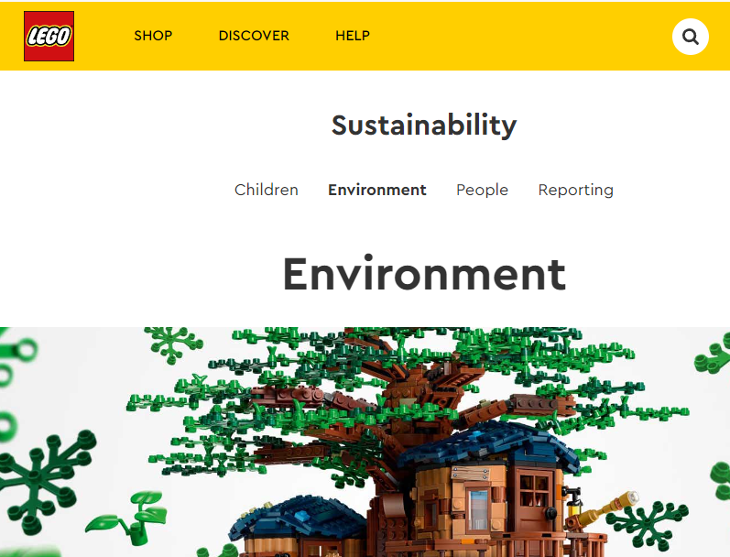
Sustainability Spotlight:
Leading companies are going "all in" on Sustainability. Take some time to explore how some of these companies are tackling the challenge…
LEGO
Lego are investing in the circular economy through their Lego Replay initiative. They’re focusing on the implementation of 12 responsible business principles that set what’s expected from its production sites, suppliers and partners and on topics such as ethics, people, children, and the environment. They also report annually to track their progress.

Slide 12
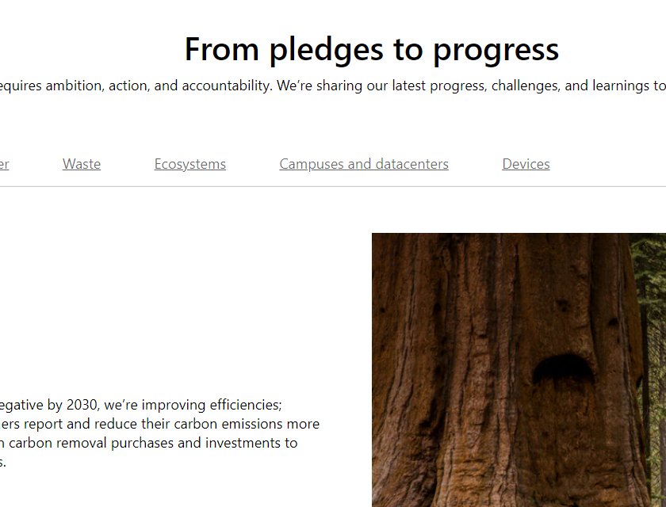
Sustainability Spotlight:
Microsoft
The technology company is investing heavily in their sustainability efforts with a particular emphasis on sharing their innovations and progress to help others too. They have committed to being carbon negative by 2030 and to remove all of their legacy emissions by 2050. Their other areas of focus are water positivity, reducing waste through circularity, protecting ecosystems, reducing the impact of datacentres and campuses, and reducing the overall impact of their devices.
To learn about the full extent of their reporting see their 2021 Environmental Sustainability Report

Slide 13
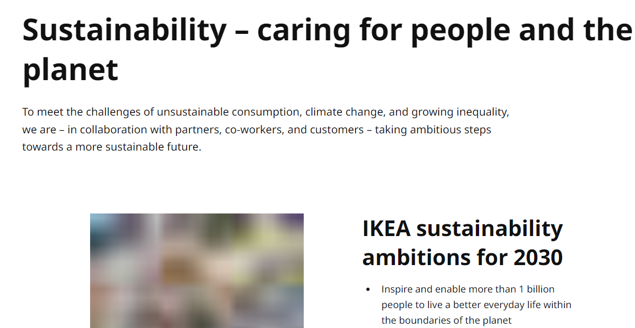
Sustainability Spotlight:
IKEA
Known for their DIY and often times less-expensive furniture, IKEA is now aiming to get recognition for its environmental sustainability efforts. Ikea has introduced new products to aid people in cutting their energy and water use, such as a tap nozzle that reduces water usage by 90 percent, and air-cleaning textiles. The company has also introduced new and more sustainable materials into their production process, with 100% cotton 77% wood in IKEA products coming from sustainable sources, citing that it will ultimately help lower costs while also doing the right thing.

Slide 14
When taking inspiration from some of the largest multinational organisations, it can be easy to become overwhelmed when looking at the scope of their efforts.
Some of the reasons commonly listed for SME’s not implementing sustainable changes are as follows:
Lack of Finances – For many businesses if an activity isn’t directly related to a business performance, it can be overlooked.
Lack of Time – Small businesses are often understaffed and so it can be difficult to find the time to put towards creating a strategy
Lack of Expertise – Sustainability as a subject can be daunting and when you lack the expertise in the area it can be possible to know where to start
Barriers to developing and implementing your own Sustainability Strategy

Slide 15
While a smaller company may not have the resources at their disposal to create global impact, they do have the advantage of much smaller barriers to implementing change with simpler structures allowing faster adaptation.
While the lack of access to resources like finance and staffing can be a problem for some businesses, many sustainable changes can be made incrementally with little impact on the day to day running of the business.
An effective Sustainability Strategy should meet you where you are. It should reflect your businesses priorities and focus resources towards where you can be most impactful.
In this module we will learn of a 6-step roadmap to develop a sustainability strategy which will allow you to create a strategy tailored to your needs.
Focusing on the Positives

Slide 16
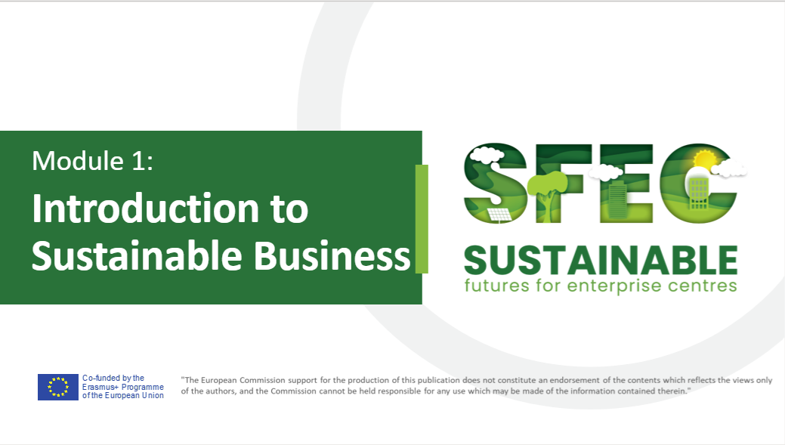
Re-cap before getting Started
The first step towards making sustainable changes to your business is to make sure you and your decision-making stakeholders are climate literate. If you haven’t checked it out already, Module 1 of this course goes into the three-pillar approach to sustainability in detail which are the foundation you need to work on your first strategy.

Slide 17
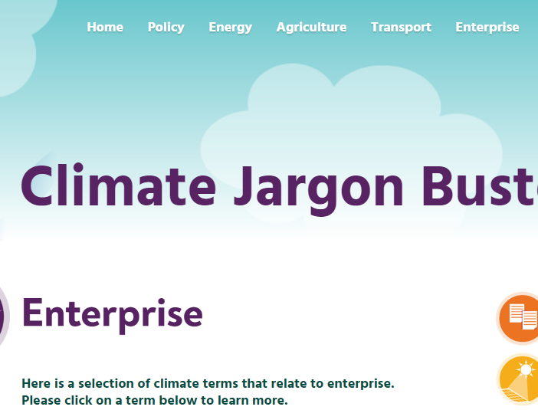
Jargon Buster
Sustainability and climate change is a highly complex and ever-changing issue that brings with it a lot of complicated jargon.
If you’re struggling with any terminology throughout these modules, use this handy Jargon Buster from Enterprise Ireland
Home - Climate Jargon Buster

Slide 18





Overview of the 6 Step Roadmap to developing an effective Sustainability Strategy for your Business
Define your purpose
Identify key issues
Set
Targets
Apply
Changes
Review
Report
Our next section brings us to Step 1, defining your purpose...

Slide 19
Section 03
What Matters to You? Defining your Purpose and Identifying Key Issues

Slide 20
Sustainability shouldn’t be developed in isolation, but instead be integrated with the overall mission of the business.
Start by reflecting on the context in which your business operates
what is your current performance?
in which ways does it have negative social and environmental impacts?
what are your competitors doing in their sustainability efforts?
what are your consumer expectations?
how can you contribute towards a more positive future on a local or regional level?
Putting Sustainability in Context
Notes:
https://youmatter.world/en/small-medium-business-sustainability-strategy/

Slide 21

Define your Purpose
“The public expectations of your company have never been greater. Every company must not only deliver financial performance but also show how it makes a positive contribution to society. Without a sense of purpose, no company, either public or private, can achieve its full potential”
Larry Fink, Chairman and CEO of Blackrock Inc. Larry Fink | BlackRock

Slide 22
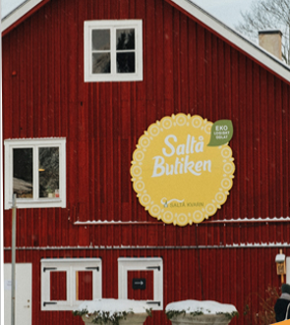
Example...
“I would not talk about sustainability as something separate from our core business. The different aspects of sustainability are so intertwined with everything we do. A successful business, a long-term sustainable business, must in every moment consider its impact”
Johan Ununger, CEO Saltå Kvarn, Swedish Organic Food SME with 60+ Employees
Carbon Offsetting
Since 2009, the company adapted carbon offset for their transport by planting trees to counter-act the carbon emissions caused by their transport of products. Additionally, Saltå Kvarn have cut their emissions by moving their transport from to truck carriers to railway and boat, contributing to a reduction of emission by 50%.

Slide 23

Your Purpose should
Provide a focal point for the business that guides everything it does
Promote game-changing innovation that looks beyond the current product portfolio and drives future growth
Benefit people’s lives and the world around us
Inspire employees and customers
Be constant and impermeable to short-term demands
Consider the Stakeholder and not just the Shareholder

Slide 24
Purpose example - Phoenix Design Aid, Denmark
https://phoenixdesignaid.com/
An International Design and Communications Agency SME with 22 employees, Phoenix Design Aid deliver contemporary and innovative designs, focusing on client needs and swift management.
Sustainable consumption and production is a priority for their company. They have contributed to the development of papers types and printing practices for many years, e.g. the development of recycled paper. They strive to minimise their CO2 emissions, by buying UN-issued emission credits and neutralise their CO2 emissions.
Education is a priority. They share their knowledge in areas of sustainability. Their support of PDAid Foundation and their work with Sauti Kuu Foundation and Kilimanjaro Initiative is commendable.
Certification: The Sustainable Development Goal. Phoenix Design Aid were the first graphic and communication agency to receive a certification in the Sustainable Development Goals (SDGs). Specifically, they have received a certification for their work and effort with 11 targets within SDG 4: Quality Education, SDG 12: Responsible Consumption and Production, SDG 13: Climate Action and SDG 17: Partnership for the Goals.

Slide 25

Consider all of your Stakeholders
Shareholders
Shareholder to Stakeholder Value
Stakeholders
Traditionally the purpose of a business was all about shareholder value. Whilst financial viability is still fundamental, companies now need to articulate a purpose beyond profit.
Why do you exist? What’s your why?
As a business you should strive to move beyond the surface level shareholder value, and consider providing value for your wider Stakeholders
Owners
Suppliers
Employees
Consumers
Local Community
Media
Government
Global Community

Slide 26
Define your Purpose: Vision, mission and values
While you may already have a Mission and a Vision, does it include sustainability? Perhaps it needs a refresh?
A strong MISSION STATEMENT is usually a concise phrase (about two to three sentences) that sets forward what the organisation does, how it does it, and, sometimes, why.
A VISION STATEMENT is a short statement—about one sentence—that describes the future-facing goals and ambitions of your organisation. It distils your vision for the future in a way that outlines your enterprise hub’s long-term goals and, similar to a mission statement, reflects your company’s core values.
The biggest difference between mission and vision statements is in the timeframe. A mission statement outlines all the things your company is doing in the present to reach your goal, while a vision statement describes what your enterprise hub is building toward in the future.

Slide 27
Your mission statement may include all or some of the following environmental components:
Articulate your environmental mission and goals.
Emphasize continuous environmental improvement.
Promote reuse, reduce and recycling.
Commit to communication and interaction with the public.
Emphasize compliance with relevant environmental laws and regulations. (Climate and Carbon targets for your country and sector).

Slide 28
Sustainability Principles to Guide your Vision, Mission and Purpose
Ground your vision in the best available science and most accurate math
Taking responsibility for your carbon footprint.
Empowering customers to follow suit
Embrace digital technology to help your suppliers and customers reduce their carbon footprints
Enlisting your employees - recognize that your employees will be your biggest asset in advancing innovation and try to create new opportunities to enable them to contribute to your efforts.

Slide 29

Also consider the following goals…
Goals related to the SDGS that matter most to you – we see Phoenix Design Aid, Denmark very clearly taking this approach
The leadership role your company will play in sustainability
Continuous environmental improvement and targets for same
Strong partnerships with your stakeholders and community

Slide 30
Section 03
What Matters to You? Defining your Purpose and Identifying Key Issues

Slide 31

Identify the sustainability issues that matter to you
No business can address all the issues that all stakeholders are interested in. But what issues are you most aligned to ?
Should your company tackle biodiversity or energy? Is protecting the local environment part of your responsibilities, or protecting the rights of people in the supply chain?
A rigorous process of identifying issues for inclusion in the strategy is therefore an essential starting point. Perhaps reviewing the Top 8 Environmental Sustainability Issues We Need to Address will give you inspiration
#1: Climate Change Largely considered the most urgent and impactful contemporary environmental crises by scientists and other experts, climate change is the most high-profile challenge facing the world today.
Source Top 8 Environmental Sustainability Issues We Need to Address | NREP​

Slide 32
#2: Natural Resource Use One of the top environmental problems facing the world is the challenge of natural resource use. Virtually all economic activity ties into natural resource use.
#3: Waste Production Of concern, not one only the rapid exploitation of various inputs, but also the growing gulf between the wealthy and the less advantaged. As the U.N. Environment Programme states, “We are facing a historic choice about how we use resources and the report scopes the potential of innovation, rethinking economic growth and the role of cities in building more resource efficient economies.
#4: Water Pollution Just one aspect - “The United Nations World Water Development Report 2017” found that “globally, it is likely that over 80% of wastewater is released to the environment without adequate treatment.
Identify the sustainability issues that matter to you
Source Top 8 Environmental Sustainability Issues We Need to Address | NREP​

Slide 33
#5: Deforestation Data from NASA shows that forests cover nearly a third of the world’s landmass, and they play an incredibly important role in the wider environment. Unfortunately, developing nations too often resort to practices such as slash-and-burn clearing and failing to care for the soil afterward, which perpetuates a vicious cycle requiring the clearing of more trees.
#6: Overfishing While fishing supports human populations across the globe and isn’t inherently harmful to the wider world, poor fishing practices can cause lasting harm.
#7: Ocean Acidification The ocean absorbs almost a third of the carbon dioxide released into the world. The past 200 years has seen approximately a 30 percent increase in [ocean] acidity and ecosystem disturbance
#8: Air Pollution Like many environmental risks, air pollution doesn’t impact every corner of the world the same. Underdeveloped countries are more at risk.
Identify the sustainability issues that matter to you
Source Top 8 Environmental Sustainability Issues We Need to Address | NREP​

Slide 34
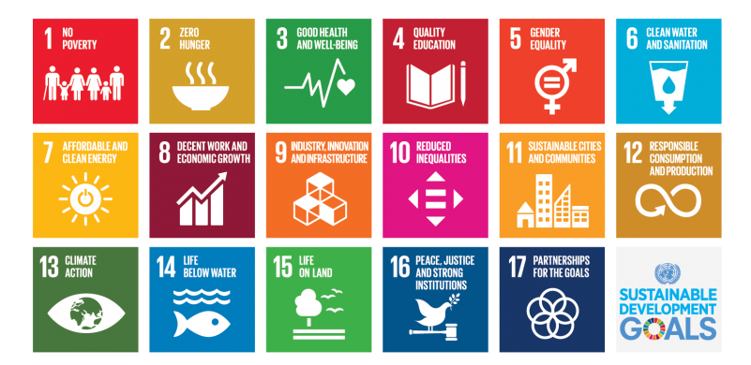
Have you identified the sustainability issues that matter to you? Now link them to the SDGs

Slide 35
Follow these steps when choosing your most important topics
Identify
Identify a long list of potential topics, and group them into 5- 10 key topics.
Engage
Engage internal and external stakeholders in discussing and ranking the topics
Prioritise
Prioritise topics for your company and its stakeholders.
Validate
Validate the choices with senior management.

Slide 36
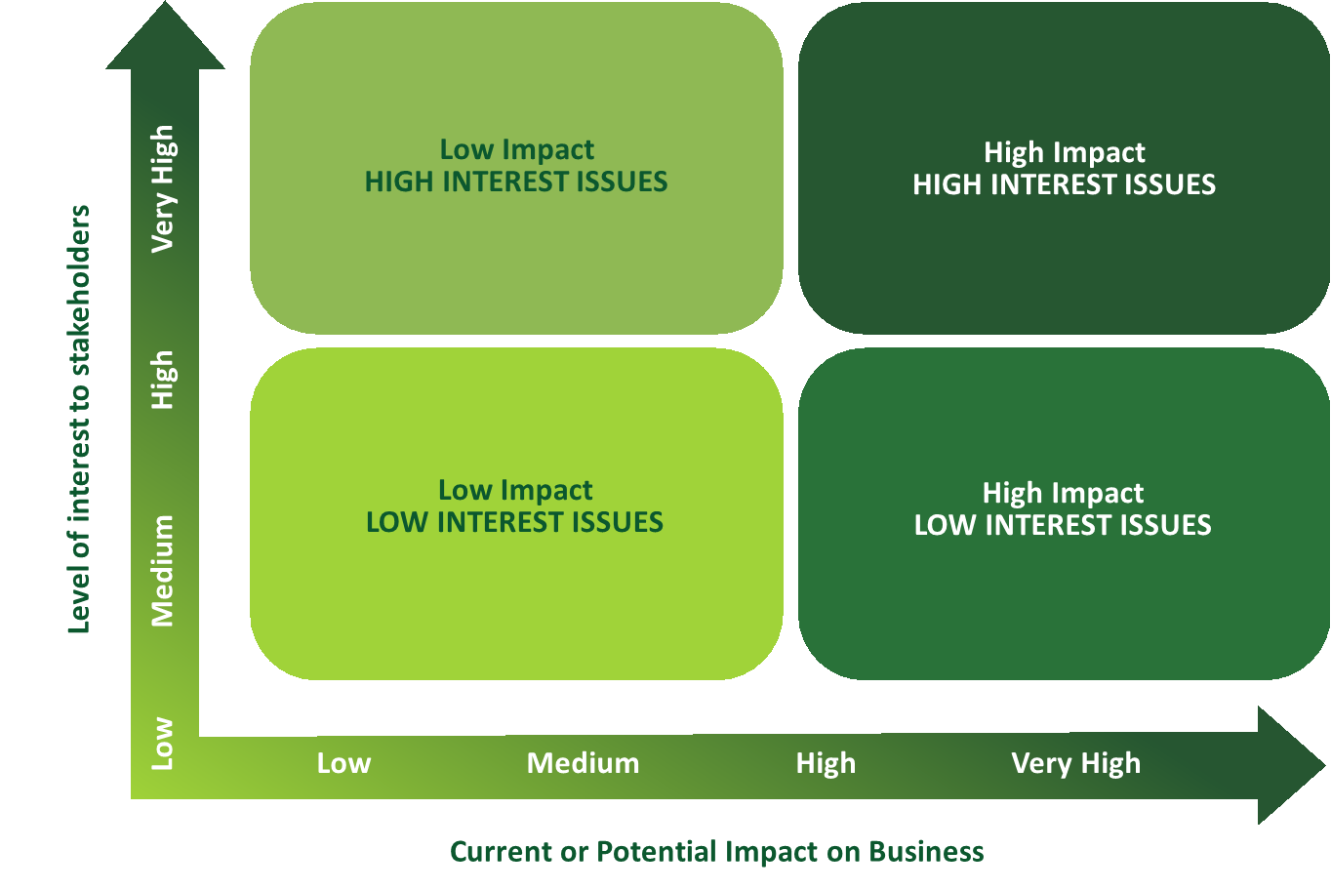
Prioritisation Matrix
The areas of focus depend on many factors and motivations within your business. To guide your decision-making, use this matrix to plot where each action makes or could make an impact.
It is important to generate stakeholder interest in your actions, but this must be managed by ensuring these actions have an impact on your business.

Slide 37
Section 04
Setting Targets and Implementing Changes

Slide 38

Set
Targets
“Setting goals is the first step in turning the invisible into the visible.”
Anthony Robbins, renowned speaker and coach

Slide 39
Targets should outline…
Setting Targets
Targets are the backbone of an effective Sustainability Strategy
Provide a focal point for those inside and outside of the business
Provide a clear set of objectives for management
Provide a yardstick by which external audiences can judge progress
How they will be measured
The people responsible for delivery
The timescale for achievement
Alignment with the SDGs

Slide 40
Setting Targets - Make sure to set a deadline for your aims. Use the SMART process.
Specific:
Your goals for sustainability should be clearly outlined and be specific to the action to be taken to achieve these goals, e.g., measures to address climate resiliency, greenhouse gas emissions, resource conservation. Defining specific targets is the crucial first step towards SMART sustainability actions and should be in line with targets and climate commitments being made e.g., reduce our carbon footprint by 5% per annum. Be practical, well-researched goals, and their implementation delivery, must also be based on economic sustainability.
Measurable:
After specific sustainability actions are defined, you must measure progress made towards these goals. But what metrics will measure success? How precisely can they be measured? How will data be collected and reported? Will the measurement methods be accepted by other stakeholders and regulators?

Slide 41

Setting Targets - Make sure to set a deadline for your aims. Use the SMART process.
Attainable:
Delivering transformative sustainability goals can be challenging over any timeframe. But you will benefit from understanding the science behind achieving ambitious goals and the gains from quick adoption. Planning for financial, human and technological resources and expertise will be key to delivering attainable goals.
Relevant :
Sustainability goals will be most successful if they are wholly relevant to you and your stakeholders, to local environmental conditions, and to the needs of your consumers.

Slide 42

Setting Targets - Make sure to set a deadline for your aims. Use the SMART process.
Time-based:
Sustainability goals should define the period over which benefits will be realized. Goals should be evaluated for short-term and long-term durability to avoid any reputational risk.
Revisit your Sustainability Plan every 2-3 years in order to ensure you stay on track and your goals are still relevant for your business.
Ensure to set a deadline for your overarching goal, and utilise actions and waypoints with their own deadlines to ensure action is being taken.

Slide 43

Apply
Changes
“You don't have to be great to start, but you have to start to be great.”
Zig Ziglar, author and salesman

Slide 44
Indicative Targets and Change Example
A good place to start could be the carbon footprint of your SME. Start with the basics
Carbon footprinting is a good starting point of any company’s journey to reducing its impact on global warming. It is known as ‘the environmental currency’
Carbon footprinting enables companies to benchmark and understand the global warming impacts of their operations, identify environmental hotspots and to take action to reduce these impacts.
A carbon footprint provides detailed CO2 impacts from all the energy, resources and materials used in the business. Carbon frameworks such as the GHG protocol help us to better understand the data to compare the CO2 impacts associated with our activities and to set targets.
We can footprint Businesses, Value Chains and Products

Slide 45
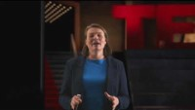
Calculating your carbon emissions – check out this TED Talk

Slide 46
Carbon Footprint Steps
3. Carbon Footprint Verification
1. Defining a Carbon Management Strategy
Data collection
Quantify emissions
Set the boundary and scope of your SME
Identify emission sources
Agree baseline & timelines
2. Conduct a full Carbon Footprint
Report
Re-check Targets
External Assessment

Slide 47
Identifying Emissions Scopes
Scope 1
Scope 2
Scope 3
Direct emissions from company-owned and controlled resources e.g Gas, Oil, Diesel
Indirect emissions from the generation of purchased energy, from a utility provider e.g. electricity
All indirect emissions not included in scope 2 that occur in the value chain e.g. commuting, waste, water

Slide 48
Data Collection can be primary or secondary
Monitoring of activity but not direct data
Top-Level Estimations
Direct Monitoring
Extrapolations (e.g. survey)

Slide 49

Large effect on system behavior
Applying your strategy. Look to apply your sustainability actions to certain leverage points within and outside your company
High
Leverage Point
Small problem-solving force
A leverage point is a place in a system or company structure where a solution element can be applied. Of note:
It's a low leverage point if a small amount of change force causes a small change in system behavior.
It's a high leverage point if a small amount of change force causes a large change in system behavior.

Slide 50
Example: Apply your sustainability strategy to these Internal Leverage Points
Board Engagement
Function Engagement
3
4
HR, Finance, Risk
Marketing
Product development
Supply chain
Business Unit role
Education
Governance
Performance monitoring
Succession planning
Risk management
Definition (policy)
Common terms
Business case
Vision
Strategy & Targets
Communications
Training
Orientation
Annual reviews
Leadership development
1
2
Employee Engagement
Commitment

Slide 51
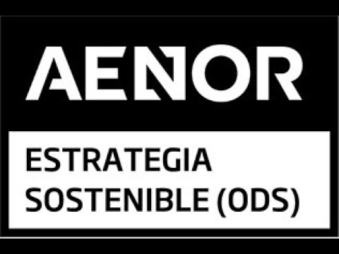
Partnerships and Progress – Explore the examples below as potential actions for your strategy
CERTIFICATION: THE SUSTAINABLE DEVELOPMENT GOALS
AENOR has developed a certification model that encourages business contribution to the SDGs, applicable to all types of organisations and sectors, the purpose of which is to respond to the need of different stakeholders.
DELVE DEEPER - AENOR model Certification of business strategy contribution to the SDGs
WATCH

Slide 52

Partnerships and Progress – Explore the examples below as potential actions for your strategy
ISO 14001 CERTIFICATION
ISO is an independent, non-governmental international organization with a membership of 167 national standards bodies.
UNITED NATIONS GLOBAL COMPACT
Become a member of the United Nations global initiative for social and environmental sustainability, formally known as the United Nations Global Compact. The Global Compact embodies Ten Principles based on internationally recognized conventions.

Slide 53
Section 05
Reviewing and Reporting on Progress

Slide 54

Review
“Mistakes should be examined, learned from, and discarded; not dwelled upon and stored.”
Tim Fargo, US author, keynote speaker, angel investor and entrepreneur

Slide 55
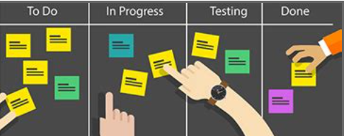
Continue making improvements by regularly reviewing and updating your Sustainability Plan
There is no doubt that issues related to sustainability can change quite quickly. Your Sustainability Plan will need to be regularly reviewed and updated not only for reasons related to continuous improvement but also to ensure it is fit for the time we live and work in.
You should adopt an agile approach to identify the most attractive opportunities for implementing sustainable practices and then planning to investigate these opportunities. On an ongoing basis, you should identify gaps in your plan and update what to keep, what to add, and what to change with regards to your business. This will further consider the plans strengths and weaknesses. Try to match key strengths with opportunities to create capabilities that can be developed into a competitive advantage

Slide 56
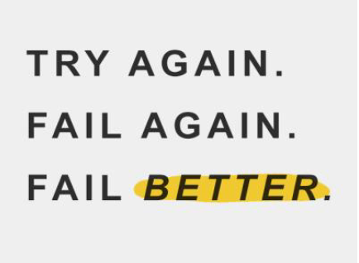
Reviewing your strategy
Part of the role of effective SME governance and oversight is to review performance and make any changes that are needed –including periodically asking whether the strategy is addressing all of the right issues.
External experts should also be invited to review the strategy and identify new opportunities - listening to feedback, taking on suggestions and building trust.
Continuous engagement should inform continual evolution and updating of the strategy.

Slide 57
Now, let's finalise this Module with the 5 steps of conducting a review of your Sustainability Strategy

Slide 58
Report regularly and at key times of the business year e.g with accounting periods, end of year/start of year, annual reviews.
Make sure your report touches on the specific targets you set out. Align them to external frameworks such as the SDGs.
Make your reports concise and easy to read. Make it clear visually how far you have come and what has been achieved.
Timely
Transparent
Aligned
Verified
Accessible
Be honest about your activities, show where you have struggled or failed to progress in your sustainability goals, it will help you discover why.
Use an external expert to assess your reports, this will validate your findings and get you valuable feedback.

Slide 59
Next up..
Module 3 Fostering a Sustainable Office Attitude

