Slide 1
Module 4
Sustainable Procurement & Supply Chains

Slide 2
Module 4 – Contents
01
What is Sustainable Procurement?
02
Supply Chains & Collaborating with Suppliers
Generally SME managers are aware of their office usage, however not all SMEs are aware of their external impact.
All SMEs acquire products, materials or services to run their businesses. At the end of this module, you will have a better understanding of what sustainable procurement is and how to adopt changes so that your business is having less of an effect on the environment. You will also recognise the importance of short supply chains and the wider impact they create.
03
Easy Wins / First Steps
04
Developing a sustainable procurement strategy
05
How do you as an SME benefit
06
Understanding the impact of change

Slide 3
Section 1
What is Sustainable Procurement?

Slide 4

Understanding the Procurement process and making this process more Sustainable!!!
Procurement is one of the most vital, transactional parts of conducting a business since the beginning of commerce. Though the days of scribes writing and checking the orders on papyrus scrolls, the basic activity involving the selection and purchase of goods and services needed for everyday functioning remains the same.
Considering the increasing environmental degradation and our endless needs, sustainable procurement has become the need of the hour.
Sustainable procurement is a method by which we ensure that the goods and services purchased by us are as sustainable as possible, with the lowest environmental impact and highest positive social results.

Slide 5

We are all aware of the significance of climate change, and organisations big or small are beginning to recognise the negative impact that our supply chains are having on this.
Consumers are also starting to demand that companies (even yours) make immediate change, and some are boycotting those companies who continue to provide minimal supply chain transparency and continue to operate without concern for their environmental impact.
The case for change is clear, and support to make the required change needs to be driven by YOU!
The Driving force behind Sustainable procurement

Slide 6



Sustainable procurement will improve the future of your business with ensured…
Gross Profits
Increasing Sales
Better customer experience
Brighter Future for all

Slide 7
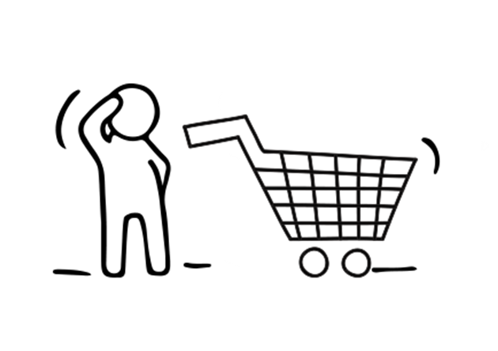
Procurement is a term used to refer to the process or the act of sourcing or obtaining services or goods for your or any business.
Procurement is usually associated with businesses as companies need to acquire goods and solicit services, often on a large scale from a third-party vendor or supplier.
These services and goods are usually vital for your business’s operations.
What is Procurement?

Slide 8
When managed efficiently and carried out effectively, procurement will help in ensuring higher business profits. It is therefore important to continuously monitor and assess your procurement process, rectify any mistakes found and strengthen any weak points.
The whole process of procurement involves:
sourcing the goods and services
deciding the terms,
making the purchase
tracking when the supplies will be delivered
What is Procurement?

Slide 9
Sustainable procurement is the act of adopting social, local economic, and environmental factors alongside the usual price and quality considerations by you as a business owner while handling the procurement process and procedures for your business.

Slide 10
The 3 Pillars of Sustainable Procurement
Effective sustainable procurement supports sustainable development. Sustainable procurement is therefore smart procurement as it takes a 3-dimensional life cycle approach against the former one-dimensional, economics-focused approach.
The three-dimensional approach does not mean that the sustainable procurement process will take 3 times longer, nor does it necessarily mean that it will be more expensive. It means that it undertakes the 3 pillars of sustainable development for achieving sustainable procurement.

Slide 11
The 3 Pillars of Sustainable Procurement
The 3 Pillars of Sustainable Procurement
Economics
(i.e. profit)
Social
(i.e. people)
Environmental
(i.e. planet)

Slide 12
Examples of the benefits of each Pillar of Sustainable Procurement
Economic
Social
Environmental
Economic Regeneration
Sustainable Economic Development
Emerging Markets
Development of SMEs
Total Cost of Ownership and Life Cycle Costing
Value for Money
Poverty Reduction.
Human Rights
Clean Drinking Water
Food Security
Fair Pay & Labour Law Protection
Anti-Child Labour Laws
Fair Trade
Health and Safety
Gender Equality
Healthy Lives & Well-Being for All
Environmental Resource Management
Urban Planning
CO2 Reduction
Alternative Energies: e.g.: solar, wind
Water Management
Sustainable Agriculture
Marine Resources Management
Protection of Ecosystems
Pollution and Waste Management

Slide 13
Informally, these pillars of sustainable procurement are known as the 3 Ps:
People
Planet
Profit
social
environmental
economic

Slide 14
Section 2
Supply Chains & Collaborating with Suppliers

Slide 15
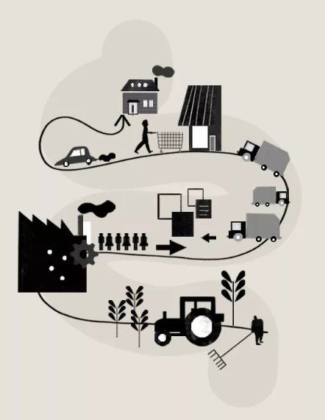
The Supply Chain: From Raw Materials to Order Fulfillment
What is a Supply Chain
A network between a company and its suppliers to produce and distribute a specific product to the final buyer; it includes different activities, people, entities, information, and resources.
In other words…Links on the chain begin with the producers of the raw materials and end when the van delivers the finished product to the end user.

Slide 16
Supply chain management is a crucial process in sustainable procurement because an optimised supply chain results in lower costs and a more efficient production cycle. Companies seek to improve their supply chains so they can reduce their costs and remain competitive. Short-supply chains are preferred from an environmental & social perspective.

Slide 17
Components of a supply chain include…
Producers
Vendors
Warehouses
Distribution
Retailers

Slide 18
Understanding Supply Chains
The functions of a supply chain include product development, marketing, operations, distribution, finance, and customer service.
Today, many supply chains are global in scale.
Effective supply chain management results in lower costs and a faster production cycle.
Long Supply chains are usually more complex harder to manage and less environmentally friendly.
Short Supply chains mean they have fewer links and are therefore easier to control which usually means the end good travels less.

Slide 19
What Are the Main Supply Chain Models?
Many types of supply chain models are available. The model a company selects will depend on how the company is structured and what its specific needs are.
Here are a few examples:
Continuous Flow Model: This traditional supply chain model works well for companies that produce the same products with little variation. The products should be in high demand and require little to no redesign. This lack of fluctuation means managers can streamline production times and keep tight control over inventory.
Fast Chain Model: This model works best for companies that sell products based on the latest trends. Businesses that use this model need to get their products to market quickly to take advantage of the prevailing trend. They need to rapidly move from idea to prototype to production to consumer. Fast fashion is an example of an industry that uses this supply chain model.
Flexible Model: Companies that manufacture seasonal merchandise often use this model. These companies experience surges in demand for their products followed by long periods of little to no demand. The flexible model ensures they can gear up quickly to begin production and shut down efficiently as soon as demand tapers off. In order to be profitable, they must be accurate in forecasting their need for raw materials, inventory, and labour.

Slide 20
Supply Chain Management Best Practices
Here are some of the best practices that are seen in successful supply chain management systems:
They support continuous improvement.
They aim for increased velocity.
They encourage collaboration among the individual businesses in the supply chain
They seek new technologies that improve their processes.
Metrics are used to allow employees to measure the success or failure of each step in the supply chain.

Slide 21
What Is the Flow of Manufacturing Costs?
Efficient supply chain systems get each piece of the product where it is needed when it is needed.
This means controlling the flow of manufacturing costs.
The flow of manufacturing costs is most relevant to businesses that produce products that require many different parts from many vendors.
For example, a clothing manufacturer may need deliveries of fabric, zippers, trim, and thread to arrive all at the same time. If some supplies arrive too early, they must be stored at the business' expense. If some arrive late, the machines stand idle while they wait.
For SMEs like you with limited resources efficient supply chain systems are essential…therefore reliable suppliers are KEY and building good relationships with them so that you can collaborate effectively is advantageous.

Slide 22

Supplier collaboration is a joint activity between the supplier and the customer to develop strategies aimed at improving the procurement of goods and services.
This collaboration offers several benefits to both parties, including
      reduced costs
      streamlined ordering processes
      reduced errors and inefficiencies
      innovation in products or services
What is Supplier Collaboration?

Slide 23
Quality data can drive smart decisions related to procurement and supplier collaboration.
Information on vendors and their products, and their historical performance can help you identify gaps, areas of strength and assess supply chain risk more effectively.
Once there is a database of connected and consistent information, you can automate collaboration and lifecycle management, enhancing supplier onboarding, communication and monitoring.
Efforts to improve supplier collaboration also increase transparency and trust. For instance, more often and clearer two-way feedback can help create consensus among stakeholders and tackle issues jointly, ultimately ensuring successful, long-standing partnerships.
How to Drive Supplier Collaboration?

Slide 24
Collaboration Skills
What skills does a good collaborator need?
Strong Collaborators will develop their written, verbal, and non-verbal communication skills. Good collaborators usually exhibit the following traits:
Effective speaking​
Effective/active listening​
A sense of humour​
A positive attitude ​
Respect
Flexibility
Honesty
Self-confidence
Emotional intelligence
Persistance
Patience
An ability to influence

Slide 25


Before starting a collaboration with a supplier, it is important to assess not only what you are seeking out of the relationship, but you must keep in mind what the other party is seeking as well. Only by understanding each other’s desires can you hope to fulfill both parties’ needs in a win-win scenario.
If you only seek a scenario where only you get what you want, but the other party is disadvantaged, you will create hostility and are less likely to end up getting the outcome you desire.
An important tip:
Have Self-awareness and Awareness of Others from the outset…

Slide 26
Being under-prepared
Assuming that everything is ok
Giving in too quickly
Allow emotions get the better of you
Overconfidence
Being too fixed in your approach
Not asking targeted questions (5Ws’: Who? What? Where? When? and Why?)
Assuming that cross-cultural collaborations are like “local" collaborations
Relying on past performance ‘it worked last time’
Common Collaboration Process Mistakes

Slide 27
The main four PHASES in the process…
Discussion Phase
Clarification Phase
Negotiation Phase
Agreement Phase
This is crucial to getting a better understanding of what the other party is looking for. You want to ensure that you are listening & questioning so that each side knows what is being sought
The clarification stage is simply to ensure that both parties have identified and established a common ground on which to start their collaboration & to minimize misunderstandings
As mentioned, a win-win outcome is the best outcome. Sometimes, it may not be possible, but it should be what both parties are striving for.
Each party should keep an open mind so that the best solution can be achieved for all parties. Agreements should be clear to all parties, without ambiguity.

Slide 28
Section 3
Easy Wins / First Steps

Slide 29
Six Tips to Drive Sustainable Procurement
4
6
Work collaboratively
Make a business case
5
Take it one step at a time
1
2
Find suppliers that align with your end-goal
Do your Homework
Create a strategy that works for you
3
source

Slide 30

1
Make a business case
So, you’ve decided it’s about time you shaped a comprehensive sustainability programme, but where to start?
The first step to making lasting change is identifying key stakeholders and decision-makers concerned with your company and communicating your business case to them. Put together a presentation that explains why sustainable procurement is essential and how it will contribute to the business’s bottom line.
Identify other cheerleaders inside or outside the company who will advocate for you and support your efforts.

Slide 31

Procurement teams and companies come in all different shapes and sizes, which means there is no one-size-fits-all when implementing sustainability initiatives.
Create a strategy that works for you
2
Identify your priorities: pain points, and high-risk areas.
Which areas of your supply chain will most benefit from the change?
Be realistic with your goals. Sustainability initiatives should never come at the expense of business success.
Figuring out how to operate more efficiently is often a practical place to start.
It’s also important to try and integrate sustainable practices into your existing procurement processes, rather than starting anew.

Slide 32

Find suppliers that align with your end-goal
3
Once you’ve figured out your sustainability priorities and ultimate aims, it’s time to review and audit your suppliers.
Which of them accommodates, or can work to accommodate, your newly-established needs?
It’s worth developing a scoresheet to rate and compare suppliers. This process is also a fantastic opportunity to get to know your suppliers better.

Slide 33

4
Work collaboratively
Change won’t happen without company-wide collaboration that ensures all areas of your organisation or company are aligned.
Indeed, 70% of companies claim that multi-stakeholder collaborations are key to more sustainable and ethical supply chains.
You might also choose to work alongside other businesses or NGOs to share best practices in achieving your common goals.

Slide 34

5
Do your homework
Sustainable procurement cannot be achieved without transparency throughout the supply chain, which means doing your homework.
You’ll need complete visibility of all your tier 1 suppliers, require tier 1 suppliers to do the same for their suppliers, and so on.
EcoVadis’ biennial report Sustainable Procurement Barometer found that 45% of organisations only have visibility with tier 1 suppliers and concerningly, 28% claim to have no visibility into their supply chains at all.

Slide 35

Those seemingly insignificant incremental changes can add up to make the greatest change.
Take it one step at a time
6
One thing we can guarantee is that change won’t happen overnight.
Implementing sustainability measures takes time, commitment and patience.
Rather than biting off more than you can chew in a small space of time, start by focusing on the quick wins.

Slide 36
RECAP:
Sustainable procurement isn’t just about buying ‘GREEN’ products. It also includes:
1
2
3
Planning ahead to manage demand
Effective ongoing contract management
Dealing with supply chain risks and impacts

Slide 37
Section 4
Developing a Sustainable Procurement Strategy

Slide 38

We want to help you discover how sustainable purchasing and ethically sourced products in your supply chain can help your business on your NET ZERO JOURNEY.
Sustainable procurement allows you to unlock the financial, operational, and reputational benefits of developing and working with sustainable supply chains.
Starting your journey to Sustainable Procurement

Slide 39

What is A Sustainable Product?
A sustainable product avoids the depletion of natural resources to maintain an ecological balance. When purchasing for sustainability you must consider that all products, supplies, and contracts may pose sustainability issues.
The sustainability impacts of the following areas must be considered:
          buying products,
          purchasing decisions,
          your supply chain.

Slide 40
What is a Sustainable Product & How will it help business?
Sustainable products should use fewer natural resources, contain fewer hazardous materials, have a longer lifespan, consume less energy or water in production or use, be able to be reused or recycled upon disposal and lastly, generate less waste upon the end of their lifespan.
Sustainable purchasing is not just about the proxy of purchasing ‘green products’, it is about minimising the negative socio-economic effects of a business’s purchasing decision.
As a business, making sustainable purchasing decisions gives you the ability to minimise the indirect, negative impacts of your organisation, its operations, and the services you deliver on the environment.

Slide 41



All businesses, no matter how small or large, need to purchase goods no matter what and we need to use our influence in a positive manner.
Here are a few aspects to think about when it comes to purchasing sustainably.
Ethically sourced and traded products are key in sustainable purchasing. Ethical sourcing ensures that minimum labour standards are met during the production of the product you are purchasing. However, Fair Trade simply refers to the ethical trading process. An example would be for a business that buys in paper to print on to consider buying in evercopy premium 100% recycled paper. This has the blue angel mark, EU Ecolabel, and forestry stewardship council to support reforestation. Similarly, A-rated equipment is better for energy usage and is more compliant with energy legislation.
What should your business consider?

Slide 42
Purchasing goods from local suppliers is incredibly beneficial as local jobs and services are supported through sustainable purchasing, which is not only beneficial for your company but also beneficial for your local economy.
When consideration is given to utilising the community and voluntary sectors, goods are more deliverable and sustainable on social factors, such as skill development within the local community.
Local job creation and developing community skills as mentioned previously will further show social sustainability and improve your profile as a sustainable company.
Buying Local!

Slide 43
Where to start and why?
External Processes:
When it comes to improving sustainability and optimising operations, procurement channels are some of the first places to focus on. After all, the supply chain not only accounts for most costs and sources of inefficiency but produces more emissions than internal operations typically do.
Internal Processes:
Inefficiencies can come from within, too. Achieving a transformational change, for the better, means maintaining proper operations across the board, from fostering supplier-buyer relationships to cultivating employee compliance.

Slide 44




In practice, sustainability is not easy to do. After all, monitoring, communicating and collaborating with many suppliers at a time is no small feat. Luckily, there are some things that YOU can do to keep procurement operations on the right track. Here are 6 actionable steps…
Define a Code of Conduct and Collaboration Requirements
Reward and Respond
Evaluate Your Existing Setup
Educate and Build Awareness

Slide 45


Keeping procurement operations on the right track…6 actionable steps – continued
Align Core Business Strategies
A Great start to an effective Sustainable Procurement Strategy
Optimise Communication

Slide 46

Evaluate Your Existing Setup
More than likely, your business has been involved with its suppliers and partners for many years. Before jumping ship for more efficient and eco-friendly partners, evaluate your existing setup. It may be better to swap merely one or two suppliers at a time, starting small. Besides, the teams you already work with may have green initiatives in place or programmes that are actively developing. It’s always a good idea to communicate your plans for improved sustainability, even just to see if anyone else is on board.
Establish a decision framework for choosing new suppliers to work with. When issuing Requests for Proposals (RFPs), be sure to negotiate environmentally sound and resource-efficient practices with potential suppliers. Also, it’s important to secure the most energy-efficient and green products available at the same or lower price than alternatives — something that should always be included in agreements.

Slide 47
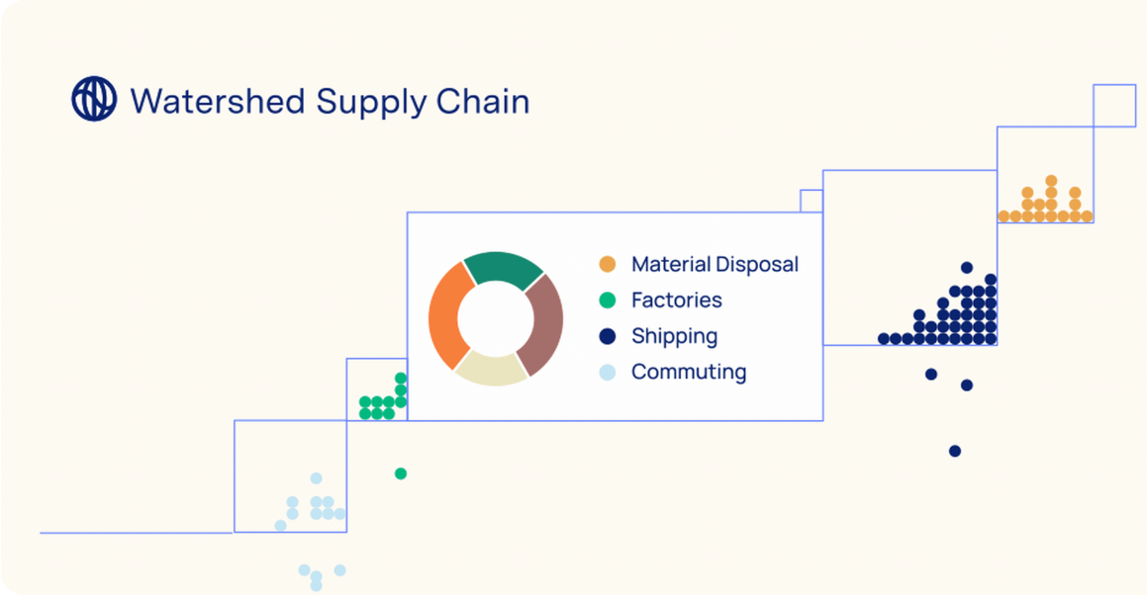
Tools that are out there to help…one example!
Watershed Supply Chain, is a solution dedicated to helping businesses reduce carbon emissions at scale across their supply chain. Their goal is to make measuring, understanding, and reducing emissions across businesses’ supply chains fast, easy, and effective.

Slide 48

Define a Code of Conduct & Collaboration Requirements
Collaborating with eco-friendly suppliers and partners is always a plus, but what does that mean? What does it look like for your business, products and practices?
For clarity, it’s important to establish a code of conduct and a series of requirements that can apply to all potential and existing suppliers. Make it clear about what you’re looking for and what their responsibilities will be. What behaviours do you expect to see, how do you want waste handled and your views on emissions? Are there limits or boundaries to said restrictions?
A good idea to honour this is by incorporating ISO standards and becoming certified. The new ISO 20400 explicitly deals with sustainable procurement practices, making it an ideal match for most businesses.

Slide 49

Educate and Build Awareness
Establish a team dedicated to corporate social responsibility and sustainability and use their help with optimising the business. More importantly, that team should also invest time educating and spreading awareness about eco-friendly initiatives with suppliers, for both existing and potential prospects.
An alternative for small to medium-sized businesses that don’t have the manpower to create a dedicated team, would be to sponsor online training programmes and seminars. By sharing these programmes with suppliers, managers can better communicate what they are looking for and what that means for the relationship. Sharing is caring!!

Slide 50
No one will protect what they don’t care about, and no one will care about what they have never experienced
“
”
David Attenborough

Slide 51


Reward and Respond
As you do with employees for conventional operations, it’s important to evaluate and respond accordingly to your supplier’s progress and achievements.
Establish a series of audit mechanisms to grade their commitment to sustainability and reward good behaviour/operations. Offer incentives to help encourage greater levels of commitment. Those incentives don’t necessarily have to be monetary, but they should show value for your partner’s time and commitment.

Slide 52

Optimise Communication
We can’t reiterate this point enough…All this talk about evaluating suppliers and prospects isn’t going to do any good if there are no open channels of communication and collaboration. It’s important to implement a streamlined method of communication across all involved parties, not just internally.
Are there ways to highlight an active process and suggest improvements? What real-time and maintenance opportunities are available to your management team? If something goes wrong, how long until the appropriate contacts are notified?
Once that line of communication is open, it’s just as important to keep it consistent and effective. You and your team must be able to communicate with any partners — not just to evaluate but to help improve collaborative processes, too.

Slide 53

Align Core Business Strategies
The adage says to practice what you preach, and that’s true here. Ensure your employees and your operations adhere to sustainable and eco-friendly requirements. If it’s not a priority for your team, then any suppliers and partners you work with are going to follow that example.
That's why you want to lead by example. Send a strong message to your partners that sustainability is ingrained in your core business practices. It’s not just a movement or an afterthought. It’s a way of life. When they see just how serious you and your constituents are, they’ll make it a priority for doing business with you, as they should.

Slide 54
While it’s certainly true that suppliers can cause real problems when it comes to sustainability and corporate social responsibility, they are not the sole reason why things go wrong. Green initiatives and improved sustainability start from within, as part of a core business strategy.
These best practices send a clear message that it’s important to establish relevant practices at a foundational level. The best place to start is by educating and training employees, managers and partners as to what they can do to contribute and maintain sustainability. Then it’s on to more actionable strategies, such as incorporating green initiatives internally, collaborating with eco-friendly suppliers and continuing to evaluate the total footprint of your business.
You can do this!!!
REMEMBER…
Sustainable Procurement Starts from within!!!

Slide 55
Section 5
How Do You as an SME Benefit

Slide 56
By committing to sustainable procurement and having the ability to meet the demands of emerging markets, even as you reduce the pressures of costs by the reduction in energy consumption and waste generation, you have these 2 main benefits to look forward to:
Your brand would be differentiated from your competitors as you procure sustainably to develop innovative products and services as demanded by your customers.
Your brand awareness would increase, and your brand positioning statement would be strengthened. However, this will require proper risk management and addressing weak areas to prevent scandals and bad publicity for your company.
Ultimate benefits when you commit to sustainable procurement strategies

Slide 57
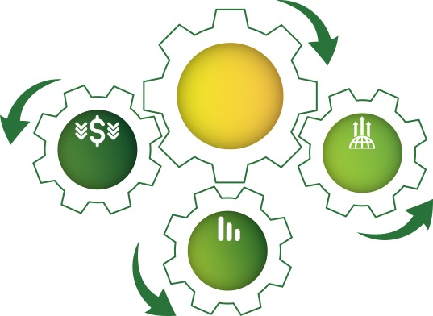
Drivers for Sustainable Procurement
Drivers for Sustainable Procurement
Cost
Reduction
Revenue Growth
Risk Reduction

Slide 58

Cost Reduction
Following sustainable procurement practices and decisions will lead to a reduction in the total cost of ownership. This is through reduced energy costs, reduced over-specification, reduced consumption and reduced social and environmental compliance costs.
For example…Avoiding energy costs. Sustainable procurement sources machines, systems, and equipment that consume the least energy and generate the least waste. Sustainable procurement seeks to reduce energy consumption and energy emissions, thus avoiding hefty costs associated with environmental degradation.

Slide 59
Risk Reduction
By following sustainable procurement practices and decisions, risks are reduced because you will no longer face the financial impact on your brand value due to bad supplier practices. You would also be saved from the economic costs of sustainable procurement disruptions like noncompliance with environmental regulations.
The process of evaluating supply chain sustainability will reveal those high-risk areas that have historically been neglected, whether it’s bad supplier practices (such as modern slavery) or environmental risks (including local pollution). Investing in sustainable practices means working alongside suppliers that are compliant (or working towards being compliant) when it comes to factors like environmental regulations.

Slide 60
Revenue Growth
By following sustainable procurement processes, you would be able to earn additional revenue through the innovation of Eco-friendly products and services and price premiums or income from recycling programmes.
As well as that well-marketed sustainability initiatives will give your brand reputation a massive boost. This can be correlated with staff retention and the attraction of top talent should also improve because employees increasingly want to work somewhere where they feel they are making a difference and doing good.

Slide 61
Summary: The benefits of Sustainable Procurement
As discussed in previous sections Sustainable procurement starts with a positive partnership with your suppliers. Building trust and monitoring performance and compliance effectively can lead to more profitable relationships with your suppliers and reduced costs for your business.
Therefore, benefits can be split into two groups:
benefits to your company and
benefits to the wider community and environment.

Slide 62
Business Benefits:
These are just 6 benefits but all with value-creating and business growth potential
4
6
Attract like-minded investors
Improve your chance of winning business with your enhanced sustainability standards
Effective risk management
5
1
2
Reduced costs through recycling, using more efficient products and services
Qualify for favourable loans, business support or tax relief
Improved reputation amongst customers and across your business sector
3

Slide 63


Benefits for the wider community and environment
Reduced waste through recycling
Improve working & living conditions by sourcing fair trade products and by avoiding purchasing goods/services from companies that don’t adhere to sound practices
Reduced carbon emissions by using energy-efficient equipment and renewable energy
Reduced use of natural resources by purchasing goods and services using recycled materials

Slide 64
Section 6
Understanding the Impact of Change

Slide 65
Why Sustainable Procurement matters…
Four key priority areas:
Sustainable consumption and production
Climate change and energy
Protecting natural resources
Creating sustainable communities and a fairer world

Slide 66
The example of waste is probably the most obvious…
Options for action include: avoiding the purchase, using less, shifting from purchasing a ‘product’ to purchasing a service, through re-use and recycling to the consideration of end-of-life management.
Sustainable procurement can have a wider range of benefits than is immediately apparent. Recycled materials and products have long been recognised as making an important contribution to sustainability by reducing landfill (and therefore methane emissions) and conserving non-renewable resources, but a report by the Waste and Resources Action Programme (WRAP) shows that over their full life cycle they also have an important part to play in reducing carbon dioxide emissions. Currently, recycling levels in the UK already reduce CO₂ emissions by 10-15m tonnes compared to incinerating or landfilling those materials – equivalent to taking 3.5m cars off the road. (Source)

Slide 67
Waste Hierarchy = Procurement Hierarchy
Waste Prevention
Re-Use
Waste Hierarchy
Recycling/Compost
Rethink Need
Eliminate waste at source (no purchase/purchase service instead of product
Energy Recovery
Reduce
Use less
Disposal
Re-Use
By customer or
supplier/contractor
Recycling
Negotiate options with contractors
Procurement Hierarchy
Energy Recovery
End of Life
Negotiate end-of-life management options with suppliers/contractors

Slide 68
"We cannot solve our problems with the same thinking we used when we created them".
Albert Einstein

