Slide 1
Module 5
GREENING YOUR PRODUCT OR SERVICE
"The European Commission support for the production of this publication does not constitute an endorsement of the contents which reflects the views only of the authors, and the Commission cannot be held responsible for any use which may be made of the information contained therein."

Slide 2
Module 5 Overview
01
Why do you need to green?
02
Greening your Products
Sustainability has shifted from an externalized consideration to a core business model and means to innovate products and services.
In this module, we also go into more detail about engaging with the circular economy and how to green your everyday practices. This module also dives into the importance of communicating responsibly.
03
Why you need a Sustainable Product Life Cycle?
04
Spotlight on Sustainable Packaging
05
Greening your Services
06
Marketing your Green Products and Services

Slide 3
Section 1
Why do you need to green?

Slide 4
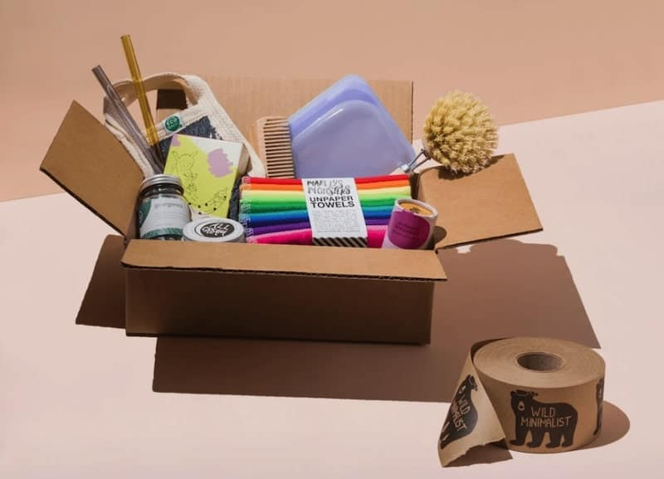
Greening your Products and Services
Greening your product or service is the right thing to do to reduce your SME's environmental impact.
As we see throughout this course (and especially in Modules 2 and 3), it also makes perfect business sense. As well as providing an excellent marketing opportunity, less is more, and it can help to protect your SME against things like from future fluctuations in resource costs.
Source

Slide 5

What does greening your product or service involve?
In order to ‘green’ product or service, you’ll need to look beyond your SME.
Sometimes, the majority of the environmental impact from your product/service’s lifecycle are produced upstream or downstream from your own operations. That's what product life cycle assessment are something you need to consider.
Your approach/es to greening your product or services will also depend on whether or not you are just starting a business or have been in business for a while and wish to make your business greener. Through this Module, you will learn some top tips i that can help you green your offering, whatever stage of business you are at.

Slide 6
How greening can improve your business bottom line:
Market Share
Reduced Costs
Other Benefits
You could increase your market share by unlocking a new green customer base
Increasing efficiency and reducing waste leads to better profit
margins
Other benefits such as increased employee
morale, strengthening the company’s image in the community can also increase profitability (lots more in Module 3)
Source

Slide 7
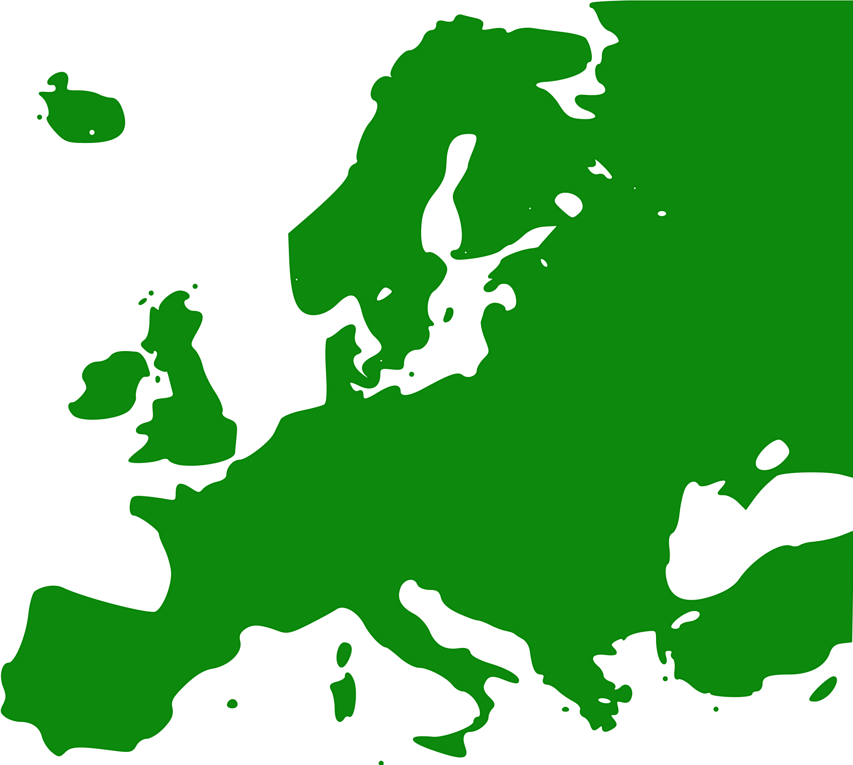
Spotlight on Europe's
Green Consumers
It might (or might not) surprise you that European consumers are leading the way on green adoption, while Australian and US consumers are the least green. ​
In their recent research report, Forrester found some interesting insights into Europe's green consumers.

Slide 8
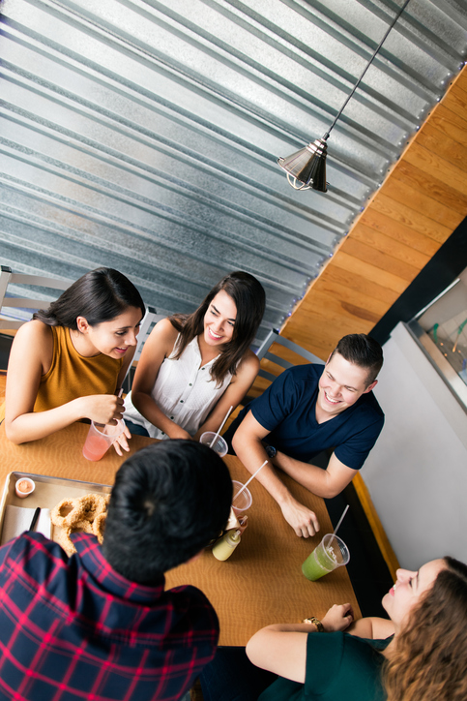
Gen Z (those born during the late 1990s and early 2000s) isn’t the only green generation.
Millennials also known as or Gen Y (born from 1980's to early I990's) are slightly greener than Gen Z.
This is mostly because the younger generation lacks the purchasing power to regularly purchase environmentally sustainable products.
Source

Slide 9

Older generations also think SMEs need to step up.
So, it would be a mistake to overlook older generations’ environmental expectations.
There is no “one size fits all” approach when it comes to green consumers, as their behaviors, attitudes, and expectations are evolving quickly.
The New Green Consumer (forrester.com)

Slide 10
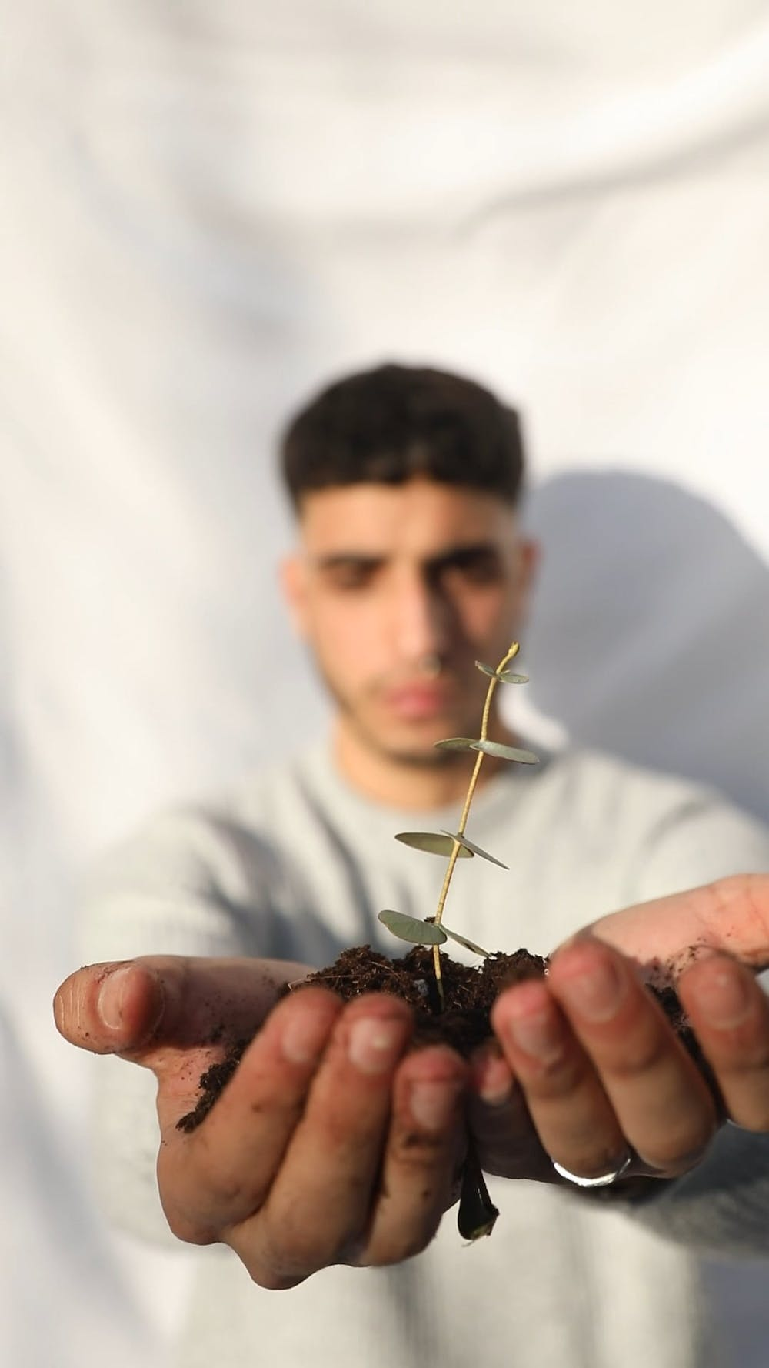
According to Forrester, attitudes towards green vary greatly amongst our fellow Europeans.
They found that
German and Swedish consumers are not as green as stereotypes suggest!
Italian and Spanish consumers top the ranking of environmentally friendly consumers.
The New Green Consumer (forrester.com)

Slide 11


KEY ACTION
GET TO KNOW YOUR POTENTIAL GREEN CONSUMERS
If you are at the start of your business journey, customer profiling is a key step to undertake. Take some time to research and profile who your green customers could be. Ask yourself what are their motivations or needs from a green perspective. Better still, ask them directly if you can in something like a customer focus group. A customer focus group would be beneficial whatever stage of business you are at.

Slide 12
SECTION O2
Greening your products

Slide 13
Why such a focus on green products?
In the past 50 years, humans have consumed more resources than in all previous history. This and other eco facts like
9 out of 10 people worldwide breathe polluted air,
500 Billion to 1 Trillion plastic bags end up in landfills each year worldwide, and
A plastic bag can take up to 1,000 years to decompose, etc.
…has drawn great attention of the end consumer towards green products and their benefits.
But where are the market opportunities for green products and services?
Source

Slide 14
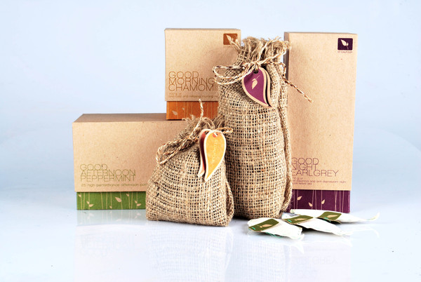
What is a green product?
In its simplest form, a green product (or service) is a sustainable product designed to minimize its environmental impacts during its whole life-cycle and even after it’s of no use.
They are typically manufactured using toxic-free ingredients and environmentally-friendly procedures and they are can be certified by recognized organizations.
Source

Slide 15
Some of the advantages of greening your products
G
R
E
E
N
Cost-effective products - green products often last longer than conventional products because they are often renewable
Low maintenance: If operated responsibly and maintained properly, green products can be low maintenance costs
Improves health:
products that are free from harmful chemicals can improve physical and mental health.
Prevents overuse of resources: Green products reduce the threat of overuse of resources and fossil fuels
Protects the environment: Green products are made from organic and biodegradable materials and hence prevents pollution

Slide 16






Green Products can be typically characterised in five ways..
Those that save energy or water
Those that contribute to a safe, healthy environment by reducing or blocking the spread of pollutants
Those that avoid certain chemical emissions.
Those that conserve natural resources and/or reduce the materials needed
Those that are made with salvaged, recycled, or waste content
Source

Slide 17
Food and Agriculture | Cities | Energy and Materials | Health and well-being
Reducing food waste in value chain | Affordable housing | Circular models - automotive | Risk pooling
Forest ecosystem services | Energy efficient buildings | Expansion of renewables | Remote patient monitoring
Low-income food markets | Electric and hybrid vehicles | Circular models - appliances | Telehealth
Reducing consumer food waste | Public transport in urban areas | Circular models - electronics | Advanced genomics
Product reformulation | Car sharing | Energy efficiency | Activity services
Technology in large-scale farms | Cultural tourism | Energy storage systems | Better maternal and child health
Dietary switch | Autonomous vehicles | Resource recovery | Healthcare training
Sustainable aquaculture | ICE vehicle fuel efficiency | End-use steel efficiency | Weight management programs
Technology in smallholder farms | Building resilient cities | Grid interconnection | Better disease management
Micro-irrigation | Smart metering | Carbon capture and storage | Electronic medical records
Restoring degraded land | Office sharing | Energy access
Reducing packaging waste | Durable and modular buildings | Green chemicals
Urban agriculture |  | Additive manufacturing
 |  | Shared infrastructure
Where are the Market Opportunities for Green Products and Services?
Source: Adapted from this report which explores the market opportunities afforded by a sustainable transition. Explore to learn more

Slide 18
The most sustainable way is to not make things. The second most sustainable way is to make something very useful, to solve a problem that hasn’t been solved….

Slide 19
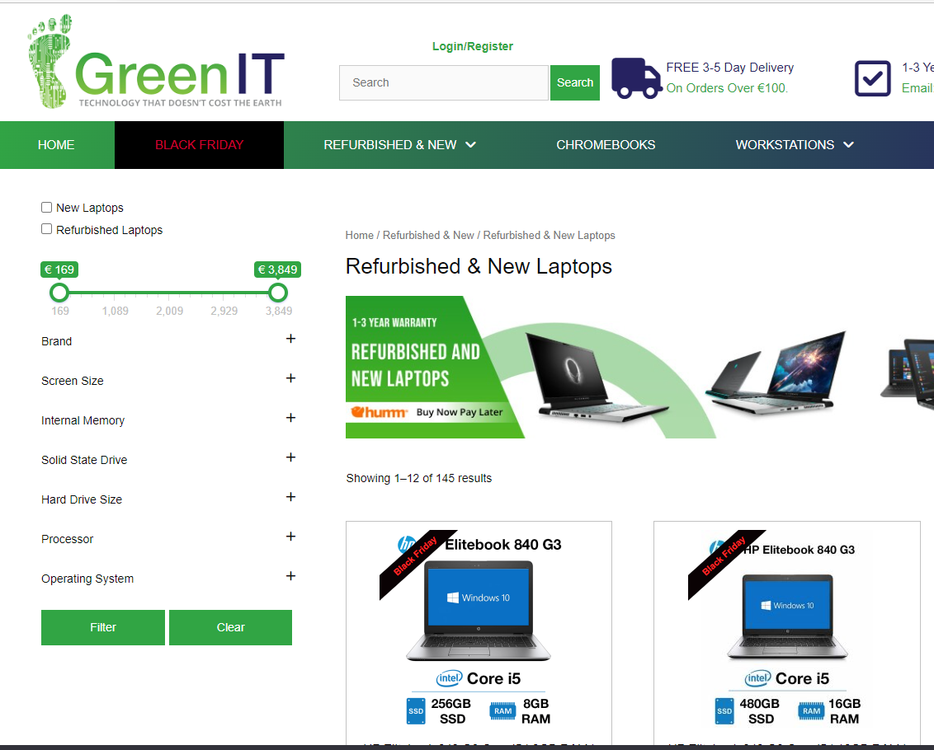
Case Study: Sustainable Businesses in Focus - Meet GreenIT
GreenIT is a premium reseller of corporate quality Refurbished Laptops, Computers, Tablets and More. All of their refurbished equipment is ex-corporate and as such is of a standard that is considerably higher than normal consumer level equipment. They source tier 1 brands such as HP, Dell, Lenovo to ensure that their customers receive only the highest level of IT equipment.
We love their motto - "Technology that doesn't cost the earth" www.greenit.ie

Slide 20
SECTION 03
Why you need a Sustainable Product Life Cycle?

Slide 21
Sustainable Products and Sustainable Life Cycles
You will recall from Module 3 the difference between green, sustainable and eco-friendly. Another definition of a sustainable product is this one:
"A sustainable product provides environmental, social, and economic benefits throughout the entire lifecycle."
Here the words "life cycle" are key. If you want to become a more sustainable business, you need to strive to improve every step of the product’s life cycle.
Let's take a look at some key stages in the product life cycle and how sustainability can/should play a role
Source

Slide 22



You can incorporate sustainability into all 7 Steps of the Product Life Cycle
PHASE 1
DESIGN
PHASE 2
CONCEPT
PROTOTYPE

Slide 23




You can incorporate sustainability into all 7 Steps of the Product Life Cycle
PHASE 2
PACKAGE
DELIVER
MANUFACTURE
MARKET
Let's take a look at some things you could consider across these phases...

Slide 24
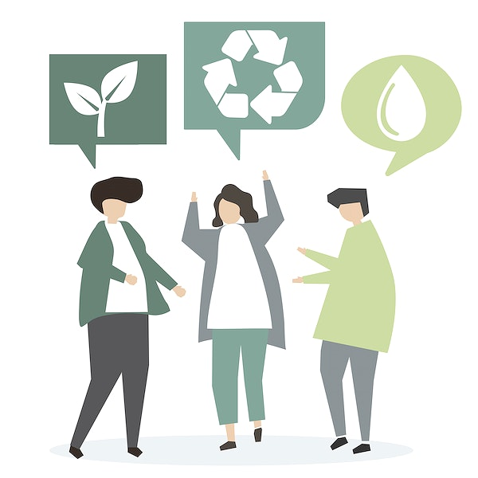
PRODUCT DESIGN PHASE
THINGS TO CONSIDER
01
Can you design for recycling?
It is often said that 80% of a product's environmental impact is already decided in the design phase.
The first step in the product's life cycle involves R&D, concept development, and product design. Here you make decisions such as material selection, assembly, and appearance.
These decisions are very important for how much environmental impact your product will have.
Source

Slide 25
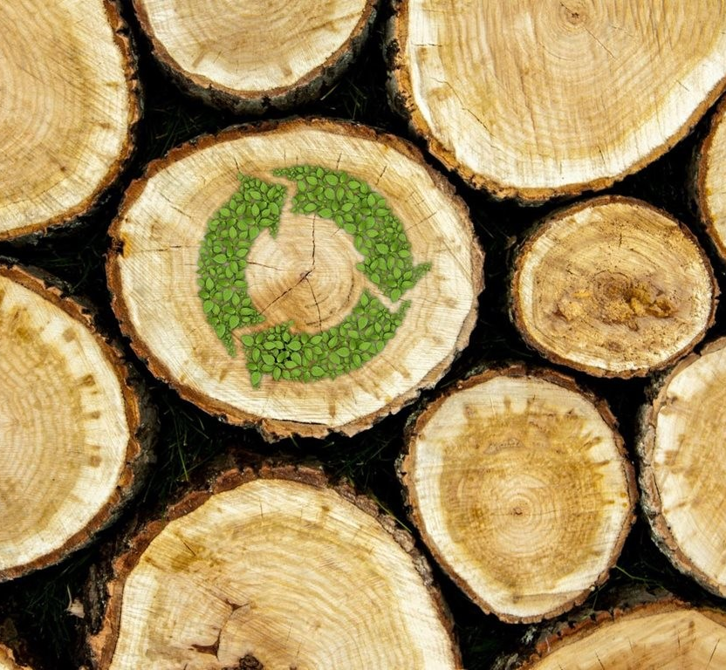
THINGS TO CONSIDER
02
Can you source sustainable materials?
What materials you use in your product determines your SME's carbon footprint. Extracting raw materials requires both energy and transportations.
In addition, nature's resources are limited, which means that they cannot be extracted forever, making it an unsustainable approach you should therefore try to consider alternatives. For example, using recycled aluminum saves 95% of energy compared to producing aluminum from new ore.
PRODUCT DESIGN PHASE
Source

Slide 26
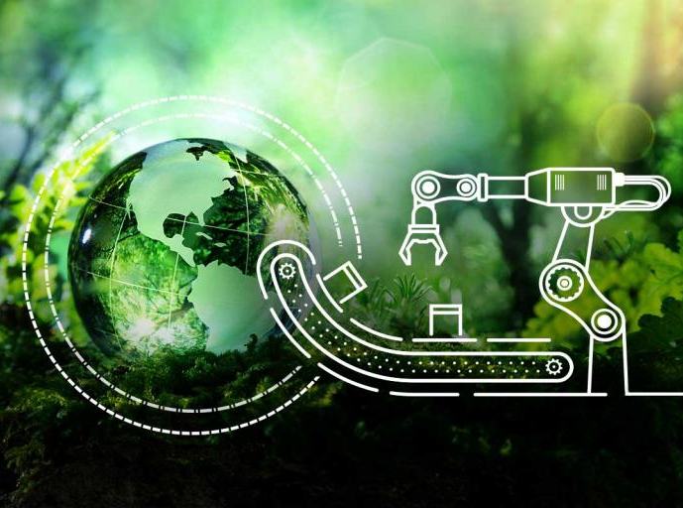
Let's consider your sustainable manufacturing processes
THINGS TO CONSIDER
03
When it comes to the factory where the product is manufactured, there are several measures to consider.
First of all, the working conditions need to be following regulations and laws.
Regarding the environmental impact of the manufacturing process, you should check and advocate for any reduction in industrial waste and ensure that waste from manufacturing your product is recyclable.
PRODUCT MANUFACTURING PHASE
Source

Slide 27
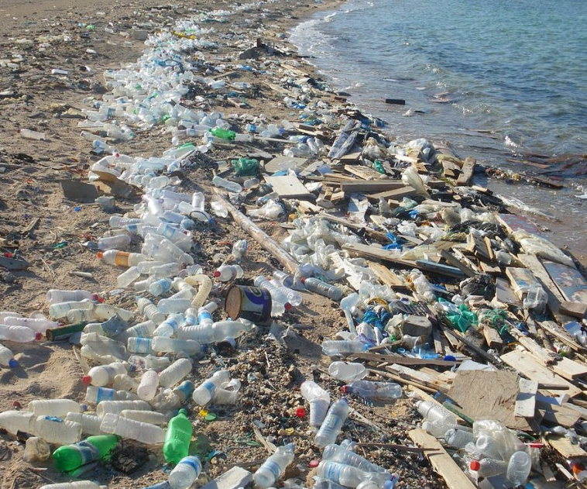
Have you thought about sustainable packaging?
THINGS TO CONSIDER
04
Pressure on business to reduce packaging waste has increased dramatically in the face of global consumer sentiment. We all remember visceral images of packaging leakage into oceans.
Packaging-waste management is subject to the highest number of regulatory measures worldwide (91 in total). In addition, there has been an increasing regulatory focus on more specific areas of packaging, including Plastic packaging, Beverage packaging, Primary versus secondary packaging.
Useful resource McKinsey Report Sustainability in packaging: Global regulatory development across 30 countries

Slide 28
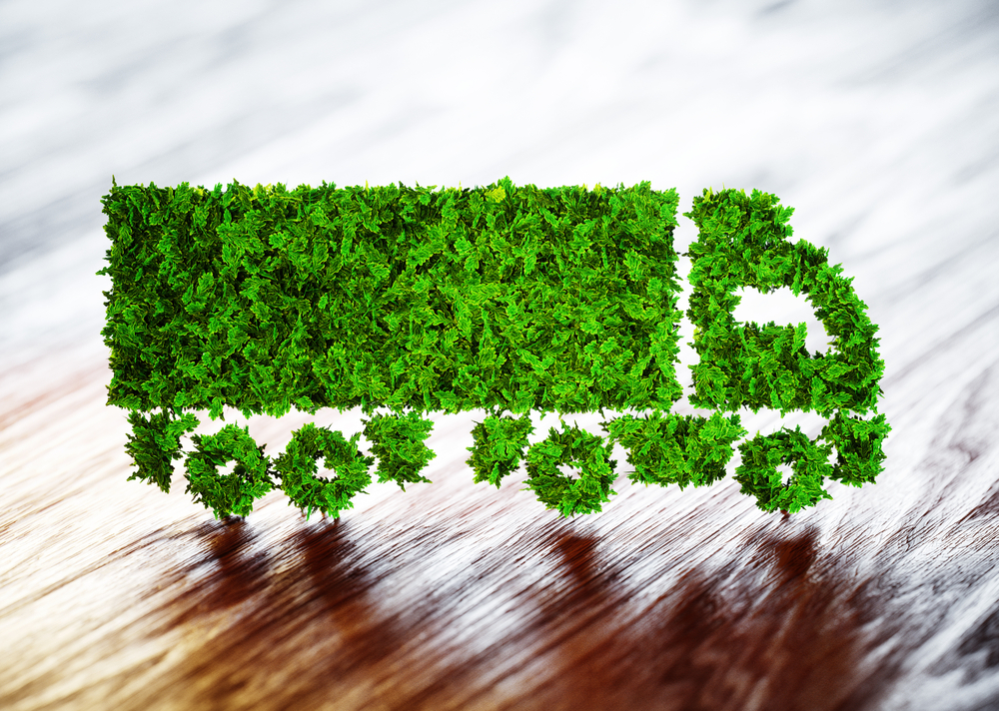
THINGS TO CONSIDER
05
Try to opt for Low Carbon Logistics
When the product has been manufactured, it's often transported to the customers or to a retail store. With the right measures, you can reduce the environmental impact of the product or service.
For example, reducing the number of transports, using hybrid/electric trucks, consolidated transport with other producers and efficient transportation packaging will reduce your overall greenhouse gas emissions.
PRODUCT DISTRIBUTION​ PHASE
Source

Slide 29
CONDUCTING A LIFE CYCLE ANALYSIS
This can be a highly complex assessment to carry out due to the number of factors involved. There are many questions to ask:
Which raw materials were involved?
Where did they come from?
How were my goods produced? How were they transported?
What does the product life cycle look like?
Does the product have longevity or is it a ‘take-make-waste’ product?
The good news is that there is are some useful tools and templates to help you/your team to work through this.

Slide 30
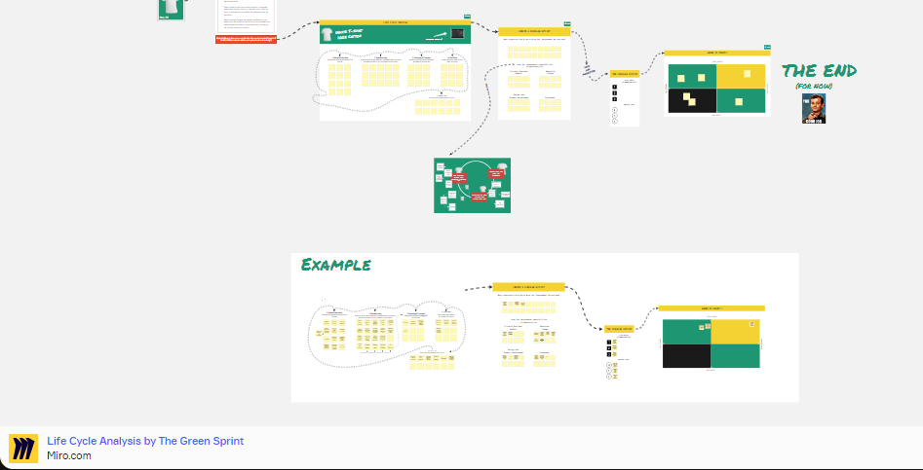
SHORT ACTIVITY – LIFE CYCLE ANALYSIS CANVAS ON MIRO
This Canvas offers a comprehensive 60-minute workshop template to help teams to work through the complete life cycle of one of their products. It provides insights and alignment on all the steps of the lifecycle of a product and helps teams to get a clearer picture and see what their opportunities for circular and sustainable development are.
CLICK LINK TO BEGIN
Minou Schillings's Life CycleExercisetemplate |Miroverse

Slide 31
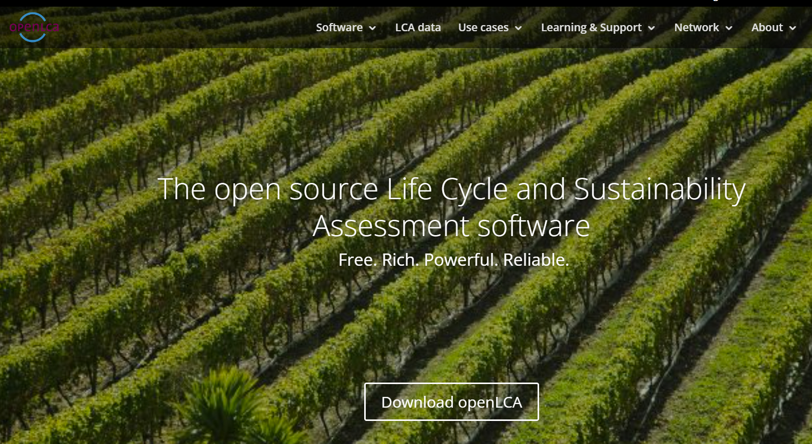
LONG ACTIVITY – ANALYSE YOUR PRODUCT LIFE CYCLE openLCA
Life Cycle Assessment Tool - The free OpenLCA tool analyses the impact of the energy used, release of toxic substances, natural resource use, etc. involved in all life cycle stages of a product (from the extraction of raw materials needed to produced it until it is no longer used and thrown away or recycled). CLICK LINK TO BEGIN
openLCA.org | openLCA is a free, professional Life Cycle Assessment (LCA) and footprint software with a broad range of features

Slide 32
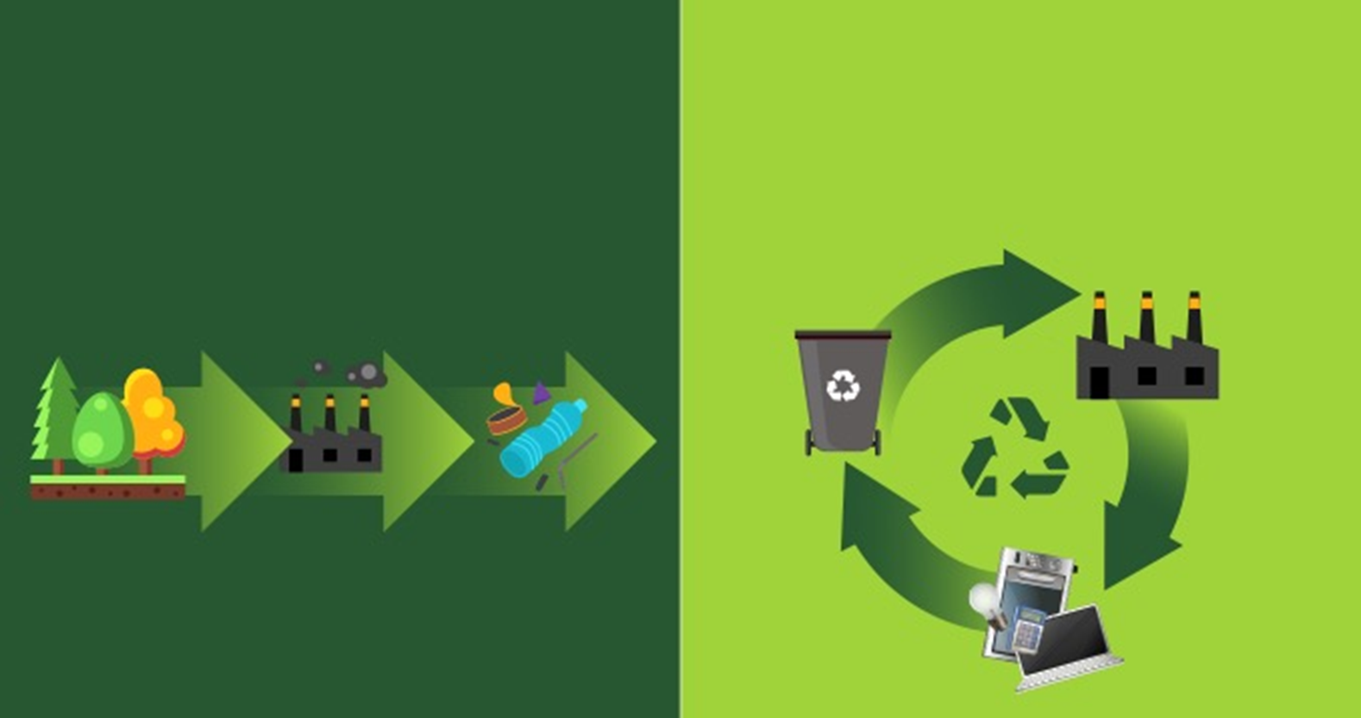
Spotlight on Circular Products and Lifecycles
Linear Economy
Circular Economy
Circular products are those that operate within the circular economy model i.e. those products that have reduced or completely no need for virgin resources and are designed with the end of their life in mind.
make
use
take
make
dispose
recycle
A circular product lifecycle enables sustainable products and sustainable consumption and to develop circular products is a great concrete way of contributing to a more sustainable society.

Slide 33
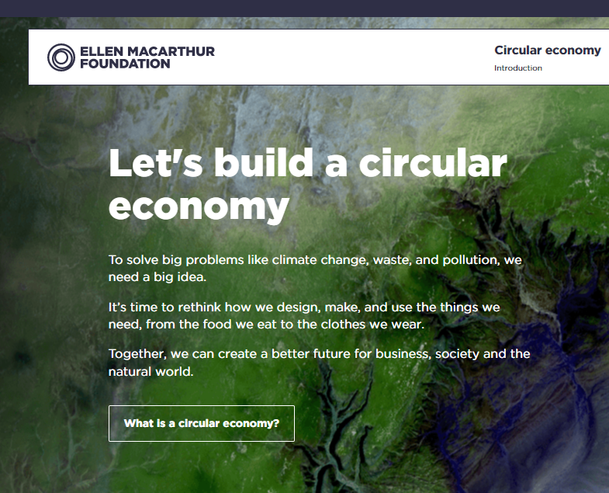
DELVE DEEPER AND LEARN MORE ABOUT THE CIRCULAR ECONOMY
The Ellen MacArthur Foundation works to accelerate the transition to a circular economy.
Browse and download thought-leading insight and analysis into the opportunity of a circular system, including circular economy books, reports and publications.
Publications | Ellen MacArthur Foundation

Slide 34
SECTION 04
Spotlight on Sustainable Packaging

Slide 35
What is Sustainable Packaging?
As you have been learning, sustainability, particularly for the environment is one of the hot topics throughout the world. So many headlines, but how can you as an SME make a difference?
One easy way that your SME can contribute to eco-friendly and sustainable living is through using sustainable packaging for your products. Customers expect it and the health of our planet demands it.
There is a wave of new innovative eco-friendly alternatives to traditional packaging materials.
From post-consumer recycled paper products to unique biodegradable materials, here’s an overview of the latest options for your packaging needs.

Slide 36
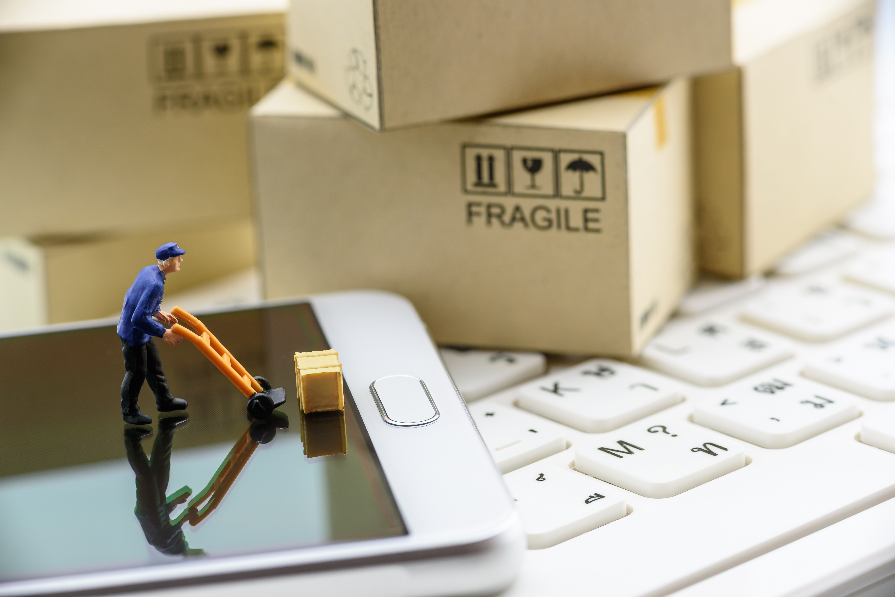
Sustainable Packaging and Changing Consumer Behaviours
The rise in online shopping in recent years has led to an increase in shipped goods, and with this surge in shipments comes a natural increase in shipping materials required as well.
There are numerous elements of packaging used to ship online purchases, from padding materials to the boxes that contain these goods. With this increase in shipped goods there has been a natural demand for packaging to keep sustainability and environmental factors in mind.
The benefits of opting for sustainable shipping materials are countless, with environmentally-conscious consumerism becoming the new standard.
Source

Slide 37
Sustainable packaging is environmentally-minded packaging that is designed with the intention of minimizing an environmental footprint.
Packaging can be sustainable in numerous ways, such as featuring 100% recycled materials, creating reusable packaging to maximize the packing material’s longevity, and choosing production processes with the supply chain that keep a carbon footprint in mind.
Let's take a look at some examples...

Slide 38
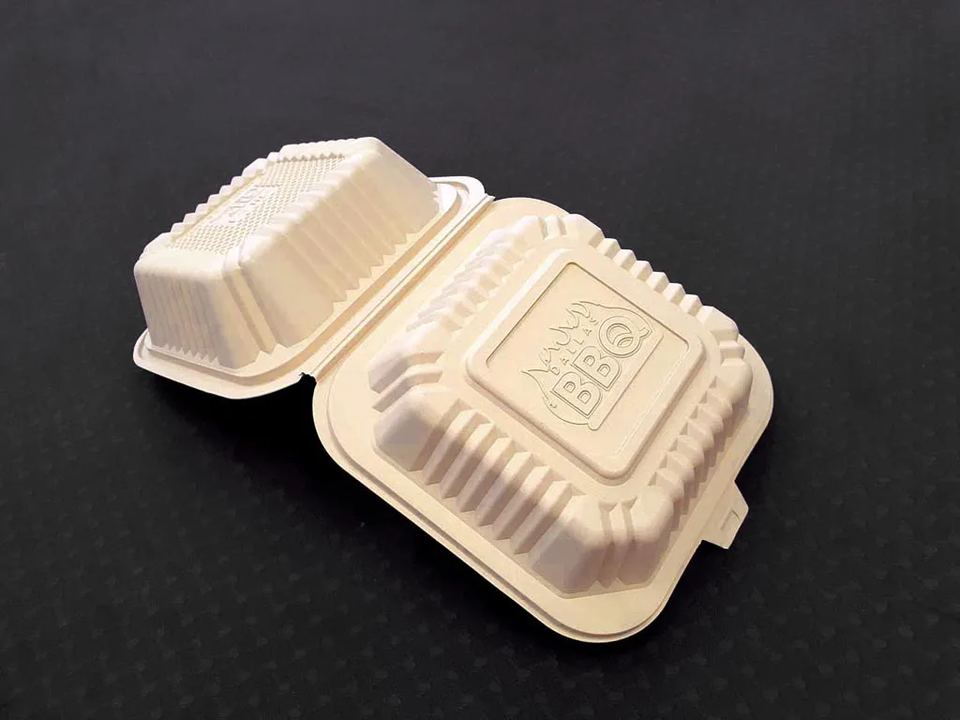
01
Compostable/ Plant Based
Packaging
When packaging is compostable, it means that the packaging is capable of disintegrating into natural elements in a compost environment.
At the end of the compost process, the material will become visually indistinguishable as it has been broken down naturally into carbon dioxide, water, inorganic compounds and biomass.
This also means that it does not leave behind any toxicity in the soil.
Some examples of compostable packaging include cardboard, paper, corn starch, bamboo,
Source

Slide 39
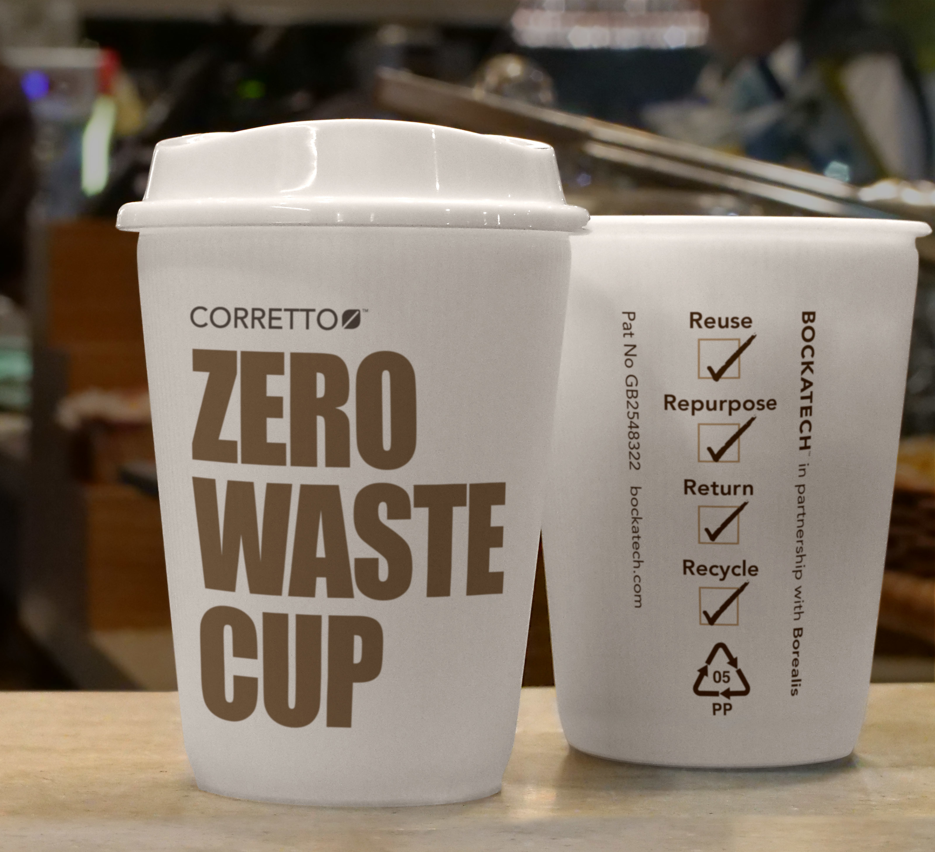
02
Reusable Packaging
Reusable packaging is packaging that is designed to be used more than once, with returnable packaging, reusable transport items, and returnable transport packaging being other forms of reusable packaging.
The goal of reusable packaging is to confront the single-use nature of many of the packing supplies we’ve used previously. Packaging that’s reusable extends the longevity and usefulness of the packaging through multiple shipments or trips.
Reusable packaging is designed using a variety of materials such as metal, plastic, or wood, with the sole goal of reusability in mind.
Source

Slide 40
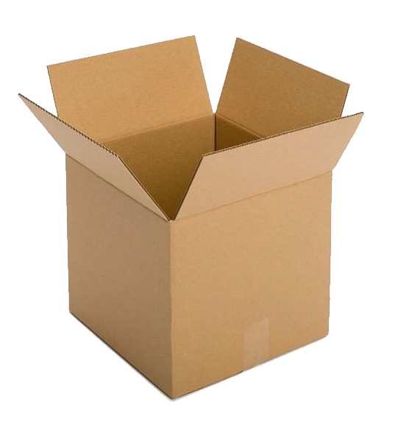
03
Recyclable Packaging
Recyclable packaging uses materials that are able to be processed again for another purpose, whether it’s to create more shipping materials or other items that can be produced with recyclable contents.
Cardboard easily takes the crown for the most commonly used type of recycled packaging. Packaging made from paper or cardboard is biodegradable as well, so even if these are used once they will naturally break down over time.
Recyclable materials include paper, card, metal, glass, and even certain types of plastics
Source

Slide 41
GETTING STARTED WITH SUSTAINABLE PACKAGING – SOME EASY FIRST STEPS
There are many ways to make adjustments to current supply chain material and packaging without causing an entire upheaval of current procedures. Some ideas ..
Reducing package sizes to use less materials
Adding a “Recyclable” logo or tag to current packaging to let customers know the material is recyclable
Reusing packaging materials whenever possible (especially for plastics)
Partnering with manufacturers and distributors that have adopted sustainable practices
Properly planning out shipments to avoid air freight when possible
Trying to use local manufacturers, when possible, to reduce the distance packages are required to travel

Slide 42
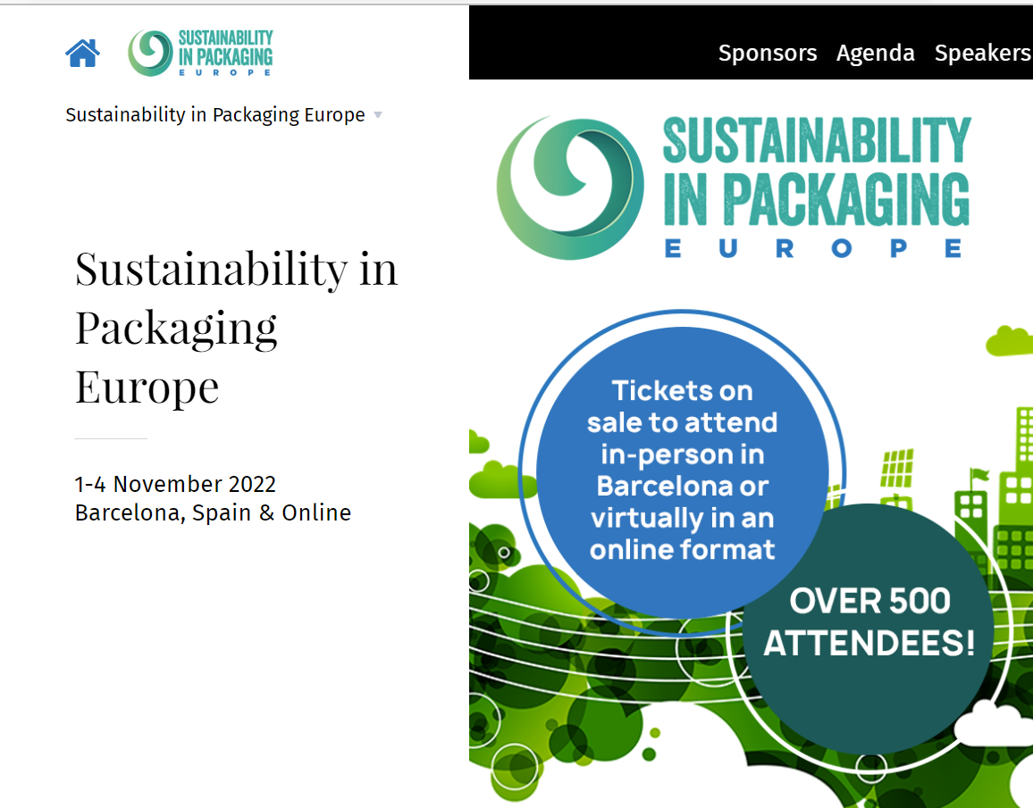
Did you know that each year 500 attendees attend Europe's Largest Sustainable Packaging Event?
In November 2022, the Sustainability in Packaging Europe event was held in Barcelona across 1-4 November as well as in an online format with over 500 packaging innovators in attendance. Discussions and networking for online and in-person attendees continued to drive innovations and packaging solutions towards a circular economy across. It is worth following, take a look at the 2022 Agenda | Sustainability in Packaging Europe

Slide 43
SECTION 05
Greening your Services

Slide 44
GETTING STARTED WITH GREENING THE SERVICES YOU OFFER
As we have learned there are simple steps that businesses can make and take to make their products greener. There are also key steps to help make your services greener.
There are many types of business services. In this section, we will take a look at a few common ones and how they can be made greener.

Slide 45
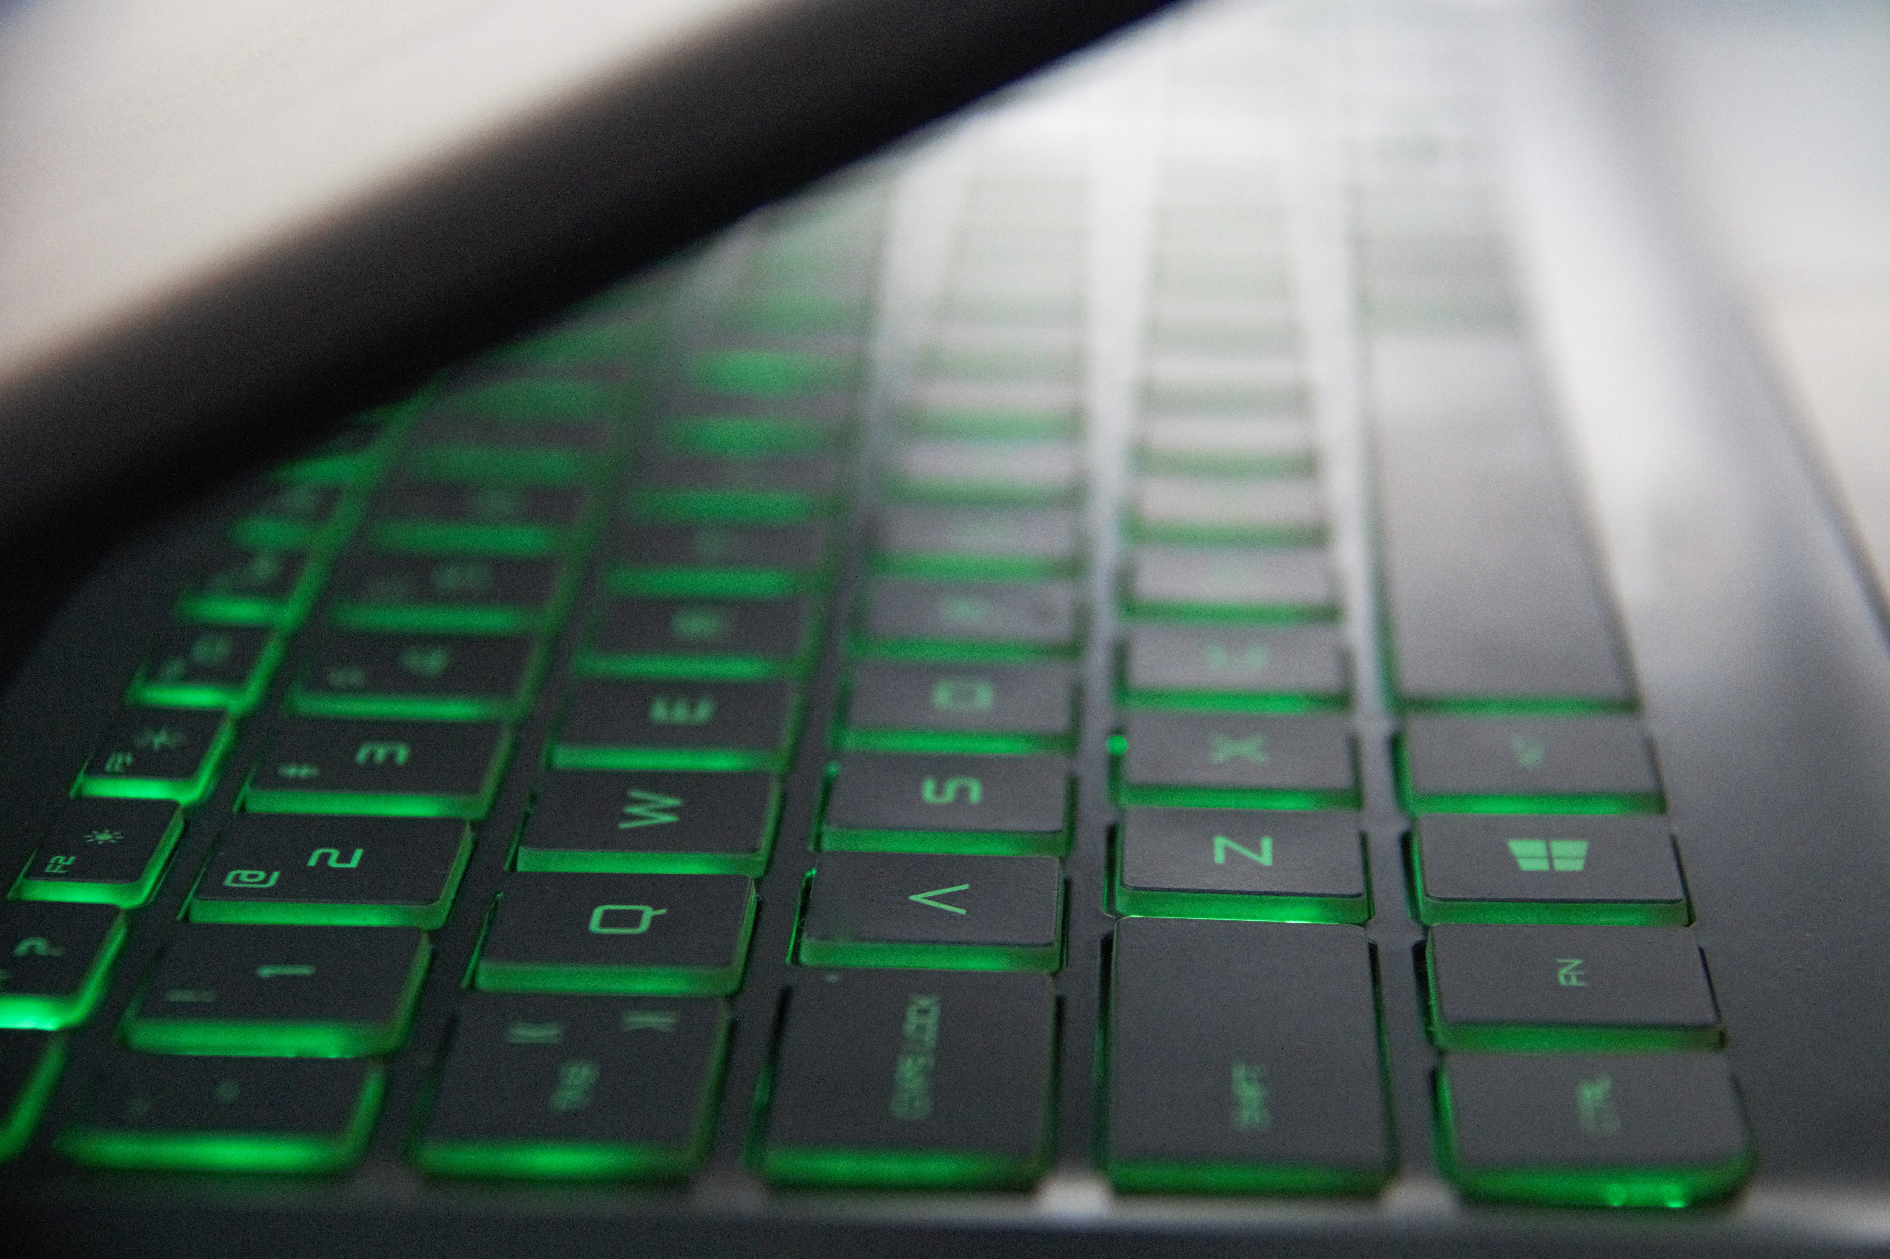
Did you know that the entire information technology (IT) sector - from powering internet servers to charging smartphones - is already estimated to have the same carbon footprint as the aviation industry's fuel emissions. And it is on course to consume as much as 20% of the world's electricity by 2030!
If you are in the business of SaaS. Green software engineering which is a relatively new discipline could be worth considering. It brings together:
Software development practices and architecture
Hardware and data center design
Electricity markets
Climate science
In this article you can learn more about What Is Green Software & How Can It Benefit Your Business? -
Green Software Services

Slide 46
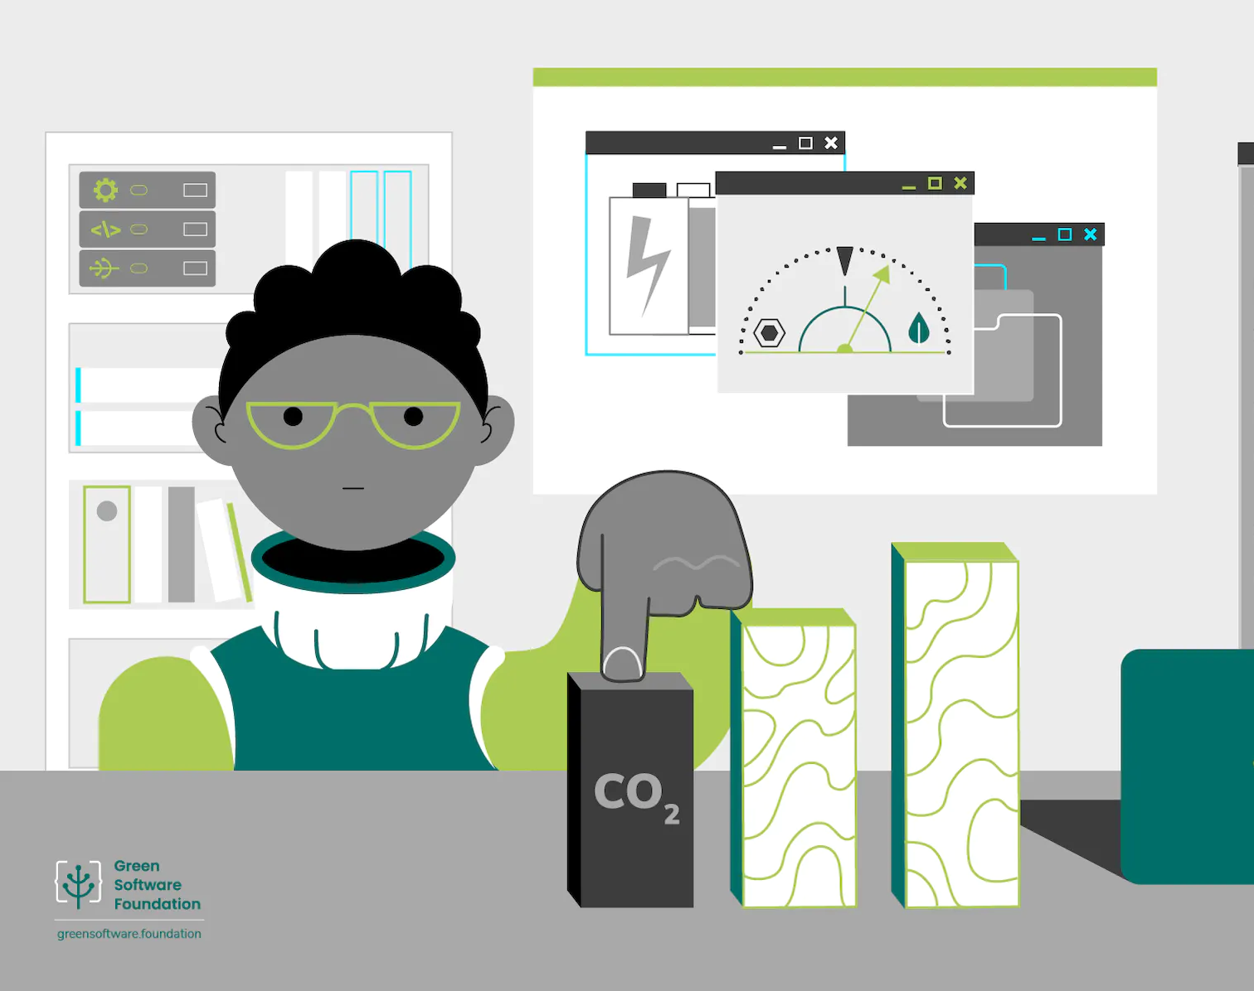
Foundation in Focus – Meet the Green Software Foundation
The Green Software Foundation is a non-profit and has been created for the people who are in the business of building software.
The mission of the Green Software Foundation is to build a trusted ecosystem of people, standards, tooling and best practices for creating and building green software.
If you are in the software business you might be interested in learning more here: https://greensoftware.foundation/

Slide 47
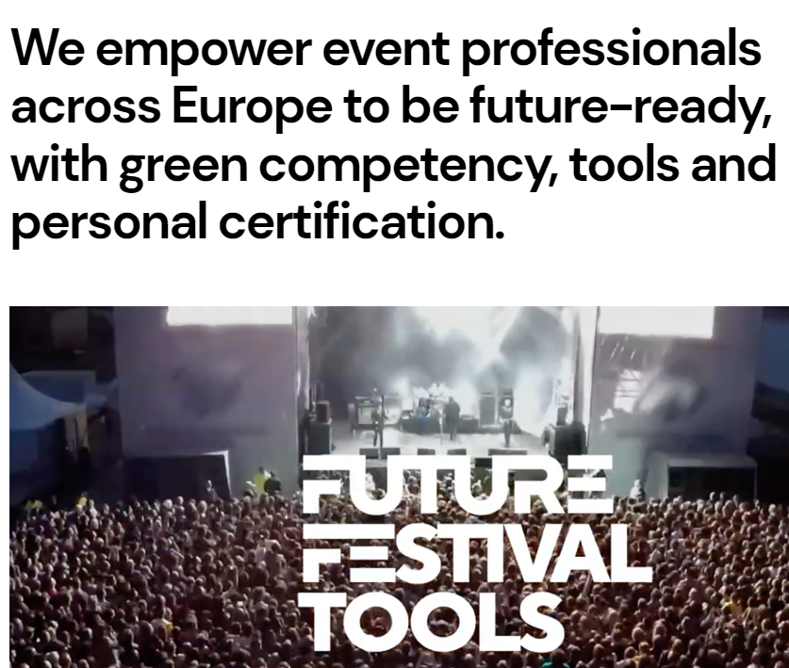

Sustainable Event Management Services
If you provide event management services you are probably already acutely aware of the need to provide more sustainable event management services.
Sustainability should be practiced in all levels of event management to ensure that an event is hosted responsibly and leaves positive legacies that benefit local communities.
Check out the impressive FUTURE FESTIVAL TOOLS ERASMUS+ project for lots of free resources to become more sustainable. Home - Future Festival Tools

Slide 48
Potential areas which sustainable event management can focus on and make improvements are:
Inclusion in event management
Quality of life in event management
Community involvement in event management
Responsible sourcing in event management
Environmental and social issues in event management
Economic and social impacts of events
Safety and health issues in sustainable event management
Social media marketing in event management
Monitoring and evaluation of events

Slide 49
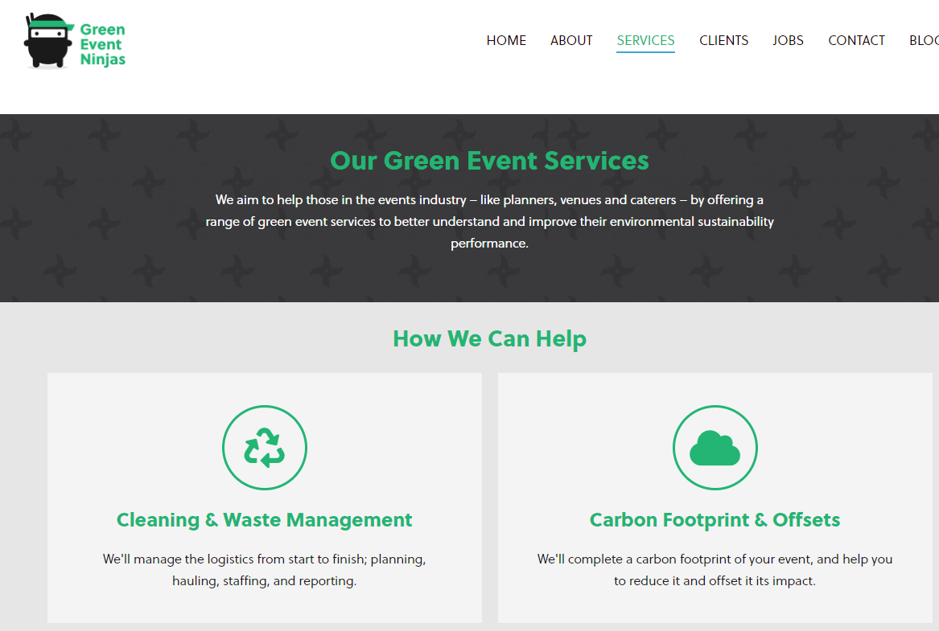
Business in Focus – Meet the Green Event Ninjas
Green Event Ninjas offer services to help those in the events industry – like planners, venues and caterers – better understand and improve their environmental sustainability performance.
Their services include Cleaning & Waste Management, Carbon Footprint & Offsets, Training & Education and Sustainability Consulting
Green Event Ninjas - Sustainable Events Made Easy

Slide 50
SECTION 06
Marketing your Green Products and Services

Slide 51
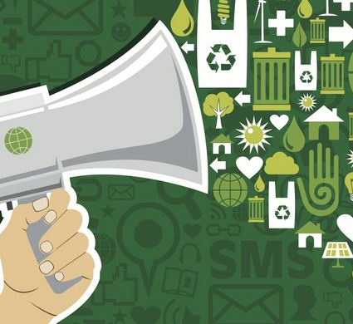
Although products and services can be considered green for more than one reason , once you define your product or service as green, the challenge becomes determining the best way to communicate this fact to the marketplace.
Examples of green marketing include advertising the reduced emissions associated with a product’s manufacturing process, or the use of post-consumer recycled materials for a product's packaging.
Some companies also may market themselves as being environmentally-conscious companies by donating a portion of their sales proceeds to environmental initiatives, such as tree planting. Be careful not to 'greenwash'!
WHAT IS GREEN MARKETING?

Slide 52
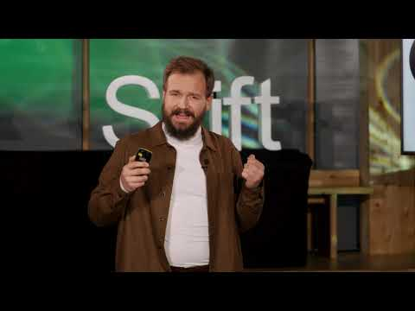
Greenwashing is when an organisation spends more time and money on marketing themselves as being sustainable than on actually minimising their environmental impact.
It’s a deceitful advertising method to gain favour with clients who choose to support businesses that care about bettering the planet.
Mathias (right) is the head of communication and politics in Skift - Business Climate Leaders, and has been running the initiative Guide Against Greenwashing in Norway since 2020.
What is Greenwashing?
Click arrow to watch...

Slide 53
How prevalent is Greenwashing?
It is very prevalent. Research by the European Commission in which company websites were screened for possible misleading sustainability claims showed that 59% of the assessed green claims were not or only partially substantiated with facts. In 42% of the cases, claims were even found to be wholly untrue or misleading.
Source

Slide 54
Avoid Greenwashing by sticking to the Green Claims Code
Repeatedly ask yourself and your PR/Marketing team:
Are your claims truthful and accurate?
Are your claims clear and unambiguous?
Do you claims omit or hide important information?
Do they only make fair and meaningful comparisons?
Have you substantiated your claims? (See next slide on green certification)

Slide 55
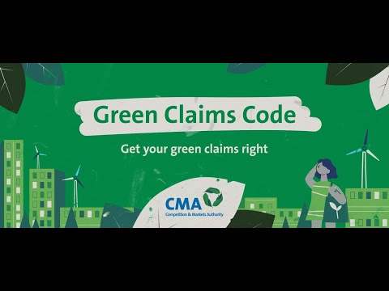
AVOID GREENWASHING – Check your Green Claims
The Competition and Markets Authority (CMA) has developed the Green Claims Code – which sets out 6 key points to check your environmental claims are genuinely green.
Watch this video and check the link below to learn more about the Green Claims Code.
https://greenclaims.campaign.gov.uk/#check_your_green_claims

Slide 56
The overall goal of green labels and certifications is to identify those products/services with the highest level of protectiveness of human health and the environment.
In order to obtain the certification, the manufacturer actually tests its product to see if it meets the applicable scientific criteria. In the case of the strongest, most reliable certifications, the organization providing the certification independently verifies that the requirements have been met. Otherwise, the validity of the representations are left to the competition to evaluate.
Green Labels and Certifications
You are learning that you must communicate your green efforts in a way that accurately represents the benefits you have created, and for that, green labels and certifications are an important consideration.
Let's look at some examples (next slide) ….

Slide 57
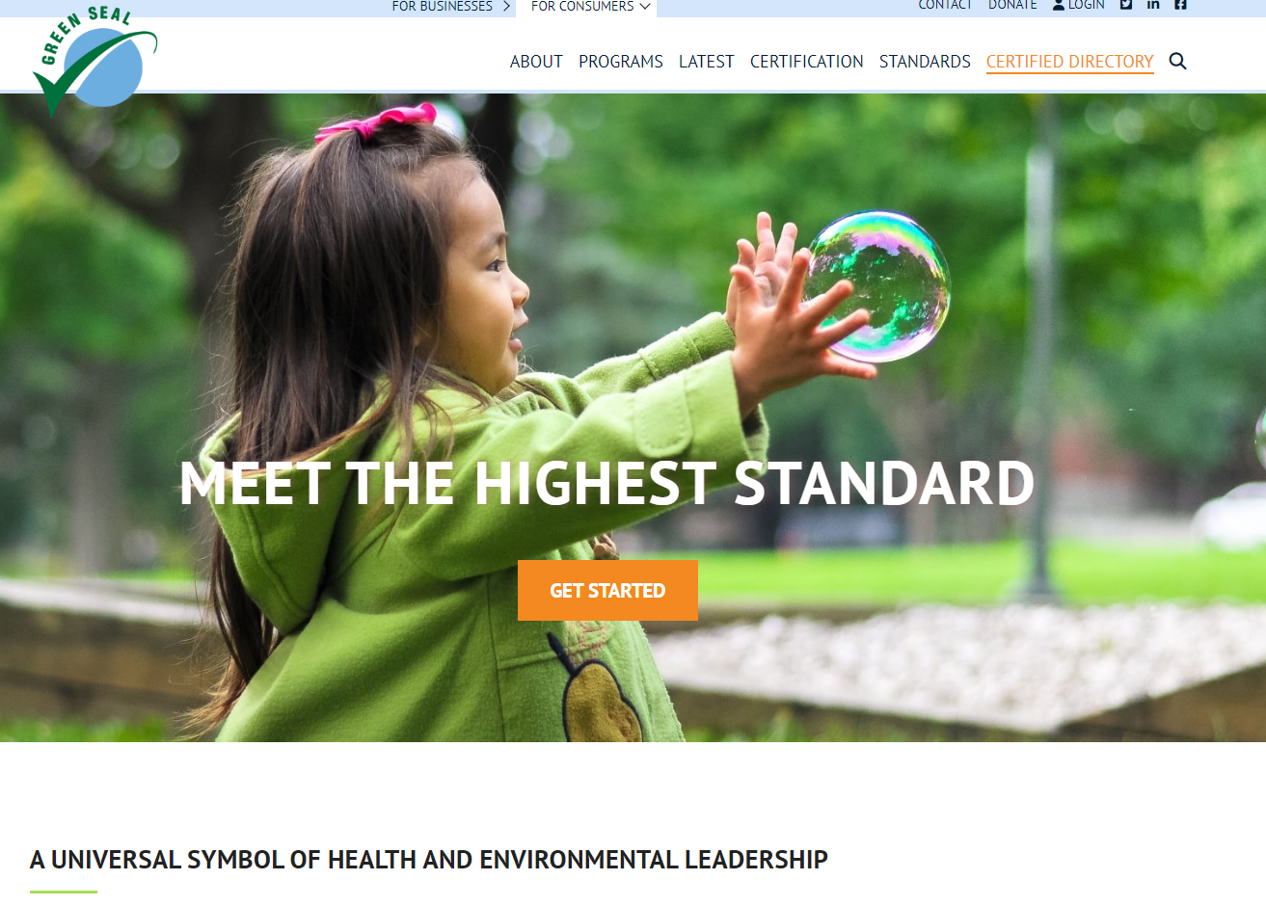
Green Seal
For more than 30 years, Green Seal has advocated for safer and more sustainable products and services
Their science-based standards reward industry innovations. Only the healthiest, most responsible, and most effective products achieve the Green Seal.
The Green Seal Compass focuses their standards on key impacts that occur throughout the product life cycle, from raw materials extraction and manufacturing to packaging, use and disposal.
​
www.greenseal.org

Slide 58
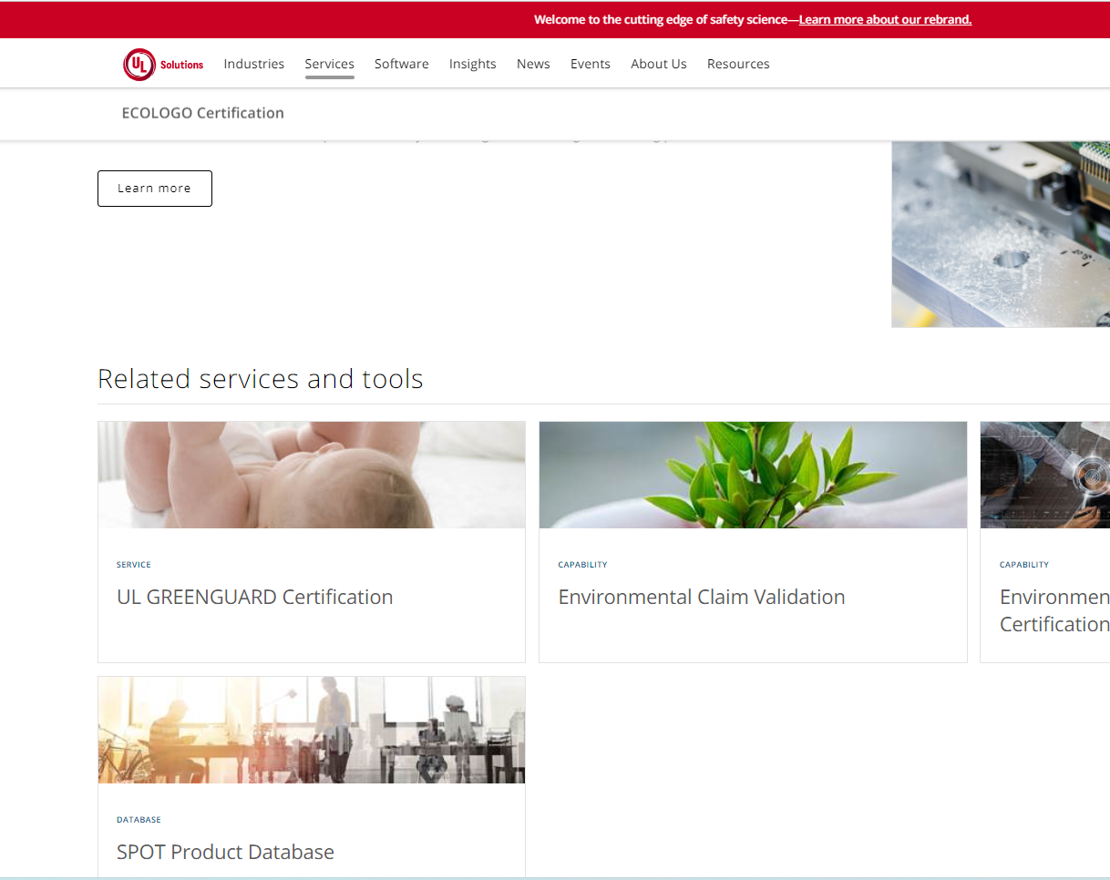
ECOLOGO® Certification
- is based on multi-attribute, life-cycle-based sustainability standards.
All products certified to an ECOLOGO Standard must meet or exceed each of the listed criteria before receiving the Mark. ECOLOGO Certification is classified as an International Organization for Standardization (ISO) Type 1 ecolabel and has been successfully assessed by the Global Ecolabeling Network, further demonstrating its credibility.
​
ECOLOGO Certification | UL Solutions

Slide 59
The Importance of Open and Transparent Communication

Slide 60
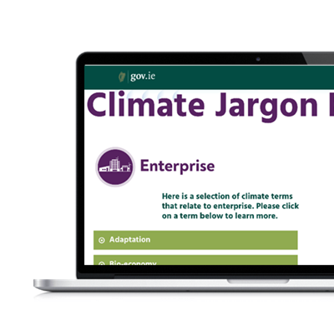
USEFUL TOOL – Climate Jargon Buster
This Carbon Jarbon Buster tool is a useful one to have in your communication toolbox. Use it to check and make sure you understand the key concepts and phrases used in sustainable business marketing and communication.
https://climatejargonbuster.ie/

Slide 61
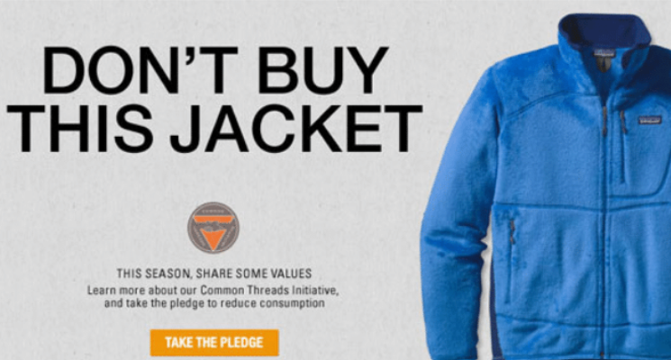
Case study - Patagonia- Don’t Buy This Jacket
Patagonia is known for their environmental and social commitments and has always strived to incorporate environmentalism into every aspect of their company. In 2011, they ran an ad on Black Friday that showed one of their jackets with the caption “Don’t Buy This Jacket”. The purpose of this ad was to address excessive consumerism, which was timely due to the wastefulness of Black Friday shopping.

Slide 62
Case study - Patagonia- Don’t Buy This Jacket
This ad certainly is memorable, and although seemingly contradictory to a typical company’s economic goals, actually goes to prove their commitment to the planet. By doing this they gain a competitive edge over other brands by being sincere in their marketing efforts and increasing their customer loyalty.

Slide 63
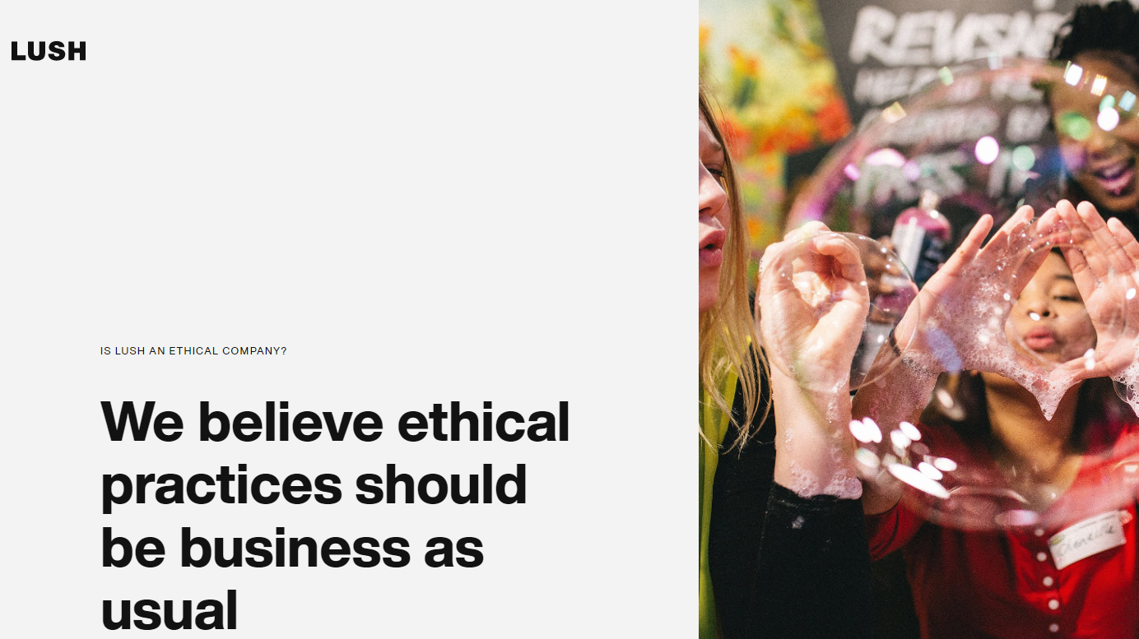
Case study: British cosmetics retailer Lush
The brand has consistently championed a range of progressive issues, from opposing animal testing to supporting LGBQT+ organisations. Just as significantly, it has placed its ethical commitments at the centre of the products it offers – especially when it comes to sustainability issues. Lush’s commitment to sustainable products has various dimensions, extending to the raw materials they use (70% of which are from self-sustaining sources) and the energy suppliers they work with.

Slide 64
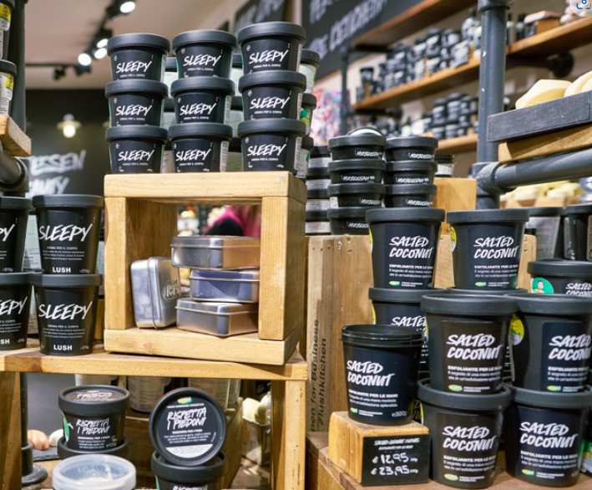
BACK TO SUSTAINABLE PACKAGING
From a marketing standpoint, however, what is most striking is their approach to packaging. Since 2008, many of Lush’s cosmetics have been sold in simple, largely unadorned black pots. Any five of these pots, once used, can be returned to Lush’s stores in exchange for a free face mask – following which the pots will be chipped down and remoulded into new ones to form a closed recycling loop.
Thus, the basic, unremarkable design of their packaging not only enables and encourages recycling but also places this front and centre in terms of their brand identity. In offering extremely simple packaging, Lush are essentially making a statement about the irrelevance of packing to their products – and their commitment to ultimately eliminating it.
Source

Slide 65
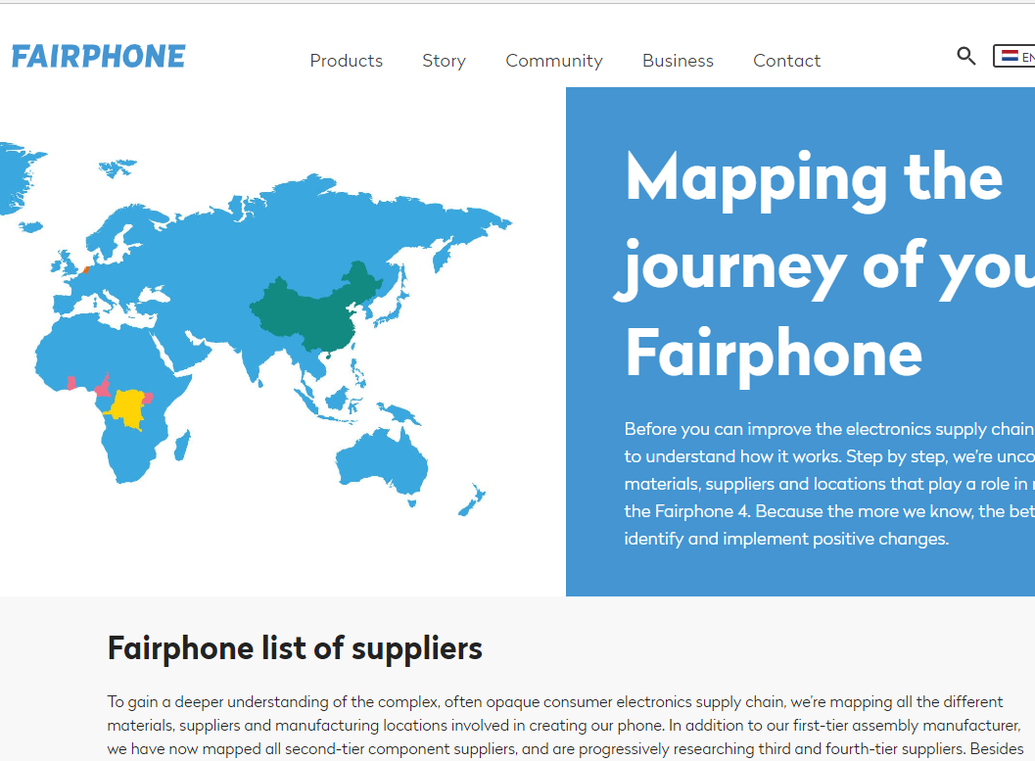
Case study - Communicating with transparency - FAIRPHONE
Fairphone seeks to build a deeper understanding between people and their products, driving conversations about what “fair” really means.
They have worked to create a more sustainable smartphone. Not only do they spend time carefully examining every stage of their supply chain. They have created an interactive source map to make their supply chain open and transparent. Well done, Fairphone!
Mapping the journey of your phone - Fairphone

Slide 66
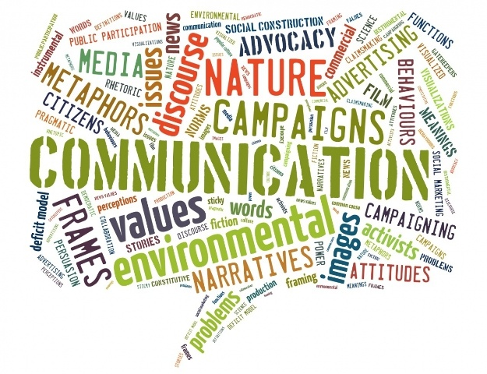
CHECKLIST FOR RESPONSIBLE COMMUNICATION
Be open and transparent. Communicate your green/sustainability actions and aspirations on your website, annual reports and all communications regarding your core services and programmes
Make sure you and your PR/Marketing team know about Greenwashing. It is important to communicate in a responsible way with accuracy and appropriate language in all cases
Choose to support projects that are linked to your mission and sustainability values
Try not to over promote basic environmental measures required by law e.g. Waste, water etc.

Slide 67
And now to our final Module 6,

