Slide 1
Module 6
Building Relations and Collaborating for Sustainable Success

Slide 2
Module 6
01
Collaborating for Sustainable Success
Our final module explores how SMEs can make a lasting impact by focusing on the multiplier power of collaborations in achieving systematic change.
02
Collaborative Culture
03
The Power of Clusters and Ecosystems

Slide 3
Section 1
Collaborating for Sustainable Success

Slide 4
What is Collaboration?
Collaboration is the process of two or more people or organisations working together to realize mutual advantage. Options range from informal networks and alliances, through joint delivery of projects to full merger. Collaborative working can last for a fixed length of time or can form a permanent arrangement. What these options have in common is that they involve some sort of exchange. Collaboration is essentially;
• Fostering a positive collective attitude.
• Encouraging a new acceptance of ‘process’.
• Remaining enthusiastic and curious about new solutions, tools and technology.

Slide 5
Business, governments, and environmental NGOs are increasingly facing sustainability challenges that are often too complex and too costly to be addressed by individual organizations.
In the past few years, sustainability leaders have recognized that progress they achieve individually is limited. As a result, new collaborative approaches to sustainability challenges have emerged and different models of collaborations have been created
company to company -examples to follow
company-NGO partnerships
single industry (Hotel Carbon Measurement Initiative)
And multi-sector collaborations (Collectively.org).
“If you want to go fast, go alone. If you want to go far, go together.”
African proverb

Slide 6
Collaboration is vital to achieving systemic change
For SMEs, collaboration on sustainability challenges can foster innovative solutions, reduce capital investment and drive real impact. Collaboration can also unlock opportunities for business growth by tackling issues such as climate- threatened supply chains.
Providing one recipe for successful collaborations is difficult. Experience in suggests key practices for successful sustainability collaborations.
While it is easy to talk-the-talk on collaboration, how easy is it for businesses to put aside differences, or to reach out across sectors, to achieve greater sustainability and new innovation?

Slide 7
In her blog ICRS chair Claudine Blamey wrote that, in the search for sustainability, few companies will be able to secure their future alone.
“Never has the sharing of ideas been more important”
Certainly, sharing ideas is central to collaboration, but some companies are starting to go above and beyond in their partnerships; creating value networks to drive a more circular economy.
With a flurry of recent collaborative announcements, edie* rounded up some of the most innovative – and unexpected -collaborations seen to date. They provide excellent learning into the potential of collaboration.
* edie is the industry-leading, purpose-driven business media brand which empowers sustainability, energy and environmental professionals of all levels to make business more sustainable through award-winning* content and events.

Slide 8
COLLABORATION IN ACTION EXAMPLES - Interface allies with recycling firms to turn windscreens into carpets
Floor manufacturer Interface’s 10-year journey towards its Mission Zero goals of having zero negative environmental impact was never going to be easy. And it certainly wasn’t going to be possible alone.
The modular flooring manufacturer turned heads with its latest green innovation, by creating the world’s first recycled latex substitute for carpets using laminate found in car windows. The firm has been working with waste and recycling partners such as Shark Solutions to find new raw, sustainable raw materials for its carpets. The new process makes use of recycled poly-vinyl butyral laminates found in windscreen glass as a latex substitute for its carpets.
We See Carbon as a Resource
Interface is the first global flooring manufacturer to sell all products as carbon neutral across their full life cycle.

Slide 9
WATCH COLLABORATION IN ACTION EXAMPLES - Interface allies with recycling firms to turn windscreens into carpets - CLICK ICON TO PLAY

Slide 10
COLLABORATION IN ACTION EXAMPLES -Formula One technology cools off supermarkets
Formula One developers Williams Advanced Engineering worked with an energy start up to solve the growing problem of cold energy for supermarkets.
Supermarkets are thought to account for almost 10% of the UK’s total energy usage, so developing new technology to reduce the burden of cold energy is vital for reducing the UK’s energy use in the long term.
The partnership with Aerofoil Energy aims to develop new aerodynamic devices to reduce fridge energy consumption by more than 40%, with the partners having already worked together on producing new aerofoils for fridge flow technologies.
Sainsbury’s is trailed the product as part of its aim to reduce operational emissions by 30%.

Slide 11
COLLABORATION IN ACTION EXAMPLES - Timberland drives shoe sustainability with recycled tyres
Out-door clothing producer Timberland found a new source for the rubber in its shoes in recycled tyres from tyre manufacturer Omni United.
The tyre and footwear industries are two of the largest users of virgin rubber, but the new range of tyres produced by Omni United would ensure no rubber goes to waste by setting them aside for reuse by Timberland under the new brand Timberland Tires.
Timberland president said the two businesses seemed “unlikely partners”, but highlighted: “Our shared values have given birth to tyres that express a lifestyle, deliver performance and safety, and prove that sustainability can be so much more than a theory.”

Slide 12
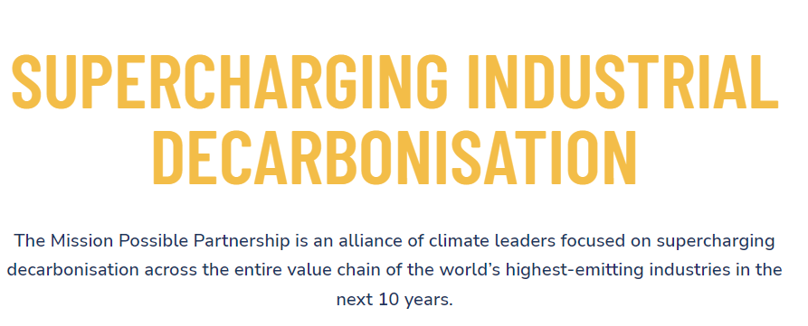
COLLABORATION IN ACTION EXAMPLES - Mission Possible Partnership.
Some 400 heavy emitters from the transport and industrial sectors have formed the partnership aimed at accelerating the low-carbon transition, with financial backing from Amazon’s Jeff Bezos.
Airbus, BASF, Boeing, Cargill, easyJet, Heathrow Airport, Royal DSM, Royal Dutch Shell and Volvo are among the first corporate members of the Partnership. The financial sector is also included Citi and Lloyds Register.

Slide 13
COLLABORATION IN ACTION EXAMPLES - Race to Zero: Retailers forge new climate-focused collaboration - edie
H&M Group, Walmart, Kingfisher and Ikea's parent company Ingka Group have launched a new initiative designed to help retailers collaborate in overcoming challenges on the transition to net-zero. The initiative is being operated in partnership with the World Business Council for Sustainable Development (WBCSD) and the COP26 High-Level Climate Action Champions initiative, as part of the Race to Zero Breakthroughs scheme.
The Race to Zero Breakthroughs aims to deliver near-term “tipping points” for decarbonisation in the world’s largest and most-emitting business sectors. Aside from retail, collaborations were floated for sectors including finance, water, aviation, energy and manufacturing.
Just 5% of retail businesses – by total global industry revenues – have committed to reducing the emissions of their value chains in line with the Paris Agreement.

Slide 14
As we have seen, Corporate collaboration can drive exponentially greater impacts. It can foster innovative solutions, level the playing field, move an industry, raise expectations for partners, influence policy and catalyze change in myriad ways.
BSR™ is a sustainable business network and consultancy focused on creating a world in which all people can thrive on a healthy planet. With offices in Asia, Europe, and North America, BSR™ provides its 300+ member companies with insight, advice, and collaborative initiatives to help them see a changing world more clearly, create long-term value, and scale impact. BSR recently launched five new collaborative initiatives for member companies. In the spirit of collaboration, LAURA GITMAN, Chief Operating Officer, BSR shared this excellent advice in 6 STEPS.
1. Don’t follow a template
Over the past decade, corporate sustainability collaborations have appeared to follow the same formula: Create industry solutions to a particular issue by forming an initiative with a multistakeholder governance structure. While these collaborations are important and powerful, they are not the only viable approach.

Slide 15
There is a need for a wide variety of collaborations: some within an industry, some multi-industry, some multistakeholder. Some are focused on standards and implementation, others on learning and sharing. But there is no one right way. For example, the Electronic Industry Citizenship Coalition grew from 15 to more than 50 electronics companies and institutionalized its own industry only entity. EICC members represent the entire industry, from retailers and electronics brands to contract manufacturers and raw materials suppliers as collaboration needed was across the complete supply chain.
2. Embrace good governance
Regardless of what form they take; good governance is a critical part of improving performance or setting standards through formal collaborations. Take the time to define decision-making processes and roles, ensure sufficient administrative time and support staff and use effective meeting facilitation techniques. In some cases, this might mean hiring staff to ensure the long-term viability of the effort.

Slide 16
3. Take advantage of external pressure
Collaboration can be challenging and sometimes needs to get an external push. The calamity at Rana Plaza that killed more than 1,000 apparel workers in Bangladesh was both predictable and avoidable. But it spawned two new collaborative initiatives focused on systemic challenges to health and safety within Bangladesh’s garment industry, (social sustainability pillar from Module 1)
4. Focus on the long term and recommit to your purpose
Collaborations take a lot of compromise, and sometimes they require two steps backward just to take one step forward. As with any long-standing relationship, it’s important to focus on the long term and remember why the group came together in the first place. Assist members to remember the value they were seeking in that collaboration. That commitment provides a foundation for healthy debate and the motivation to push through the difficulties.

Slide 17
5. Know when to move on.
Often, we associate ending an effort with failure, when it’s actually a sign of success. Every group should review progress annually and assess whether it makes sense to continue. For three years, Laura led the Licensing Working Group, which comprised media and entertainment companies focused on helping licensees improve their social and environmental performance. The group achieved a lot and then asked, “Now what?” They recognized that they had accomplished our goals, and the next step was for individual companies to integrate the lessons. So, they sunset the group. Too often groups in similar situations struggle to find a purpose to stay together. Instead, we should celebrate these endings, as there is plenty more work to do in other areas.
6. Be open to informal collaboration.
Many informal networks play an important role in collaboration as well.

Slide 18
KEY INSIGHTS FROM EXPERIENCED COLLABORATORS
Most collaborations start small. Designing the membership criteria to accommodate future growth, new partners, and cross-industry participation is important in order to increase the future impact of the collaboration and attract a good mix of partners with valuable expertise and capabilities.
Successful collaborations evolve and attract new partners.
Membership criteria should define the expected contributions from each member such as financial support, human resources, time, and intellectual property. An ad-hoc volunteer approach to resources and time may create disproportionate commitment and, therefore, tension among members.
Financial contribution models can be as diverse as the different collaboration models. Members may pay the same participation fee or provide tiered contributions depending on size, membership status, level of participation, or other criteria.

Slide 19
KEY INSIGHTS FROM EXPERIENCED COLLABORATORS
Transparent communication within the partner organizations, among partners, and externally with stakeholders supports the success of the collaboration.
Every collaboration has numerous stakeholders with different motivations, agendas, and areas of influence. Mapping them is important to identify stakeholders who are interested in solving problems. Engaging these stakeholders, interested in finding solutions, helps the collaboration make progress, establish credibility, and find trusted partners to spread its story. Convening a circle of “critical friends” from academia, nonprofits, media, and standard setters (a concept developed by Richard Ellis, VP CSR Walgreens Boots Alliance) is highly valuable because of their different capabilities, technical expertise, and perspective. Successful collaborations not only educate stakeholders, but also are about creating a shared vision and partnering with them

Slide 20
6 ways collaboration can boost sustainability | Greenbiz
10 things we learned about collaborating for sustainability | Guardian sustainable business | The Guardian
DELVE DEEPER ..
Some excellent articles
Did you know the EU funds Sustainability Partnerships for SMEs?
The EU wants to support Sustainability Partnerships of SMEs. It put out an open call to create partnerships between NGOs, Civil Society Organisations (CSOs) and SMEs.
The goal of this call is to team the expertise of NGOs and CSOs to assist SMEs in their transition to more sustainable business models. It aims at enhancing the collaboration between SMEs and NGOs/CSOs active in the same regions, while funding practical projects to boost the environmental and/or social performance of SMEs. This call builds on the goals of the Enterprise Europe Network and provides members with an additional tool to assist SMEs.

Slide 21
A FINAL WORD IN THIS SECTION…
Collaborating with others can provide you with the additional skills and resources to do things that you couldn’t achieve on your own.
Getting collaboration right though, takes effort and a culture open to change.
Collaborations require serious effort to make the collaboration work.
As an SME, you may sometimes feel alone, without any resources to utilise but your own. Finding collaborators means having a built-in coalition of partners, a readymade group to provide support and encouragement.

Slide 22
Section 2
Collaboration Culture

Slide 23
A collaborative culture is one where collaboration is regular and deliberate.
Collaboration doesn't just occur if someone happens to initiate it. Instead, it's baked into processes of how people do their work every day and into the attitudes they take about that work.
At its heart, a collaborative culture values the idea that we are better together. It centers on the idea that collective intelligence drives the most creative solutions.
“We cannot solve our problems with the same thinking we used when we created them.”
Albert Einstein

Slide 24
What are the benefits of a collaborative culture?
We are seeing more and more that collaboration is one of the most powerful ways to create innovation.
One study found that companies with collaborative cultures were five times as likely to be high performing.
DELVE DEEPER - How to Create a Collaborative Culture | The Workstream (atlassian.com)

Slide 25
Collaboration Culture in a Nutshell
Bringing people together to arrive at a solution faster and easier than had it been done alone. You innovate, solve problems together, bring together cross-functional expertise and knowledge to see a new solution, or tackle a challenging issue. But it’s also the ability to bring people together to talk about difficult topics, and therein a culture challenge
Conflict is inevitable, where you’re bringing different people together to work on projects, clashes are all too common.
Building a collaborative culture requires seeing conflict as a positive thing, building out the values and processes necessary to leverage its beneficial qualities.
Conflict leads to better solutions, higher-quality work, and motivated employees, because disagreement can be seen as a way of generating solutions that may not be readily available.

Slide 26
Collaboration Culture in a Nutshell
A collaboration is best when it challenges everyone involved. Be there to push, spur each other on and to help the best ideas to be bigger.
Encourage one another
Ask for progress reports
Be accountable
Don’t think too small
Never let great ideas be squandered
DELVE DEEPER https://medium.com/@jasonkeath/partners-in-crime-the-power-of-finding-your-creative-collaborator-7d8aaf7af07b

Slide 27
Collaboration Culture Needs Dedicated Time
A good example of a company benefitting from dedicating time to collaboration and innovation is Google. In 2004, Google Founders, Larry Page and Sergey Brin, decided that employees could use up to 20% of their time on side projects. They refocused the work to make sure that employees became personally responsible for new innovations. Not all of the projects were successful. And not everyone took advantage of the freedom within the new policy. But some did, and a few developed widely successful projects, such as AdSense, Gmail, and Google Maps. While this approach is not possible for everyone, nor is it recommended for SMEs with little resources, dedicating time for collaboration, either within your organization or through clusters, is a great way of creating new ideas.

Slide 28
Setting the Ground Rules for your Collaboration Session
Setting the right environment for collaboration is an essential first step. Starting by setting some ground rules so everyone of all levels feels comfortable to contribute.
Rule #1: Generate as many ideas as possible during the session.
While it can seem counterintuitive to most of us, brainstorming is about quantity rather than quality. By placing the focus on getting as many ideas as possible, people are more willing to share things that they otherwise might write off as irrelevant or over the top.
Rule #2: Criticizing ideas is not allowed.
Brainstorming isn’t about critiquing ideas on the spot — it’s simply about generation. That lack of immediate feedback empowers people to share ideas more openly without the fear of failure or disapproval.

Slide 29
Setting the Ground Rules for your Collaboration Session
Rule #3: Wild and ambitious ideas are welcome.
During a brainstorming session, you want people to think big. That’s exactly why this principle (which you might hear called “freewheeling”) exists. It encourages more creative thinking, because people know that they’re not just allowed — but actually encouraged — to think outside of the box.
Rule #4: People are encouraged to build on other ideas.
Finally, there’s a concept called “piggybacking.” While criticisms aren’t allowed, brainstorming participants are welcome to build upon other people’s contributions. This creates a more collaborative atmosphere, where good ideas get even more traction.

Slide 30
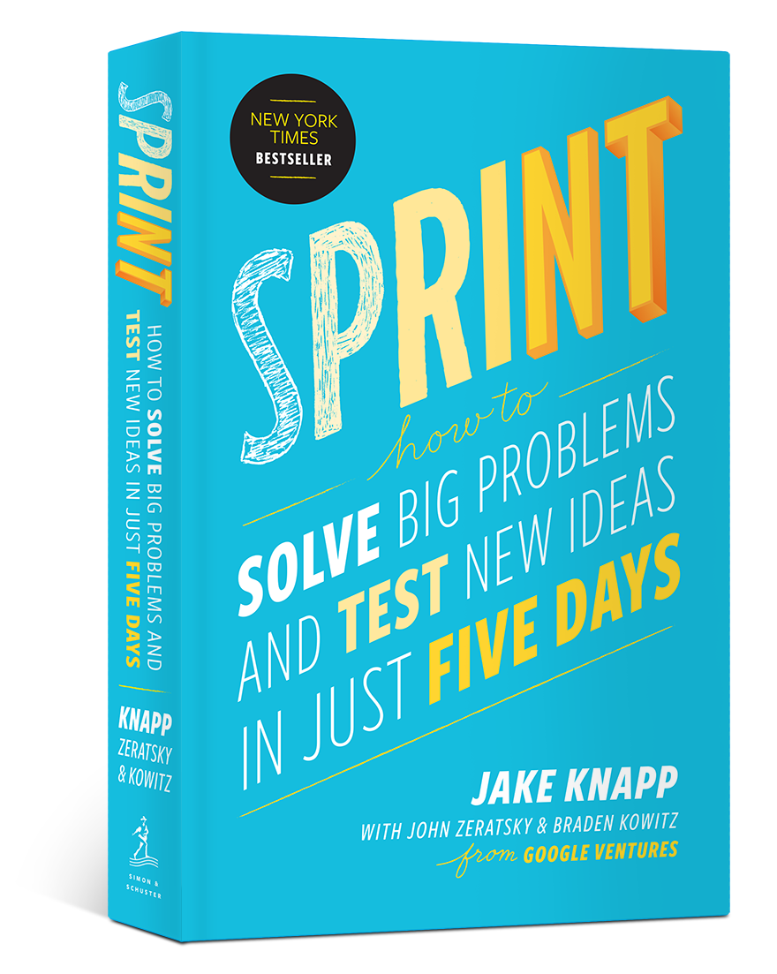
Find Time for Collaborative Innovation
Where we’re busy in work, finding time for active collaboration can be difficult. Organising a dedicated brain storming session can be a good way of structuring this time for Innovation
Design Sprints can be a highly effective use of time if done right.
First designed at Google by Jake Knapp, design sprints have become a popular way of tackling difficult problems at start-ups and other rapidly changing businesses.
In these next few slides we are going to work through how a design sprint might be utilised to create innovative solutions for sustainability related problems

Slide 31
Organising a Design Sprint for Collaboration
UNDERSTAND
DEFINE
IDEATE
PROTOTYPE
TEST

Slide 32
01
Understand
This first day "understand" is critical for the smooth progress of the Sprint as it serves to align with the objectives of the workshop and to define the problem better. This problem framing effort is the heart of the first day.
For a Sustainability Sprint, if you don’t have expertise within your organisation either spend some time getting up to speed or bring in an external expert who can help your team understand the issue you’re solving.
Notes:
https://design-sprint.com/understand/

Slide 33
02
Define
In the Define stage, you will organize the information you have gathered during the Empathize stage. You’ll analyze your observations to define the core problems you and your team have identified up to this point. Defining the problem and problem statement must be done in a human-centered manner.
A sample problem statement for sustainability might be:
“How might we build stronger client relationships while reducing our travel related carbon footprint”
Notes:
https://www.interaction-design.org/literature/article/5-stages-in-the-design-thinking-process

Slide 34
03
Ideate
During the third stage of the design thinking process, your team are ready to generate ideas. You’ve grown to understand your users and their needs in the Empathize stage, and you’ve analyzed your observations in the Define stage to create a user centric problem statement. With this solid background, and clear purpose for your session, your time can go about rapidly ideating solutions. It’s important we remember our ground rules to ensure the best outcome.

Slide 35
SHORT ACTIVITY – USING PLAY TO STIMULATE IDEATION
It can be helpful to start the ideation stage with something informal like an ice breaker game.
There are 100s to choose online, but a quick and simple option can be to break your team into smaller groups and have them create the worst solution to the problem that they can think of and present back to the group. It’s a fun, consequence free place to start, that makes everyone feel open to contribute to the session.

Slide 36
04
Prototype
The design team will now produce a number of inexpensive, scaled down versions of the product to investigate the key solutions generated in the ideation phase. These prototypes can be shared and tested within the team itself, or on a small group of people outside the design team. This can be a great opportunity to involve other members of your team.
It’s important that we find out the flaws in our solutions at an early stage.

Slide 37
05
Test
Designers or evaluators rigorously test the complete product using the best solutions identified in the Prototype stage.
Congratulations!! This is the last stage of the process. Transitioning to a more sustainable business model is a daunting task so it is important that we don’t treat collaboration sessions as one offs, and continually expand on our ideas.
Design sprints are iterative processes so the results generated can be built on continually.
Notes:
Designers or evaluators rigorously test the complete product using the best solutions identified in the Prototype stage. This is the final stage of the five-stage model; however, in an iterative process such as design thinking, the results generated are often used to redefine one or more further problems.
Congratulations!! You have completed your first design sprint. Transitioning to a more sustainable business model is a daunting task so it is important that we don’t treat collaboration sessions as one offs, and continually expand on our ideas.

Slide 38
Section 3
The Power of Clusters and Ecosystems

Slide 39
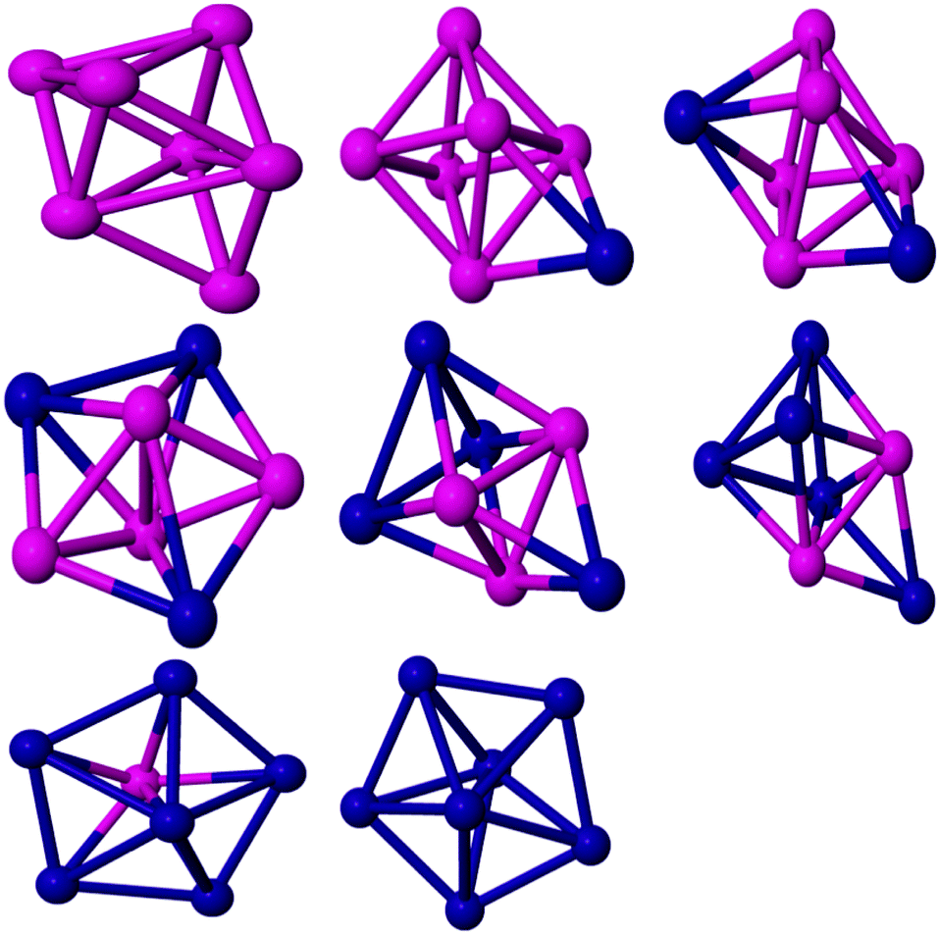
The Power of Clusters
‘Clusters’ describe a group of related or mutually dependent businesses and resources that are grouped together in a defined area or in a virtual environment that is dependent on strong commitment to connectivity.
Clusters feed on diversity and change.
They are uniquely diverse in structure, sector and services. Importantly, they are drivers with the potential to revive the economy. New value is created when: technical innovation, creativity and business entrepreneurship are deployed together to solve sustainability problems

Slide 40
SPOTLIGHT ON WELSH SUSTAINABILITY CLUSTER
A well facilitated and productive Sustainability Cluster will support businesses on their journey of continuous improvement to deliver the values of resilience, quality, responsibility and authenticity.
A Sustainability Cluster was established by Food and Drink Wales to utilise the successful triple helix approach adopted by other Welsh Food and Drink Clusters. This model includes government, industry and academia working hand in hand to tackle common industry problems and collaborating to drive the Welsh Food and Drink industry forward

Slide 41
SPOTLIGHT ON SWEDISH SUSTAINABILITY CLUSTER
The Sustainable Cluster Development project aims to promote the growth of a strong and sustainable life science sector, where Stockholm/Uppsala, Sweden will be perceived as an internationally leading development environment for life science companies and thus mentioned among the top five life science environments in Europe.
The life science sector in Uppsala is facing challenges and is in need of change. Those challenges consist of a future generational change with the risk of a significant loss of skills and an industrial revolution that means that industry boundaries are blurred. To meet these challenges, the Sustainable Cluster Development project wants to create new forms of cluster formation and collaboration in life science.
In the long term, the goal is to promote the growth of a strong and sustainable life science sector where Uppsala as a region is to be perceived as an internationally leading development environment. Sustainable Cluster Development will collaborate with other actors to achieve its goals. To develop and broaden the cluster organization, the collaboration will be linked between academia, business, and society in life science.

Slide 42
The Power of Ecosystems
Ecosystems are a way of looking at the world. A seminal study of the practice of ecosystem building was conducted in 2021 by Impact Hub Amsterdam. It mixes practical operation and strategic/academic considerations. They contend that ecosystems are actually hard to explain and tough to ‘manage’ but are still significant as an approach because they enable:
finding and collaborating with diverse but like-valued partners
parallel learning, experimentation and embodiment of new ways forward
the emergence of networks of trust that last beyond ‘projects’

Slide 43
The Power of Ecosystems
Impact Hub Amsterdam describes an ecosystem-builder is a person or organisation that takes the perspective of the whole and hosts the emergence of new and deeper relations to create more impact in pursuit of a shared purpose.

Slide 44
Impact Hub Amsterdam highlight the five phases of Ecosystem Building can be summarised as:
Phase 01 | Stakeholder convening
In most ecosystems, there were already a number of connections between members in certain stakeholder groups. It is described as a growing felt sense for change, and “itch” to do something differently. T
his phase is characterised by a yearning for something new, and to discover that together with others in ‘the field’. It can also be a time for ecosystem players to be letting go of old beliefs in order to step into a new and more generative space.
It is in this place that convening may surface naturally from a group itself and/or be called by an organisation (or individual) who sees the potential of bringing the ecosystem together around a shared issue or topic.

Slide 45
Phase 02 | Convergence
As shared interest grows, diverse players start to converge around a shared purpose - or exploration of purpose if that is not yet clear. The Sustainable Fashion Lab in Brazil spent the first two years primarily developing the relationships, sensing possible futures, systems mapping and exploring a shared theory of change. The role of their ecosystem-builder was largely nurturing the relationships and building a shared systems perspective.
They report that convergence can happen in either of two ways: through commitment to relationship first “we are in this together” and with trust that a compelling shared purpose will emerge to take the group to its next level or through content with a named shift that “x needs to transition” and compelling the players that are interested to jump into a journey together.
This can sometimes be the phase that tries to make sense of where the whole thing is heading - and if it is worth investing time and resources in it while embarking on this journey of unpredictable but promised emergence. The importance of onboarding new participants - building trust, hosting with openness and curiosity, also encouraging participants to reflect on their own role as they explore engagement is key.

Slide 46
Phase 03 | Ecosystem Attention + Cultivation
Here the work turns further inward to deepen and build more symbiotic relationships, with the ecosystem-builder paying attention to dynamics such as the relationship between smaller and larger actors and how to enable optimal collaboration, or who else needs to be invited into the ecosystem to bring expertise or a missing perspective. As the ecosystem grows, and starts to initiate actions for external impact, the internal culture evolve, and the culture (interior state) and cohesion becomes more important.
The ecosystem becomes more complex as the interplay between the cultures and practices of individual organisations interact with the emerging culture of the collective ecosystem. It is not all harmony, and, in this phase, conflicts will come up. This is basically good news and difficult at the same time. Good news because people bring in their information and their insights. It is also difficult because conflicts can also easily become destructive. It is the specific role of the ecosystem-builder to create the enabling conditions for constructive conflicts to take place. There is also a push for external relevance and “let’s take action”.

Slide 47
Phase 04 | Divergence
Divergence has healthy and unhealthy expressions. In one impact ecosystem, the ecosystem attracted so many keen intermediary parties that it edged out the original beneficiaries that the ecosystem had sought to respond to.
Maturity meant saturation and was very expensive to maintain as it tried to outlive its own utility. In other cases, the system became accustomed to - or comfortable with - itself and so closed itself off and without new fresh air, drew itself to a quick closure.
In some cases, the organic nature became too formalised “because we needed to write it all down” and/or politics sought to co-opt or extract from successful practices”.

Slide 48
Phase 05 | Embodiment of New Thinking + Doing
This last phase is one of normalisation - or mainstreaming - where the new perspective, practices, and experiments become embodied into the next level of how the system behaves.
This is where, in seeking transition on a specific issue or thematic area, the path that has been illuminated with the vision of what might be possible (Phase 01-03) becomes integrated and grounded practice.
This is the place where we put the ideas into action/behaviour and cultivate new channels for collaboration and visibility. It is often also the beginning of a new cycle , with a new ‘itch’, and potential new coalitions of stakeholders to convene - and new roles for organisations, including for ecosystem-builders.

Slide 49
ECOSYSTEM in ACTION
Manon Klein of Impact Hub Amsterdam shared the changing role of Impact Hub Amsterdam in the local food ecosystem. Impact Hub Amsterdam started organising incubators (2010) and accelerators (2013) for social entrepreneurs and building a community around impact entrepreneurship, working in support of the Sustainable Development Goals.
It still continues to do so, but in recent years Impact Hub Amsterdam decided to focus on specific issues, such as circular economy and sustainable food chains. As Impact Hub Amsterdam noticed a gap between the growing number of sustainable food startups and the growing interest in the market, it decided to develop a specific initiative on food, more than just incubation and acceleration: the Impact Hub Sustainable Food Ecosystem

Slide 50
ECOSYSTEM in ACTION
The Rediscovery Centre is the National Centre for the Circular Economy in Ireland. Based in the repurposed Boiler House in Ballymun, it is a creative movement connecting people, ideas and resources to support greener low-carbon living. They bring together the skills and expertise of artists, scientists, designers and craftspeople united in a common purpose of sustainability.
They have developed a bespoke demonstration eco-facility, and support four reuse social enterprises: Rediscover Furniture, Rediscover Fashion, Rediscover Paint and Rediscover Cycling. These businesses use unwanted materials for new product development and design demonstrating effective resource efficiency, reuse and low carbon living. It is supported by a spectrum of funders, including the EPA, Depart of Communications, Climate Action and Environment, and Dublin City Council.

Slide 51
Thank you so much for completing our course. Please continue to engage via social media channels:-
Sustainable Futures for Enterprise Centres (facebook.com)
Profile / Twitter
(17) Sustainable Futures for Enterprise Centres: Overview | LinkedIn

