Slide 1
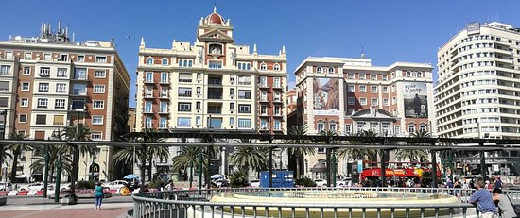
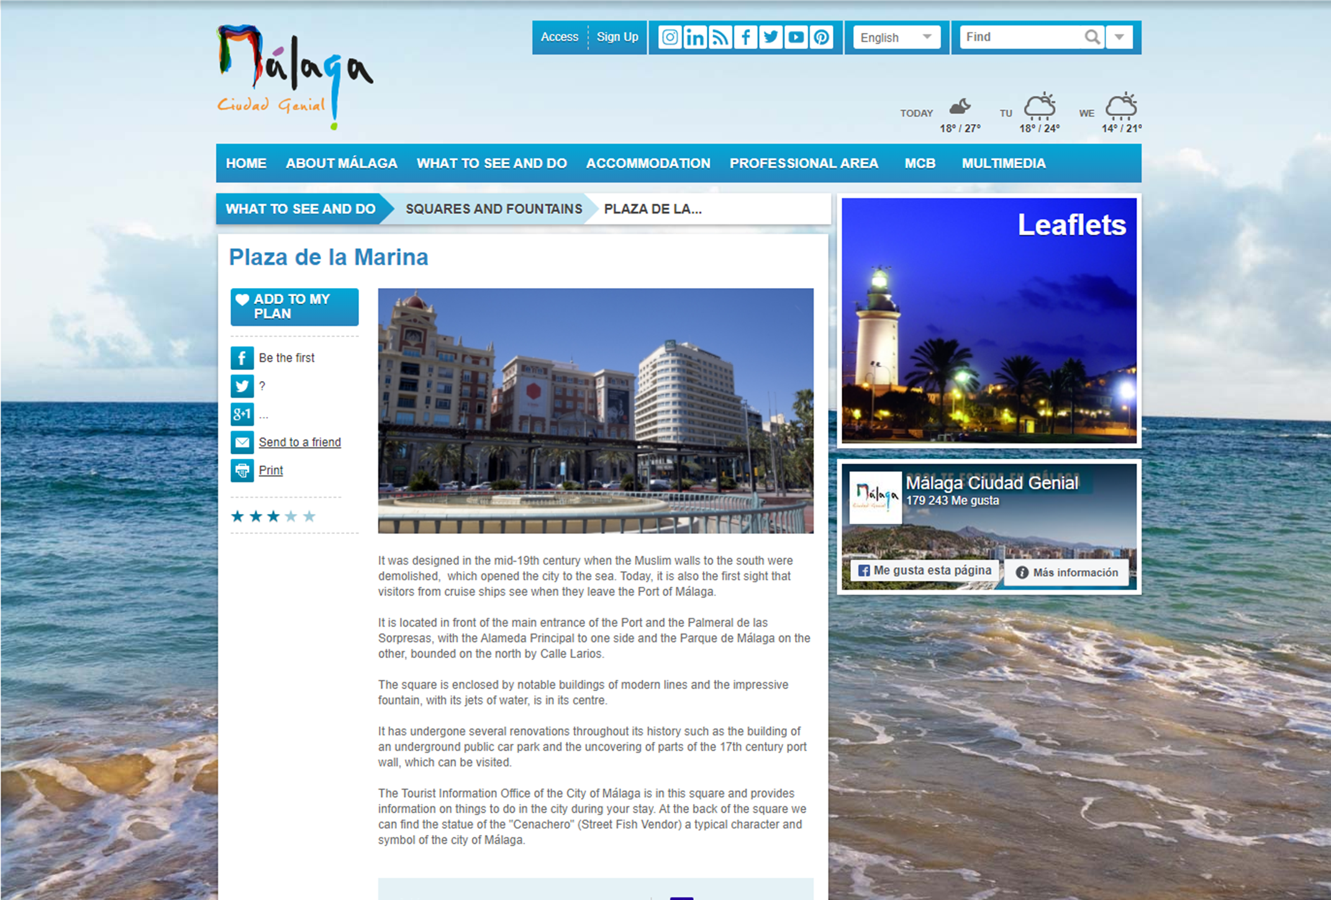
PLAZA DE LA MARINA
Company Name
PLAZA DE LA MARINA
Date of Interview
06.10.21 via telephone call
Contact Person
Gerardo Romero Domínguez (CEO) of Lynka
Email
CLICK
TO VIEW
gromero@lynka.net
Organizstion Description:
LYNKA is an international engineering studio that was created with the aim of becoming an engineering company of reference, mainly in the sectors of Energy & Water, Building and Telecommunications.
Our international experience and the knowledge of our staff make LYNKA an engineering company adapted to the new times, offering the appropriate solutions demanded by our clients in each market in which they work.
LYNKA has a vocation of service to society, believes in the entrepreneur as an economic engine, is committed to cutting-edge technology, quality, innovation in business, and the environment.
Case Description:
GRUPO TEAR S.L., whose VAT number is B93157584 and address is Plaza Jesús El Rico nº 5 (Málaga), offered a technical project for the facilities of the 4-star Hotel in Plaza Marina, Málaga.
The project included the execution and justification of the following specialities Fire Protection Installations, Transformer Substations and Medium Voltage, Low Voltage Interior Electricity, Thermal Installations for Air Conditioning, DHW, Gas and Indoor Air Quality, Microgeneration Installation, Gas Receiving Installation, Thermal Demand Limitation Study and Energy Qualification and the Plumbing, Sanitation and Telecommunications installations.
Estudio de Ingeniería Lynka, S.L. was awarded the project with the corresponding justification of the calculations in accordance with current regulations, energy efficiency and the well-being of people and ensured the coordination of these works, guaranteeing the integrity of the installation and compatibility between systems, thus avoiding unnecessary redundancies that increase the complexity and cost of the project.

Slide 2
ORGANISATION PROFILE
HOW MANY STAFF IS DIRECTLY EMPLOYED BY THE ORGANISATION?
IN ADDITION TO STAFF PRE COVID, HOW MANY PEOPLE ACCESS THE BUILDING ? (eg tenants, students, members of the public etc)
300
80 EMPLOYEES
MORE THAN PEOPLE DAILY
HOW LONG HAS THE ORGANISATION BEEN DRIVING A GREEN REVOLUTION/ INTRODUCED SDG POLICY’S OR ACTIONS?
WITHIN LAST 17 YEARS
WHAT SECTOR/S IS THE ORGANISATION ACTIVE IN?
HOW WOULD YOU DESCRIBE YOUR MAIN STAKEHOLDERS OR OCCUPANTS?
LYNKA is active in the building, Telecommunications and Energy & Water sectors.
Industrial companies, architects, public services, individuals. In general, interest groups related to the sectors mentioned above.
GOOD PRACTICES
WHAT IS YOUR VISION AND STRATEGY RELATED TO SUSTAINABLE DEVELOPMENT/CLIMATE ACTIONS?
The company's vision of sustainable development is to carry out work with the best achievable energy rating in order to reinforce our commitment to the environment and to the well-being of people. To this end, the company's strategy is to assist our clients with professionals in each of the specialities.

Slide 3
GOOD PRACTICES
WHAT ACTIONS DID YOU TAKE?
n the drafting, construction management and certification of technical projects for the installations of a 4-star hotel in Plaza de la Marina, Malaga. The best practice actions carried out have been: - Design and sizing Microgeneration installation, which complies with the basic document DBHE4 of the CTE "Minimum solar contribution to domestic hot water". - Design and dimensioning of a rooftop Solar Photovoltaic Installation that will satisfy the basic document DBHE5 of the CTE "Minimum photovoltaic contribution of electrical energy". - Justification of DB-HE1 of the CTE "Limitation of energy demand", which sets the requirements on the building envelope aimed at limiting energy demand, and Energy Efficiency Certification (RD 47/2007), including the necessary documentation for the processing with the Regional Ministry of Innovation, Science and Enterprise of the registration in the Register of Energy Certifications of the project. The certificate for the registration of the project's energy rating was signed by the architect, as well as by the specialist technician who drafted the thermal installation project. - Justification of DB-HE3 of the CTE "Energy efficiency of lighting installations".
WHICH PARTNERS AND STAKEHOLDERS WERE INVOLVED?
In addition to our company, the client who contracted our services was GRUPO TEAR, S.L
DID YOU RECEIVE ANY KIND OF TRAINING OR SUPPORT REGARDING YOUR ACTIONS?
All the technicians involved have the necessary formation (degree, courses, masters) for the development of the works with their respective sections oriented to the sustainability and the well-being of the people.
WHICH RESULTS DID YOU ACHIEVE ALREADY?
In the realised installations, the achievements already obtained from the implementation of the above-mentioned actions have been:
Reduction of energy consumption
Well-being of customers and staff inside the building and increased satisfaction and recommendations from both sides.
WHAT ARE YOUR FUTURE PLANS AND NEXT STEPS?
Future plans include the possibility of certifying the facilities according to BREEAM or LEAD, and if necessary, to analyse and update the climate systems in accordance with current regulations.

Slide 4
RECOMMENDATIONS
WHAT KIND OF HELP AND TOOLS DO YOU NEED TO REALISE YOUR FUTURE GOALS?
WHAT ARE YOUR MOST IMPORTANT TIPS & ADVICE TO GIVE TO OTHER ORGANISATIONS TO IMPLEMENT SDG WITHIN THEIR BUSINESS?
BREEAM and LEAD certification courses
Renewable energy supply
Introduction of sustainability professionals
Consult advisors.
Support from professionals already trained in Sustainable Development (advisors)
Attending lectures or meetings on circular economy, sustainability and wellbeing programmes.
Keeping up to date with new regulations.
WHAT SUSTAINABLE GOALS WOULD YOU LIKE TO IMPLEMENT IN THE FUTURE?
01
Sustainable Infrastructure/Buildings – SDG11 Sustainable cities and Communities and SDG13 Climate action:
Improve the efficient development/design of climate facilities with the introduction of new specialists (within the next 6 months).
Energy and Resource Efficiency – SDG 7 Affordable and clean energy and SDG12 Responsible consumption and production:
Increasing the building's percentage of renewable energy with the introduction of self-consumption plants or aerothermal generators. (Within the next 1-3 years).
02
Sustainable Eco-systems and Collective Action – SDG4 Quality Education, SDG12 Responsible consumption and production and SDG17 Partnership for the Goals:
03
Provide our staff with training courses on new ways to implement sustainable development in the next 1-3 years
Digital Technology for Sustainable Enterprise Centres – SDG8 Decent work and Economic Growth and SDG13 Climate action:
04
Improvement of the domestic technologies which increase and ensure people’s wellbeing (within the next 6 months)
05
Sustainable Futures for Enterprise Centres – SDG 9 -Industrial innovation & infrastructure and SDG17 Partnership for the Goals:
Improvement or update of photovoltaic or solar installation design programmes (within the next 1-3 years)

