Slide 1
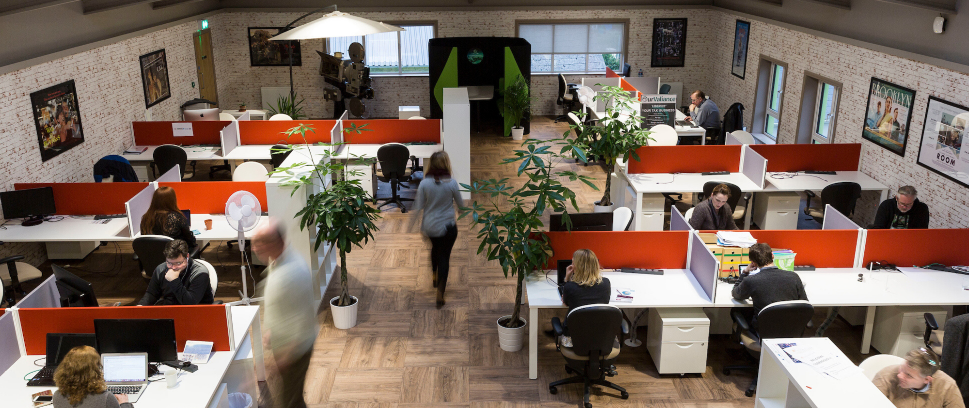

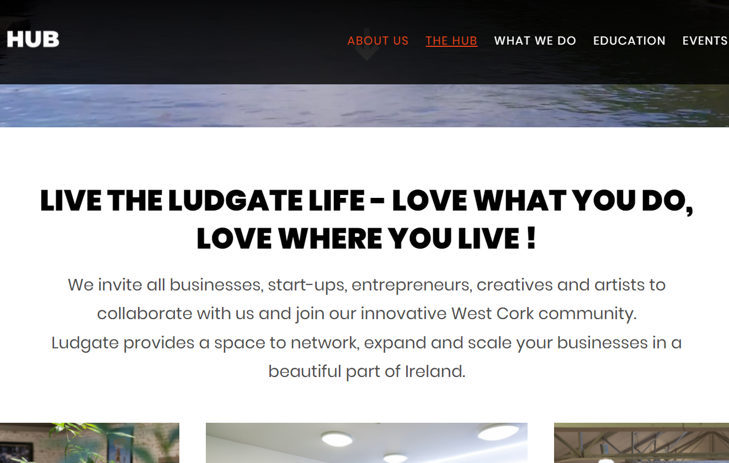
LUDGATE
Company Name
Ludgate Skibbereen
Date of Interview
06.08.21 via Video Interview
Contact Person
Kieran Collins, Education Innovation Manager
Email
CLICK
TO VIEW
Kieran@ludgate.ie
The Ludgate of Skibbereen, in the rural south of Ireland has been described as a pioneering rural digitalization project in Ireland since it opened its doors in 2016. Housed in a former bakery in the previously retail and agri dominated economy of Skibbereen, the Ludgate provides the local community with ultra fast connection speeds and a place to work and share ideas.
The Hub has space for 75 workers providing hot-desking, meeting rooms, private offices and student workspaces. The Ludgate provides the opportunity for workers who would traditionally have to commute to Cork City to work remotely. The Ludgate's goal is to facilitate the creation and evolution of start ups by providing them with the physical space and facilities from which to base their company. Along with their regular tenants, the ludgate also run a number of education programmes, entrepreneur/start-up programmes, and host events.
As a future focused rural digital hub, the ludgate are always looking to prepare the local community for the jobs of tomorrow. The Ludgate's vision is to help support education so that it is relevant to the needs of 21st Century learners, educators and organisations. The aim of the education programme is to graduate a greater number of students from west cork to STEM degree programmes leading to job placement and rural regeneration.
Ludgate's start-up ecosystem has a strong reputation of being diverse, welcoming and accessible. The Ludgate utilises strategic partnerships with corporates, academia and investors that help grow the budding new businesses of the community. The Ludgate runs internship programmes, mentor hours and is launching the propeller series which is a series that interviews experts and provides insights for entrepreneurs in the area.
As a key player in the community of Skibbereen, the Ludgate also hosts a number of events highlighting different areas of interest to the community. Along with their own exhibitions and events, the Ludgate also makes their facilities available to organisations which can be used for conferences, training days, ideation days, workshops and festivals

Slide 2
ORGANISATION PROFILE
HOW MANY STAFF IS DIRECTLY EMPLOYED BY THE ORGANISATION?
IN ADDITION TO STAFF PRE COVID, HOW MANY PEOPLE ACCESS THE BUILDING ? (eg tenants, students, members of the public etc)
4 FULL-TIME EMPLOYEES
50 PEOPLE WEEKLY
HOW LONG HAS THE ORGANISATION BEEN DRIVING A GREEN REVOLUTION/ INTRODUCED SDG POLICY’S OR ACTIONS?
WITHIN LAST 5 YEARS
WHAT SECTOR/S IS THE ORGANISATION ACTIVE IN?
HOW WOULD YOU DESCRIBE YOUR MAIN STAKEHOLDERS OR OCCUPANTS?
Local Enterprise/ Education/ Community Development
Remote workers / SMEs / Start-Ups
GOOD PRACTICES
WHAT IS YOUR VISION AND STRATEGY RELATED TO SUSTAINABLE DEVELOPMENT/CLIMATE ACTIONS?
The Ludgate was founded on the vision of sustaining the area of West Cork by preparing for jobs of the future. The Ludgate's goal is to facilitate the creation and evolution of start ups by providing them with the physical space and facilities from which to base their company. Ludgate provides a connection between Entrepreneurs, Investors and Institutions so they can build a better future for West Cork enabling start ups to succeed through the challenging ideation stage through to growth. Rural regeneration is hugely important for sustaining the economy and they achieve these goals through:
Offering facilities with digital connectivity, closing the digital divide between rural and urban by equipping our cluster schools with the technology and learning platforms to develop STEM skillsets in our young.
Supporting Employment and Careers in Rural Areas through advertising employment opportunities and operating as a bridge between the employment seeker and the employer.
The enhancement of services within West Cork allowing employees to live and work remotely with no impediments to connectivity and the equipment necessary to operate effectively.
Supporting our community of West Cork to transition to a Climate Neutral Society through the dissemination of informative events

Slide 3
GOOD PRACTICES
WHAT ACTIONS DID YOU TAKE?
The Ludgate Hub is a proud ground roots initiative and was started when a group of local stakeholders got together to develop the future of the town. Assembling a board and from there, using their networks to make the best strategic partnerships in order to build out the digital hub and provide it with the best possible amenities in order to attract enterprising initiatives and individuals. Instead of constructing from scratch, the Ludgate chose to retrofit a semi-derelict site that previously served as a bakery, modernising an aging site of employment into a hub for jobs of the future.
As a key player in the community the Hub viewed themselves as more than a digital hub and host cultural events as well as education initiatives. The Ludgate’s STEM based education and experience initiatives are investing in the future skill base of the area. The Ludgate uses their expanding network to their advantage and regularly host events on issues of relevance such as the 'opportunities in a climate neutral environment' which was co-hosted by tenant Nexalus.
WHICH PARTNERS AND STAKEHOLDERS WERE INVOLVED?
The Ludgate is primarily a community led initiative that started when a group of local businesspeople and stakeholders had the idea of upgrading an old bakery into a digital hub. Many of these original stakeholders continue to serve on the board and combined with their investment of time and money with the capital from grants and sponsorship they continue to grow the capacity of the Ludgate. These funders and partners include: Enterprise Ireland, AIB, Vodafone, Fields of Skibbereen, Google, Cork County Council, KPMG, Siro, ESB and Ronan Daly Jermyn.
DID YOU RECEIVE ANY KIND OF TRAINING OR SUPPORT REGARDING YOUR ACTIONS?
As a community led project, the ludgates operations are supported through their network of stakeholders. Through this networking approach they gained access to a number of supports. Enterprise Ireland and AIB provided them with the finances needed to retrofit the original and new premises while Vodafone, Siro and the ESB allowed them to achieve high speed connectivity.
WHICH RESULTS DID YOU ACHIEVE ALREADY?
The Ludgate successfully renovated a vacant building, making it energy efficient and providing a space for enterprises and individuals to work, share and create. Prior to the founding of the Ludgate, West Cork was not deemed a feasible location for digital start-ups, but through the Ludgate's strategic partnerships with SIRO, the Vodafone and ESB joint venture, Skibbereen now has access to ultrafast fibre broadband. As a rural digital hub, the Ludgate is viewed as an example of what can be achieved throughout Ireland. The Ludgate has outgrown its initial footprint in just 5 years with funding secured to expand into another vacant building in the community of Skibbereen.
WHAT ARE YOUR FUTURE PLANS AND NEXT STEPS?
The Ludgate's success has led to a need to expand their footprint. They have secured funding to move into a secondary school that has been laying vacant. For this second retrofit there is an increased focus on how they can be more sustainable and are installing PV solar panels as well as EV charging points as part of the planned renovation. Ludgate 2 is being built to the same high standard of high broadband speeds with an increased focus towards catering for the creative industries with plans to create studios that allow users to record music, podcasts or educational resources.

Slide 4
RECOMMENDATIONS
WHAT KIND OF HELP AND TOOLS DO YOU NEED TO REALISE YOUR FUTURE GOALS?
WHAT ARE YOUR MOST IMPORTANT TIPS & ADVICE TO GIVE TO OTHER ORGANISATIONS TO IMPLEMENT SDG WITHIN THEIR BUSINESS?
Greater access to training for sustainability across a range of topics. Sustainability training specific to enterprise centres.
More guidance on how to host your own sustainability workshops with tenants and students.
There needs to be greater knowledge sharing between enterprise centres and the opportunity to meet and discuss shared issues.
There is no next step to create momentum after pioneering an education initiative
Think long-term
Utlise your network.
WHAT SUSTAINABLE GOALS WOULD YOU LIKE TO IMPLEMENT IN THE FUTURE?
01
Sustainable Infrastructure/Buildings – SDG11 Sustainable cities and Communities and SDG13 Climate action:
Ongoing
Energy and Resource Efficiency – SDG 7 Affordable and clean energy and SDG12 Responsible consumption and production:
02
6 -12 months
Sustainable Eco-systems and Collective Action – SDG4 Quality Education, SDG12 Responsible consumption and production and SDG17 Partnership for the Goals:
03
Ongoing
Digital Technology for Sustainable Enterprise Centres – SDG8 Decent work and Economic Growth and SDG13 Climate action:
Ongoing
04
05
Ongoing
Sustainable Futures for Enterprise Centres – SDG 9 -Industrial innovation & infrastructure and SDG17 Partnership for the Goals:

