Slide 1
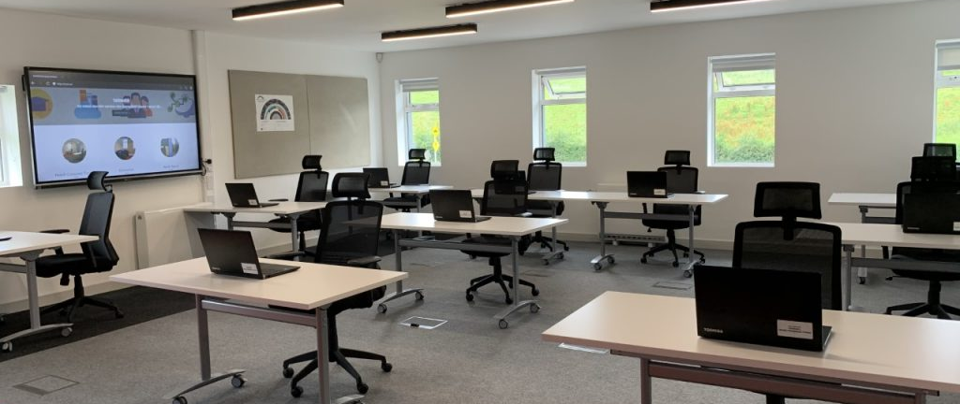

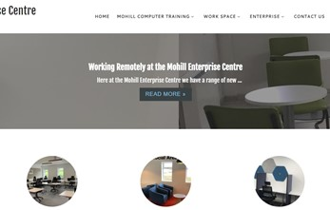
MOHILL ENTERPRISE CENTRE
Company Name
Mohill Enterprise Centre
Date of Interview
22.08.21 via Phone Interview
Contact Person
John Mannion, Manager
Email
CLICK
TO VIEW
John@MCT.ie
Mohill Enterprise Centre was established in 1998 in South County Leitrim in the Irish midlands. Because of the central location of South Leitrim, Mohill is a preferred option as a commuter town for people working in both Galway and Dublin. With work from home now a viable option, Mohill Enterprise Centre is putting their community on the map as a viable rural work hub, developing the digital readiness of the area under the guidance of their motto ‘Work Smart, Learn Smart’.
MEC offers a wide variety of smart flexible office space including hotdesking, small offices and industrial units. All office space has free access to high-speed fibre broadband among other office services such as printing. MEC also offers a range of fully equipped rooms suited to both training and meeting purposes. Training rooms cater for groups from 4-20 attendees and are adapted for online and mixed-use facilitation with interactive displays and green screens.
In conjunction with the MSLETB (Mayo, Sligo and Leitrim Education and Training Board), MEC makes a range of training services available for the local community. They offer business mentoring for individuals and small businesses as well as a range of ICT training through MCT (Mohill Computer Training).
MEC have been implementing a sustainability agenda for over 5 years and aim to transfer their effort to the community. They are involved in a LECo project (Local Energy Community) and are constantly striving to improve their energy efficiency and have also run a number of sustainable energy workshops to transfer their knowledge to the local community.

Slide 2
ORGANISATION PROFILE
HOW MANY STAFF IS DIRECTLY EMPLOYED BY THE ORGANISATION?
IN ADDITION TO STAFF PRE COVID, HOW MANY PEOPLE ACCESS THE BUILDING ? (eg tenants, students, members of the public etc)
4 EMPLOYEES
MORE THAN PEOPLE WEEKLY
60
HOW LONG HAS THE ORGANISATION BEEN DRIVING A GREEN REVOLUTION/ INTRODUCED SDG POLICY’S OR ACTIONS?
SINCE THE BEGINNING IN 2002
WHAT SECTOR/S IS THE ORGANISATION ACTIVE IN?
HOW WOULD YOU DESCRIBE YOUR MAIN STAKEHOLDERS OR OCCUPANTS?
Local Enterprise/ Education/ Community Development
Students/ Public/ Micro-enterprises/Community
GOOD PRACTICES
WHAT IS YOUR VISION AND STRATEGY RELATED TO SUSTAINABLE DEVELOPMENT/CLIMATE ACTIONS?
Mohill Enterprise centre have been implementing a sustainable agenda for the past 5 years and aim to have sustainability feed into the local community by setting a strong example. MEC are trying to position themselves as an attractive community for the new work-force who are looking for more quiet sustainable locations to base themselves in the new work from home environment.
Mohill Enterprise Centre works with their partners in order to constantly improve their energy rating and reduce waste in the Enterprise centre while also working with the local community to improve their overall carbon footprint. Through working with the local community and improving their own sustainability MEC are working to address sustainable development goal 9, fostering sustainable innovation, and SDG 11, sustainable cities and communities.

Slide 3
GOOD PRACTICES
WHAT ACTIONS DID YOU TAKE?
Mohill Enterprise Centre constantly strives to improve the energy efficiency of their premises and contribute towards the development of their local community. MEC utilised their network and created connections that aided them on their sustainability journey. From a number of grants MEC have invested 400,000 euro into their infrastructure and services over the past 5 years. They have greened their electricity with PV panels (SDG 7) and retrofitted their infrastructure with improved insulation and lighting (SDG 9). MEC also play a key role in a network of stakeholders striving to make Mohill a sustainable Community (SDG 11). MEC continue to provide a collaborative work space and facilitated the upskilling of the community in digital and business skills (SDG 4, 8 + 9)
WHICH PARTNERS AND STAKEHOLDERS WERE INVOLVED?
SEAI, Leitrim County Council, Leitrim Development Company, Contract Research Unit IT Sligo (Engineering Consultants). MEC also have an extended network of partners including Solas, Pobal, MSLETB and Enterprise Ireland
DID YOU RECEIVE ANY KIND OF TRAINING OR SUPPORT REGARDING YOUR ACTIONS?
Mohill Enterprise Centre utilised their extensive network and the aids that were available to them. MEC have worked in conjunction with MSLETB in order to provide their training. SEAI and Contract Research Unit IT Sligo have provided grants and consultancy to help them achieve their sustainability improvements. This has helped them to develop their infrastructure and energy masterplan.
WHICH RESULTS DID YOU ACHIEVE ALREADY?
Mohill Enterprise Centre is a successful centre for learning and business with 100s of visitors weekly. Since beginning their sustainability journey ago they have successfully retrofitted their premises with improved insulation, smart heating and energy management systems, efficient lighting, and PV panels. MEC have successfully upgraded their old industrial space into micro-offices to meet the needs of the new digital work force. MEC also play a key role in an ongoing LECo (Local Energy Communities) project to make Mohill as energy efficient as possible. They have assisted in the development of a feasibility study, have run a number of sustainable energy workshops and have a EV charging point for community members to use.
WHAT ARE YOUR FUTURE PLANS AND NEXT STEPS?
Mohill Enterprise Centre are constantly looking to improve their facilities and position themselves as a green place to work and visit. In the next year they are hoping to install a public display monitor that communicates their efforts, including energy from their PVs to the public. They are looking to join the connected hubs network and make their facilities accessible to remote workers. MEC with Leitrim County Council are looking at utilising derelict land next to them to create a car park covered with PVs, that would facilitate extra EV charging.

Slide 4
RECOMMENDATIONS
WHAT KIND OF HELP AND TOOLS DO YOU NEED TO REALISE YOUR FUTURE GOALS?
WHAT ARE YOUR MOST IMPORTANT TIPS & ADVICE TO GIVE TO OTHER ORGANISATIONS TO IMPLEMENT SDG WITHIN THEIR BUSINESS?
Assistance with grants. The process of accessing grants can often be complex.
It can be difficult to sell new ideas and investments to people so assistance in conveying a vision in order to achieve buy-in.
Utilise your network and ask for help. If you are struggling in certain areas reach out to specialists in the area
Focus on the needs of the community first.
Network with organisations with similar goals to your organisations.
WHAT SUSTAINABLE GOALS WOULD YOU LIKE TO IMPLEMENT IN THE FUTURE?
01
Sustainable Infrastructure/Buildings – SDG11 Sustainable cities and Communities and SDG13 Climate action:
Within next 6 months – MEC is hoping to expand their footprint by utilising derelict land and adding more PVs
Energy and Resource Efficiency – SDG 7 Affordable and clean energy and SDG12 Responsible consumption and production:
02
This is an ongoing process for MEC and is due to be upgraded soon with the addition of a public display monitor
Sustainable Eco-systems and Collective Action – SDG4 Quality Education, SDG12 Responsible consumption and production and SDG17 Partnership for the Goals:
03
This is an ongoing project for MEC as they work to mobilise the community in the LECo project
Digital Technology for Sustainable Enterprise Centres – SDG8 Decent work and Economic Growth and SDG13 Climate action:
With Mohill Computer Training located on the premise MEC are leading the way in digital infrastructure for the local community
04
05
1 - 3 years
Sustainable Futures for Enterprise Centres – SDG 9 -Industrial innovation & infrastructure and SDG17 Partnership for the Goals:

