Slide 1
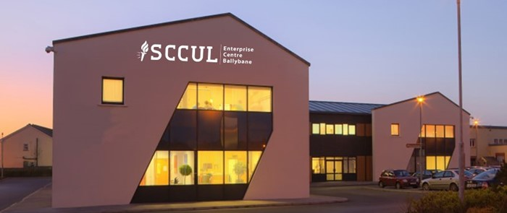

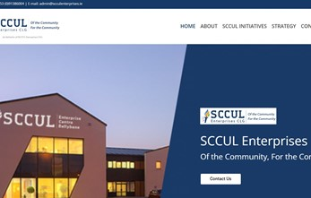
SCCUL
Company Name
SCCUL Enterprises CLG
Date of Interview
30.07.21 via Phone Interview
Contact Person
Annette Hassett, Operations Manager
Email
CLICK
TO VIEW
Annette@scculenterprises.ie
Founded in Galway in 2002, SCCUL Enterprises CLG is a registered charity set up by, but independent to St. Columba’s Credit Union. As a not-for-profit social enterprise, SCCUL aims to champion societal change by promoting community, enterprise, wellbeing, and social inclusion. This is achieved through a number of successful initiatives operating from the west of Ireland.
SCCUL Enterprise Centre provide local SME’s, social enterprises and community groups with the opportunity to develop and grow with their state-of-the-art infrastructure and support services. The SCCUL model relies on revenue generated from the provision of these commercial services in order to provide opportunities for local start-ups and the rest of the SCCUL initiatives.
Biz Mentors is one of SCCULs free initiatives for business owners, start-ups, social enterprises and community groups. It aims to provide free access to pro-bono business advice for those who would otherwise not have access to this help.
SCCUL Enterprises also runs the Ballinfoile Castlegar Neighbourhood Centre which provides essential services to the local community in the form of sports facilities, meeting rooms, and mental health services.
SCCULs model of reinvesting rent from their enterprise centre into their free initiatives maximises their impact on the local community heloing them realise their vision ‘To alleviate poverty and disadvantage by empowering positive well-being and growth.

Slide 2
ORGANISATION PROFILE
HOW MANY STAFF IS DIRECTLY EMPLOYED BY THE ORGANISATION?
IN ADDITION TO STAFF PRE COVID, HOW MANY PEOPLE ACCESS THE BUILDING ? (eg tenants, students, members of the public etc)
5 FULL-TIME EMPLOYEES
PEOPLE WEEKLY
>1000
HOW LONG HAS THE ORGANISATION BEEN DRIVING A GREEN REVOLUTION/ INTRODUCED SDG POLICY’S OR ACTIONS?
SINCE THE BEGINNING IN 2002
WHAT SECTOR/S IS THE ORGANISATION ACTIVE IN?
HOW WOULD YOU DESCRIBE YOUR MAIN STAKEHOLDERS OR OCCUPANTS?
Local Enterprise/ Education/ Community Development/ Health / Non-Profit
Charities / Students/ Public/ Micro-enterprises/ Community
GOOD PRACTICES
WHAT IS YOUR VISION AND STRATEGY RELATED TO SUSTAINABLE DEVELOPMENT/CLIMATE ACTIONS?
SCCUL Enterprises CLG was founded with the community in mind and meets the sustainable development goals through its vision, mission, and values.
SCCULs vision is ‘to alleviate poverty and disadvantage by empowering positive well-being and growth’.
Their mission statement is ‘to facilitate individual, community and economic growth in a sustainable manner through socio-economic development and the provision of supports and infrastructure.’
In line with their organisation culture, SCCUL provides services that are; community focused, respectful, accessible, inclusive, empowering and innovative.

Slide 3
GOOD PRACTICES
WHAT ACTIONS DID YOU TAKE?
SCCUL has taken an approach of clearly defining their values, vision and mission and creating a strategy to meet these that they review biennially. SCCUL consistently engage with local communities and stakeholders to see what else they can do to realise their vision.
The SCCUL Enterprise Centre was built in 2002 to the highest building standards at the time and constantly look to upgrade their systems to meet the rising expectations of energy efficiencies. As well as supporting local enterprise with their suite of hotdesks, business units, and training rooms, SCCUL utilised their network and two-tier social inclusion model to set up biz-mentors and biz-mentors international linking businesses up with pro-bono advisers. SCCUL also expanded into the therapy and rehabilitation space when they set-up their therapeutic Support Centre, SCCUL Sanctuary. Constantly looking to see how they can service the community and provide free to access resources, they set-up the Ballinfoile Castlegar Neighbourhood Centre providing sports, recreational and mental health services.
WHICH PARTNERS AND STAKEHOLDERS WERE INVOLVED?
Set up by, but independent to St. Columba’s Credit Union, SCCUL Enterprises CLG is governed by an independent, voluntary Board of Directors who are responsible for the overall governance and strategic direction of the organisation. SCCUL's tenants and network of partners include a number of associated charities and for-profit organisations. Local and national bodies such as Enterprise Ireland and Galway County Council also provide support for the development of SCCUL Enterprises services and have a vested interest in their contribution to the local community.
DID YOU RECEIVE ANY KIND OF TRAINING OR SUPPORT REGARDING YOUR ACTIONS?
Support for SCCULs actions has mostly come in the form of funding from local and national bodies as well as expertise from their growing network.
WHICH RESULTS DID YOU ACHIEVE ALREADY?
Since their founding in Galway in 2002, SCCUL Enterprises CLGs model of reinvesting revenue into expanding their capacity and opening new free services has proved a great success, with over 1000 people accessing their buildings and services weekly. The infrastructure is maintained and upgraded for energy performance and the services provided sustains the local area. Their services support a number of user groups from local businesses, charities and aspiring entrepreneurs to members of the local community.
WHAT ARE YOUR FUTURE PLANS AND NEXT STEPS?
SCCUL consistently look for where they can serve their community. Over the course of the next year SCCUL plans to invest 1 million euro into their infrastructure and add 9000 sq/ft onto their existing useable footprint through renovation upgrading. SCCUL also plan to upgrade their digital technology by implementing a hot desking and smart door system in their enterprise centre that will allow them to join the national connected hubs providing remote working facilities throughout Ireland.

Slide 4
RECOMMENDATIONS
WHAT KIND OF HELP AND TOOLS DO YOU NEED TO REALISE YOUR FUTURE GOALS?
WHAT ARE YOUR MOST IMPORTANT TIPS & ADVICE TO GIVE TO OTHER ORGANISATIONS TO IMPLEMENT SDG WITHIN THEIR BUSINESS?
Information on what funding streams are available, both nationally and in Europe for sustainable initiatives.
What support is available for implementing new initiatives.
Sustainable communities are an essential part of a sustainable future, focus first on the community and how the enterprise centre can serve it.
Invest the time to set out your organisation values, and from there build your vision and mission statement.
With a clear vision and mission statement it is important to build a strategy that aims to meet these. By taking this structured approach from the outset you can better articulate your ambitions when accessing finance to grow.
WHAT SUSTAINABLE GOALS WOULD YOU LIKE TO IMPLEMENT IN THE FUTURE?
01
Sustainable Infrastructure/Buildings – SDG11 Sustainable cities and Communities and SDG13 Climate action:
Within the next 6 months with the expansion of the SCCUL footprint by refurbishing / building 9000 sg/ft of additional space
Energy and Resource Efficiency – SDG 7 Affordable and clean energy and SDG12 Responsible consumption and production:
02
Ongoing
Sustainable Eco-systems and Collective Action – SDG4 Quality Education, SDG12 Responsible consumption and production and SDG17 Partnership for the Goals:
03
Ongoing – this is built into the values of the organisation and SCCUL constantly look to serve the community
Digital Technology for Sustainable Enterprise Centres – SDG8 Decent work and Economic Growth and SDG13 Climate action:
With the next 6 months – introduction of connected hubs and increased hot desking
04
05
1 - 3 years
Sustainable Futures for Enterprise Centres – SDG 9 -Industrial innovation & infrastructure and SDG17 Partnership for the Goals:

