Slide 1
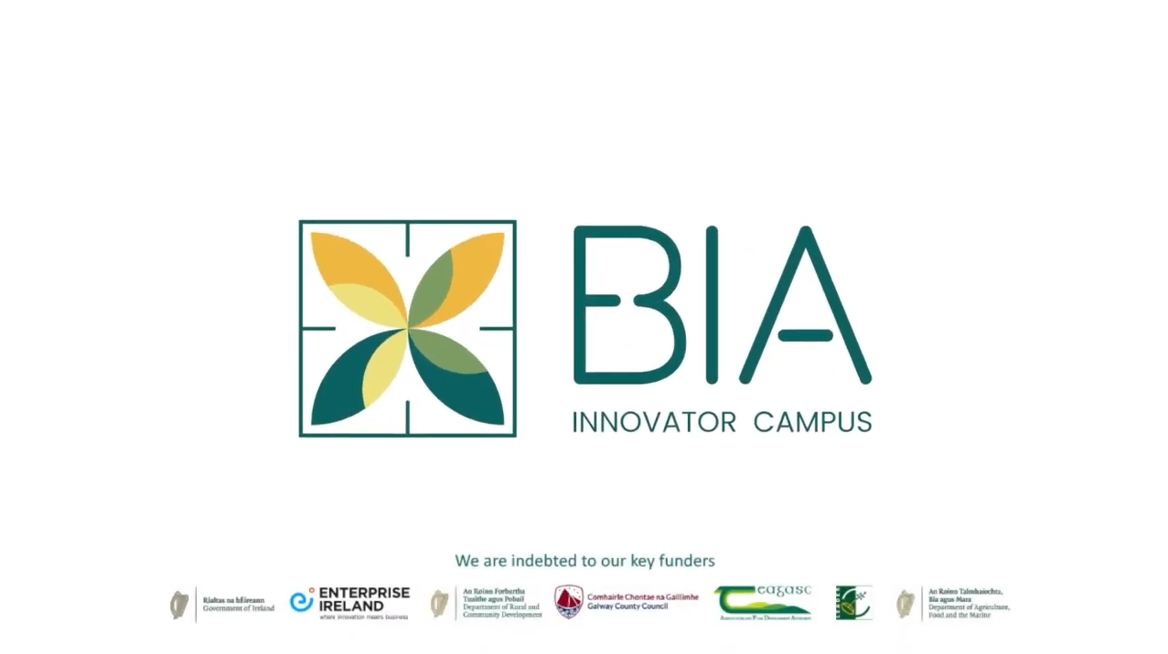
Bia Innovator Campus
Bia Innovator Campus CLG
24/06/21 via in person interview
Elaine Donohue, General Manager
Elaine.Donohue@biainnovatorcampus.ie
CLICK
TO VIEW
The Bia Innovator Campus CLG is a not-for-profit CLG company which is co-located at Teagasc (agri-food state agency) in Athenry in the West of Ireland. When complete in 2022 the Bia Innovator Campus will launch a new era for food innovation and incubation in Ireland West. At the moment in Ireland there is a recognised gap where the west of Ireland does not have enough food incubators to match the large potential of the natural resources of the region.
Once complete in 2022, The Bia Innovator Campus will benefit a number of key groups for the agri-food sector in Ireland West:
Food start-ups seeking supports
Scaling food SMEs
Farming community looking to add value to their primary produce
Food industry educators and training educators
The Bia Campus will provide their support across 4 key areas:
Bia Eolas is all about providing access to powerful food industry knowledge and skills in one place with a powerful mix of technical innovation and commercial support
Bia Obair fulfils a real need and tackles a bottleneck in scaling our regional food companies. It consists of 9 independent own door starter units, 3 independent own door HPSU growth units, and 4 unique co-working food incubators (Dairy, meat, seafood and Multiproduct)
Bia Blas will become a centre of food culture and foodie experiences in Galway and the Hidden Heartlands region. BIA Blas will give tourists, be they individuals, families or groups a new all-weather visitor experience to enjoy and a dedicated space for our culinary talent to showcase their work and earn income.
Bia Luas will provide a much-needed continuum pathway structure to support food businesses to grow and scale up

Slide 2
ORGANISATION PROFILE
HOW MANY STAFF IS DIRECTLY EMPLOYED BY THE ORGANISATION?
IN ADDITION TO STAFF PRE COVID, HOW MANY PEOPLE ACCESS THE BUILDING ? (eg tenants, students, members of the public etc)
360
4 FULL-TIME EMPLOYEES
WHEN OPEN THERE WILL BE JOBS
ACROSS 40+ BUSINESSES
HOW LONG HAS THE ORGANISATION BEEN DRIVING A GREEN REVOLUTION/ INTRODUCED SDG POLICY’S OR ACTIONS?
SINCE ITS INCEPTION
WHAT SECTOR/S IS THE ORGANISATION ACTIVE IN?
HOW WOULD YOU DESCRIBE YOUR MAIN STAKEHOLDERS OR OCCUPANTS?
Local Enterprise and Education
Tenants, SMEs, and Students
GOOD PRACTICES
WHAT IS YOUR VISION AND STRATEGY RELATED TO SUSTAINABLE DEVELOPMENT/CLIMATE ACTIONS?
The BIA Innovator Campus recognises the important role it plays as a facilitator of food innovation in the west of Ireland, and as an ambassador for the preservation of the region's natural resources. Bia fosters entrepreneurship and development among local communities and encourages resident food SMEs to preserve and respect nature and consider all of our impact on climate change.

Slide 3
GOOD PRACTICES
WHAT ACTIONS DID YOU TAKE?
The founding organisations recognised a gap in Ireland West where there are not enough food incubators and worked hard since 2017 to raise 7 million euro to build a state-of-the-art facility to fill this gap.
The Bia Innovator Campus is located in a unique region of natural beauty and resources. As an ambassador and facilitator for the growth of the Western region of Ireland’s agri-food sector as a sustainable industry, The Bia Innovator Campus strives to be best in class in terms of sustainability for food hubs. They are achieving this by carefully considering sustainability at every step and taking the following measures among others:
The campus is being built to an energy efficiency rating of A
Using a modular building system, the campus can be modified and upgraded for future expansion
There will be an e-charge point on site
The campus utilises on site rainwater harvesting
Most importantly, every effort is being made to encourage and support a sustainable culture on campus among all users and food producers
WHICH PARTNERS AND STAKEHOLDERS WERE INVOLVED?
BIA Innovator Campus CLG is a not-for-profit CLG company benefitting from a high profile, high performance voluntary Board of Directors that reflect a multi-agency economic -sectoral development – community - education balance. The founding organizations include Galway Country Council, Teagasc, GRETB, Local Enterprise Office, SCCUL, WDC and Athenry County Council.
DID YOU RECEIVE ANY KIND OF TRAINING OR SUPPORT REGARDING YOUR ACTIONS?
The Bia founders have worked hard to raise the capital needed to launch this state of the art project. The campus benefits from a highly experienced and diverse board who provide their insight which insures the project reaches it’s potential. The Bia Innovator Campus benefits from its board and organisational partnerships. Co-located on the grounds of Teagasc , they have provided a food technologist to provide businesses the necessary expertise.
WHICH RESULTS DID YOU ACHIEVE ALREADY?
The Bia Innovator Campus has funding secured and a state of the art facility that is due to be completed in 2022. With a board in place and companies signed up to set up their operations on the campus they are well on their way to successful implementation. As part of their BIA Eolas, they are already taking part in some impactful EU projects.
WHAT ARE YOUR FUTURE PLANS AND NEXT STEPS?
The Bia Innovator Campus is planning for its opening in 2022. They are building their tenant base and look forward to welcoming small and scaling businesses to their premises. In terms of sustainability they are currently working on a Campus Sustainability Guide which will help the tenants get on board with Bia’s sustainability ambitions.
It is key for the campus to establish a strong sustainability policy from the outset and engage with tenants and surrounding producers. Once the campus is up and running at full capacity the Bia team plan on integrating sustainability throughout their operations through Bia Ealos, Bia Obair, Bia Blas and Bia Luas

Slide 4
RECOMMENDATIONS
WHAT KIND OF HELP AND TOOLS DO YOU NEED TO REALISE YOUR FUTURE GOALS?
WHAT ARE YOUR MOST IMPORTANT TIPS & ADVICE TO GIVE TO OTHER ORGANISATIONS TO IMPLEMENT SDG WITHIN THEIR BUSINESS?
For large projects funding is always a key challenge but with a robust feasibility study and the goodwill of our founding partners the Bia Innovator campus makes a compelling case across a number of funding streams
Continue to build the team with Bia Innovator campus and upskill the existing team to make them as climate literate as possible and drive our green mission
Identify where your niche within the sustainability issues lie and see what you can do to improve from there
Build an experienced and multi-sectoral board that will ensure your plans are meeting the needs of the region
Develop a clear strategy and use that to build the connections and support you need to make a difference
Invest in a wide scoping feasibility study – it will be the foundation of your SDG plans and will help to convince your team and other stakeholders of the value of your project.
Give yourself longer to realise SDG changes than originally envisaged.
WHAT SUSTAINABLE GOALS WOULD YOU LIKE TO IMPLEMENT IN THE FUTURE?
01
Sustainable Infrastructure/Buildings – SDG11 Sustainable cities and Communities and SDG13 Climate action:
Next 1 to 3 years
Energy and Resource Efficiency – SDG 7 Affordable and clean energy and SDG12 Responsible consumption and production:
Next 1 to 3 years
02
Sustainable Eco-systems and Collective Action – SDG4 Quality Education, SDG12 Responsible consumption and production and SDG17 Partnership for the Goals:
Next 1 to 3 years
03
Digital Technology for Sustainable Enterprise Centres – SDG8 Decent work and Economic Growth and SDG13 Climate action:
Next 1 to 3 years
04
05
Next 1 to 3 years.
Sustainable Futures for Enterprise Centres – SDG 9 -Industrial innovation & infrastructure and SDG17 Partnership for the Goals:

