Slide 1
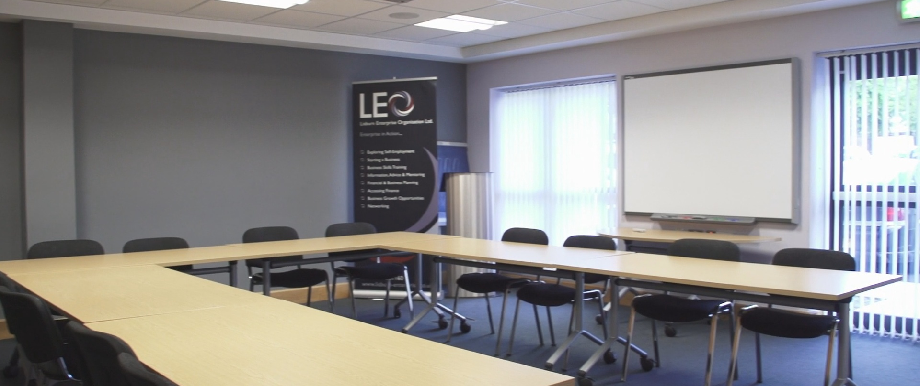
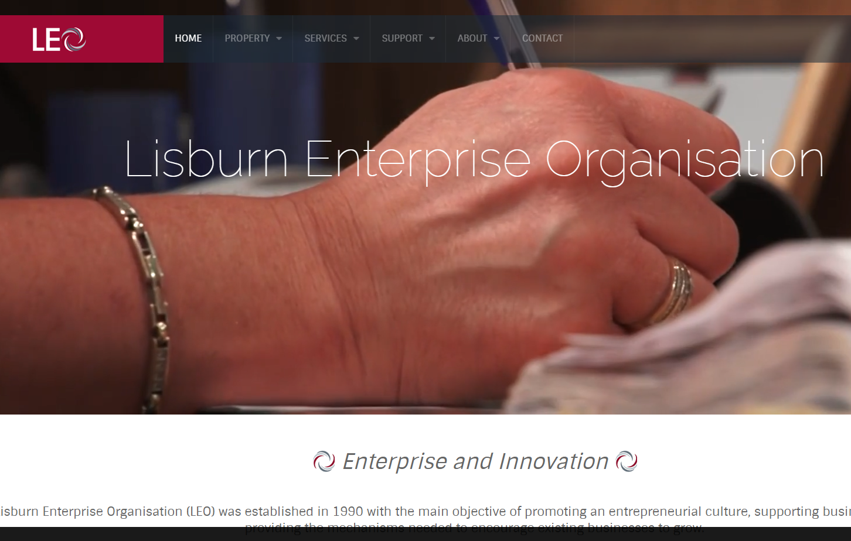
Lisburn Enterprise Organisation
Company Name
Lisburn Enterprise Organisation (LEO)
Date of Interview
10/11/2021
Contact Person
Martina Crawford – Chief Executive
Email
CLICK
TO VIEW
martina@lisburn-enterprise.co.uk
Lisburn Enterprise Organisation (LEO) was established in 1990 with the main objective of promoting an entrepreneurial culture, supporting business start-up and providing the mechanisms needed to encourage existing businesses to grow. LEO is an independent, not for profit organisation offering support in the form of guidance and advice, premises, conference facilities, administrative support and virtual office services. LEO’s focus is not only on business creation but also business development at
both a strategic and operational level. The Organisation benefits from a dedicated Board of Directors representing public and private sector interests. This voluntary Board has overseen the effective running of LEO since its inception. Partnership is also a key priority of the Organisation and strong working relationships exist with Lisburn & Castlereagh City Council, South-Eastern Regional College, Enterprise Northern Ireland, Princes Trust and Invest NI to name a few

Slide 2
ORGANISATION PROFILE
HOW MANY STAFF IS DIRECTLY EMPLOYED BY THE ORGANISATION?
IN ADDITION TO STAFF PRE COVID, HOW MANY PEOPLE ACCESS THE BUILDING ? (eg tenants, students, members of the public etc)
500
5 EMPLOYEES
MORE THAN PEOPLE DAILY
(Pre-Covid)
HOW LONG HAS THE ORGANISATION BEEN DRIVING A GREEN REVOLUTION/ INTRODUCED SDG POLICY’S OR ACTIONS?
SINCE 2010
WHAT SECTOR/S IS THE ORGANISATION ACTIVE IN?
HOW WOULD YOU DESCRIBE YOUR MAIN STAKEHOLDERS OR OCCUPANTS?
Local Enterprise
SMEs / Micro-businesses
GOOD PRACTICES
WHAT IS YOUR VISION AND STRATEGY RELATED TO SUSTAINABLE DEVELOPMENT/CLIMATE ACTIONS?
Lisburn Enterprise Organisation aims to promote an entrepreneurial culture which will strengthen the local economy and boost economic development. They work tirelessly by providing sustainable, long term supports for business start-up and business growth. In terms of sustainable development they provide low cost office space, through their phase 7 development they have implemented sustainable approaches.

Slide 3
GOOD PRACTICES
WHAT ACTIONS DID YOU TAKE?
LEO provide low cost office spaces as part of their Phase 6 development. In 2018 they opened their new Phase 7 development, which provides more sustainable, low cost, modern office spaces for tenants. LEO had in depth discussions with developers and architects around the planning and development of the Phase 7 development. Throughout these consultations LEO were advised on the best course of action to ensure a sustainable, green and climate friendly build. These included ensuring locally sourced, sustainable products were used within the building, the inclusion of solar panels to decrease use of gas heating. In addition to this the Phase 7 building has motion activated lights which are programmed on a timer schedule, this reduces electricity consumption. Finally LEO have employed a waste management company who handle the recycling of waste, easing the burden on landfills, conserving natural resources, and saving energy.
WHICH PARTNERS AND STAKEHOLDERS WERE INVOLVED?
Local Architects
Building Consultants
Waste Management Co.
WHICH RESULTS DID YOU ACHIEVE ALREADY?
Reduced use of Gas heating through solar panels
Reduced electricity use overall through motion sensors
Recycling implementation
Reduction of landfill use
Energy saving
More sustainable overall Phase 7 building & learnings which will inform future development
WHAT ARE YOUR FUTURE PLANS AND NEXT STEPS?
LEO plans to learn from the Phase 7 build and apply this in relation to any new development undertakings in the future. They will continue to encourage their licensees to utilise the recycling, waste management scheme in order to minimise overall environmental impact

Slide 4
RECOMMENDATIONS
WHAT KIND OF HELP AND TOOLS DO YOU NEED TO REALISE YOUR FUTURE GOALS?
WHAT ARE YOUR MOST IMPORTANT TIPS & ADVICE TO GIVE TO OTHER ORGANISATIONS TO IMPLEMENT SDG WITHIN THEIR BUSINESS?
As a self-funded entity MEAG relies on the expertise of their board for support.
Start by talking to people who have done it already
The best starting point is to develop a strong board with a good broad range of skills and connections
When working in the community, word of mouth can be the most efficient way of growing, and so getting out there and connecting with the community is important
WHAT SUSTAINABLE GOALS WOULD YOU LIKE TO IMPLEMENT IN THE FUTURE?
01
Sustainable Infrastructure/Buildings – SDG11 Sustainable cities and Communities and SDG13 Climate action:
1-3 years
Energy and Resource Efficiency – SDG 7 Affordable and clean energy and SDG12 Responsible consumption and production:
02
Ongoing
Sustainable Eco-systems and Collective Action – SDG4 Quality Education, SDG12 Responsible consumption and production and SDG17 Partnership for the Goals:
03
Ongoing
Digital Technology for Sustainable Enterprise Centres – SDG8 Decent work and Economic Growth and SDG13 Climate action:
04
1-3 years
05
Sustainable Futures for Enterprise Centres – SDG 9 -Industrial innovation & infrastructure and SDG17 Partnership for the Goals:
Next 6 to 12 months.

